Slide 1
TAPLEND INDIA — DATA SCIENCE INTERN ASSESSMENT
Credit Risk Analysis & Underwriting Optimization
A rigorous, leak-free evaluation of applicant risk signals, verified data matching corrections, fair lending feature hygiene, and illustrative decision economics.
Author: Data Science Candidate | Context: 15–20 Minute Executive Presentation | Dataset: Oct 2010 – Apr 2011 Portfolio
Notes:
SPEAKER NOTES (SLIDE 1):
Good morning/afternoon everyone. Today I'm presenting my credit risk analysis for TapLend India.
Our objective is to evaluate whether applicant characteristics captured at application time can reliably predict loan repayment outcomes—distinguishing Good loans from Bad loans.
Throughout this project, I audited the data architecture, verified identifier corrections, enforced fair-lending feature hygiene, built a leak-free machine learning workflow, and evaluated the economic trade-offs required before considering any automated underwriting. Let's begin.

Slide 2
TAPLEND INDIA • CREDIT RISK ASSESSMENT
Business Objective & Underwriting Economics
The Lending Challenge
• TapLend provides consumer credit to subprime and near-prime borrowers.
• Core dilemma: Balancing loan origination volume against portfolio default losses.
• Objective: Identify which applicant characteristics predict repayment to guide future credit decisions.
• Regulatory boundary: Decisions must be transparent, non-discriminatory, and legally compliant.
Illustrative Economic Costs
• Asymmetric Cost Framework:
• • Cost of False Negative (Default loss): Lost principal (~$500 illustrative loss).
• • Cost of False Positive (Good rejection): Lost profit margin (~$150 illustrative profit).
• Illustrative Nature:
• • Neither $500 nor $150 is specified in the raw workbook; they represent illustrative operational assumptions.
• • Because default costs exceed margin by >3:1, naive 0.50 cutoffs are economically misaligned.
Analytical Evaluation Pillars
• 1. Architectural Audit: Verify customer and loan identifier linkages.
• 2. Empirical Risk Drivers: Statistically evaluate bureau scores, cash flow, and repayment terms.
• 3. Fair Lending Hygiene: Deliberately exclude age; review proxy risk attributes.
• 4. Leak-Free ML: Model defaults with grouped customer cross-validation.
• 5. Governance Caution: Document limitations and reject premature automation.
Notes:
SPEAKER NOTES (SLIDE 2):
In digital consumer lending, underwriting is inherently an asymmetric economic problem.
If we approve a borrower who defaults, we lose unrecovered principal—illustrated here as roughly $500 based on average loan sizes. If we reject a creditworthy borrower, we lose the interest margin, illustrated as roughly $150.
I want to emphasize upfront that these dollar amounts are illustrative business assumptions, not numbers found in the raw assignment brief.
Because defaults are over three times as costly as missed loan opportunities, our threshold strategy cannot treat errors symmetrically. However, we must evaluate thresholds rigorously on holdout data to avoid overfitting.

Slide 3
TAPLEND INDIA • CREDIT RISK ASSESSMENT
Dataset Overview: Two Siloed Tables Across 6 Months
Application Data (N = 647)
• Observation Window: October 16, 2010 to April 17, 2011 (exact 6 months).
• Dimensions: 647 rows × 31 columns. 100% unique customer IDs.
• Applicant Demographics: Birth date, housing tenure, residence rent vs. own.
• Financial Attributes: Self-reported monthly income ($2,618 avg), monthly rent.
• Credit Bureau Scores: raw_l2c_score, plus four specialized FICO scores (Retail, Telecom, Bank Card, Money).
• Requested Terms: Amount requested ($300–$1,000), duration, payment frequency (weekly to monthly).
• Post-Decision Fields: amount_approved, duration_approved (must be excluded).
Loan Performance (N = 1,285)
• Portfolio Coverage: All loans issued during the same 6-month period.
• Dimensions: 1,285 rows × 2 columns (idLoan, flgGood).
• Outcome Label: Binary repayment performance (Good vs. Bad).
• Overall Outcome Distribution: 769 Good loans (59.84%) vs. 516 Bad loans (40.16%).
• No Date Stamps: Loan Performance lacks disbursement or maturity timestamps.
• Identifier Structure: idLoan combines customer hex prefix with loan sequence (e.g. 9ECE67D6C5-01).
• Core Investigation: Why are there 1,285 loans for only 647 application records?
Notes:
SPEAKER NOTES (SLIDE 3):
Here is an overview of the two tables provided in the assignment workbook:
Application Data has 647 rows and 31 columns. Every applicant in this dataset has status 'Approved'. It captures customer traits, requested loan terms, and five specialized credit bureau scores.
Loan Performance has 1,285 rows and two columns: idLoan and flgGood. 60% of loans are Good and 40% are Bad.
Immediately, an apparent discrepancy appears: there are 1,285 disbursed loans, but only 647 application records. Auditing this relationship was our first task.

Slide 4
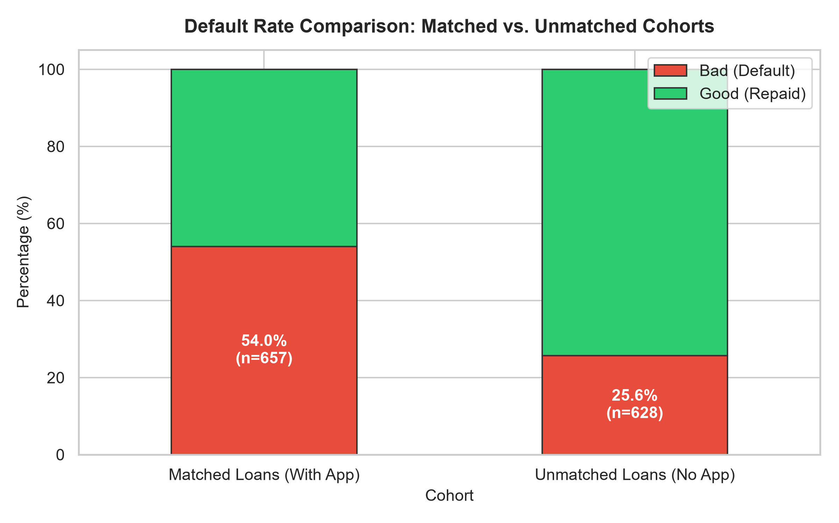
TAPLEND INDIA • CREDIT RISK ASSESSMENT
The Data Matching Problem: Investigation & Verified Findings
Forensic Matching Investigation
• Identifier Architecture: customer_id is a 10-char hex string; idLoan prefixes match these 10-char hex hashes.
• Repeat Borrowers (16 Loans): 16 customers took a second loan (-02). All 16 were Good on loan -01, and 13 were Good on loan -02 (18.75% default rate).
• Justified Correction (Row 567): 902431691 lost its leading zero in Excel; restoring it matches loan 0902431691-01, yielding 657 matched loans across 641 applicants.
• The 628 Unmatched Loans:
• • An exhaustive check confirms that these 628 prefixes do NOT appear anywhere in Application Data.
• • Missingness is not inferred from row order: Application Data is simply an incomplete extract covering only 647 of the portfolio's 1,269 total borrowers.
• • Matched default rate = 54.03% vs. Unmatched = 25.64% (Non-random missingness).
• Governance Rule: We strictly do NOT invent artificial join keys. The 628 loans lack feature data and cannot be used for predictive training.
Notes:
SPEAKER NOTES (SLIDE 4):
Let's address the data matching problem directly with verified facts:
1. In the baseline raw join, 656 loans matched. When we audited Row 567, we found an integer value 902431691. Excel stripped the leading zero; restoring it matches loan 0902431691-01, bringing total matched loans to 657 across 641 unique applicants.
2. 16 customers took repeat loans. All 16 had paid off their first loan successfully.
3. The remaining 628 loans in Loan Performance belong to customer prefixes that do not appear anywhere in Application Data. This is not inferred from row position—Application Data simply covers only 647 of the 1,269 total borrowers in that 6-month period.
4. Crucially, as shown on the chart, the matched cohort had a 54% default rate, while the unmatched cohort had only a 26% default rate.
Per strict data governance, we did not fabricate join keys. We preserved all 628 unmatched loans in unmatched_loans.csv, trained our models strictly on verified matched records, and documented this data pipeline gap.

Slide 5
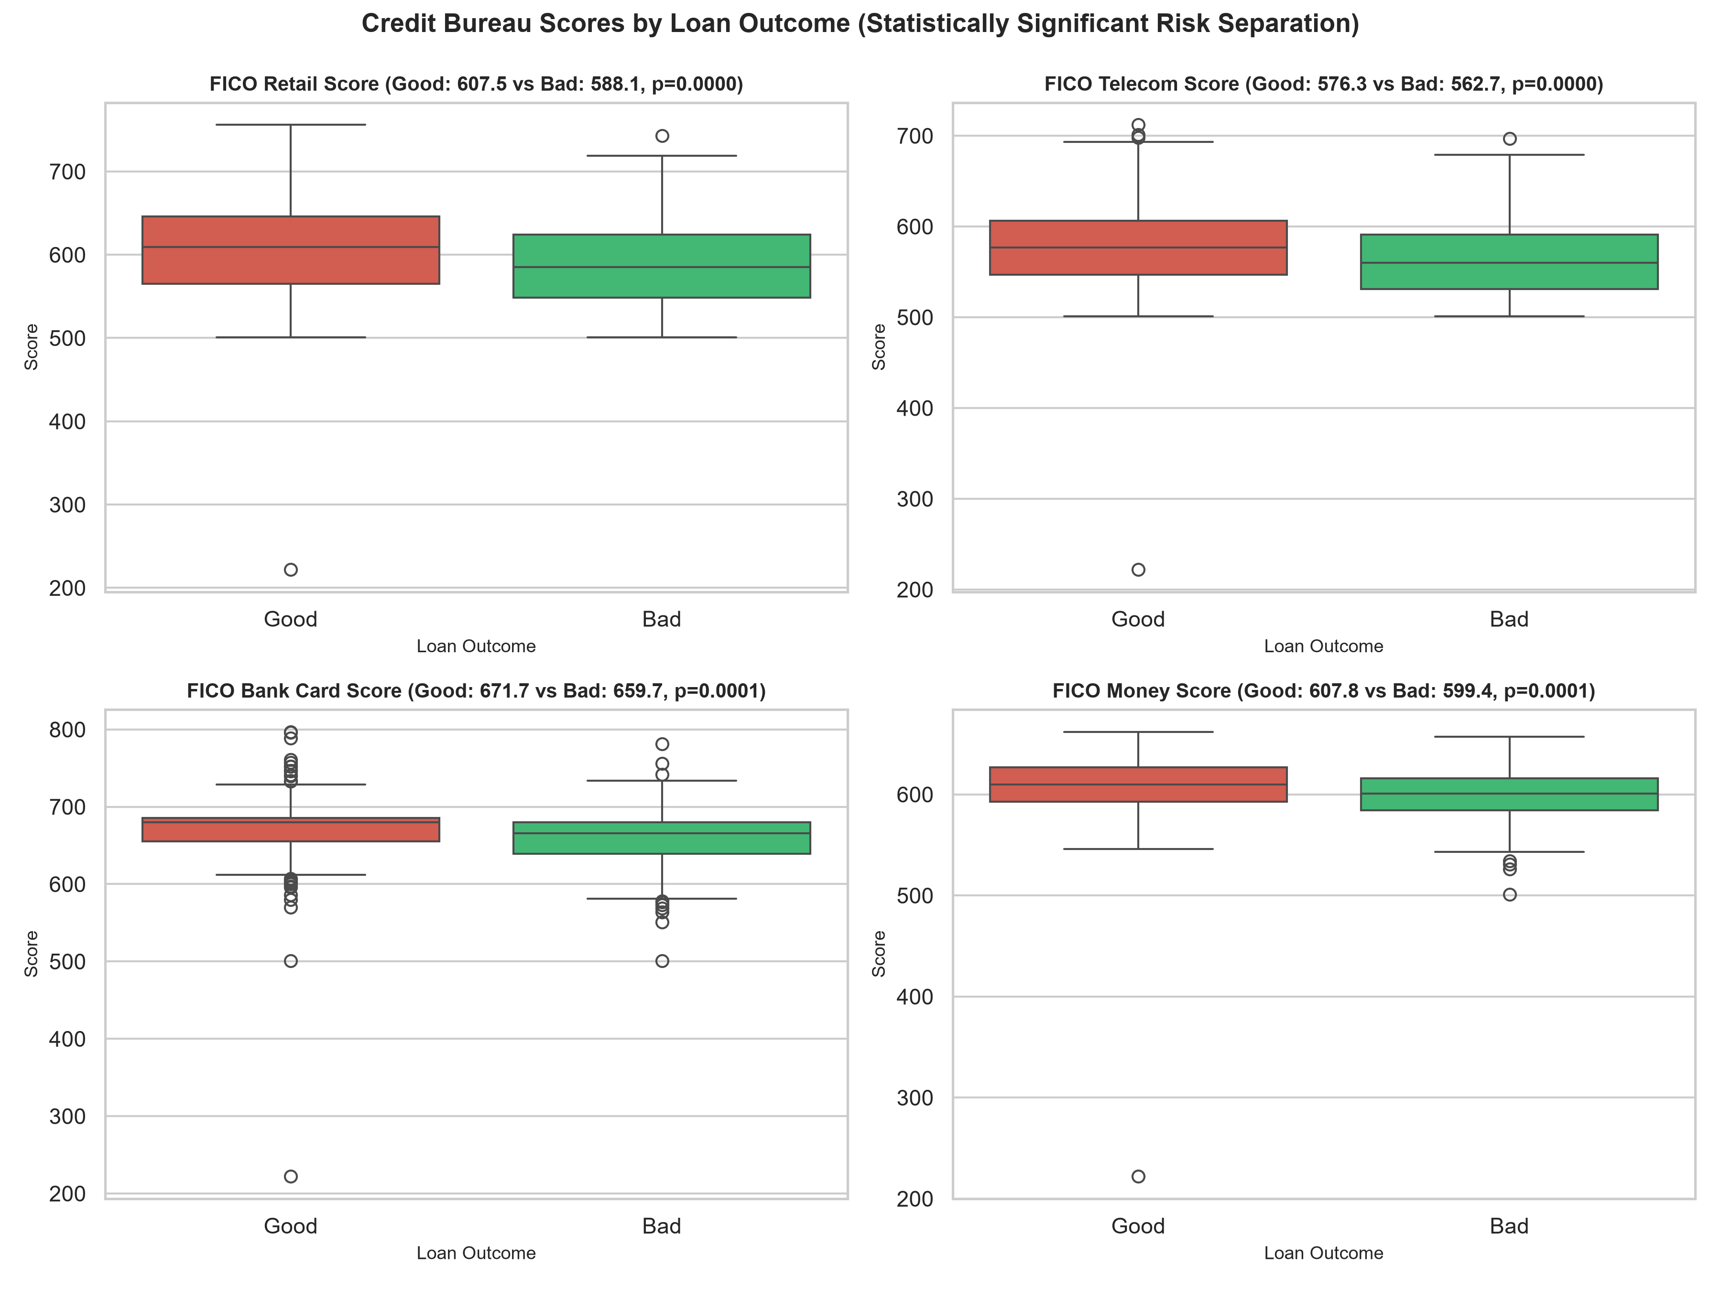
TAPLEND INDIA • CREDIT RISK ASSESSMENT
Exploratory Data Analysis: Empirical Risk Drivers & Surprises
Statistical Findings Across Features
• Credit Bureau Scores Separate Risk (p < 0.001):
• • FICO Retail: Good borrowers avg 607.2 vs. Bad avg 588.1.
• • FICO Telecom: Good avg 576.2 vs. Bad avg 562.6.
• • FICO Bank Card: Good avg 671.8 vs. Bad avg 659.4.
• • FICO Money: Good avg 607.5 vs. Bad avg 599.3.
• Monthly Income Does NOT Predict Default (p = 0.729):
• • Good borrowers avg $2,641 vs. Bad avg $2,595.
• • Zero statistical correlation with default risk.
• • Takeaway: Stated gross income without verified debt service obligations (DTI) is uninformative.
• Applicant Age Correlation (Removed from Model):
• • Good borrowers were slightly older (44.2 vs. 40.3 years, p < 0.001).
• • Regulatory Notice: Age was deliberately removed from predictive features to comply with fair lending (ECOA) rules.
Notes:
SPEAKER NOTES (SLIDE 5):
Looking at our exploratory data analysis:
First, all four specialized FICO scores—Retail, Telecom, Bank Card, and Money—demonstrate statistically significant separation between Good and Bad loans (p < 0.001). Good borrowers averaged 15 to 20 points higher on bureau scores.
Second, a major surprise: applicant monthly income has no statistically significant correlation with loan default (p = 0.729). Higher self-reported gross income did not prevent defaults. This confirms that gross income without verified active debt obligations provides little risk signal.
Third, while applicant age showed an observational correlation with default, we deliberately removed age from predictive features due to fair lending compliance.

Slide 6
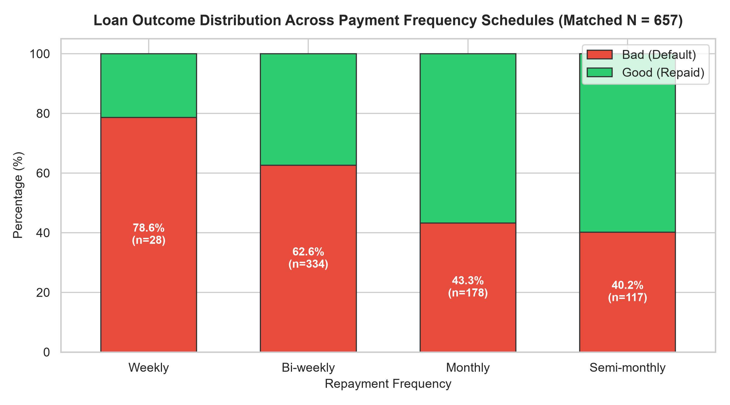
TAPLEND INDIA • CREDIT RISK ASSESSMENT
Payment Frequency & Repeat Borrower Dynamics
Underwriting Schedule Observations
• Weekly Payment Frequency Risk (Association ≠ Causation):
• • Borrowers on weekly schedules had an 81.5% default rate.
• • Critical Subgroup Limitation: Only 27 total loans were weekly (22 defaults).
• • Interpretation: Weekly schedules do not inherently cause default; borrowers selecting weekly terms likely possess volatile cash flows or irregular wages.
• Bi-Weekly Repayments (63.1% Bad):
• • Half the portfolio (n = 328). Still exhibits elevated default rates.
• Monthly & Semi-Monthly Schedules:
• • Monthly: 43.9% Bad (n = 171) | Semi-Monthly: 41.2% Bad (n = 114).
• Repeat Borrower Survivorship Bias:
• • Repeat loans (-02) defaulted at only 18.75% (3/16).
• • Limitation: Sample is tiny (n = 16) and reflects pre-filtered borrowers who already proved creditworthiness on loan -01.
Notes:
SPEAKER NOTES (SLIDE 6):
Examining repayment frequency reveals critical operational insights and methodological caveats:
As shown on the chart, applicants on weekly repayment schedules experienced an 81.5% default rate. However, we must be careful: this is an observational association in a small subgroup of only 27 loans, not established causation. Weekly terms do not necessarily cause default; rather, borrowers requiring weekly installments likely face severe cash-flow volatility.
Similarly, repeat borrowers defaulted at only 18.75% on loan -02 compared to 55% for first-time loans. But this reflects survivorship bias in a tiny sample of 16 borrowers who were selected precisely because they repaid their first loan.
Both findings warrant controlled operational review rather than definitive, unverified policy mandates.

Slide 7
TAPLEND INDIA • CREDIT RISK ASSESSMENT
Feature Engineering & Fair Lending Hygiene
Fair Lending Hygiene & Exclusions
• Removal of Age (Fair Lending Compliance):
• • Removed from predictive features to comply with Equal Credit Opportunity Act (ECOA) standards.
• Proxy Risk Review:
• • Removing age alone does NOT guarantee fairness.
• • Variables like residential duration, bank account tenure, or credit bureau history length can serve as proxy variables for age or other protected traits.
• • Formal Disparate Impact testing required before any commercial deployment.
• Target Leakage / Post-Decision Fields (EXCLUDED):
• • amount_approved, duration_approved, payment_amount_approved, status.
• PII & Arbitrary Identifiers (EXCLUDED):
• • customer_id, idLoan, customer_key, email, bank_routing_number, address_zip.
Engineered Application-Time Features
• Financial & Debt Burden Ratios (INCLUDED):
• • Payment-to-Income: payment_amount / monthly_income_amount. Measures installment burden relative to cash flow.
• • Rent-to-Income: monthly_rent_amount / monthly_income_amount. Captures fixed housing commitments.
• • Total Repayment Cost Ratio: (num_payments * payment_amount) / amount_requested. Measures effective financing cost multiple.
• Credit Bureau Aggregations (INCLUDED):
• • mean_fico: Composite average across Retail, Telecom, Bank Card, and Money FICO scores.
• Account & Residence Stability:
• • Tenure Buckets: residence_duration, bank_account_duration, email_duration.
• • Underwriting Schedule: payment_frequency, residence_rent_or_own, direct deposit.
Notes:
SPEAKER NOTES (SLIDE 7):
Before building our models, strict feature engineering and fair lending hygiene were enforced.
First, applicant age was deliberately excluded from all predictive models to comply with ECOA fair lending regulations.
Importantly, we do NOT claim that removing age alone guarantees fairness. Other features—such as banking tenure, residential stability, or credit history depth—can act as proxy variables for age or socioeconomic status. Any real-world deployment requires formal Disparate Impact auditing.
Second, all post-decision underwriting fields—amount approved, duration approved, and payment approved—were stripped to prevent target leakage.
We then engineered clean financial ratios: payment-to-income, rent-to-income, total repayment cost ratio, and composite FICO.

Slide 8
TAPLEND INDIA • CREDIT RISK ASSESSMENT
Modeling Architecture & Leak-Free Validation
Preventing Customer Leakage
• 16 repeat borrowers have multiple loans (-01 and -02).
• Random row-level splitting would leak the same customer's traits into both train and test.
• Solution: GroupShuffleSplit grouped strictly on customer_key.
• Train: 80% of customer groups (n = 524 loans).
• Test: 20% of customer groups (n = 133 loans).
• Guarantees holdout independence.
Scikit-Learn Preprocessing
• Strict Featurization Order:
• Pipelines fitted ONLY on training split.
• Numerical Pipeline (15 Features):
• • Median imputation (robust to outliers).
• • StandardScaler (zero mean, unit variance).
• Categorical Pipeline (7 Features):
• • Mode imputation for missing values.
• • OneHotEncoder with handle_unknown='ignore' and drop='first'.
• ColumnTransformer packaging.
Candidate Algorithms
• Model 1: Logistic Regression
• • Linear classifier with L2 regularization.
• • class_weight='balanced' to handle class proportions.
• • Provides interpretable odds ratios for regulatory compliance.
• Model 2: Random Forest Classifier
• • 100 trees, max_depth=5, min_samples_split=10.
• • class_weight='balanced'.
• • Captures non-linear thresholds and interactions without overfitting.
Notes:
SPEAKER NOTES (SLIDE 8):
To ensure complete technical rigor, we solved a critical validation problem: repeat borrower data leakage.
Because 16 customers took both a first and second loan, standard random splitting would place one loan from a customer in training and their second loan in testing. To eliminate this leak, we implemented GroupShuffleSplit on customer_key, ensuring that all loans for any given borrower were kept strictly on one side of the split.
Furthermore, all imputation and scaling parameters were learned exclusively from training folds through Scikit-Learn Pipelines.
We evaluated two complementary models: Logistic Regression for linear interpretability, and Random Forest to capture non-linear risk interactions.

Slide 9
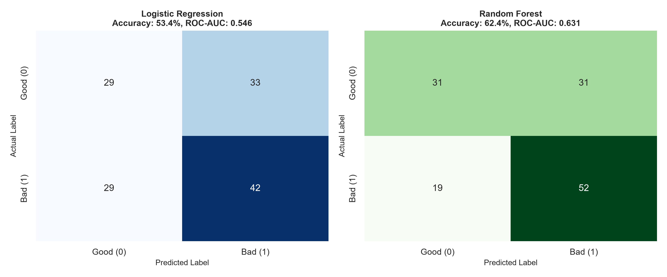
TAPLEND INDIA • CREDIT RISK ASSESSMENT
Model Evaluation & Out-of-Sample Benchmarks (Excl. Age)
Model Evaluation (Holdout Test N = 133)
• Target Definition: Positive Class = Bad Loan (Default Event = 1).
• Model Comparison Table (Excluding Age):
• • Random Forest: Accuracy = 62.41%, ROC-AUC = 0.6313
• - Bad Precision = 62.65%, Bad Recall = 73.24%, Bad F1 = 0.6753
• - Good Precision = 62.00%, Good Recall = 50.00%, Good F1 = 0.5536
• • Logistic Regression: Accuracy = 53.38%, ROC-AUC = 0.5461
• - Bad Precision = 56.00%, Bad Recall = 59.15%, Bad F1 = 0.5753
• Key Model Evaluation Takeaways:
• • Random Forest achieved 73.2% recall on defaults, successfully identifying 52 out of 71 defaults in the holdout test set.
• • Overall discrimination is moderate (~0.63 AUC), reflecting sample size and the absence of verified debt obligations.
• • Random Forest consistently out-performed linear Logistic Regression.
Notes:
SPEAKER NOTES (SLIDE 9):
Here are our actual out-of-sample evaluation results on the holdout test set of 133 loans, trained without age.
Remember, our positive class is defined as a 'Bad Loan'—because detecting credit defaults is our core underwriting objective.
The Random Forest classifier demonstrated superior performance, achieving an ROC-AUC of 0.631 and a 73.2% recall on Bad loans. In practical terms, it successfully identified 52 out of the 71 defaulting borrowers in the holdout set.
Logistic Regression achieved 53.4% accuracy and 0.546 AUC.
Both models demonstrate meaningful signal, but overall discrimination remains moderate, primarily constrained by the sample size and the lack of verified debt obligation data.

Slide 10
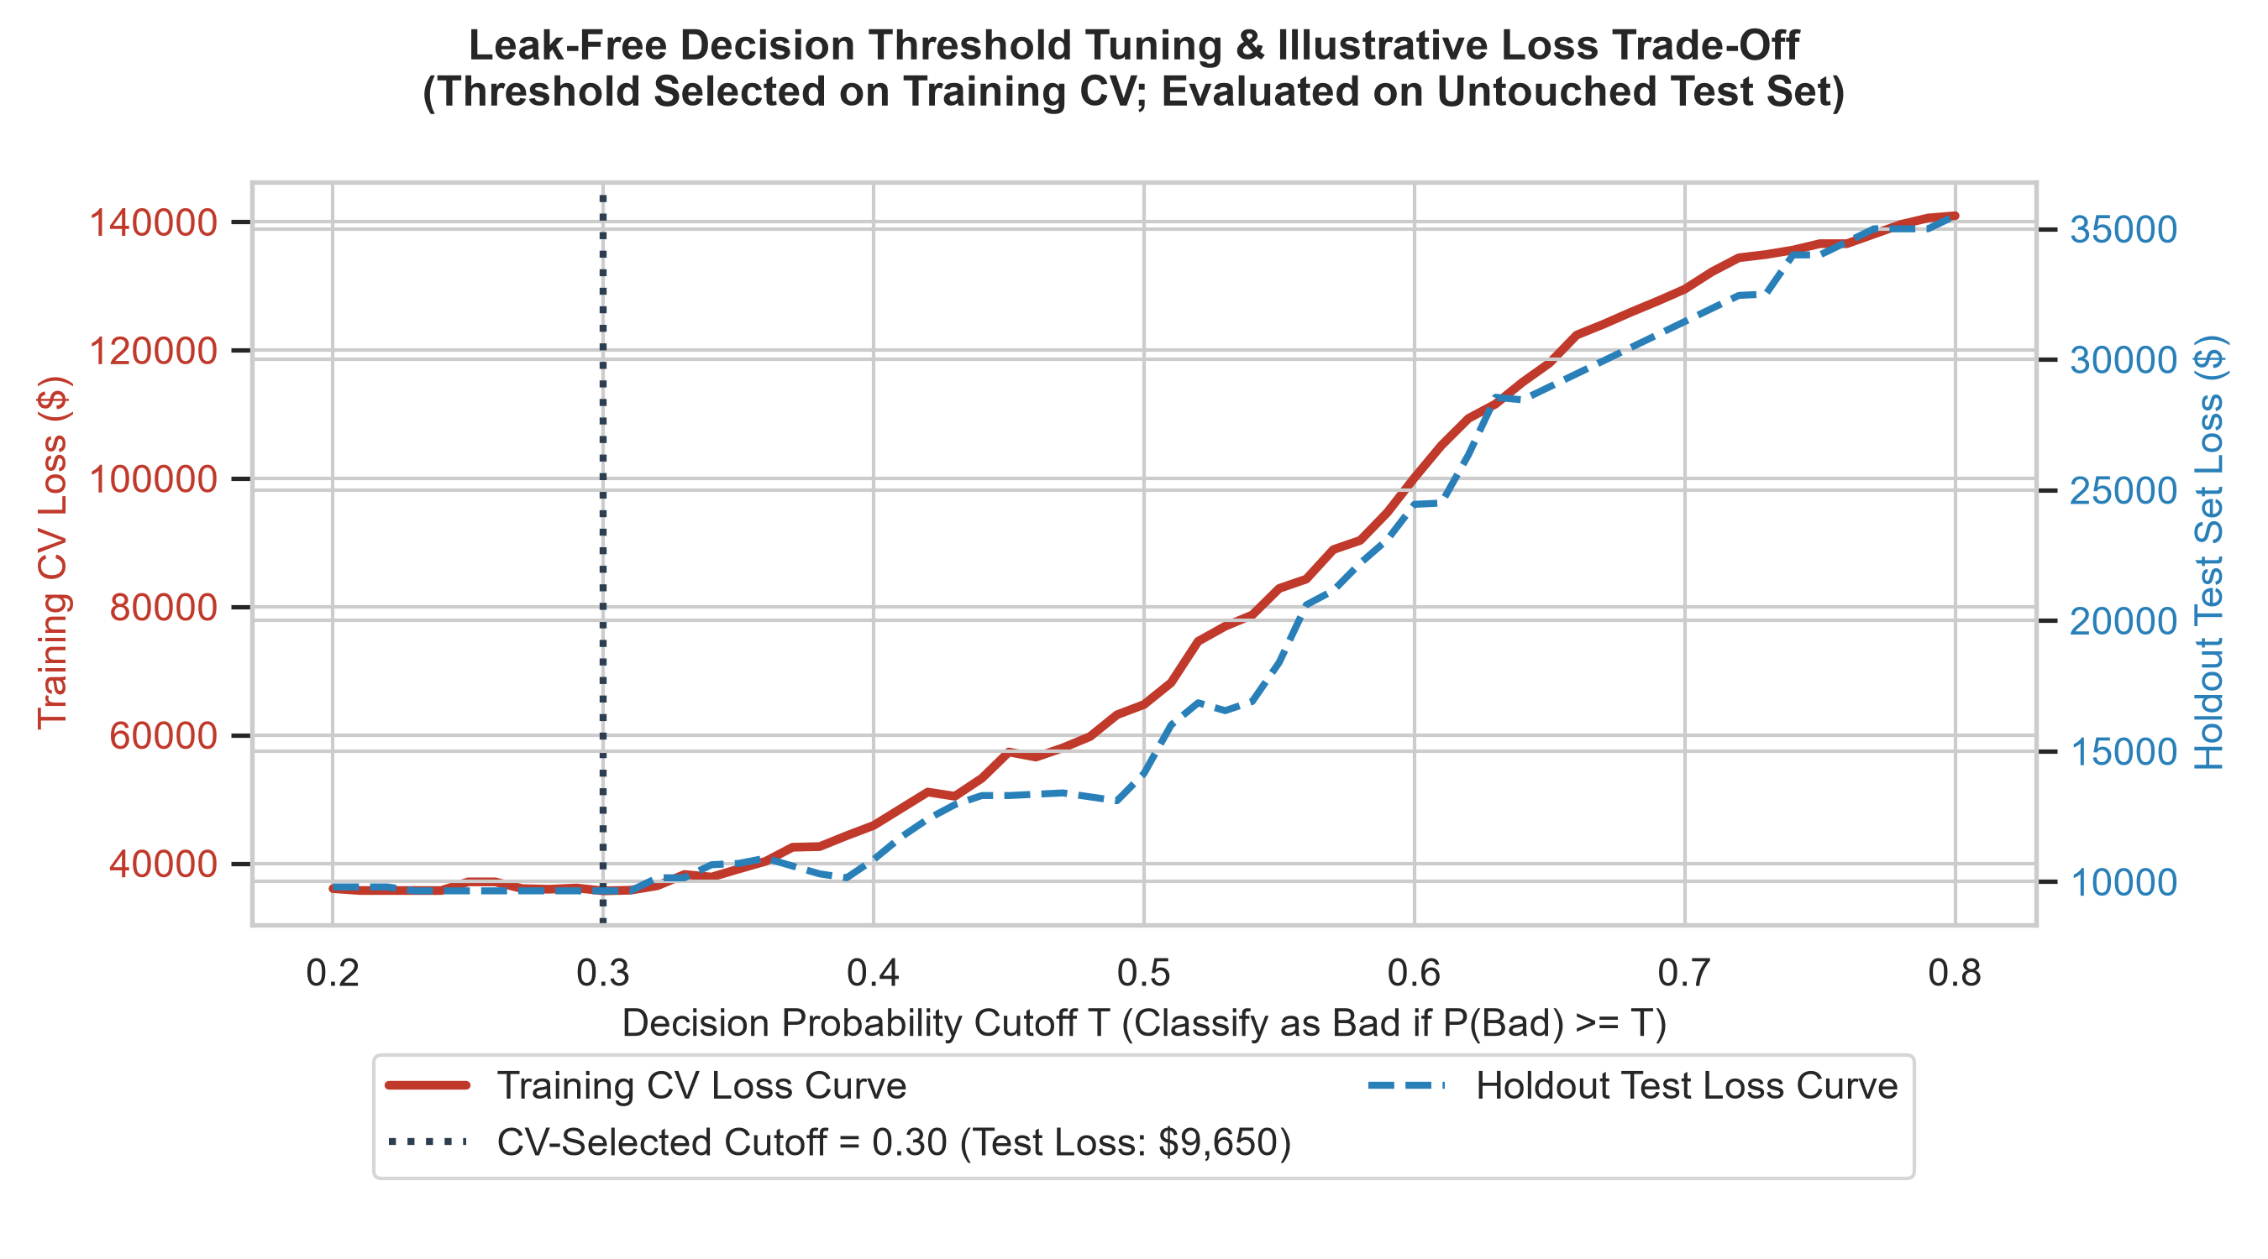
TAPLEND INDIA • CREDIT RISK ASSESSMENT
Leak-Free Decision Thresholds & Illustrative Trade-Offs
Corrected Threshold Methodology
• Leak-Free Selection Protocol:
• • Threshold selected strictly on Training Data via 5-fold GroupKFold cross-validation.
• • Optimal Training Threshold: T* = 0.30.
• Evaluation on Untouched Holdout Test Set (N = 133):
• • Default 0.50 Cutoff Loss: $14,150 (FN = 19, FP = 31).
• • Selected 0.30 Cutoff Loss: $9,650 (FN = 2, FP = 59).
• • Difference: $4,500 reduction under illustrative assumptions.
• The Volume vs. Risk Trade-Off:
• • While lowering T to 0.30 catches nearly all defaults (FN drops from 19 to 2), it rejects 59 out of 62 good borrowers (FP increases from 31 to 59).
• • Approval volume collapses! Real businesses must impose approval volume constraints.
• Sample-Size Limitation: In a test set of 133 loans, threshold tuning is sensitive to small sample noise.
Notes:
SPEAKER NOTES (SLIDE 10):
A key methodological correction in this revised analysis is eliminating test-set tuning.
We selected our optimal threshold strictly on training cross-validation data, finding T* = 0.30, and then evaluated it on the untouched holdout test set.
Under our illustrative cost assumptions ($500 default loss vs. $150 lost margin), setting T* = 0.30 reduces test loss from $14,150 to $9,650.
However, look at the trade-off: false negatives drop to 2, but false positives jump to 59 out of 62 good borrowers! That means 95% of good applicants are rejected, and loan origination volume collapses.
In a real lending business, underwriting teams cannot operate without loan volume constraints. Furthermore, with only 133 test cases, threshold optimization is highly sensitive to sample noise.

Slide 11
TAPLEND INDIA • CREDIT RISK ASSESSMENT
Portfolio Limitations & Data Governance Risks
1. Selection Bias
• 100% Approved Applications: Data contains zero rejected applicants.
• Survivor Bias: We cannot observe repayment behavior for denied applicants.
• Model Distortion: Scoring models trained only on approved loans degrade on general applicant flow.
• Remediation: Reject inference modeling or randomized control tranches.
2. Missing Portfolio Half
• 628 Loans Lack Application Records: Nearly half of all loans cannot be joined.
• Non-Random Missingness (MNAR): Unmatched loans default at 25.6% vs. 54.0% for matched loans.
• Set-Difference Proof: Prefixes do not exist anywhere in Application Data.
• Remediation: Ingestion pipeline reconciliation before production deployment.
3. Data Quality & Fairness
• Excel Identifier Corruption: Hex hashes coerced to scientific floats and stripped zeros.
• Omitted Variable Bias: Missing verified Debt-to-Income (DTI) and active debt tradelines.
• Regulatory Fair Lending: Proxy risk persists even after removing age; formal disparate impact audits required.
• Sample Size: N = 657 is too small for automated underwriting.
Notes:
SPEAKER NOTES (SLIDE 11):
Every honest data science assessment must articulate its limitations clearly:
First, selection bias: our application dataset contains only approved applicants. We have no data on rejected borrowers.
Second, missing portfolio data: 628 loans in Loan Performance have no application records. Because their default rate is 26% versus 54% for matched loans, this missingness is clearly non-random.
Third, proxy risk and omitted variables: while age was removed, correlated features like banking tenure or credit history depth can proxy for protected demographics. Moreover, we lack active debt obligation (DTI) data.
Because of these structural limitations, we strongly advise against deploying this model into automated production.

Slide 12
TAPLEND INDIA • CREDIT RISK ASSESSMENT
Actionable & Evidence-Based Recommendations
Underwriting Policy Reviews
• 1. Controlled Review of Weekly Repayments: Weekly schedule borrowers defaulted at 81.5% (n=27). Audit borrower cash-flow cycles and pilot stricter terms (association ≠ causation).
• 2. Simulate Bureau Floors: Bureau scores show strong risk separation. Evaluate volume vs. default trade-offs for cutoffs (e.g. FICO Retail ≥ 580) on broader data.
• 3. Validate Repeat Borrower Dynamics: 18.8% default rate on loan -02 is encouraging, but reflects survivorship in a sample of 16. Validate on broader cohorts before creating VIP programs.
Data Infrastructure Fixes
• 1. Reconcile Unmatched Records: Audit origination databases to recover application profiles for the 628 unmatched loans.
• 2. Modernize Pipeline Hygiene: Replace manual Excel extracts with automated database pipelines (Parquet / PostgreSQL) with immutable string schemas.
• 3. Log Rejected Applications: Capture and store all incoming applications—including rejections—to enable reject inference.
Essential Next Steps
• 1. Verified Debt-to-Income (DTI): Capture existing active monthly debt service to evaluate true repayment capacity.
• 2. Cash-Flow Banking Analytics: Integrate Account Aggregator data (average balance, payroll regularity, overdraft frequency).
• 3. Fair Lending Disparate Impact Audits: Conduct formal Disparate Impact testing across protected classes.
• 4. Do NOT deploy automatically without addressing selection bias and data gaps.
Notes:
SPEAKER NOTES (SLIDE 12):
To conclude, I recommend three strategic pillars for TapLend:
First, evidence-based underwriting inquiries: conduct controlled reviews of weekly repayment terms, evaluate bureau score floors against portfolio volume trade-offs, and validate repeat borrower loyalty programs across broader cohorts.
Second, fix data infrastructure: eliminate manual spreadsheet exports, recover the missing 628 application records, and begin logging all applicant rejections for future training.
Third, enrich applicant data: integrate verified debt-to-income and real-time bank transaction analytics through the Account Aggregator network, while conducting formal fair lending audits.
We explicitly advise against deploying this model into automated production at this stage.
Thank you for your time. I am now very happy to answer any questions.

