Slide 1


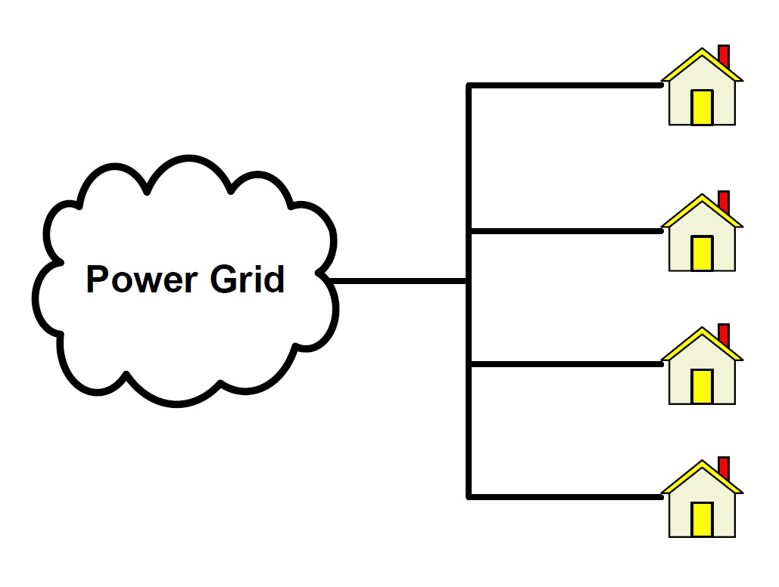
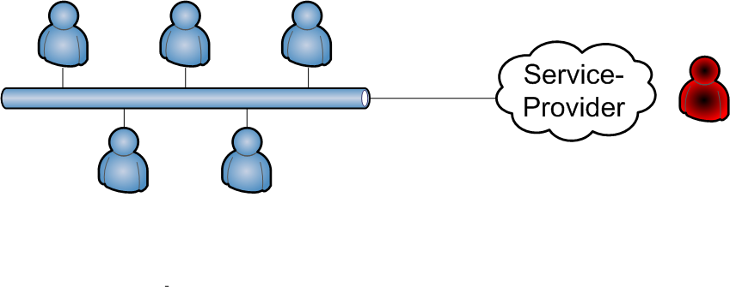

Jalal Arabneydi
Ph.D. Candidate
Supervisor: Aditya Mahajan
Thesis Topics
Optimal Control in Stochastic Systems
(Centralized and Decentralized)
Reinforcement Learning Algorithms
(Particularly, Q-learning Algorithms)
Focused on applications in Smart grids
Demand response in smart grids
Approach/Results
Developed a new solution approach for Team Optimal Control of decentralized stochastic systems with mean-field sharing information structure.
Developed a new generic approximate RL algorithm for decentralized stochastic systems
Solved interesting examples:
Optimal strategy for a service that is not only profitable but also customer-satisfactory.

