Slide 1
A signaling method and algorithm to change the schedule and allocation in persistent scheduling
Aditya Mahajan
Anand Bedekar

Slide 2
Problem description
LTE proposes persistent scheduling as a means to achieve higher spectral efficiency for periodic and predictable traffic like VoIP
In persistent scheduling we lose the ability to adapt the MCS and the size of the current allocation according to the variation in the channel conditions and packet length.
Problem: Determine a method to adapt the MCS and allocation in persistent scheduling, while maintaining spectral efficiency of persistent scheduling.
Proposed Solution:
The base-station tells the mobile a persistent schedule, MCS (possibly skip if blind detection) and allocation (resource blocks) to use with that schedule.
Before each scheduled transmission, the base-station can send one of three messages to the mobile:
  Temporarily change the persistent schedule for a specified number of frames, and then revert to the persistent schedule (in a L1/L2 control message presently in the standard).
  Permanently change the persistent schedule to a new persistent schedule (presently not in the spec, although might be an obvious extension of the original persistent schedule message).
  Temporarily change the persistent schedule for a specified number of frames, and then change to a new persistent schedule.
In the absence of any message the previous schedule is adhered to.
Algorithm to determine when to send different messages, so as to minimize the average resource consumption (number of allocated slots and signaling overhead).

Slide 3
Description of proposed methodology
— The signaling method
Before an uplink or a downlink connection starts the base station sends the mobile a persistent schedule. The persistent schedule consists of
  Frame numbers in which traffic for this mobile will be scheduled.
  The slots in the scheduled frames where data for the mobile will be sent in downlink, or where the mobile should send its data in uplink.
  The MCS according to which data is to be transmitted in these slots.
The headers of the MAC SDU may be compressed using some header compression scheme like ROHC.
For downlink the mobile may send a CQI message containing quantized channel state information to the base station.
The start and stop of voice activity are signaled over a separate control channel. The persistent schedule is application only during voice activity.

Slide 4
Description of proposed method
— The signaling method
At the beginning of the scheduled transmission frame, the base station can send the mobile one of three messages
  MSG1(n,m,a) Change the persistent schedule temporarily for n number of frames, and after that revert to the persistent schedule. The message contains the components of the new temporary schedule (MCS m, allocation a).
  MSG2(m,a) Change the persistent schedule permanently with a new persistent schedule. The message contains components of the new permanent schedule (MCS m, allocation a).
  MSG3(n,m,a,m’,a’) Change the persistent schedule temporarily for n number of frames, and after that change to a new persistent schedule. The message contains the components of the temporary schedule (m,a) and the new schedule (m’,a’).
In the absence of any one of the above messages, the base-station and the mobile stick to the previously specified schedule.
At the start of a new voice activity, MSG2 may be sent to signal a new persistent schedule. If MSG2 is not sent, the persistent schedule at the end of the previous voice activity is used.
Use the dynamic resource allocation control message with a bit flipped on to indicate a change in persistency.

Slide 5
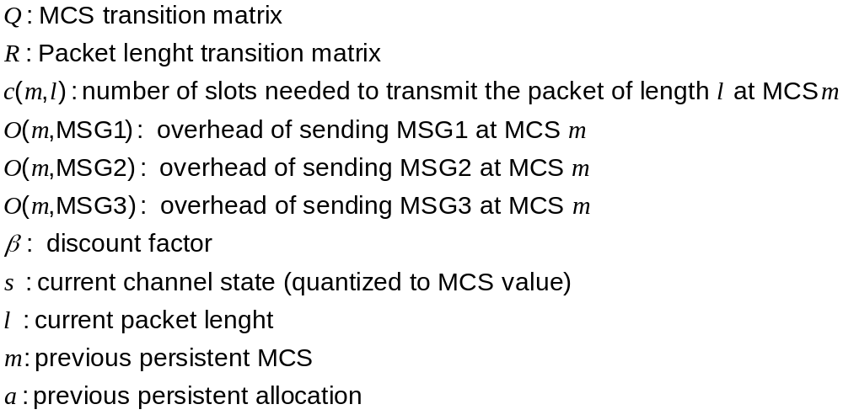
Description of proposed method
— The Algorithm
Each transmission frame uses either the number of slots specified by the current persistent allocation or when the persistent schedule is overridden by a temporary schedule, the number of slots specified by the temporary schedule
Each signaling message has an overhead that may depend on the current MCS.
This algorithm determines when and how to change the persistent schedule in order to minimize the average slots used per frame
The algorithm consists of two components — the offline component to choose the optimal scheduling rule γ for different user classes, and an online component to implement to identify the user class and use appropriate γ.
Notation

Slide 6
Description of proposed method
— The offline component
System Info
c(.,.) β,
O(.,MSG1), O(.,MSG2), O(.,MSG3)
Database of User Profiles
Database of User Profiles
User Profile
Q, R
User Profile
Q, R
User Profile
User Profile
γ
γ
Obtain User profile from database
Obtain optimal allocation rule for that user.
Store optimal allocation rule in a user database
γ
γ
User Profile
Q, R
User Profile
Q, R
Explained on the next page
User Profile
User Profile
γ
γ

Slide 7


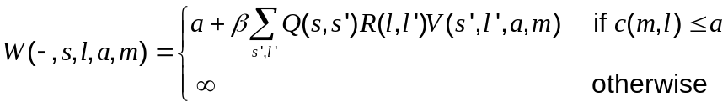


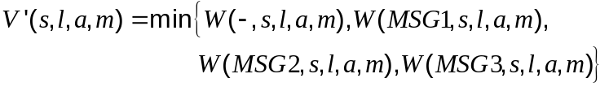
Description of proposed method
— The offline component
Initialization
No
Evaluate
Continue next page

Slide 8
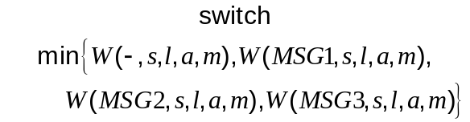









Description of proposed method
— The offline component
Evaluate
Continued from previous page
m’ and a’ are the arg min in the calculations of W(MSG2,s,l,a) and W(MSG3,s,l,a)

Slide 9




Description of the Proposed Method
— The online component
Something needs to be said about identifying the user
Database of User Profiles
START
Identify user class based on user velocity and user equipment type
User Profile
User Profile
γ
γ
User Profile
User Profile
Get optimal allocation rule for that user class.
γ
γ
γ
MSG1
No
STOP
Frame to
transmit
Yes
MSG2/MSG3
m’ and a’ obtained from MSG2/MSG3

Slide 10
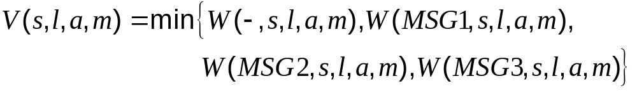
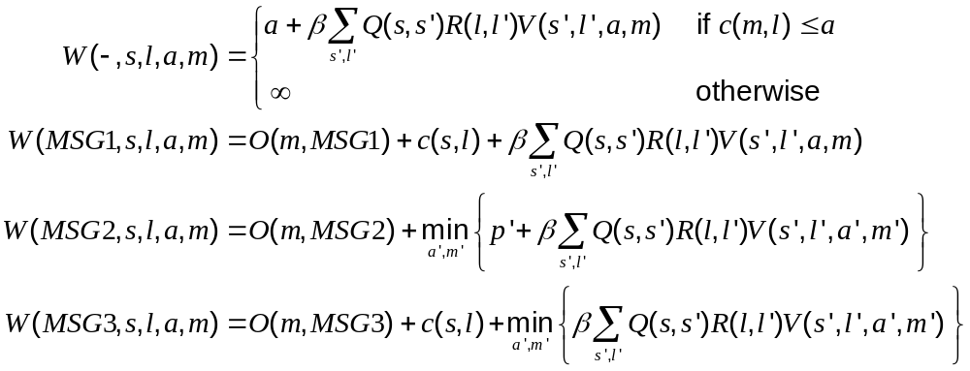
Description of proposed method
— The Algorithm
This slide may be deleted
Find the fixed point V of the following system of equations
where

Slide 11
Description of proposed method
— The Algorithm
At the beginning of the transmission frame, let s be the current (quantized) channel state, l be the packet length, p be the current persistent allocation, and m be the current persistent MCS.
Calculate
If the minimum is
  W(-,s,l,p,m): send no message
  W(MSG1,s,l,p,m): send MSG1 with number of frames to override=1, new MCS=s, new allocation = c(s,l).
  W(MSG2,s,l,p,m): send MSG2 with new persistent MCS=m’ and new allocation=p’ where (p’,m’) is the arg min in the definition of W(MSG2,s,l,p,m).
  W(MSG3,s,l,p,m): send MSG3 with number of frames to override=1, temporary MCS=s, temporary allocation=c(s,l), new persistent MCS=m’ and new allocation=p’ where (p’,m’) is the arg min in the definition of W(MSG3,s,l,p,m).
This slide may be deleted

Slide 12
Prior Art
Persistent Scheduling is proposed in LTE contributions R1-060099, R1-060173, R2-061920, R2-062913, R2-062758
However, these methods do not include the option of changing the persistent schedule.
The proposed method includes the option to change the persistent schedule. It also provides an algorithm that specifies how and when the persistent schedule should be changed.
Benefits
The proposed method significantly reduces the signaling overhead.
In dynamic scheduling the average overhead is 7.33 symbols per frame
Using the proposed method, the average overhead is
Type of Traffic | Average Overhead (symbols per frame)
Ped A 3 km/h | 2.36
Ped B 3 km/h | 1.30
Ped B 30 km/h | 2.57
VehA 30 km/h | 2.66
VehA 120 km/h | 2.66

Slide 13
Business Case
Improving the spectral efficiency of persistent scheduling in LTE
Applicable to enhancements of 802.16e if they include persistent scheduling.
Infringement and Detection
The signaling method is easy to detect since the message are sent over the air interface
The use of the algorithm is hard to detect since it is an internal lookup table algorithm implemented in the base station.
Workarounds
Other algorithms can be used, but they will not be as efficient as the proposed algorithm.

Slide 14
Uniqueness/Novel Aspects
The base station has the ability to permanently or temporarily change the persistent schedule.
The current channel state, the current packet length, the current persistent schedule, and the overhead for each signaling message is taken into account while deciding how and when to change the persistent schedule.

