Slide 1
Clustering and Regression Analysis of Financial Health and Stock Performance
Notes:
Have you ever been confused about which stock to buy? I certainly was, especially when I first started investing. We’re supposed to look at metrics like revenue, net income, and earnings per share. But let’s be honest, it doesn’t always guarantee a win. Sometimes it works out, other times it doesn’t, and often we just don’t have the time or energy to dig deep into the numbers. That’s why I decided to take a different approach. Today, I’m going to walk you through an analysis and research project I implemented to systematically identify financially resilient companies and accurately predict their stock prices. This project combines clustering, regression, and resilience analysis to provide a comprehensive framework for making smarter investment decisions.

Slide 2

The problem
Context
Objective
The financial health of companies is a critical determinant of their stock performance and overall market stability.
Investors and risk managers rely on comprehensive analyses of financial metrics to make informed decisions.
Predicting stock prices and understanding financial resilience are key components of financial risk management.
The goal was to cluster companies based on their financial metrics and predict stock prices using historical data.
Ultimately, the project sought to identify patterns and insights that could inform better investment and risk management decisions.
Notes:
What drives a company's financial health, and how does it affect its stock performance?
Understanding a company's financial stability is vital for both investors and risk managers.
My project aimed to cluster companies based on their financial health and predict stock prices using historical data.
The goal was to uncover patterns that lead to better investment decisions and improved risk management strategies.

Slide 3





Dataset and Technology Used
Programming Language: Python
Libraries and Tools:
Data Manipulation: Pandas and Numpy
Visualization: Matplotlib, Seaborn and Plotly
ML Tasks: Scikit-learn
Dataset Description:
Source: Kaggle: New York Stock Exchange (NYSE) Dataset
Features: Financial metrics (fundamentals), historical stock prices
Data Span: Stock prices (2010-2016), Fundamentals (2012-2016)
Notes:
To tackle this problem, I sourced a dataset from Kaggle namely – New York Stock Exchange dataset that provides a comprehensive view of companies' financial health. There were 4 datasets included amongst which two – the financial metrics and the stock prices dataset were used for this analysis.
The fundamentals dataset included key financial metrics like revenue, net income, total assets, and liabilities, among others. Whereas the stock prices dataset included the open/close/volume related data.
The dataset was rich, encompassing a diverse range of companies across different sectors. This variety allowed to perform a thorough analysis and ensure that the findings were not biased towards any specific industry.
I leveraged Python as the main programming language. Pandas was used for data cleaning and manipulation, while Seaborn, Matplotlib and Plotly handled the data visualization tasks. For the clustering and regression analyses, I used Scikit-learn, which provided efficient implementations of the algorithms.

Slide 4
Challenges
Challenge 1
Challenge 2
Challenge 3
Handling Large and Complex Datasets
Identifying Key Financial Metrics
Clustering and Predictive Modelling
Notes:
This project faced key challenges.
First, data quality was an issue, with inconsistencies and missing values requiring robust cleaning and feature selection for accuracy.
Next, selecting the right financial metrics was crucial; too many could cause overfitting, while too few might miss important details.
Lastly, making the findings interpretable was essential to ensure the insights were actionable for investors and risk managers.

Slide 5
Implementation

Slide 6
Cleaning and preparing financial data, followed by exploratory analysis to identify key financial metrics for clustering.
Predicting stock prices using Linear Regression.
Comparing the financial stability of companies to assess their resilience to market conditions.
Data Cleaning and EDA
Clustering
Analysis
Regression
Analysis
Combined
Analysis
Financial
Resilience Analysis
Group companies into clusters based on similar financial profiles using K-Means clustering.
Integrating clustering and regression results to explore the relationship between financial health and stock performance.
Notes:
The implementation process, as shown in the flow chart, began with gathering and inspecting the financial dataset, followed by data cleaning to address missing values and outliers.
Key financial metrics were then selected for clustering and regression.
K-Means clustering grouped companies based on these metrics, while multiple regression models (Linear Regression, Support Vector Regression, and Random Forest) were used to predict stock prices, aiming to minimize prediction errors.
A combined analysis cross-validated the clustering and regression results, identifying clusters with the most reliable stock predictions.
Finally, resilience analysis assessed the stability of companies within each cluster, especially in tough market conditions, providing valuable insights for investment decisions.

Slide 7
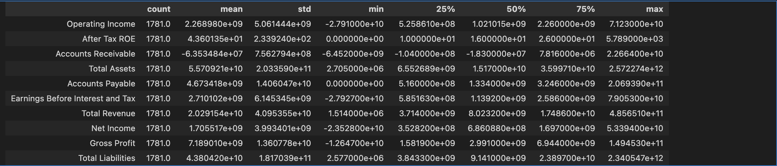
Data Cleaning and EDA
1. Data Cleaning
Initial Inspection
Handling Missing Values
Duplicate Removal
Date Conversion
Notes:
I began with an initial inspection of the dataset, examining data types, identifying inconsistencies, and spotting outliers to understand the data comprehensively.
I addressed missing values by imputing the mean and removed duplicate entries to ensure accuracy.
Date columns were standardized and converted to datetime objects in Python, essential for future time-series analysis.
The table at the slide's bottom shows a statistical summary of the cleaned data, highlighting significant variability.
Here, you can see the large variability reflects the diversity in company sizes and financial health within the dataset, which is why clustering was particularly useful in segmenting companies into more homogeneous groups.

Slide 8
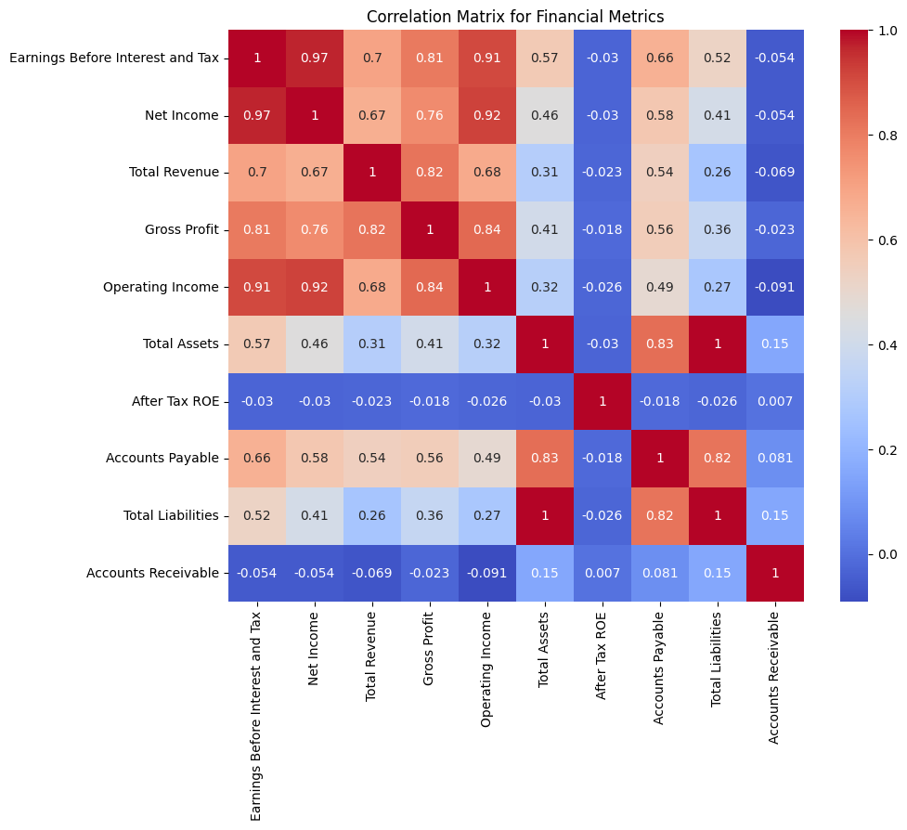
EDA
2. Exploratory Data Analysis on Cleaned Data
Distribution Analysis
Correlation Matrix
Pair Plot Visualization
Feature Engineering
Notes:
With the data cleaned, I proceeded to Exploratory Data Analysis (EDA).
I first examined the distribution of key financial metrics using histograms and box plots to understand data spread and identify skewness or outliers.
The heatmap on the right shows a correlation matrix of key financial metrics, highlighting strong positive correlations, such as between 'Operating Income' and 'Net Income'.
To explore these relationships further, I used pair plots to visualize bivariate relationships, revealing potential linear dependencies or clusters.
Lastly, I performed feature engineering, selecting the most correlated features for clustering analysis.

Slide 9
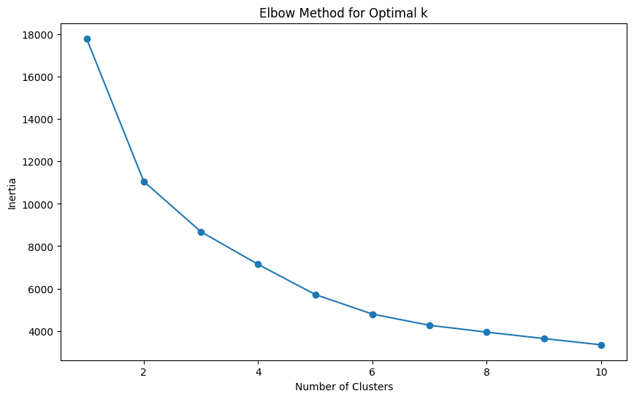
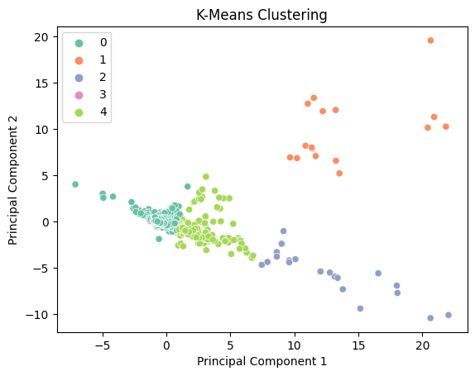
Clustering Analysis
Task:
The goal of the clustering analysis was to group companies based on their financial health, allowing us to identify distinct segments that share similar financial characteristics. This helps in understanding market dynamics and assessing financial risk.
Implementation:
Number of Clusters: Determined an optimal number of clusters using the Elbow Method.
K-Means Clustering Algorithm: Used the K-Means clustering algorithm, that partitions the companies into distinct clusters.
Notes:
I conducted a clustering analysis to group companies based on financial health, identifying segments with similar characteristics like profitability, revenue, and liabilities.
Technical Insight:
To determine the optimal number of clusters, I used the Elbow Method, which plots the within-cluster sum of squares against the number of clusters.
The 'elbow' in the curve indicated that five clusters were optimal.
I then applied the K-Means clustering algorithm, which effectively separated companies into distinct clusters, each representing a unique financial profile.

Slide 10
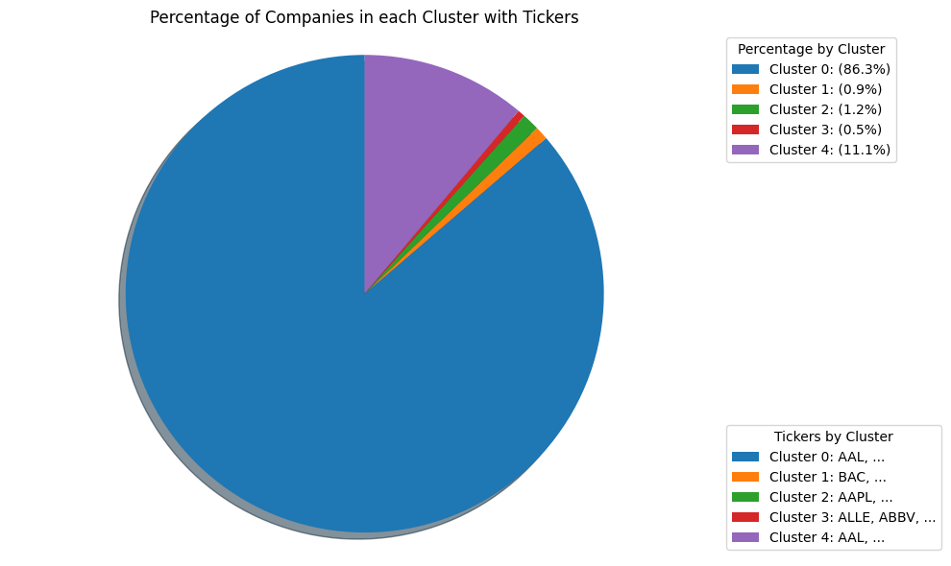
Clustering Analysis - Insights
Cluster Insights:
The analysis identified distinct financial clusters, with robust companies like AAPL showing higher predictability and lower risk, guiding strategic investment and risk management decisions.
Cluster Characteristics:
Each cluster represented a distinct group of companies with similar financial profiles.
For example, one cluster represent highly profitable companies with strong operating income and revenue, while another cluster consists of companies with moderate profitability but higher liabilities.
Notes:
After forming the clusters, I analyzed their characteristics to extract insights. Each cluster represented companies with similar financial profiles.
For example, one cluster included highly profitable companies like Apple (AAPL) with strong operating income and revenue, while another contained companies with moderate profitability but higher liabilities.
Technical Insight:
The pie chart illustrates the distribution of companies across clusters, showing that Cluster 0 contains most companies, while Cluster 2, including financially robust companies like AAPL, is smaller but stronger.

Slide 11
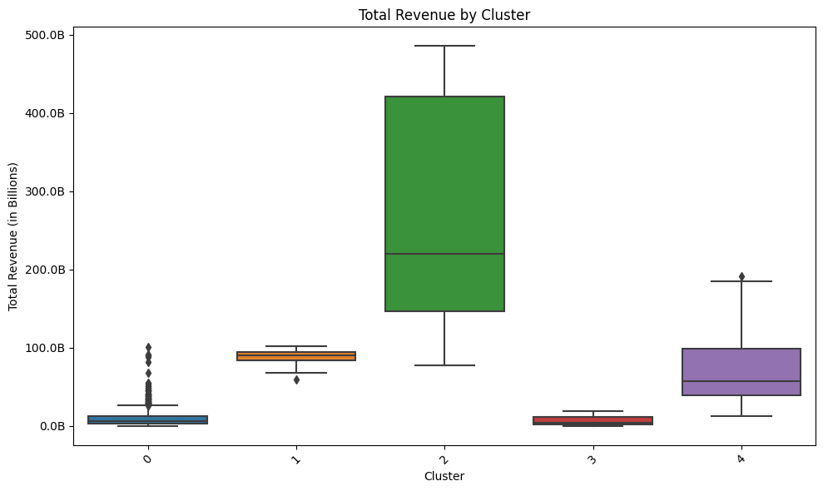
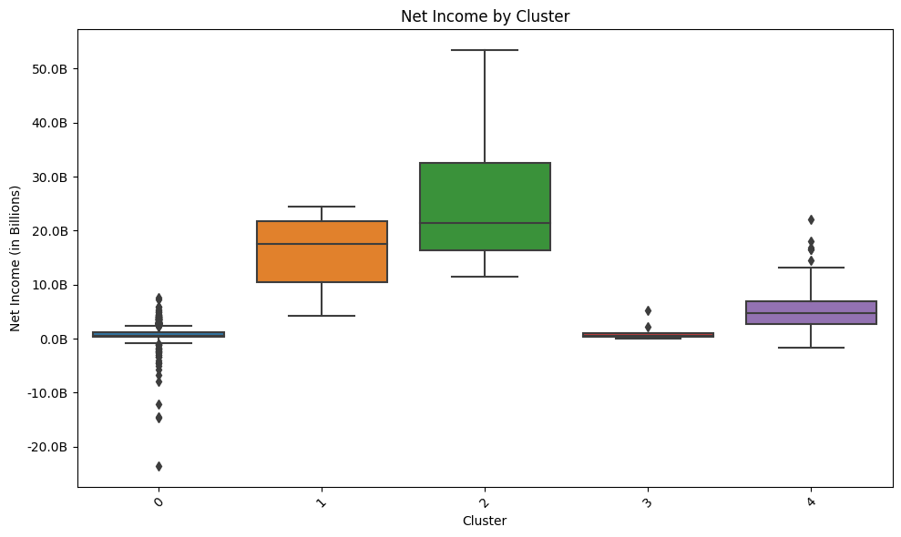
Clustering Analysis - Results
This insight allows investors to target stable clusters for more reliable returns, as from the box and bar charts we can clearly observe Cluster 2 is the most stable one in terms of Revenue and Net Income.
Notes:
The results from the clustering analysis reveal significant insights into the financial health of different clusters.
Cluster 2 emerges as the most financially robust, with the highest median Total Revenue and Net Income, indicating strong and consistent performance.
This cluster is ideal for investors seeking stable returns.
Conversely, Cluster 0, despite containing the majority of companies, shows lower median values for both revenue and income, suggesting these companies are less profitable and potentially riskier.

Slide 12
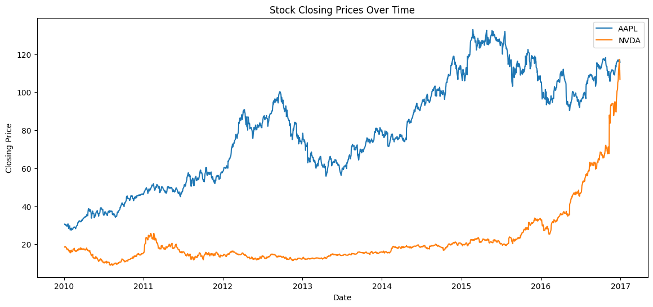
Regression Analysis
Task:
The regression analysis aimed to predict the future stock prices of companies based on historical
financial data. By accurately forecasting stock prices, we can provide valuable insights for
investment decisions and financial risk management.
Implementation:
Introduced a new feature, 'previous_close', which was critical in predicting the next day's closing price.
Three different regression models have been used to predict stock prices: Linear Regression, Support Vector Regressor (SVR), and Random Forest Regressor.
The dataset was split into training and testing sets to evaluate the model's performance.
Notes:
The primary goal was to predict future stock prices using historical financial data by building models for accurate predictions.
I introduced a new feature, 'previous_close' price, which captures the stock's closing price from the previous trading day.
I used three regression models: Linear Regression, Support Vector Regressor (SVR), and Random Forest Regressor.
To ensure the models generalize well to unseen data, I split the dataset into training and testing sets.
The chart on the right shows the stock closing prices over time for AAPL (in blue) and NVDA (in orange), highlighting their trends over several years.

Slide 13
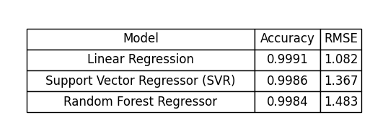
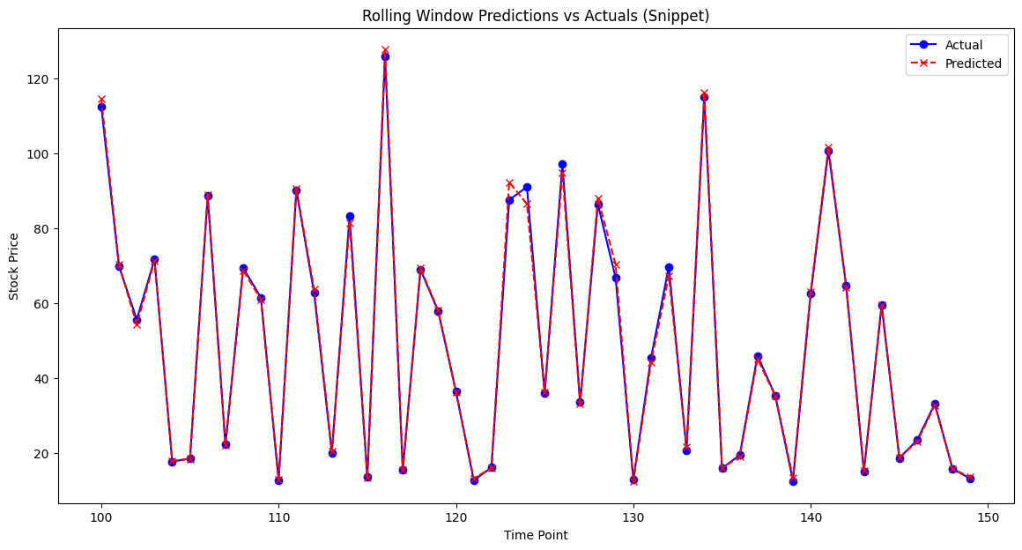
Regression Analysis - Results
Stock Performance:
The model's performances was evaluated using RMSE.
The regression model provided reliable short-term predictions of stock prices – suggesting that historical prices are strong indicator for future performance.
This can be utilized for stocks within clusters which provide lower risk and higher stability.
Notes:
The models' performance was evaluated using Root Mean Squared Error (RMSE).
As shown in the table, Linear Regression performed slightly better, with a lower RMSE, indicating more accurate stock price predictions.
On the right, the plot compares the model's predictions to actual stock prices, showing minimal deviation, which demonstrates the robustness of our models in predicting stock prices.
Overall, the regression models provided reliable short-term stock price predictions, confirming that historical prices are strong indicators of future performance.

Slide 14
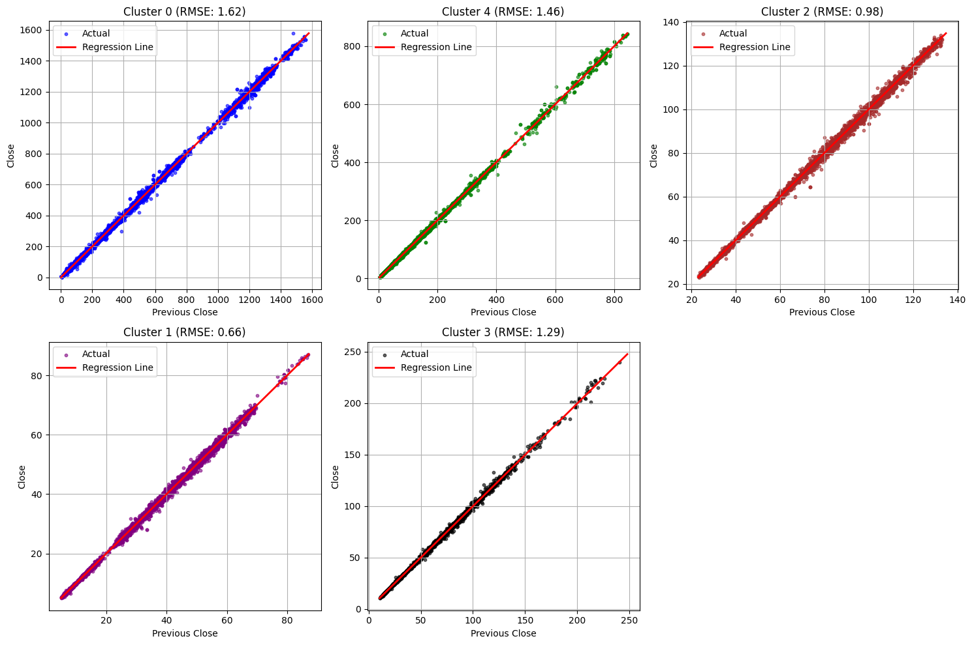
Combined Analysis
Task:
The combined analysis aimed to integrate the results from the clustering and regression analyses to explore how financial health impacts stock price predictions. By leveraging both clustering and regression, we can gain deeper insights into market behavior and financial resilience.
Implementation:
Cluster-Specific Regression Models: Developed separate regression models for each financial cluster identified during the clustering analysis.
Cluster Performance: Analyzed how well the regression models performed within each cluster. This included comparing the predictive accuracy (e.g., RMSE, R-squared) across clusters to determine which groups of companies had more predictable stock prices.
Notes:
The combined analysis integrated insights from both clustering and regression models to understand how a company's financial health impacts stock price predictions.
I developed cluster-specific regression models, meaning separate regressions were performed for each financial cluster.
The scatter plots show actual versus predicted stock prices for each cluster, revealing some variation in predictive accuracy.
Notably, clusters with stronger financial health yielded more accurate predictions, as indicated by a tighter fit to the regression line and lower RMSE.

Slide 15
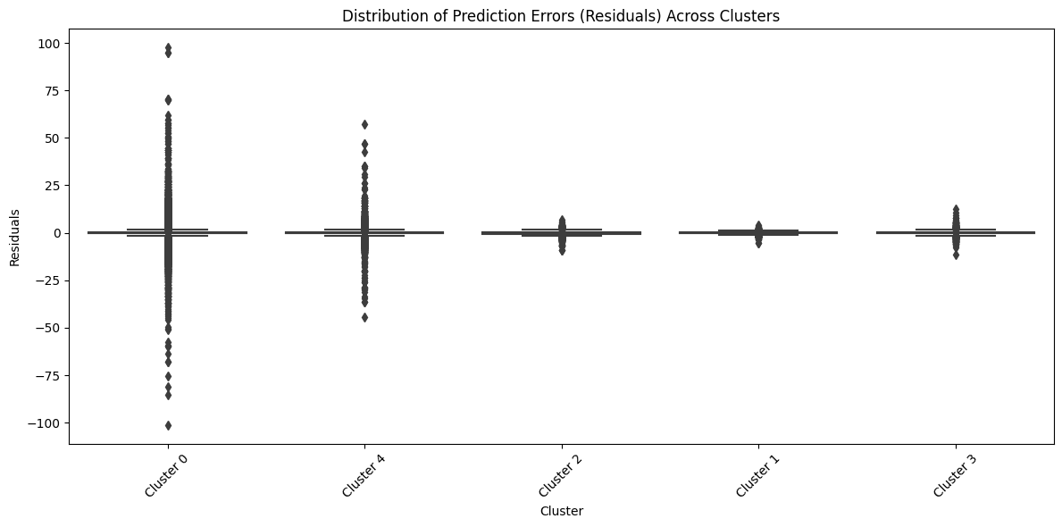
Combined Analysis - Results
Insightful Patterns:
The analysis revealed that companies in certain clusters (e.g., those with high revenue and low liabilities) exhibited more predictable stock price movements, likely due to their financial stability.
This insight can be used to develop predictive models that aid in short-term trading strategies, especially for stocks within clusters showing lower RMSE indicating more reliable price predictions.
Notes:
The box plot shows the distribution of prediction errors (residuals) across different clusters.
By analyzing the spread and central tendency of these residuals, we can see which clusters had more predictable stock prices.
Clusters with high revenue and low liabilities—indicative of strong financial health—showed tighter, more centered residuals, suggesting better stock price predictions.
This indicates that financial stability, as captured by clustering, significantly influences stock price predictability.
Investors might focus on clusters with lower RMSE for more reliable price predictions.

Slide 16
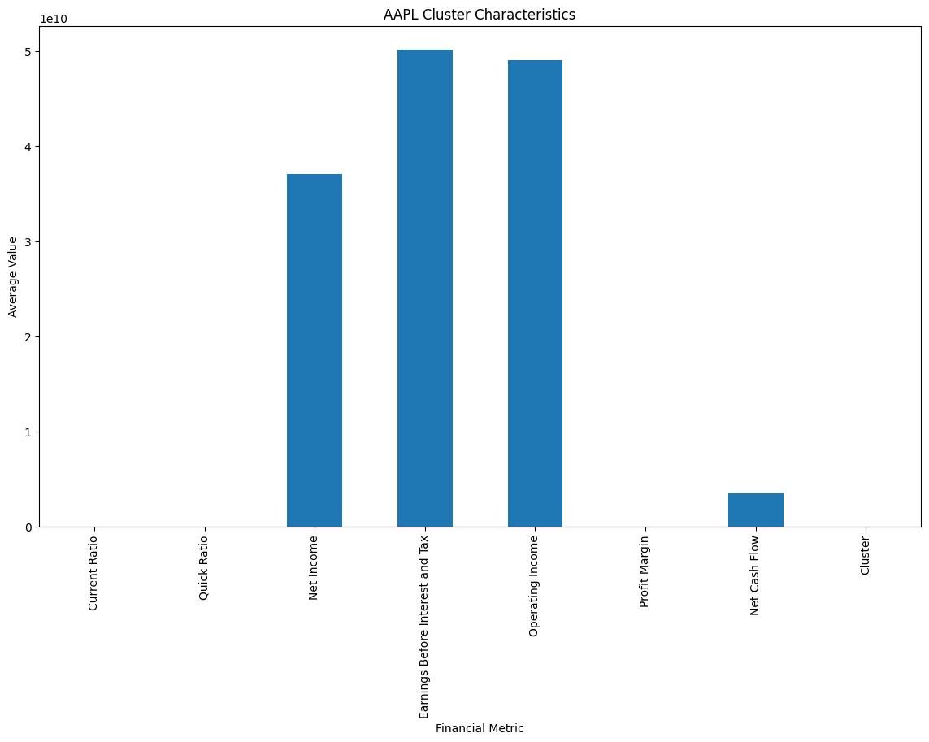
Financial Resilience Analysis
Task:
The financial resilience analysis aimed to assess the robustness of companies within different clusters by evaluating key financial health indicators. This analysis helps identify which companies are better equipped to withstand economic downturns or financial stress.
Implementation:
Selected Metrics: Key metrics such as Current Ratio, Quick Ratio, Net Income, Earnings Before Interest and Tax (EBIT), Operating Income, Profit Margin, and Net Cash Flow were chosen to measure financial resilience.
These metrics are critical in evaluating a company's ability to manage its obligations and maintain profitability under adverse conditions.
Notes:
The financial resilience analysis aimed to assess the robustness of companies within the identified clusters by evaluating key financial health indicators,
such as the Current Ratio, Quick Ratio, Net Income, EBIT, Operating Income, Profit Margin, and Net Cash Flow.
These metrics help gauge a company's ability to manage obligations and maintain profitability under adverse conditions.
The bar chart on the right shows the average values of these metrics for Apple (AAPL) within its cluster, highlighting Apple's strong financial health, which positions it well to withstand economic downturns.

Slide 17
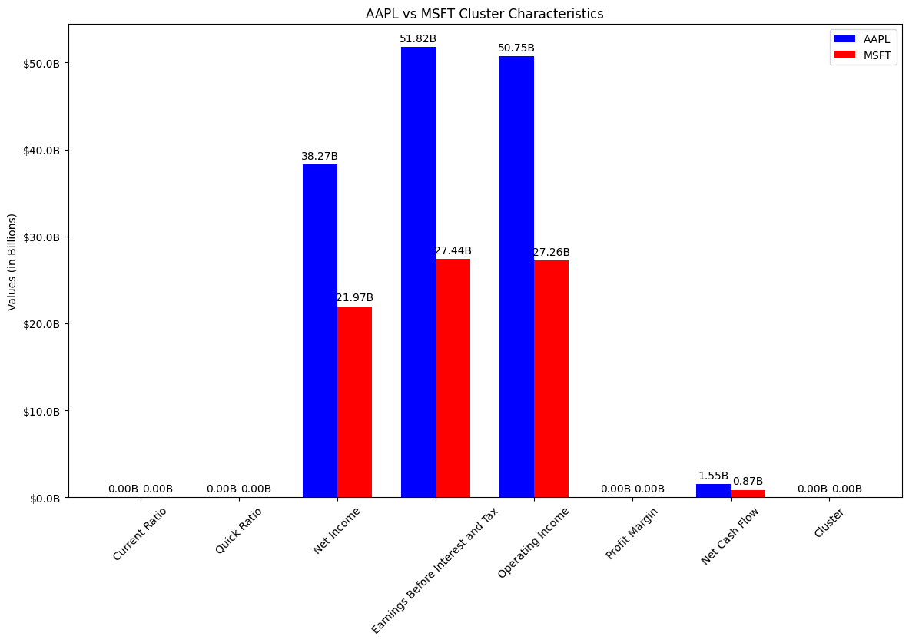
Financial Resilience Analysis - Results
Case Study (AAPL and MSFT):
Cluster Comparison:
A focused comparison of Apple (AAPL) and Microsoft (MSFT) within their respective clusters highlighted how these companies' financial resilience metrics compared to others in their clusters.
Insight:
Apple (AAPL) demonstrates stronger financial resilience compared to Microsoft (MSFT) with significantly higher net income, EBIT, and operating income, indicating superior profitability and operational efficiency.
Risk Management:
Understanding the financial resilience of different clusters allows for better risk management, especially when constructing portfolios that aim to minimize exposure to financially vulnerable companies.
Notes:
In the financial resilience analysis, I compared Apple (AAPL) and Microsoft (MSFT) within their respective clusters to see how their financial resilience metrics stacked up.
The bar chart on the right shows that Apple outperforms Microsoft in key metrics like Net Income, EBIT, and Operating Income, indicating stronger profitability and operational efficiency for Apple.
This insight is crucial for risk management, as understanding the financial resilience of different clusters aids in better decision-making when constructing investment portfolios, particularly in minimizing exposure to financially vulnerable companies.

Slide 18
Conclusion
Summary of Analysis:
Comprehensive Approach: This project applied clustering, regression, and financial resilience analyses to gain deep insights into the financial health and predictability of companies within the dataset.
Key Findings:
The analysis revealed that clusters with stable revenue and strong financial indicators are associated with lower investment risk.
This is supported by the regression analysis, which showed that stocks within these clusters have a low error rate in price predictions.
Additionally, the resilience analysis further confirmed that these companies are well-positioned to withstand tough market conditions, making them strong candidates for investment.
Future Work
Enhanced Model Development
Feature Engineering consisting macroeconomic indicators.
Broader Application
Notes:
This project integrated clustering, regression, and financial resilience analyses to identify financially healthy companies.
Clustering revealed distinct groups with stable revenue and strong financial indicators.
Regression models showed that stocks in these clusters had lower error rates in price predictions, indicating reliability.
The resilience analysis confirmed that these companies are well-positioned to withstand tough market conditions, making them strong candidates for investment.
This comprehensive approach ensured robust analysis and minimized risk.
Looking ahead, enhancing the analysis with more sophisticated models like LSTM, incorporating additional financial metrics, exploring alternative machine learning techniques, or integrating macroeconomic indicators could improve accuracy and ensure more reliable predictions.
Applying this analysis to a broader set of companies or industries would further validate the findings and expand its applicability, leading to more accurate and actionable insights for risk management and investment strategies.

Slide 19
Q&A

