Slide 1

Customer Shopping Behavior Analysis
Data-Driven Insights for Strategic Growth

Slide 2

THE CHALLENGE
The Business Challenge
Shifting Patterns
Retail company seeking to understand evolving customer purchasing behavior across segments.
Key Drivers
Identify what truly moves the needle on sales, satisfaction, and repeat purchases.
Strategic Goal
Optimize marketing, product strategy, and customer engagement for measurable growth.

Slide 3
Dataset Overview
3,900
18
1
Transactions Analyzed
Key Features
Unified Database
Spanning multiple product categories and customer segments.
Demographics, purchase details, and behavioral signals.
Data cleaned and integrated with MySQL for structured, reliable analysis.

Slide 4
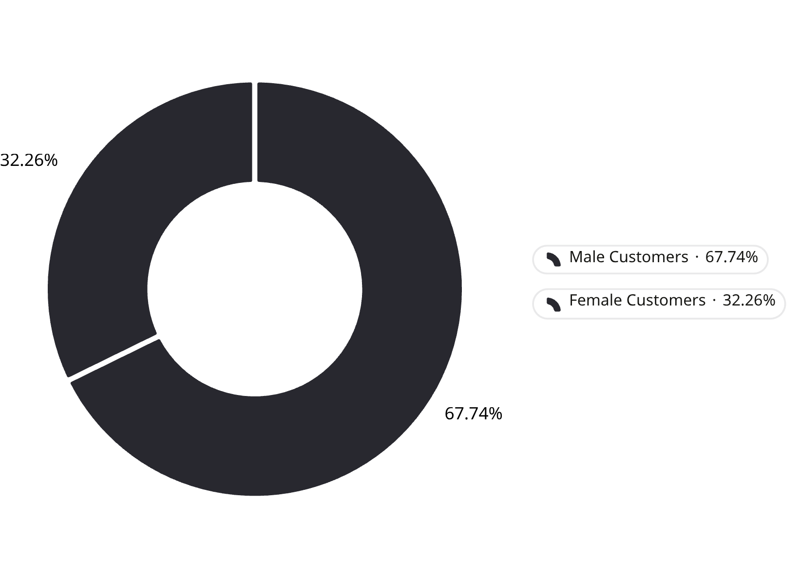

Revenue Split: Male vs. Female Customers
REVENUE ANALYSIS
A Clear Gender Gap in Spending
Male customers account for $157,890 — 67.7% of total revenue, while female customers contribute $75,191, or 32.3%.
This disparity signals a significant, untapped opportunity to expand acquisition and engagement strategies targeting the female customer segment.
Closing even half the gender revenue gap could add ~$40K+ in incremental revenue.

Slide 5

Customer Age & Spending Patterns
Average Customer Age
Average Purchase Value
44 years — with a broad range from 18 to 70, indicating a multigenerational customer base requiring tailored engagement.
$59.76 per transaction — a stable baseline that masks meaningful variation across age cohorts and product categories.
Segmentation Opportunity
Age-based analysis reveals distinct spending behaviors — targeted campaigns by demographic cohort can materially lift conversion rates.

Slide 6
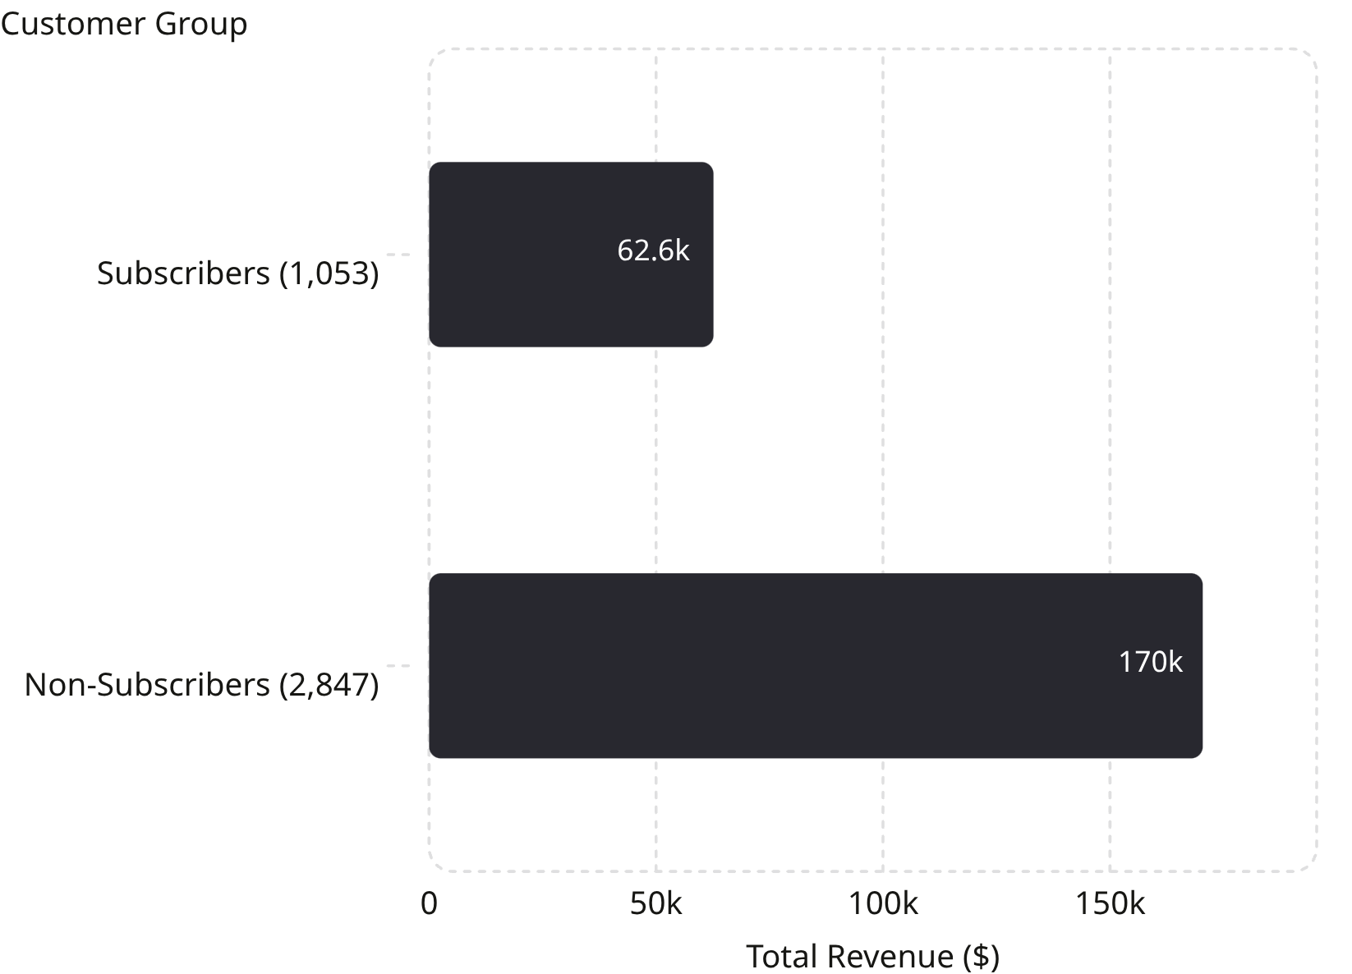

Subscription Impact on Revenue
SUBSCRIPTION ANALYSIS
Non-Subscribers Drive 73% of Revenue
With 2,847 non-subscribers generating $170,436 at a $59.87 average spend, the bulk of revenue comes from customers yet to be enrolled in a subscription model.
Subscribers (1,053 customers) generate $62,645 at a comparable $59.49 average — demonstrating that spend per transaction is nearly identical, making conversion the primary growth lever.
Converting non-subscribers unlocks predictable, recurring revenue without requiring new customer acquisition.

Slide 7




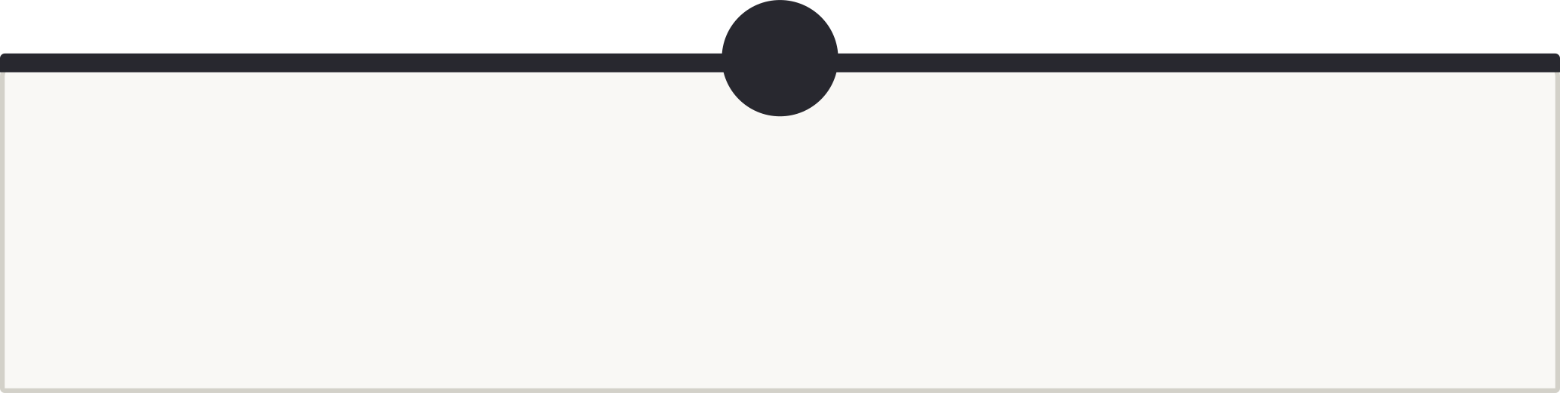

Top-Performing Products by Rating
Gloves
Sandals
3.86 rating — top-ranked product. Strong candidate for featured placement and bundling strategies.
3.84 rating — high seasonal demand. Ideal for targeted summer campaigns and cross-sell opportunities.
Boots
3.82 rating — consistently well-rated. Proven driver of repeat purchases and customer loyalty.
High-rated products correlate directly with customer satisfaction and repeat purchase rates — prioritizing inventory and marketing investment here maximizes ROI.

Slide 8
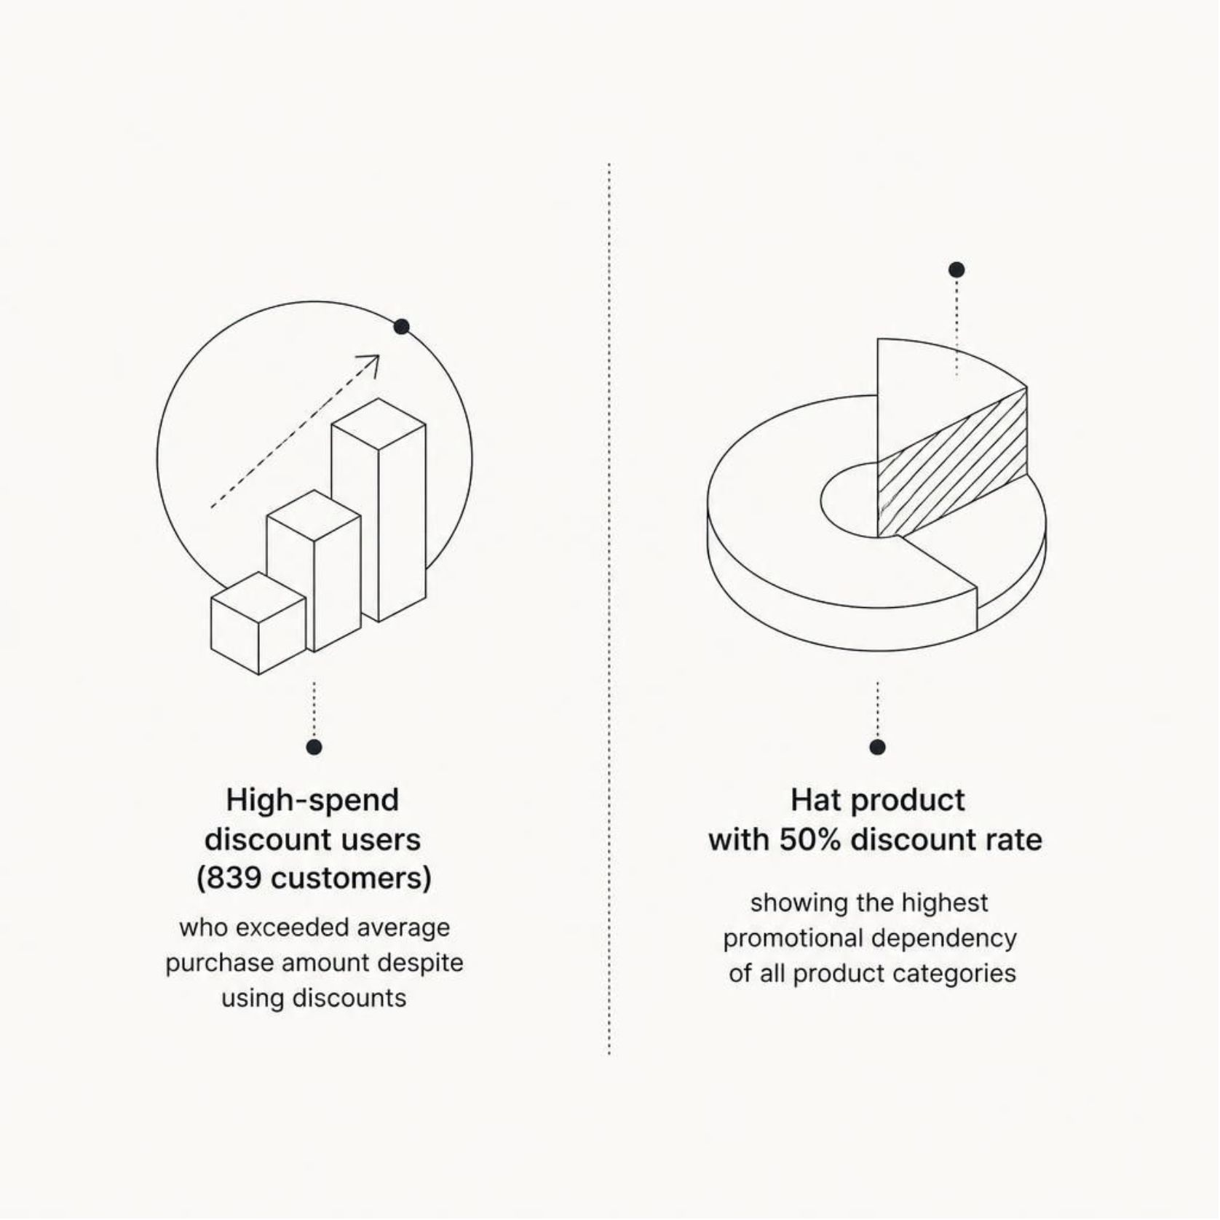
Discount Strategy Effectiveness
DISCOUNT ANALYSIS
Discounts Drive Volume — But at What Cost?
839 high-spending customers used discounts yet still exceeded the average purchase amount, suggesting discounts are not eroding basket size for premium buyers.
However, Hats carry a 50% discount rate — the highest promotional dependency across all categories — pointing to a margin risk that warrants immediate review.
The opportunity is clear: reduce discount reliance on high-rated, high-demand products while preserving volume through loyalty and subscription incentives.

Slide 9
Shipping Preference & Purchase Value
Express Shipping
Standard Shipping
Premium Uplift
$60.48 average purchase value per order
$58.46 average purchase value per order
+3.5% higher spend among express users — premium service self-selects higher-value orders
Express shipping customers represent a higher-value segment. Upsell campaigns and express-tier loyalty perks can further increase average order value and strengthen retention.

Slide 10


Key Recommendations
Expand Female Customer Acquisition
Female customers represent only 32.3% of revenue. Targeted campaigns, curated product recommendations, and segment-specific promotions can close the gap.
Convert Non-Subscribers to Membership
With 73% of revenue from non-subscribers at nearly identical spend rates, structured conversion incentives will unlock predictable, recurring revenue.
Optimize the Discount Strategy
Reduce promotional dependency on high-rated products like Hats. Redirect discount spend toward loyalty and subscription conversion programs.
Leverage Shipping Preferences for Upsell
Express shipping users spend 3.5% more. Promote premium shipping tiers at checkout to attract and retain higher-value customers.

