Slide 1

Udyam Digital
A small business goes digital in one sitting, on a phone
Team RNG. Enterprise Track A: business case
Demo video (YouTube)
Code (GitHub)
Privacy note and field test (Google Drive)

Slide 2

Only 7.4% of small-business leads activate, at ₹15,053 each. The drop reasons we can remove are about process, not demand
17.6 days
8 months
1,338 drops
average from lead to activation, with about 3 status-chase calls per customer
to pay back acquisition on a micro customer: ₹20,007 cost against ₹2,505 a month
cite visits, slow or complex quotes, or paperwork: the steps a digital journey replaces
Price is the largest single reason at the quote stage (621 of 1,113 drops). We don't claim to fix it: the advisor avoids upselling and shows a cheaper option, but cannot discount.
Stage | Drop reason | Leads | Our fix
Contacted | No time for a visit / visit not scheduled | 827 | No visit: chat advisor on a phone
Needs assessed | Quote too complex / took too long | 385 | Instant quote, one price, no codes
Quote accepted | Paperwork too long / details did not match | 126 | Consent, OCR and registry checks in minutes
KYC complete | Installation delayed beyond 21 days | 98 | Tracker now; delivery capacity still needed
Needs assessed | Price too high / competitor cheaper | 621 | Not solved: smallest bundle only helps partly

Slide 3
Prioritise professional offices first, then multi-site, with one clear monthly price for each segment
Segment | Leads | Activate | ₹/month | 6-mo churn | Cost per activation | Payback
Professional offices | 1,247 | 11.1% | 6,796 | 13.8% | ₹10,695 | 1.6 mo
Small multi-site | 755 | 11.0% | 31,233 | 10.8% | ₹15,614 | 0.5 mo
Small manufacturers | 289 | 12.8% | 19,980 | 8.1% | ₹15,324 | 0.8 mo
Micro retail and services | 2,709 | 4.1% | 2,505 | 22.7% | ₹20,007 | 8.0 mo
Professional offices: largest high-value pool, cheapest to acquire, and the journey runs fully self-serve. Multi-site and manufacturers: highest value, but they need specialists. The advisor qualifies, then hands off with a summary.
Micro: 54% of leads. Field visits here took 25.8% of all spend for 7.3% of activations (₹53,026 each), so serve them digital-only.
Segment and example | Bundle | Monthly | Setup | Contract
Micro: kirana, no GSTIN | Biz 5G AirFiber 100 | ₹999 | ₹0 | 6 months
Professional: clinic, 6 staff | Biz Fibre 100, Cloud Email × 6, Endpoint Security × 6 | ₹2,671 | ₹0 | 12 months
Multi-site: restaurant, 4 outlets | Biz Fibre 300, Failover, Cloud CCTV and SD-WAN, per outlet | ₹21,788 | ₹33,200 | 24 months
Manufacturer: textile unit, 40 staff | Leased Line 20, Machine Monitoring IoT × 2 | ₹10,398 | ₹16,000 | 24 months
Each price is the midpoint of the catalogue range; activated leads paid 0.48 of the way through it on average, with no gap by tier or segment. Examples are computed by the same pricing engine the app uses.
1,466 leads (29%, and 47% of micro) have no GSTIN. The micro and professional bundles need none, so KYC asks only for an ID, address proof and a declaration of no GSTIN.

Slide 4
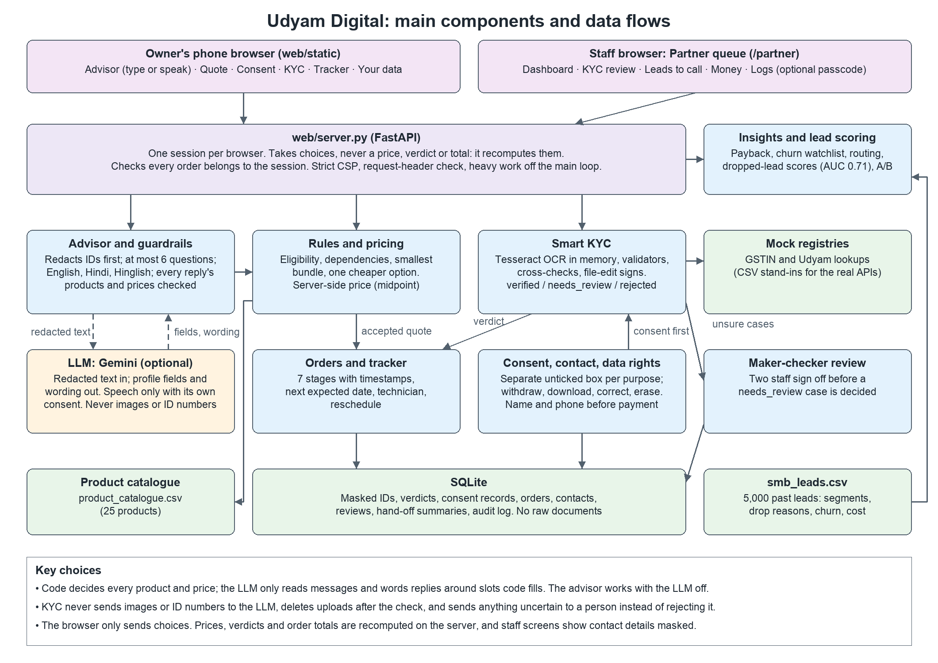
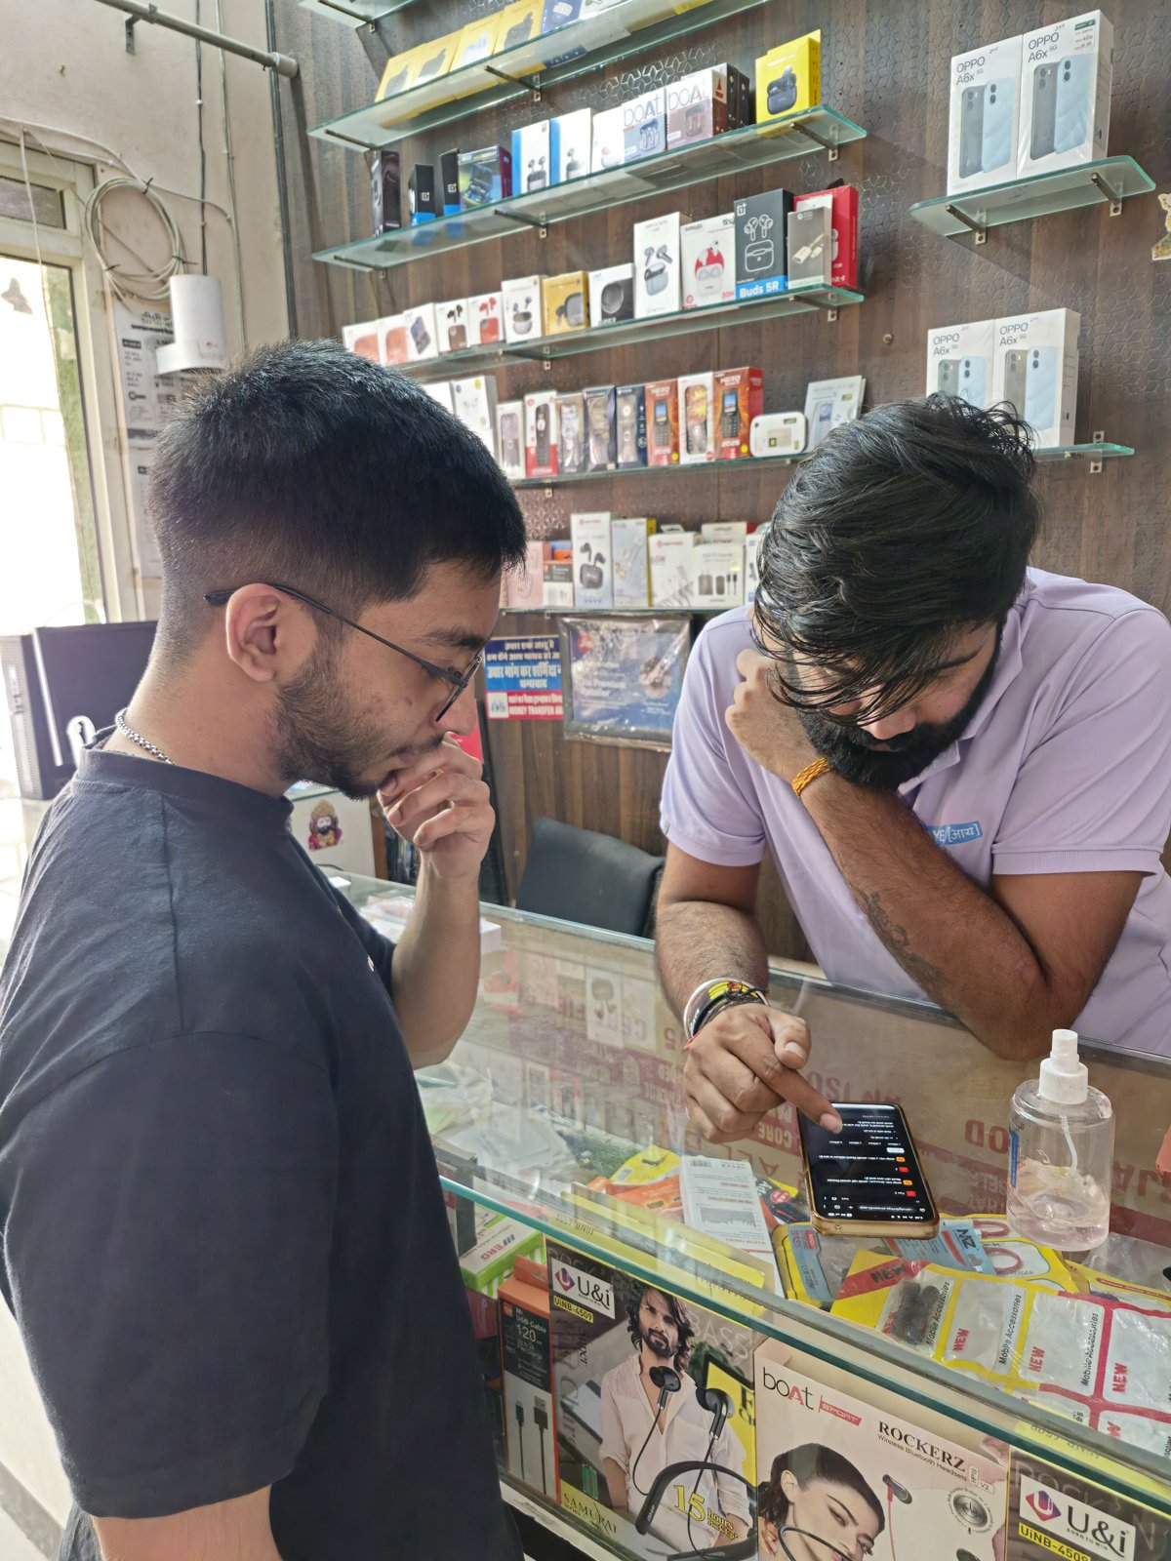
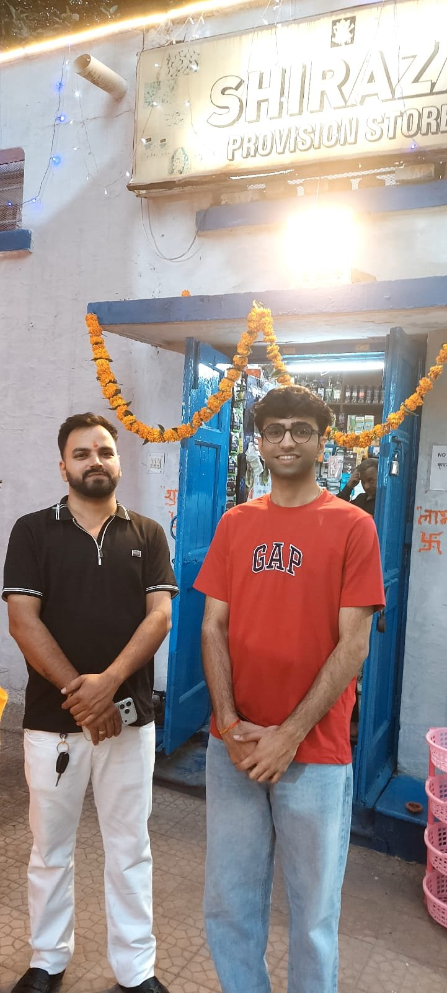
A working journey where code, not the LLM, decides
Advisor
Quote
English, Hindi, Hinglish, typed or spoken. At most 6 questions, no upsell
One price, recomputed on the server; the chat stays open to change it
Smart KYC
Tracker
Consent first. OCR, checksums, registry checks, file-edit signs
7 stages with timestamps, reschedule; download or erase your data
The LLM reads messages and words replies around slots that code fills, so it can't type a price or product name in any language.
Tested on our own cases, not the judges': 258 of 258 advisor scenarios pass in English, Hindi and Hinglish, and no eligibility or price breaks across 303,408 business profiles. All 12 KYC applicants match our manual review (5 verified, 5 needs review, 2 rejected), and 0 of 192 forged certificates verified.
For staff: unsure KYC cases need two people to sign off, dropped leads are ranked for a call-back (AUC 0.71 on held-out folds), and a churn watchlist flags orders to check in on.
Identifiers are stripped from chat before storage. Document images stay in memory and never reach the LLM.
Field test with local shop owners, who tried the advisor and quote.
More from the field test (Google Drive)

Slide 5
Customers who chase status more churn more, and recovering half of process drops takes activation to about 11%
NPS also falls from 7.5 to 6.0 across the same range (p<0.001). This is a correlation, so a pilot should test it.
56 of 368 activated bundles broke a catalogue rule, and 22 activations sit on a cancelled or suspended GSTIN. Enforcing rules in code stops both.
Referral converts best (14.8%), WhatsApp campaigns worst (2.8%).
Hotspot users churn at 24.7% against 8.3% on business broadband (p=0.002).
GSTIN: 9.6% activate against 2.0% without, and the gap holds within micro (6.3% against 1.6%).
368 to 566
activations per quarter, from the same 5,000 leads (7.4% to 11.3%). At today's spend that is ₹9,787 each, the basis of the ₹10,000 target
Assumption
50% recovery is our estimate, not data. 30% gives 487 activations and 70% gives 645
To validate
Pilot measures real recovery, and our build and run costs still need to be set against it

Slide 6
Roll out in three steps, and measure five numbers
Phase | Scope
1. Pilot | Professional offices, Tier 1, Hindi and English, starting with Accel mobile customers (9.2% activate)
2. Extend | Micro digital-only, Tier 2, and regional languages, starting with Tamil and Punjabi (about 4%)
3. Assisted | Multi-site and manufacturers via specialists
Metric | Now | Target
Lead to activation | 7.4% | 11%
Days to activate | 17.6 | 10
Status chases | 3.0 | 1 or fewer
Cost per activation | ₹15,053 | ₹10,000
Micro 6-month churn | 22.7% | 15%
Field force: off micro and onto complex accounts and hand-offs, which arrive with a saved summary.
Partners: keep credit for their leads, run installs, and call a ranked queue of dropped leads (the top tenth activate at 2.2 times the average).
Targets are our proposals. Keep at zero: rule-breaking bundles (56 today), activations on an inactive GSTIN (22), and false KYC rejections.

Slide 7
Main risks, and what we are asking for
Risk | Mitigation
Advisor gives a wrong plan or price | Rules engine decides; replies are validated; regression scenarios run before release
KYC wrongly rejects a real business | Rejection needs hard evidence; anything uncertain goes to a person
Personal data exposure (DPDP Act) | Per-purpose consent, masked fields, images not retained, withdrawal in tracker
Install capacity limits the gains | 98 drops are install delays; tracker doesn't fix capacity. Indore and Mysuru take 8+ days from KYC to activation vs 4.8 overall (under 10 customers each, so verify)
Channel conflict with partners | Partners keep attribution and install work; specialists get hand-offs
Ask: approve a pilot in professional offices, Tier 1 cities, with real registry access, then decide on Phase 2 from measured recovery.
See it for yourself: Demo video (YouTube) · Code (GitHub) · Privacy note and field test (Google Drive)

