Slide 1
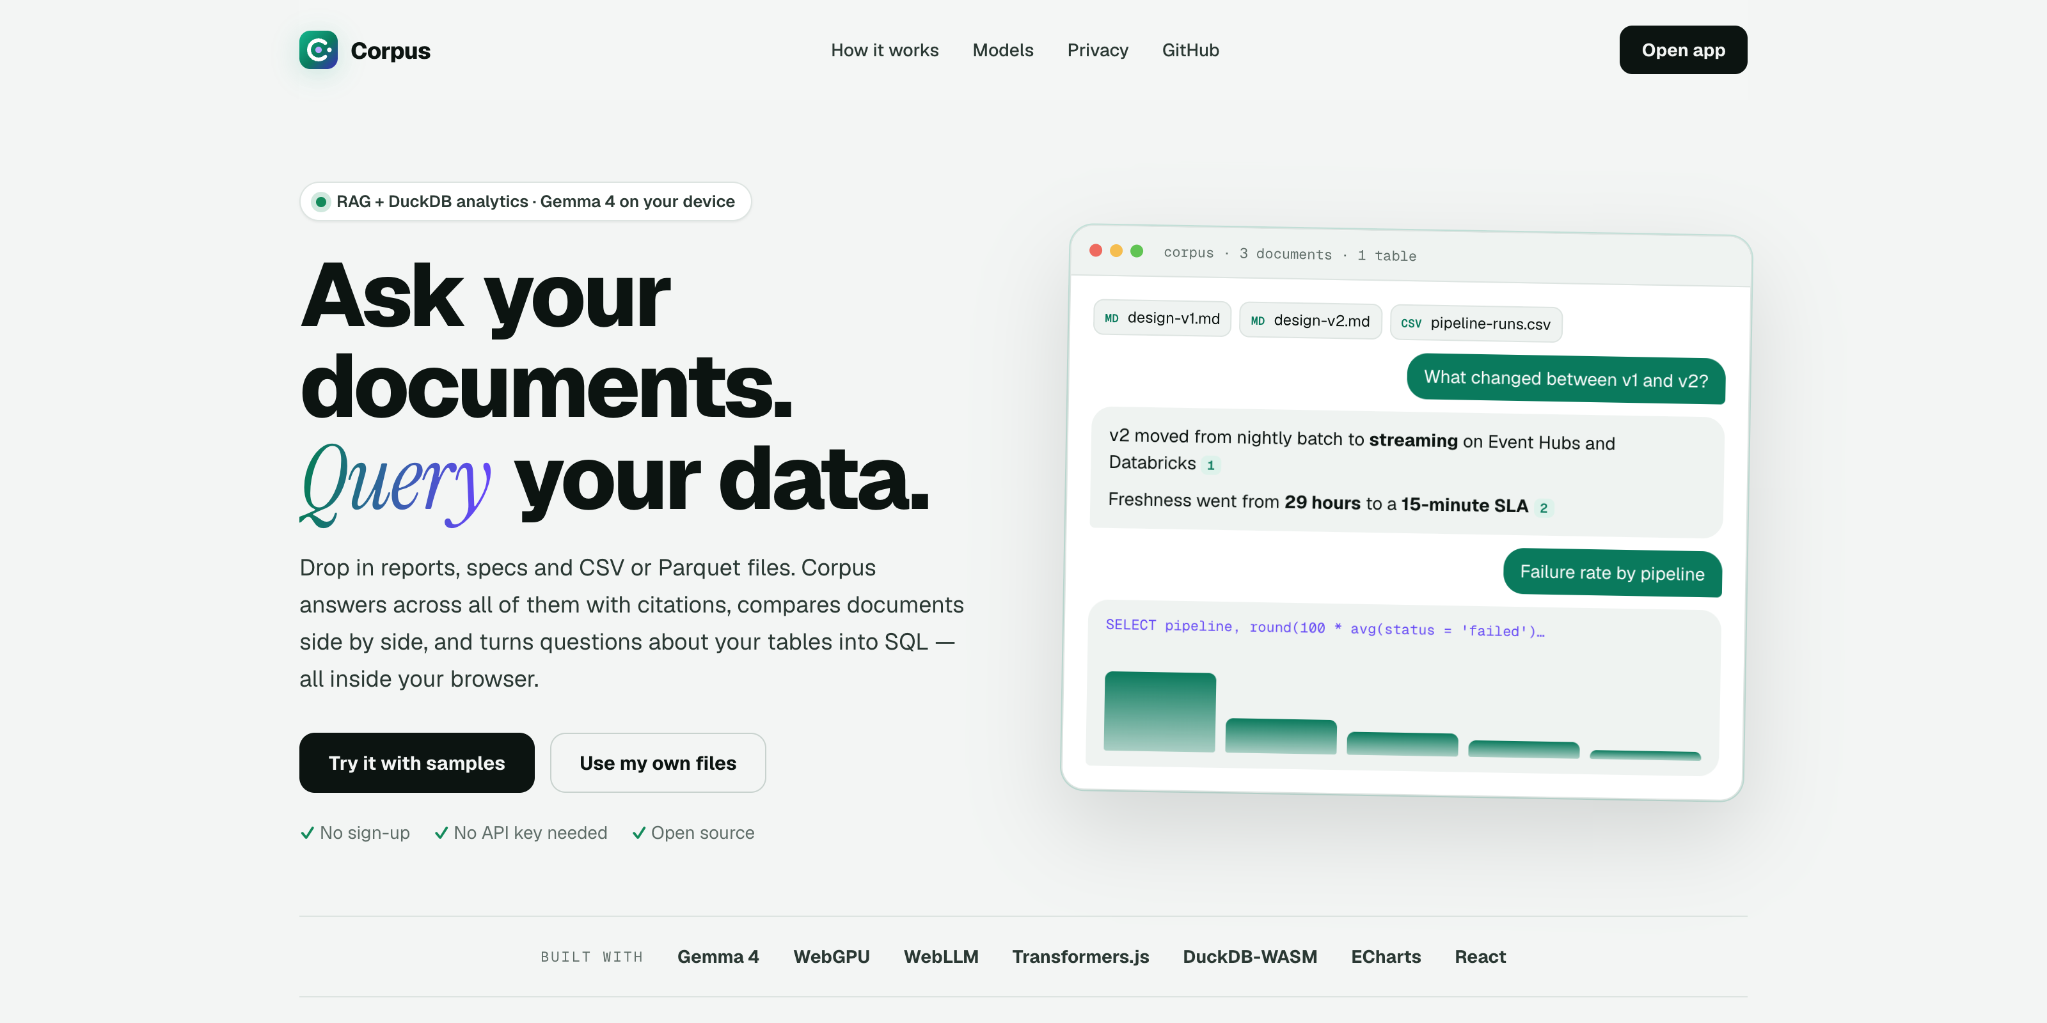
CORPUS
DOCUMENT AI + DATA ENGINEERING / CASE STUDY
01
CORPUS
Ask your documents.
Query your data.
A browser-native RAG and analytics workspace: cited answers across files, side-by-side comparison, and SQL over CSV and Parquet with DuckDB.
GEMMA 4 / WEBGPU / TRANSFORMERS.JS / DUCKDB-WASM / REACT / ECHARTS
ADITYA MALVIYA
1 / 8

Slide 2
CORPUS
DOCUMENT AI + DATA ENGINEERING / CASE STUDY
02
THE PROBLEM: ANSWERS YOU CANNOT CHECK
Unverifiable answers
Documents and data apart
Privacy and cost
Chat tools summarise files fluently, but you cannot see which sentence a claim came from, or whether the newest version won.
Design docs and post-mortems live in one tool, the run logs and CSVs in another. Nobody asks both in one place.
Uploading internal files to a hosted LLM is often not allowed, and API keys put a price on every question.
The response: retrieval, SQL and a small model in the browser, every claim cited.
ADITYA MALVIYA
2 / 8

Slide 3
CORPUS
DOCUMENT AI + DATA ENGINEERING / CASE STUDY
03
ONE PIPELINE, TWO PATHS
01 INGEST
02 CHUNK
03 EMBED
04 RETRIEVE
05 ROUTE
06 GENERATE
pdf.js · mammoth
DuckDB-WASM
→
page-aware
900 / 150 overlap
→
MiniLM · WebGPU
IndexedDB cache
→
BM25 + cosine
+ MMR diversity
→
overview · compare
lookup · data
→
Gemma 4 · cited
or SQL + DuckDB
Document path
Data path
Intent routing picks the strategy: an overview samples the whole file evenly and gets a narrative answer; a comparison retrieves evidence per document; a named file scopes the search.
CSV, Parquet and JSON become DuckDB tables. The table profile is indexed as text, so chat can describe a dataset, and number questions become SQL.
ADITYA MALVIYA
3 / 8

Slide 4
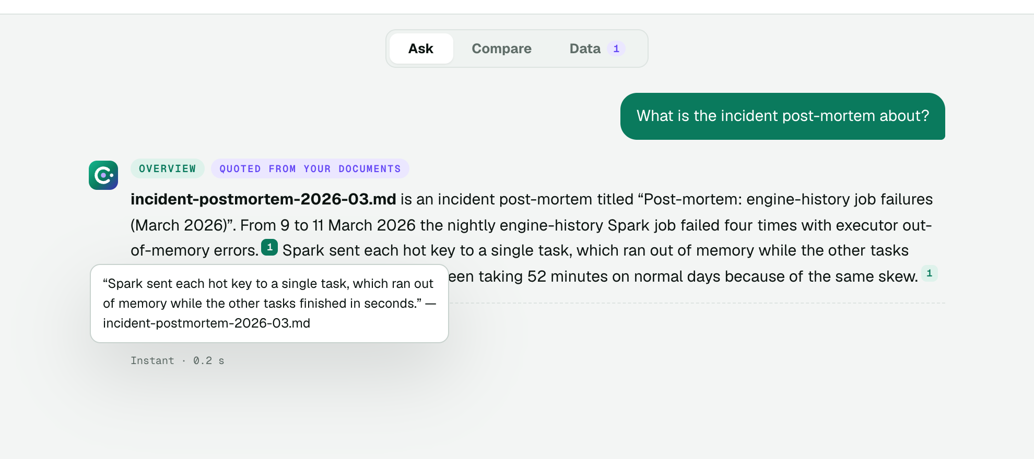
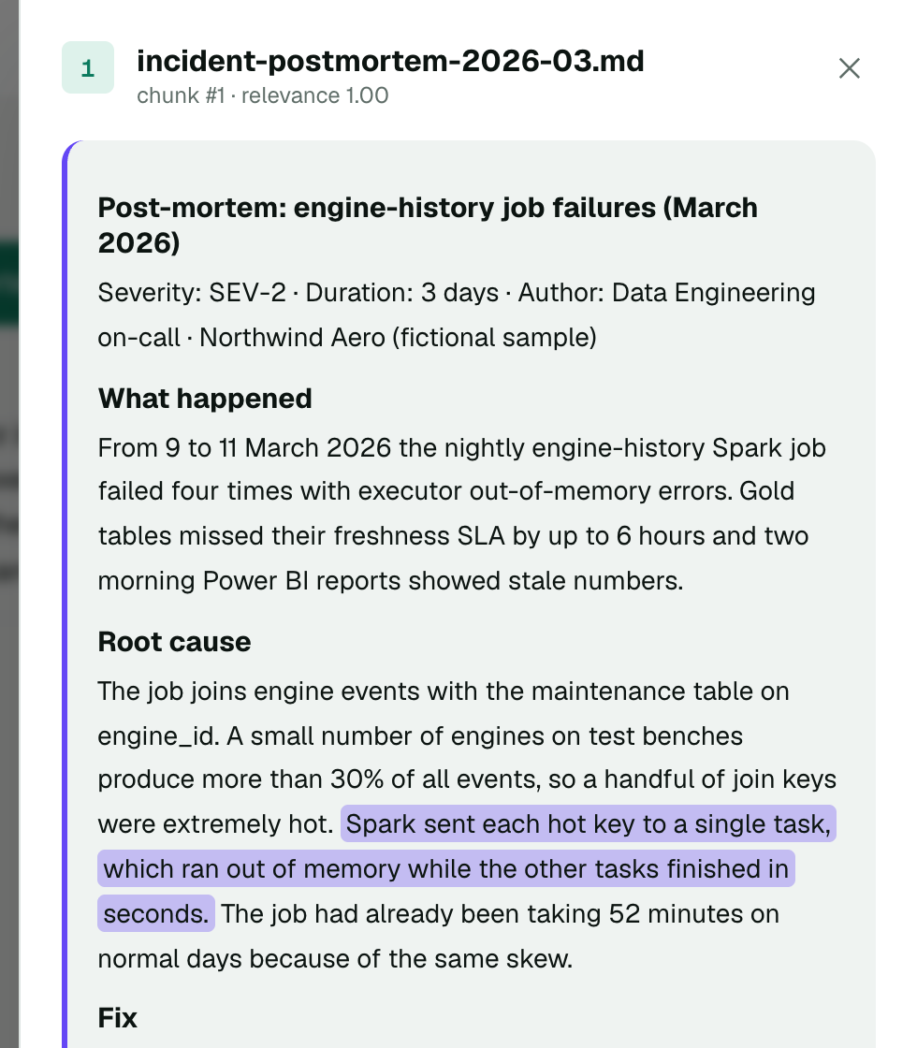
CORPUS
DOCUMENT AI + DATA ENGINEERING / CASE STUDY
04
EVERY CLAIM CARRIES ITS PROOF
Hover a citation to read the exact supporting sentence; click to open the passage with that sentence highlighted.
ADITYA MALVIYA
4 / 8

Slide 5
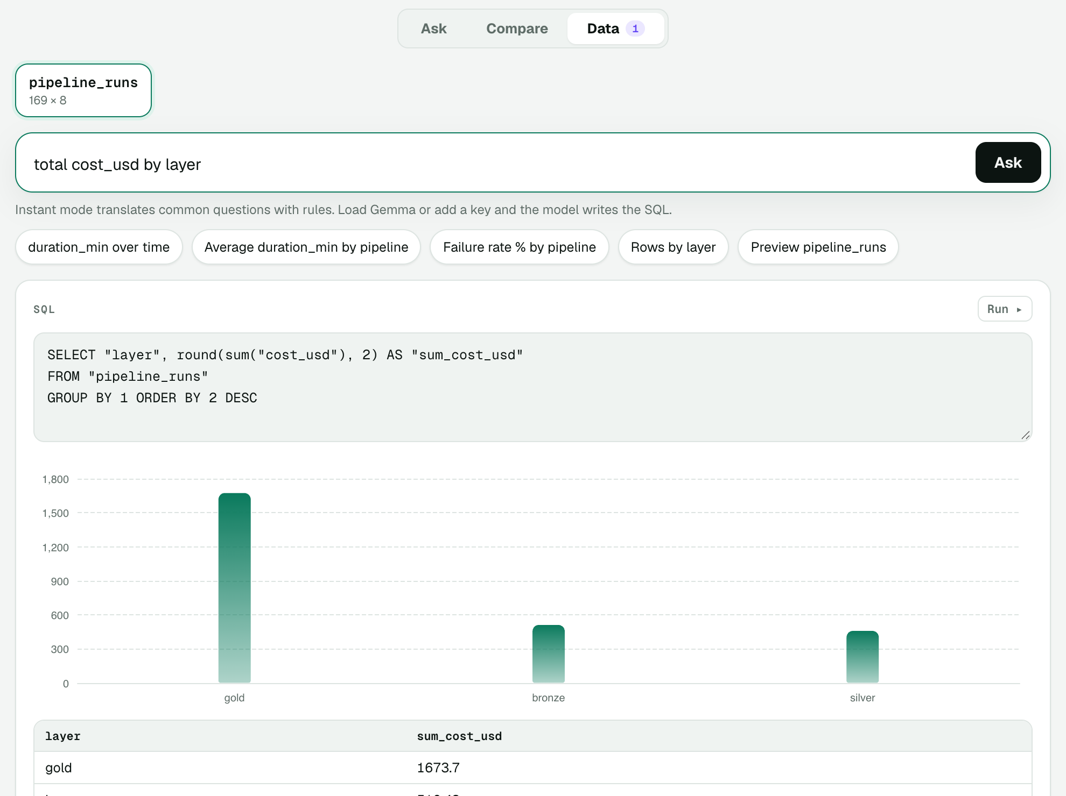
CORPUS
DOCUMENT AI + DATA ENGINEERING / CASE STUDY
05
QUESTIONS BECOME SQL YOU CAN READ
Guarded generation
Only one read-only SELECT runs. A failed query is sent back to the model with the DuckDB error for one corrected retry.
Works without a model
Instant mode translates common questions with rules: "average duration by pipeline", "failed runs over time".
Charted and explained
Results pick a bar or line chart, and the model explains the numbers in one or two plain sentences.
ADITYA MALVIYA
5 / 8

Slide 6
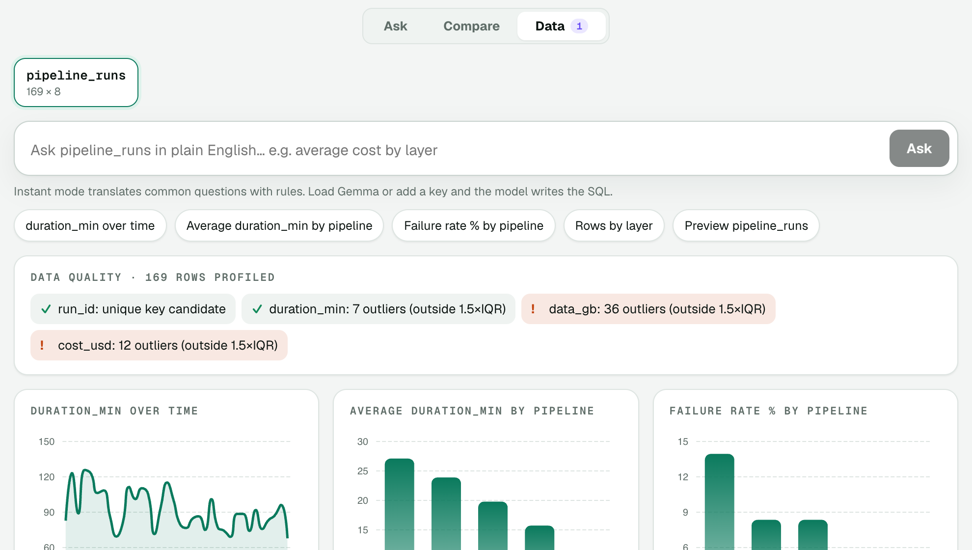
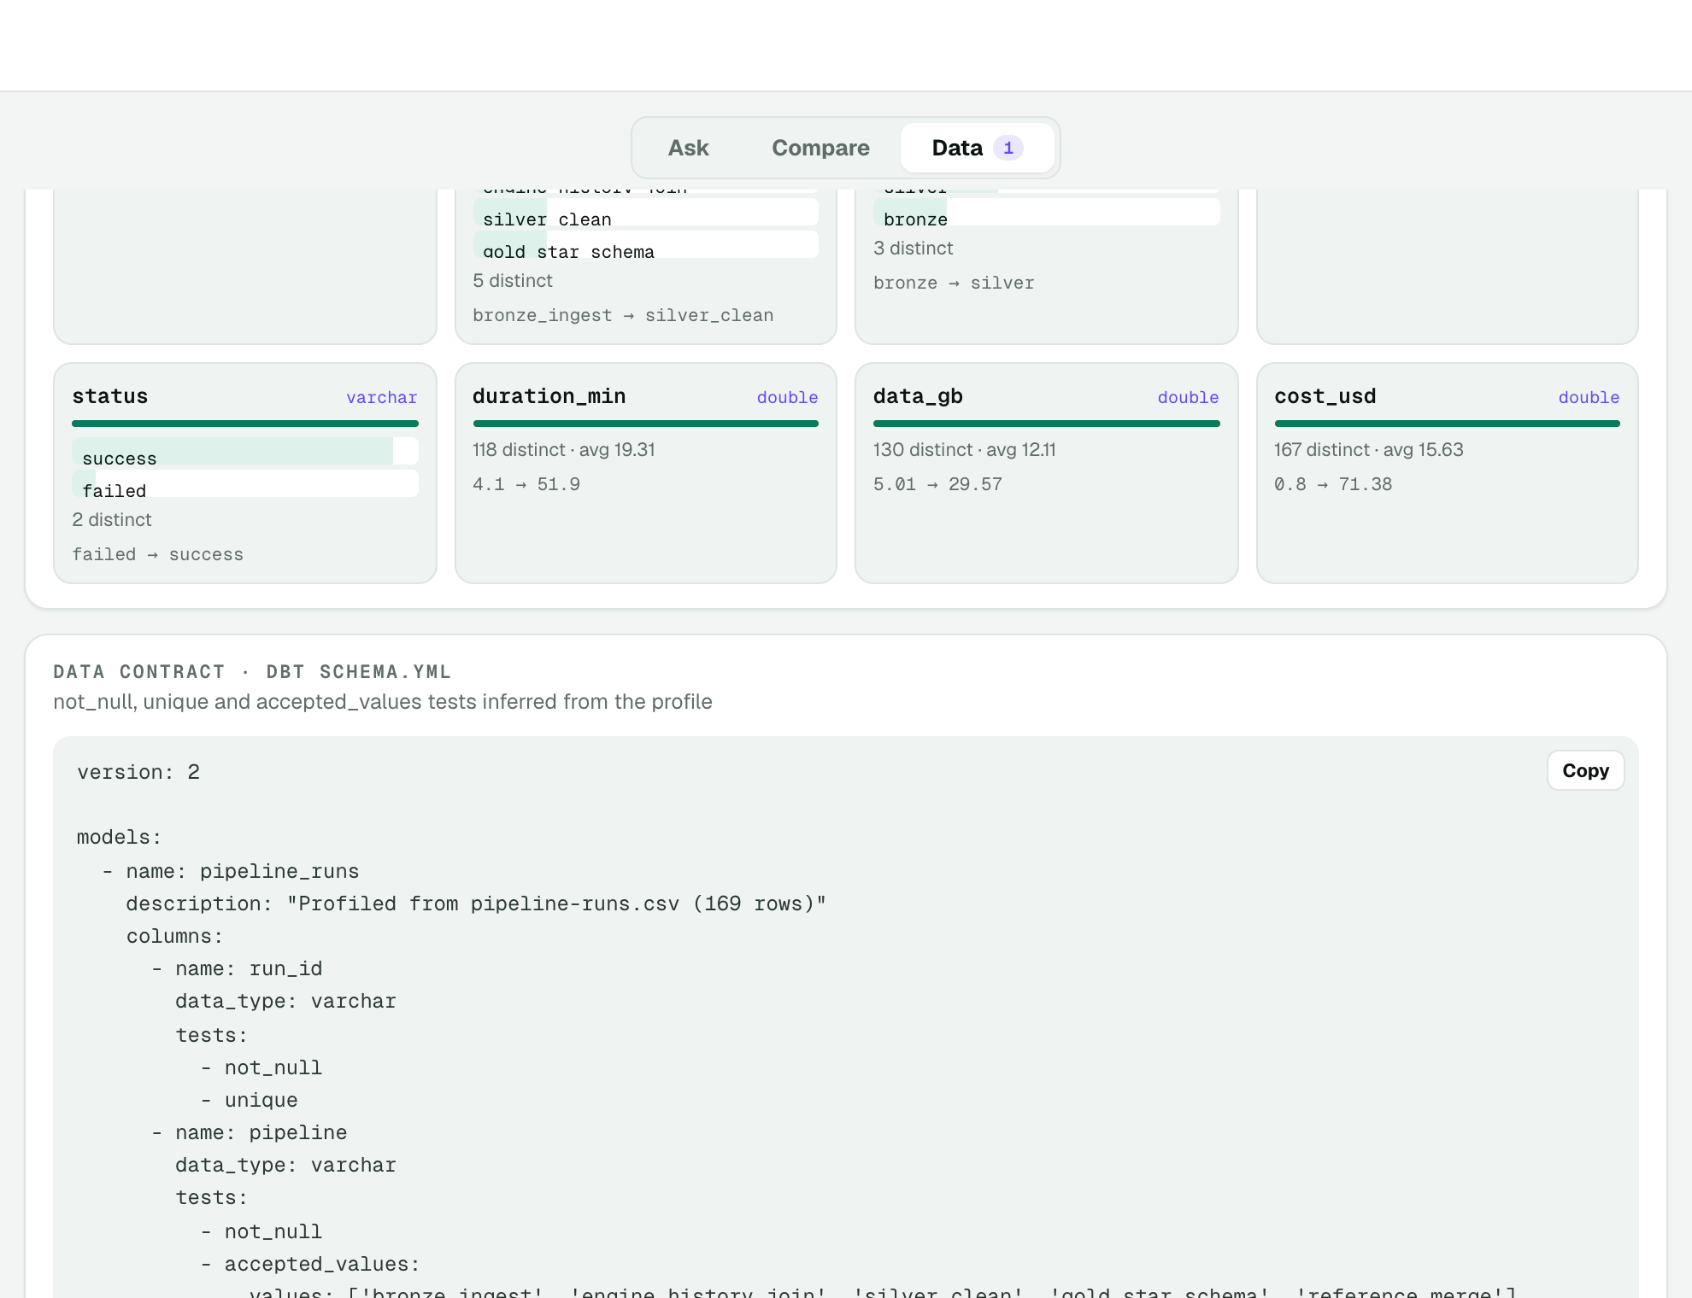
CORPUS
DOCUMENT AI + DATA ENGINEERING / CASE STUDY
06
PROFILED ON ARRIVAL, SHIPPED AS A CONTRACT
Nulls, cardinality, IQR outliers, duplicates, key candidates
dbt schema.yml: not_null, unique, accepted_values
ADITYA MALVIYA
6 / 8

Slide 7
CORPUS
DOCUMENT AI + DATA ENGINEERING / CASE STUDY
07
RETRIEVAL IS MEASURED, NOT ASSUMED
RETRIEVER
HIT@1
HIT@3
MRR
Small-model accuracy
On-device models get a compressed context (the best sentences per passage) plus a citation safety net.
Keyword (BM25)
100%
100%
1.00
Vector (cosine)
75%
88%
0.82
Zero re-work on refresh
Documents, table files and every embedding persist in IndexedDB, keyed by content hash.
Hybrid + MMR
100%
100%
1.00
GPU where it helps
Eight golden questions over the sample documents, scored live in the pipeline panel. Keywords catch exact terms; vectors catch meaning; the hybrid keeps both.
Embeddings run on WebGPU in a worker (fp16), falling back to WASM; cached per text.
ADITYA MALVIYA
7 / 8

Slide 8
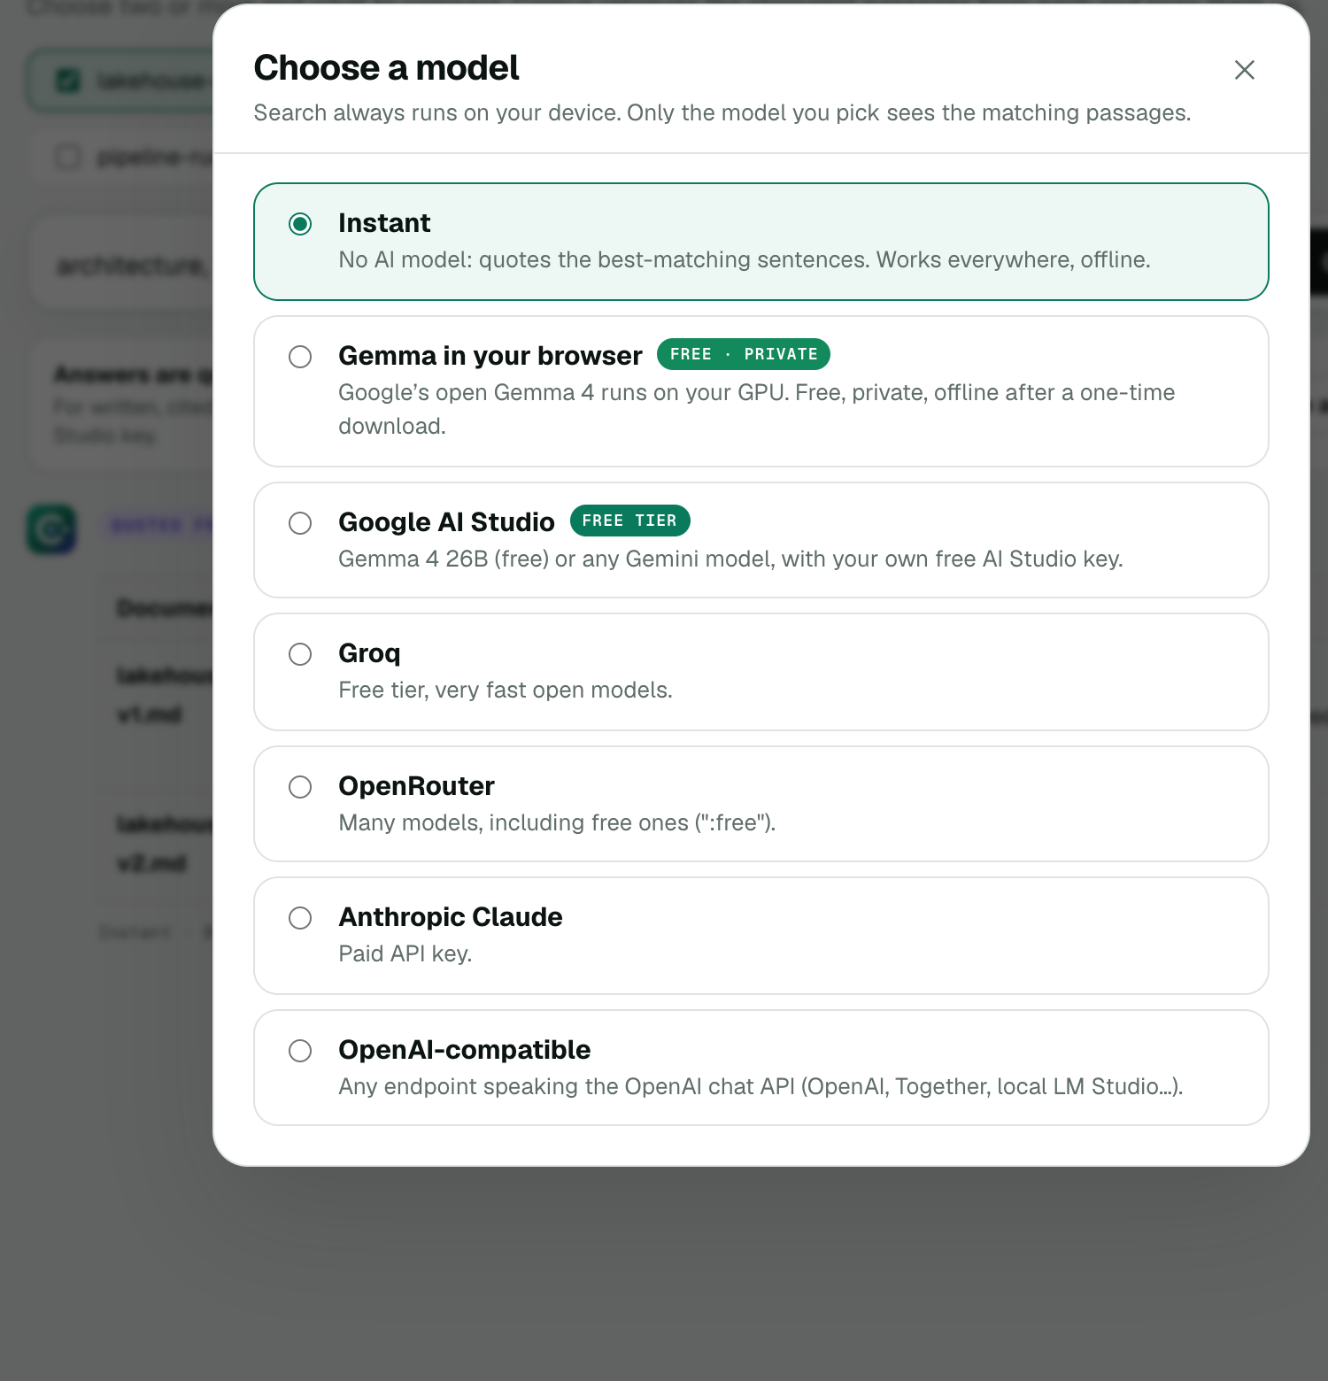
CORPUS
DOCUMENT AI + DATA ENGINEERING / CASE STUDY
08
FREE TO RUN, PRIVATE BY DEFAULT
Gemma 4 in the browser
Gemma 4 E2B on WebGPU via WebLLM. Free and offline after a one-time 2.8 GB download.
Bring your own key
Google AI Studio (Gemma 4 26B free tier), Groq, OpenRouter, Anthropic or any OpenAI-compatible API. Keys stay in the browser.
Instant mode
No model at all: ranked, cited quotes and rule-based SQL in milliseconds.
adityamalviya04692.github.io/Project-Corpus/
github.com/adityamalviya04692/Project-Corpus
ADITYA MALVIYA
8 / 8

