Slide 1
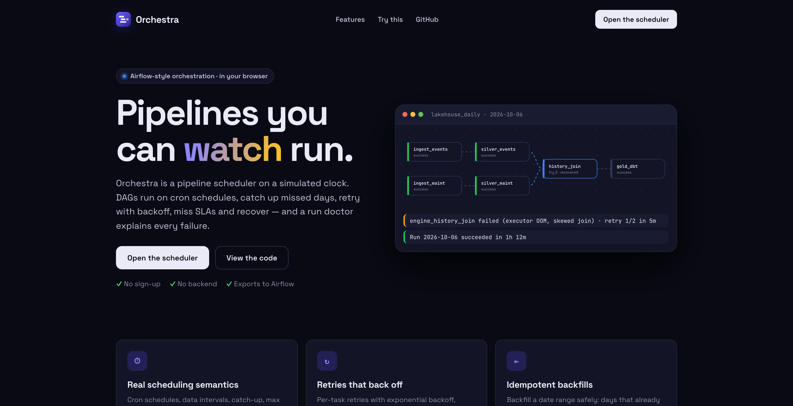
ORCHESTRA
PIPELINE ORCHESTRATION / CASE STUDY
01
ORCHESTRA
Pipelines you
can watch run.
An Airflow-style scheduler on a simulated clock: cron, catch-up, retries with backoff, idempotent backfills, SLAs, and a doctor that explains every failure.
TYPESCRIPT / REACT / YAML DAGS / AIRFLOW 2 EXPORT / VITEST / GITHUB PAGES
ADITYA MALVIYA
1 / 8

Slide 2
ORCHESTRA
PIPELINE ORCHESTRATION / CASE STUDY
02
THE PROBLEM: ORCHESTRATION IS INVISIBLE
Scheduling is subtle
Failures hide in retries
Backfills are risky
Data intervals, logical dates and catch-up confuse even experienced engineers. A run for 1 Oct starts on 2 Oct.
A flaky Spark join passes on its second try. Dashboards stay green while the SLA quietly slips.
Re-running history double-loads data unless every run is idempotent per logical date.
The response: a real scheduler loop you can watch, break and replay, with a doctor that explains it.
ADITYA MALVIYA
2 / 8

Slide 3
ORCHESTRA
PIPELINE ORCHESTRATION / CASE STUDY
03
ONE HEARTBEAT, SIX STEPS
01 SCHEDULE
02 ACTIVATE
03 ATTEMPT
04 RESOLVE
05 DISPATCH
06 CLOSE
cron · data intervals
catch-up
→
max_active_runs
one per logical date
→
retries · backoff
timeouts
→
trigger rules
upstream_failed
→
parallelism
pools
→
SLA misses
run state
Deterministic by design
DAG-as-code
Every outcome is seeded by DAG, logical date, task and try, so a scenario replays exactly and the engine is covered by unit tests: catch-up, backoff, trigger rules, timeouts, pools, backfill.
DAGs are YAML, validated like a scheduler would at import (cycles, unknown upstreams, bad cron, undeclared pools) and exported as an Apache Airflow 2 file.
ADITYA MALVIYA
3 / 8

Slide 4
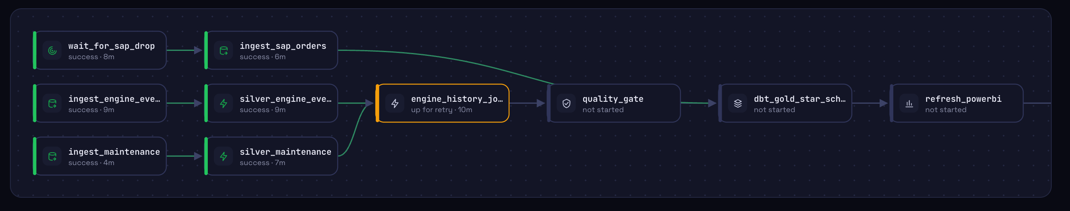
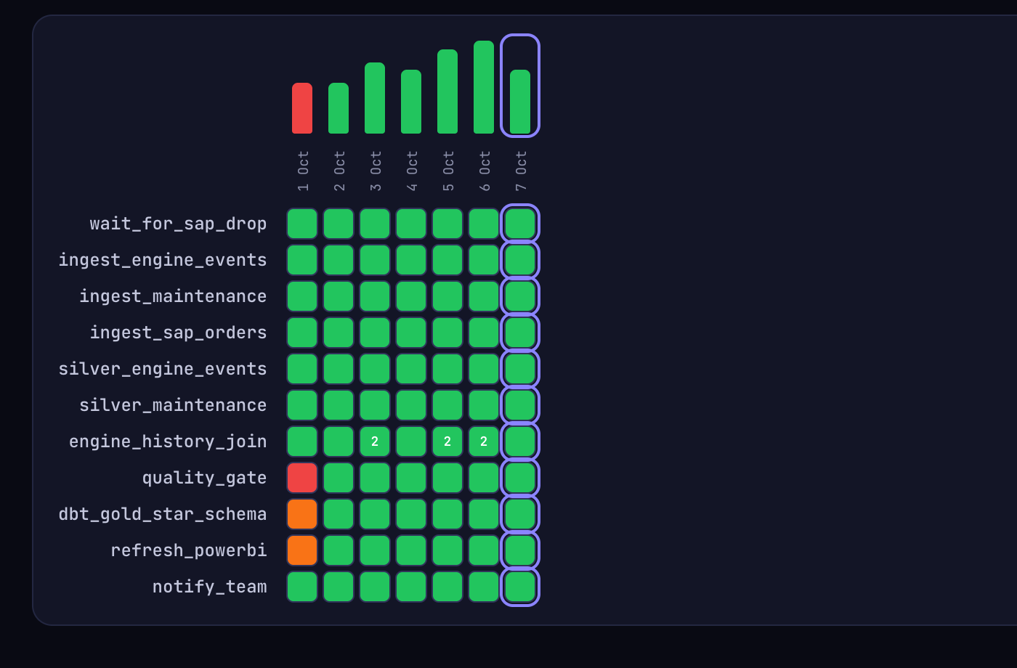
ORCHESTRA
PIPELINE ORCHESTRATION / CASE STUDY
04
WATCH IT RUN, THEN READ THE PATTERN
Live graph
Tasks take the state of the selected run; edges into running tasks animate.
Airflow-style grid
One column per run: the red day, the blocked tasks and the retry counts stand out at once.
ADITYA MALVIYA
4 / 8

Slide 5
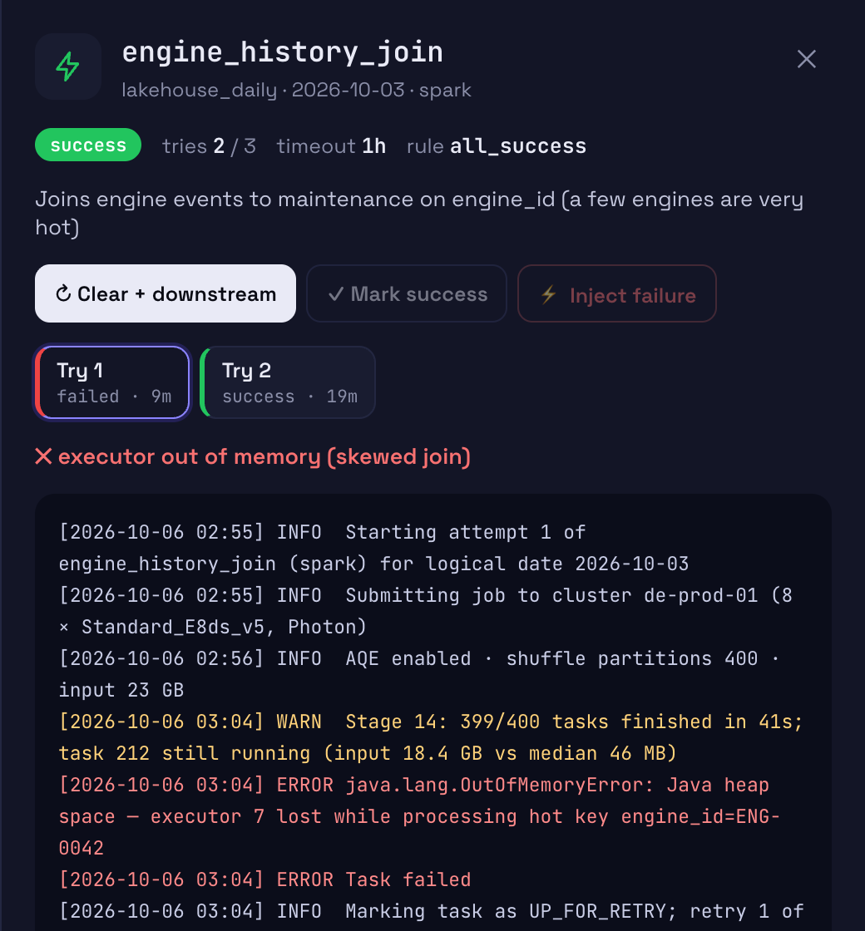
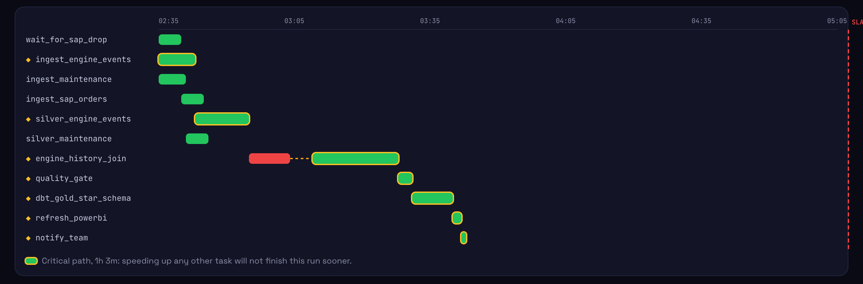
ORCHESTRA
PIPELINE ORCHESTRATION / CASE STUDY
05
A FLAKY JOIN, RETRIED WITH BACKOFF
Try 1 dies on a skewed key (OOM), waits 5 min, try 2 passes. The Gantt shows the lost time on the critical path.
ADITYA MALVIYA
5 / 8

Slide 6
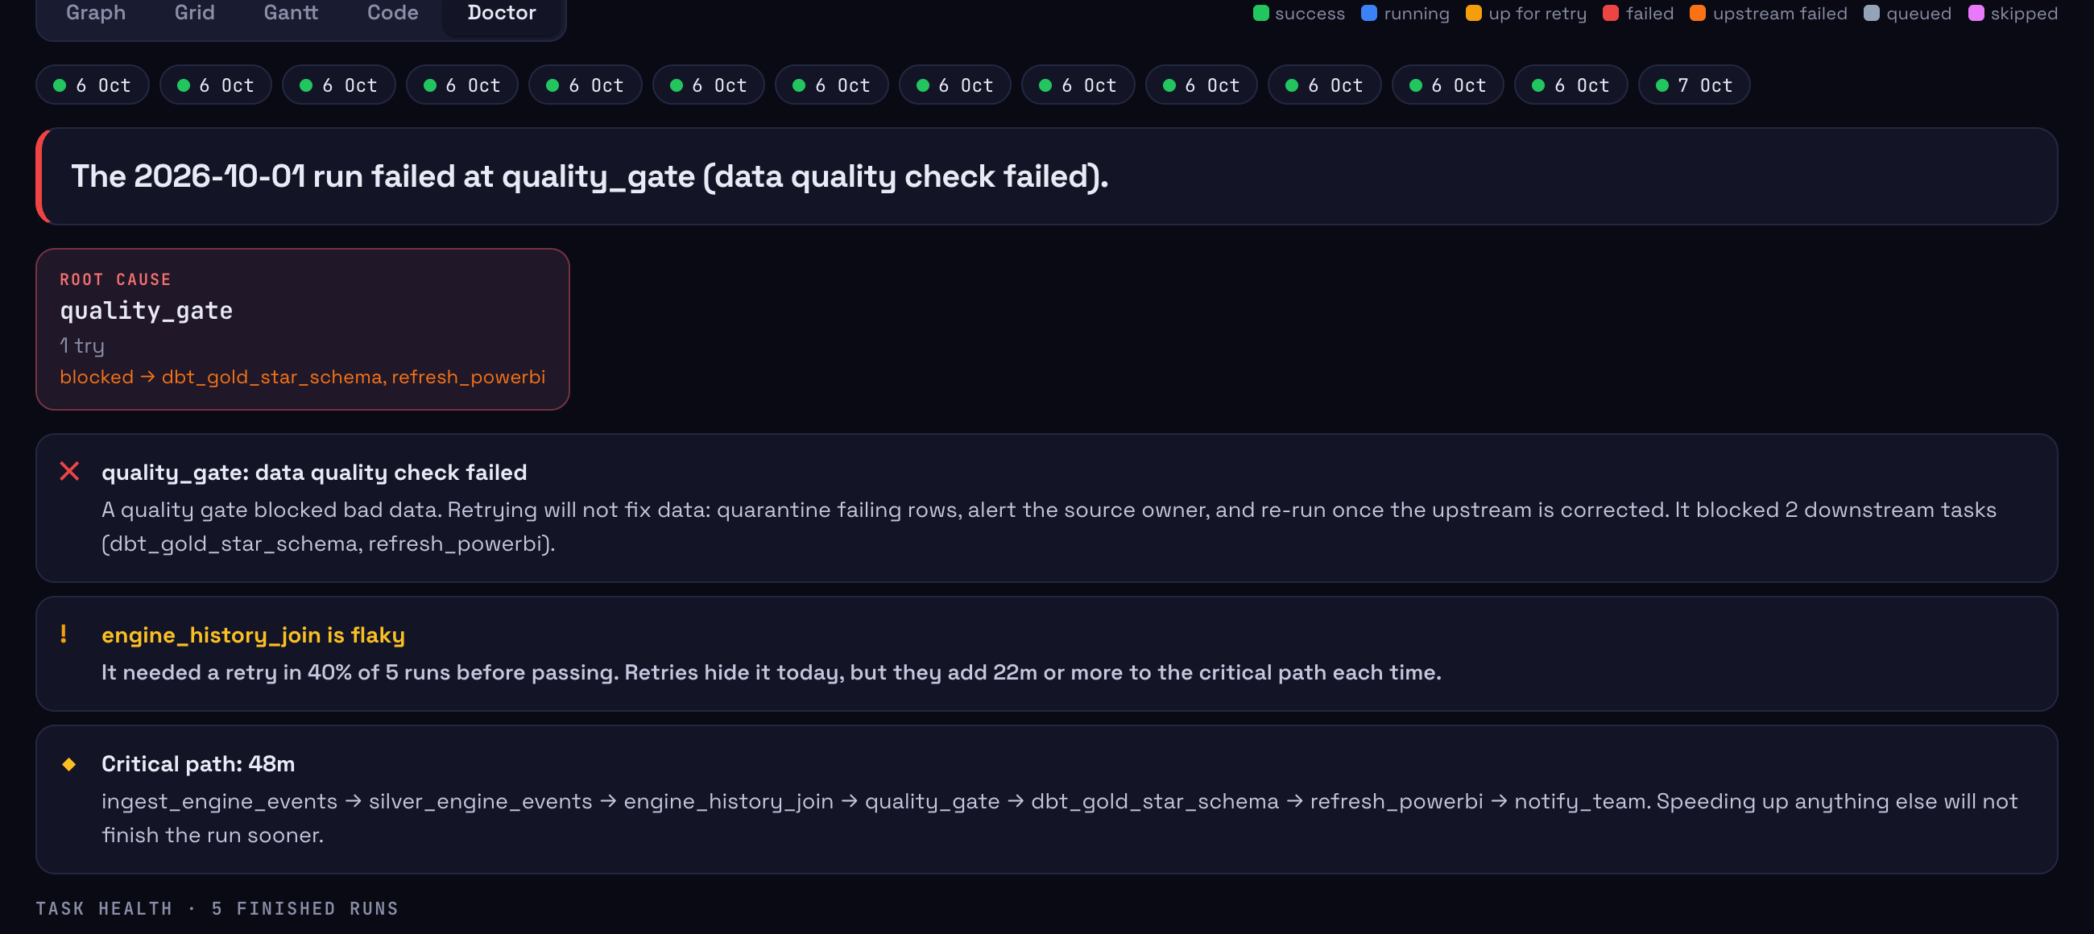
ORCHESTRA
PIPELINE ORCHESTRATION / CASE STUDY
06
CAUSE VS BLAST RADIUS, IN PLAIN ENGLISH
Root cause
quality_gate failed on bad data and blocked dbt and Power BI downstream.
Transient or deterministic
Retries are advised for connection errors, never for a failing quality check.
Flaky and slow tasks
Retry-to-pass rate, p95 vs timeout, and the critical path across runs.
ADITYA MALVIYA
6 / 8

Slide 7
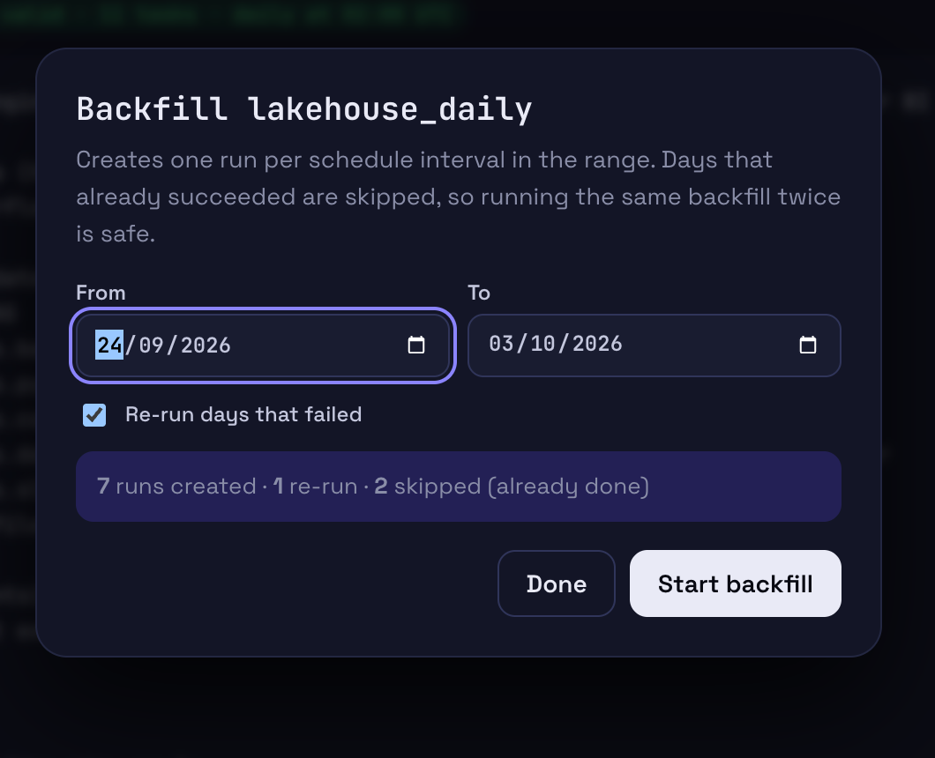
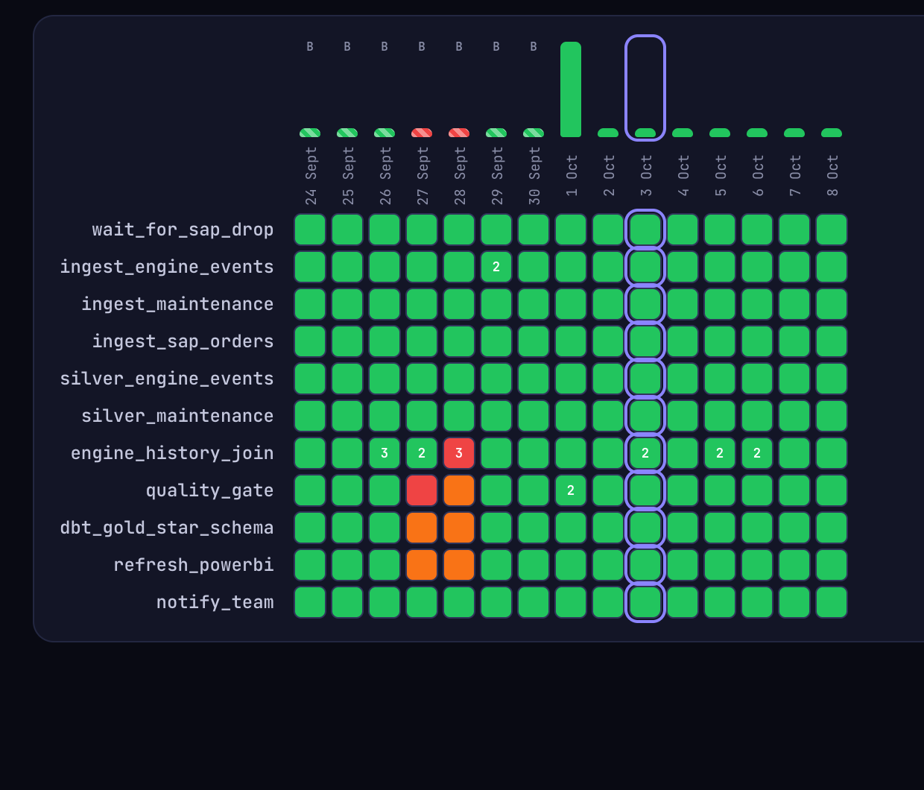
ORCHESTRA
PIPELINE ORCHESTRATION / CASE STUDY
07
BACKFILLS THAT ARE SAFE TO REPEAT
Same range again: 0 created, 10 skipped. One run per logical date; failed days re-run only on request.
ADITYA MALVIYA
7 / 8

Slide 8
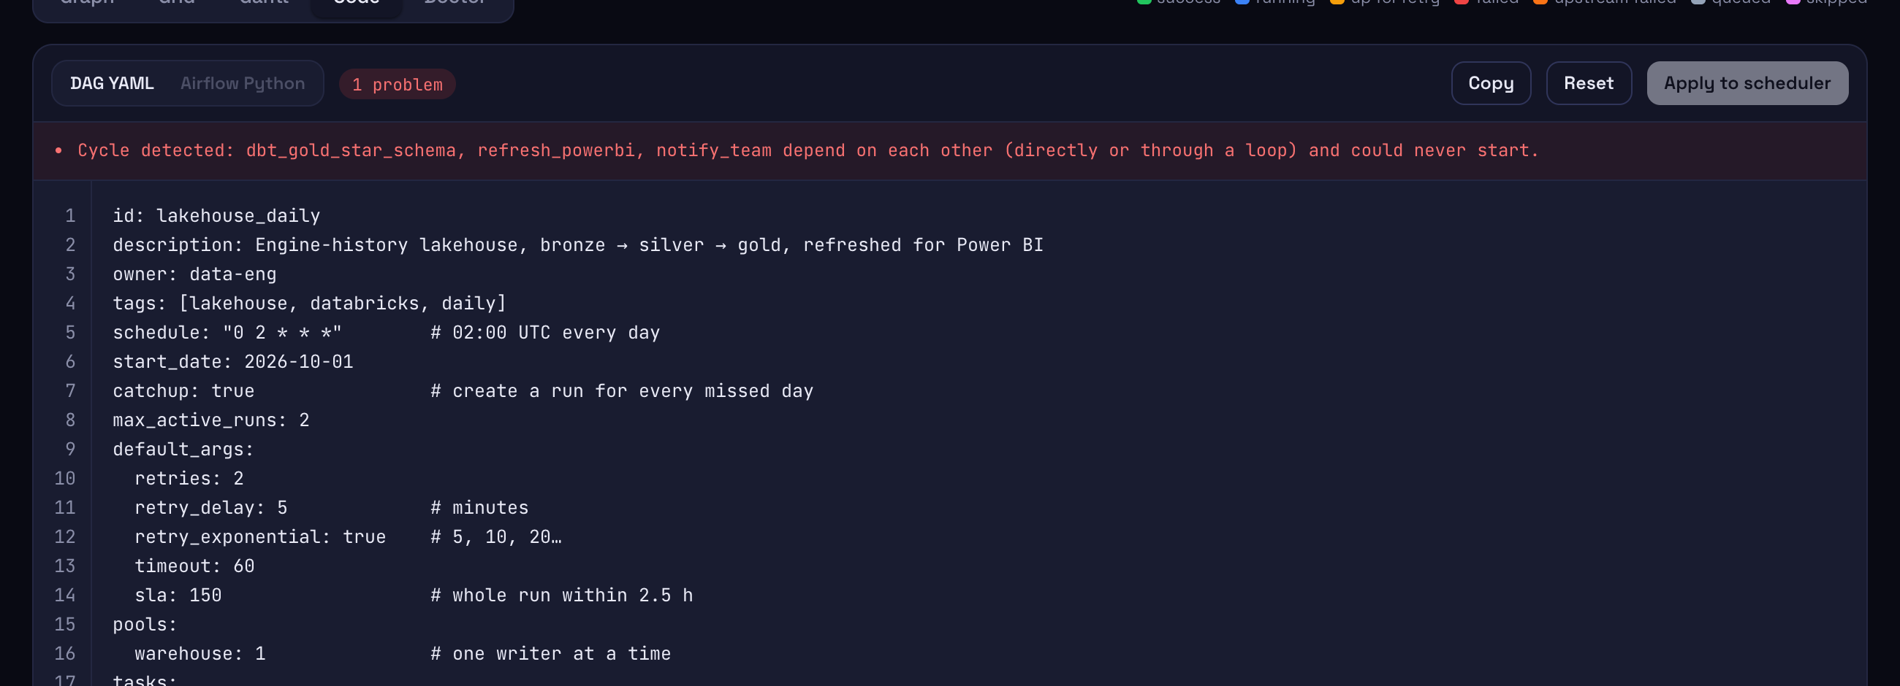
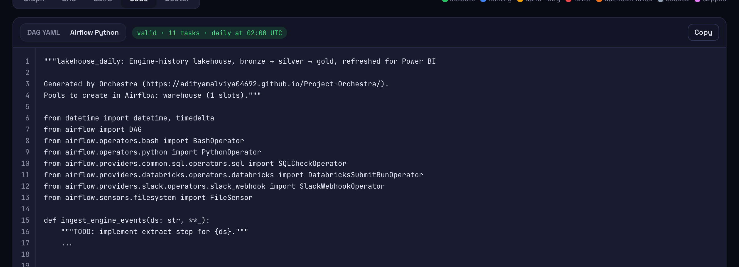
ORCHESTRA
PIPELINE ORCHESTRATION / CASE STUDY
08
DAG-AS-CODE, READY FOR AIRFLOW
A cycle is caught before it reaches the scheduler
Retries, backoff, SLAs, pools and trigger rules carry over
adityamalviya04692.github.io/Project-Orchestra/
github.com/adityamalviya04692/Project-Orchestra
ADITYA MALVIYA
8 / 8

