Slide 1
DATALENS
LOCAL ANALYTICS / CASE STUDY
01
DATALENS
Dataset quality,
without the upload
A browser-based profiler that turns raw files into evidence, charts and reproducible cleaning SQL.
DUCKDB-WASM / REACT / ECHARTS
ADITYA MALVIYA
1 / 6
Notes:
Project by Aditya Malviya. Sources: https://github.com/adityamalviya04692/datalens and https://adityamalviya04692.github.io/datalens/ . Screenshots captured from the live application during this revision.

Slide 2
DATALENS
LOCAL ANALYTICS / CASE STUDY
02
THE PROBLEM: UNTRUSTED INPUT FILES
Hidden quality issues
Repeated manual checks
Sensitive datasets
Missing values and duplicate rows can distort an analysis before a dashboard even exists.
One-off notebooks scatter profiling logic and make the next file harder to compare.
Uploading source records creates a privacy barrier for quick exploratory analysis.
The response: run profiling and cleaning inside the browser.
ADITYA MALVIYA
2 / 6
Notes:
Project by Aditya Malviya. Sources: https://github.com/adityamalviya04692/datalens and https://adityamalviya04692.github.io/datalens/ . Screenshots captured from the live application during this revision.

Slide 3
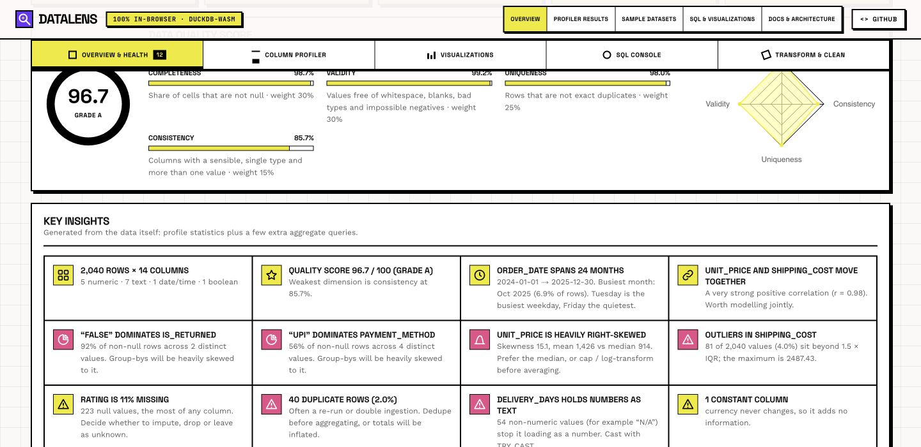
DATALENS
LOCAL ANALYTICS / CASE STUDY
03
THE PROFILE EXPLAINS ITS SCORE
96.7 / 100
Synthetic orders sample
A high overall grade can still hide issues that matter.
40 duplicate rows
223 missing ratings
129 untrimmed city values
ADITYA MALVIYA
3 / 6
Notes:
Project by Aditya Malviya. Sources: https://github.com/adityamalviya04692/datalens and https://adityamalviya04692.github.io/datalens/ . Screenshots captured from the live application during this revision. Live synthetic orders.csv: 2040 rows, 14 columns. Quality score 96.7, not a production benchmark.

Slide 4
DATALENS
LOCAL ANALYTICS / CASE STUDY
04
HOW I BUILT THE PROFILING ENGINE
01 LOAD
Register the local file in DuckDB-WASM. Keep source rows in the browser.
02 COMPUTE
Use SQL passes for wide aggregates, IQR outliers and exact duplicates.
03 EXPLAIN
Weight completeness 30%, validity 30%, uniqueness 25%, consistency 15%.
04 REPRODUCE
Generate one cleaning statement, reprofile the result and export the data.
ADITYA MALVIYA
4 / 6
Notes:
Project by Aditya Malviya. Sources: https://github.com/adityamalviya04692/datalens and https://adityamalviya04692.github.io/datalens/ . Screenshots captured from the live application during this revision.

Slide 5
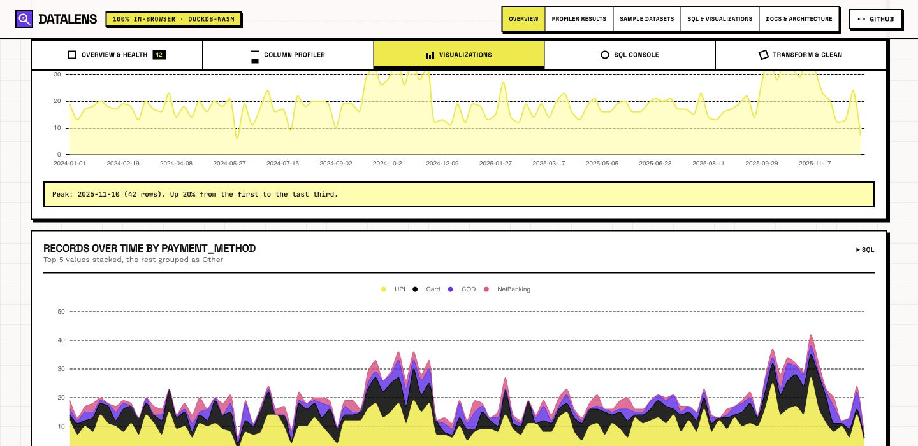
DATALENS
LOCAL ANALYTICS / CASE STUDY
05
CHARTS TURN STATISTICS INTO QUESTIONS
Synthetic demo: monthly patterns reveal when to investigate, not why a change occurred.
ADITYA MALVIYA
5 / 6
Notes:
Project by Aditya Malviya. Sources: https://github.com/adityamalviya04692/datalens and https://adityamalviya04692.github.io/datalens/ . Screenshots captured from the live application during this revision. The current Visualizations screen shows trends and seasonality. Charts are selected from column types. Correlation does not prove causation.

Slide 6
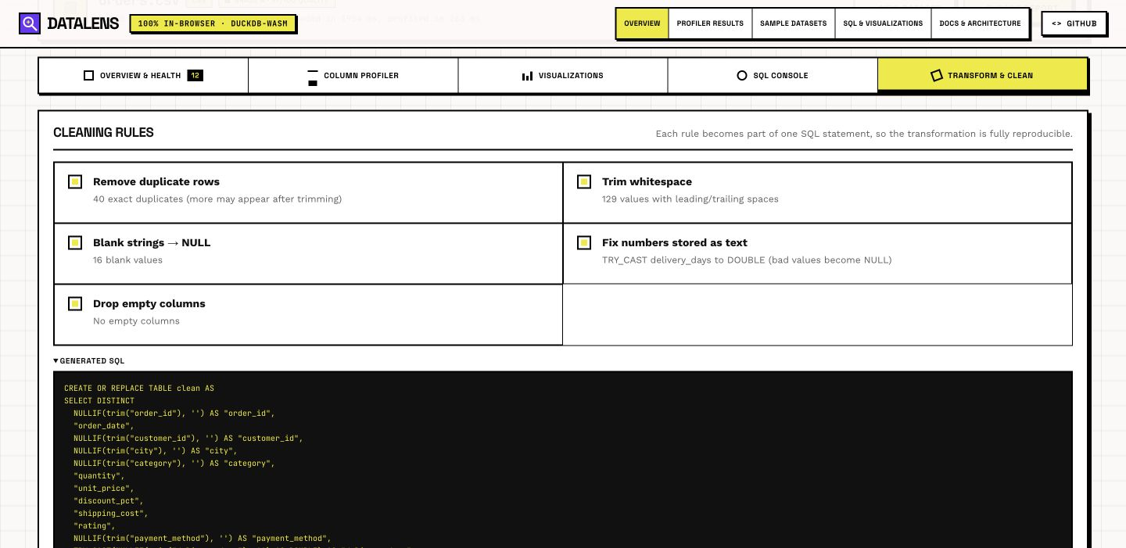
DATALENS
LOCAL ANALYTICS / CASE STUDY
06
CLEANING THAT LEAVES AN AUDIT TRAIL
Readable SQL
Dedupe, trim strings, normalize blanks and fix types with a reproducible transformation.
Boundaries
Browser memory limits file size. Some readers download DuckDB extensions. Demo results are synthetic.
adityamalviya04692.github.io/datalens/
ADITYA MALVIYA
6 / 6
Notes:
Project by Aditya Malviya. Sources: https://github.com/adityamalviya04692/datalens and https://adityamalviya04692.github.io/datalens/ . Screenshots captured from the live application during this revision.

