Slide 1
FLOWFORGE OS // ENGINEERING CASE FILE
FLOWFORGE
Visual pipelines. Inspectable code.
> BUILD Connect transformations on a graph
> RUN Preview each step in DuckDB
> EXPORT SQL, PySpark and a dbt project
12 STEP TYPES 4 CODE TARGETS
ADITYA MALVIYA / LOCAL EXECUTION
[01/06]
Notes:
Project by Aditya Malviya. Sources: https://github.com/adityamalviya04692/flowforge and https://adityamalviya04692.github.io/flowforge/ . Screenshots captured from the live application during this revision.

Slide 2
FLOWFORGE OS // ENGINEERING CASE FILE
[01] WHY A VISUAL WORKSTATION
THE PROBLEM
THE IMPLEMENTATION
A pipeline diagram alone cannot show what a join changed or what code will run after export.
A typed graph drives local execution. Each node exposes its schema and preview, while exports remain readable.
Design goal: shorten the loop between graph, data and code.
ADITYA MALVIYA / LOCAL EXECUTION
[02/06]
Notes:
Project by Aditya Malviya. Sources: https://github.com/adityamalviya04692/flowforge and https://adityamalviya04692.github.io/flowforge/ . Screenshots captured from the live application during this revision.

Slide 3
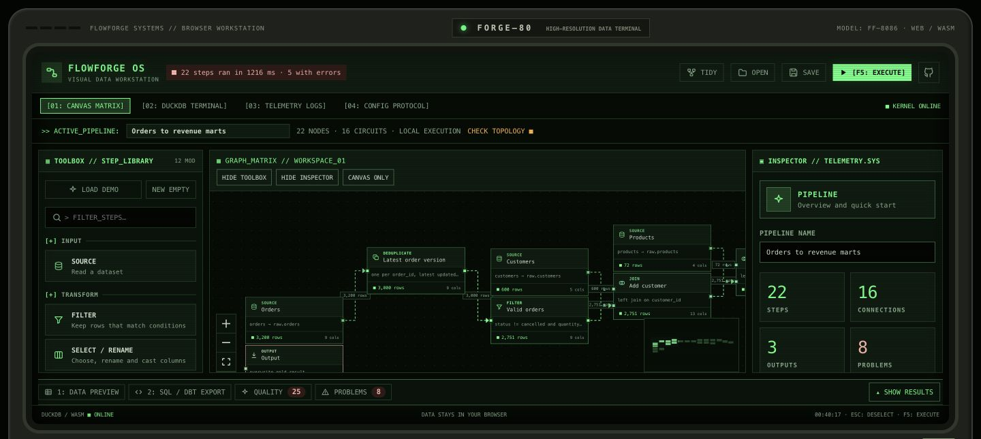
FLOWFORGE OS // ENGINEERING CASE FILE
[02] THE GRAPH MAKES ERRORS VISIBLE
Current workspace: disconnected steps trigger topology warnings.
Valid branches still expose row counts and schemas.
ADITYA MALVIYA / LOCAL EXECUTION
[03/06]
Notes:
Project by Aditya Malviya. Sources: https://github.com/adityamalviya04692/flowforge and https://adityamalviya04692.github.io/flowforge/ . Screenshots captured from the live application during this revision. Live workspace contains user-added incomplete steps. Screenshot intentionally demonstrates validation, not a clean benchmark run.

Slide 4
FLOWFORGE OS // ENGINEERING CASE FILE
[03] COMPILER AND EXECUTION DESIGN
01
GRAPH
Typed step configuration and named input ports
02
VALIDATION
Required inputs, invalid configuration and cycle checks
03
EXECUTION
Dependency order with a DuckDB view for each step
04
EXPORT
Shared SELECT compiler for SQL targets; separate PySpark emitter
ADITYA MALVIYA / LOCAL EXECUTION
[04/06]
Notes:
Project by Aditya Malviya. Sources: https://github.com/adityamalviya04692/flowforge and https://adityamalviya04692.github.io/flowforge/ . Screenshots captured from the live application during this revision.

Slide 5
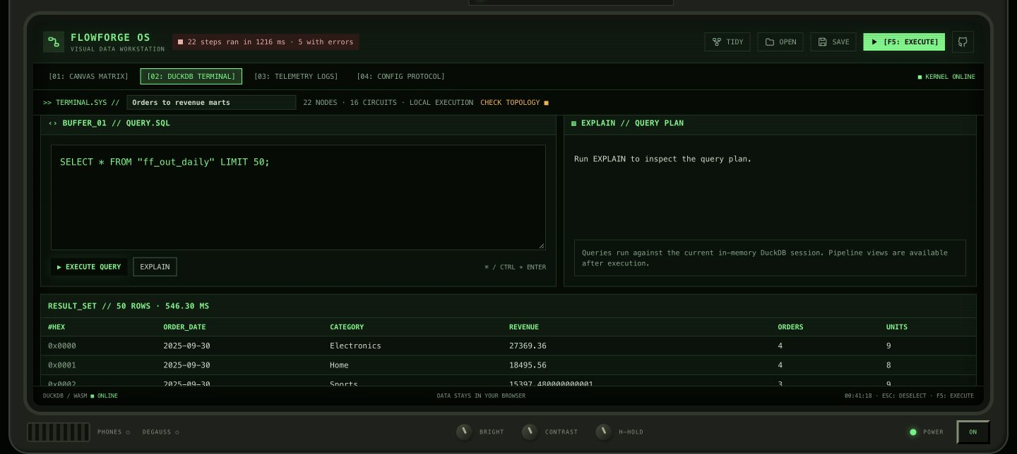
FLOWFORGE OS // ENGINEERING CASE FILE
[04] SQL REMAINS AVAILABLE
The terminal queries the same in-memory views as the graph.
This keeps the transformation logic open to inspection.
ADITYA MALVIYA / LOCAL EXECUTION
[05/06]
Notes:
Project by Aditya Malviya. Sources: https://github.com/adityamalviya04692/flowforge and https://adityamalviya04692.github.io/flowforge/ . Screenshots captured from the live application during this revision.

Slide 6
FLOWFORGE OS // ENGINEERING CASE FILE
[05] VALIDATION AND LESSONS
17
Exported SQL: end-to-end DuckDB checks
PySpark: Python AST syntax checks
Joins: explicit, collision-free columns
native-engine tests
reported in the repository
LIMITS
AST checks do not prove Spark runtime parity. Expressions need target compatibility. Browser memory limits scale.
adityamalviya04692.github.io/flowforge/
ADITYA MALVIYA / LOCAL EXECUTION
[06/06]
Notes:
Project by Aditya Malviya. Sources: https://github.com/adityamalviya04692/flowforge and https://adityamalviya04692.github.io/flowforge/ . Screenshots captured from the live application during this revision.

