Slide 1
PipeScope
PROJECT CASE STUDY
Spark performance,
with downstream context
An investigation tool that connects execution evidence
to the tables and columns a pipeline feeds.
Spark event logs / SQL lineage / In-browser analysis
Aditya Malviya
01
Notes:
Project by Aditya Malviya. Sources: https://github.com/adityamalviya04692/pipescope and https://adityamalviya04692.github.io/pipescope/ . Screenshots captured from the live application during this revision.

Slide 2
PipeScope
PROJECT CASE STUDY
Why runtime and lineage belong together
The investigation gap
My approach
Spark metrics explain where execution slows down. SQL dependencies explain what a change can affect.
Parse event logs for evidence-backed findings. Resolve SQL at column level. Match statements to the tables they build.
The result is one place to prioritize a bottleneck and inspect its downstream impact.
Aditya Malviya
02
Notes:
Project by Aditya Malviya. Sources: https://github.com/adityamalviya04692/pipescope and https://adityamalviya04692.github.io/pipescope/ . Screenshots captured from the live application during this revision.

Slide 3
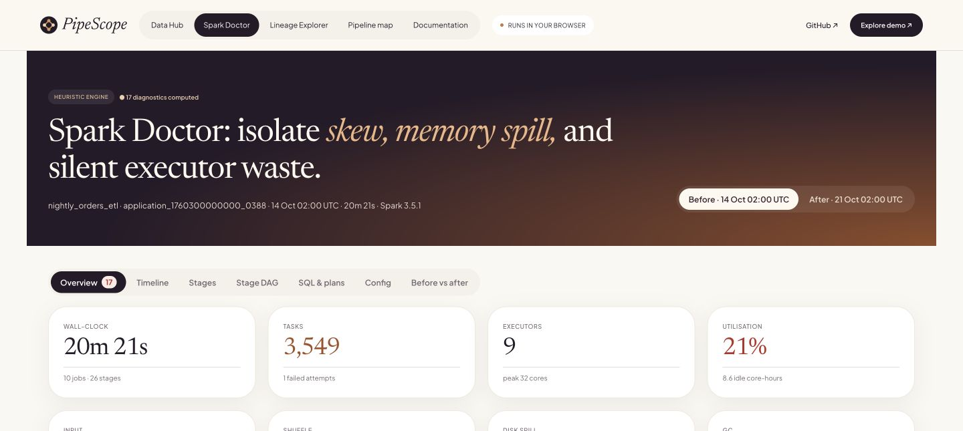
PipeScope
PROJECT CASE STUDY
Diagnostics start with execution evidence
17 rules
Skew, spill, garbage collection, small files and idle cores.
Each finding includes metrics, a threshold and a suggested fix.
Synthetic nightly-orders demo
Aditya Malviya
03
Notes:
Project by Aditya Malviya. Sources: https://github.com/adityamalviya04692/pipescope and https://adityamalviya04692.github.io/pipescope/ . Screenshots captured from the live application during this revision. Screenshot displays synthetic demonstration logs, not measured client or employer impact.

Slide 4
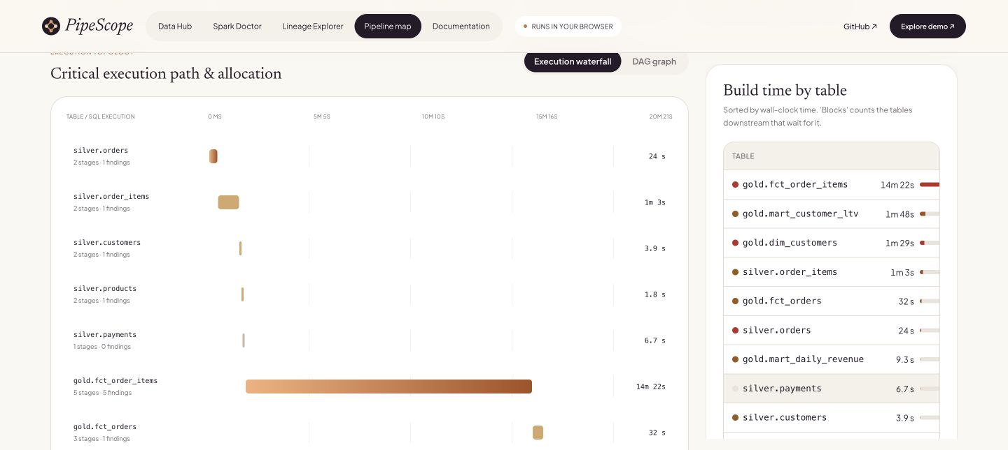
PipeScope
PROJECT CASE STUDY
The slowest build has downstream consequences
14m 22s
Synthetic demo: gold.fct_order_items dominates build time.
The critical path helps distinguish blocking work from parallel work.
Aditya Malviya
04
Notes:
Project by Aditya Malviya. Sources: https://github.com/adityamalviya04692/pipescope and https://adityamalviya04692.github.io/pipescope/ . Screenshots captured from the live application during this revision. Synthetic demo execution waterfall and table build timings. 14m22s is the before-run build time for gold.fct_order_items.

Slide 5
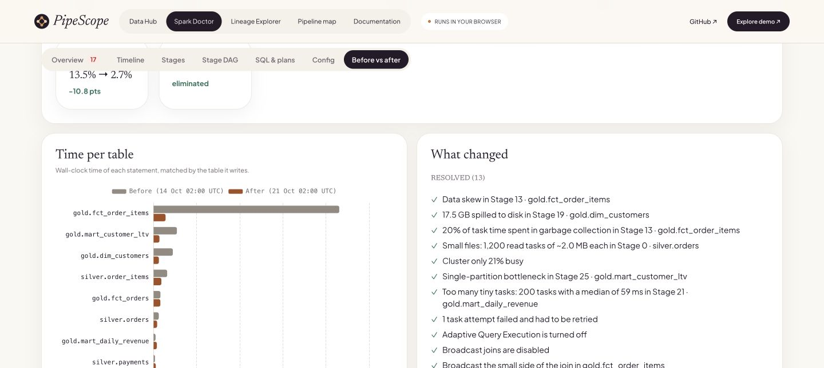
PipeScope
PROJECT CASE STUDY
Before-and-after comparison
20m 21s
Before tuning
4m 27s
After tuning
Synthetic demonstration only. The 4.6× ratio illustrates comparison features, not a production result.
Aditya Malviya
05
Notes:
Project by Aditya Malviya. Sources: https://github.com/adityamalviya04692/pipescope and https://adityamalviya04692.github.io/pipescope/ . Screenshots captured from the live application during this revision. Both event logs are synthetic fixtures. 1221 / 267 = 4.573, rounded to 4.6. Do not attribute this to employer work.

Slide 6
PipeScope
PROJECT CASE STUDY
How I built the analysis engine
Execution analysis
SQL dependency analysis
A Web Worker streams event logs and computes stage percentiles, utilization and diagnostic findings.
Pyodide runs sqlglot in the browser to resolve column dependencies and SQL or dbt lineage.
Boundaries
SQL lineage does not cover DataFrame code. Gzip is the supported compressed-log format. Diagnostic thresholds need workload context.
adityamalviya04692.github.io/pipescope/
Aditya Malviya
06
Notes:
Project by Aditya Malviya. Sources: https://github.com/adityamalviya04692/pipescope and https://adityamalviya04692.github.io/pipescope/ . Screenshots captured from the live application during this revision. Repository reports 16 Python and 36 Vitest tests. The sqlglot wheel is version-pinned and checksum verified.

