Slide 1
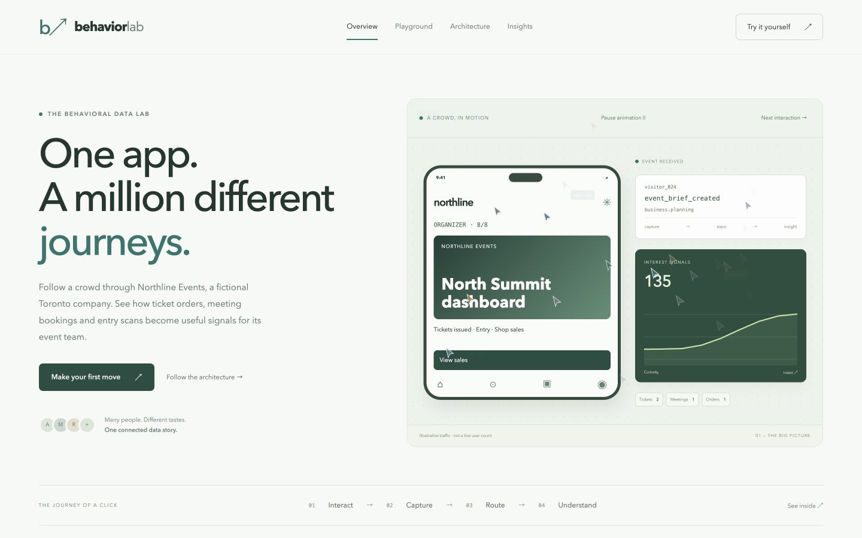
Behavior Lab
Behavioral analytics for a corporate-events application
Northline Events is a fictional Canadian company.
A working phone experience makes event capture and client insights inspectable.
Aditya Malviya · Portfolio project
01

Slide 2
The event-business problem
Connect client activity with commercial follow-up
Event browsing, ticket orders and meeting requests often live in separate systems.
Behavior Lab records the action, preserves its source and explains the resulting profile.
Aditya Malviya · Portfolio project
02

Slide 3
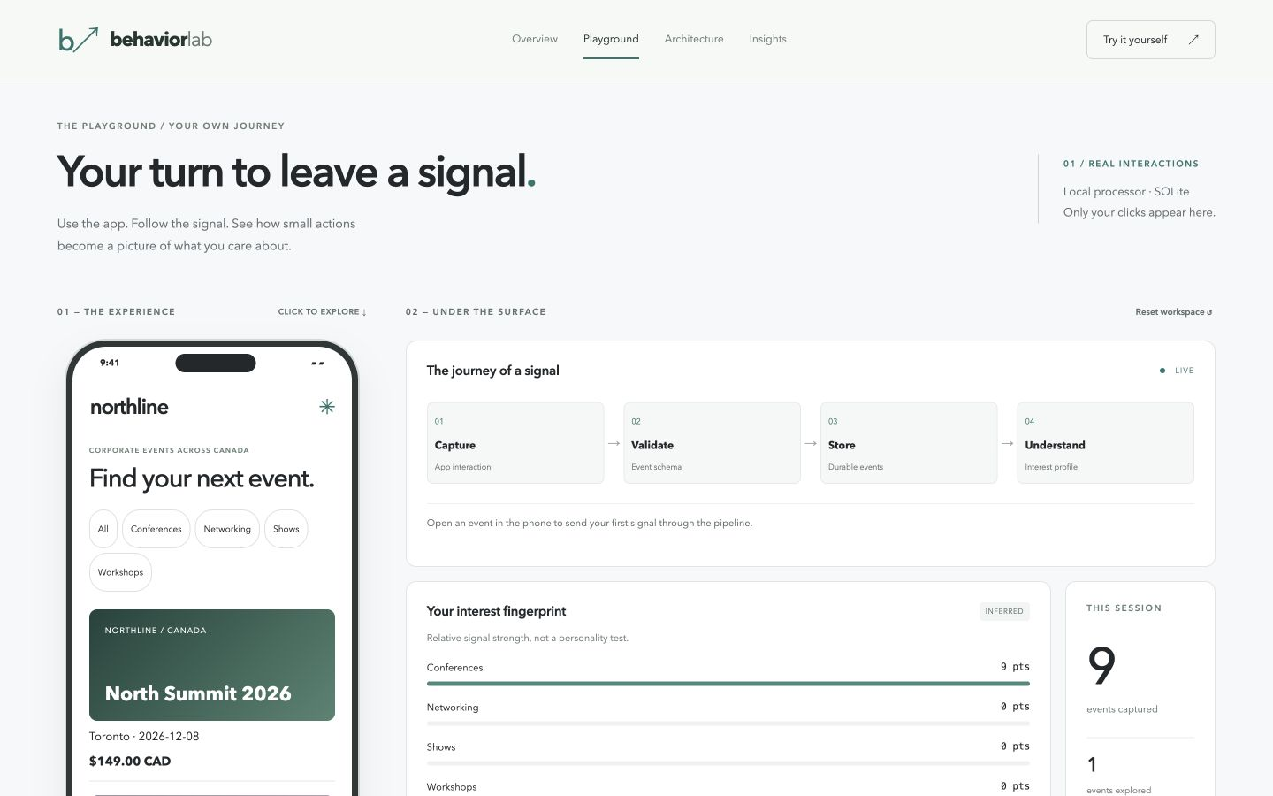
A complete demo journey
Browse, buy, plan and attend
Discover Canadian events and order tickets or merchandise.
Book a consultation, prepare a brief and request a proposal.
Issue tickets, simulate entry and reconcile attendance with sales.
Aditya Malviya · Portfolio project
03

Slide 4
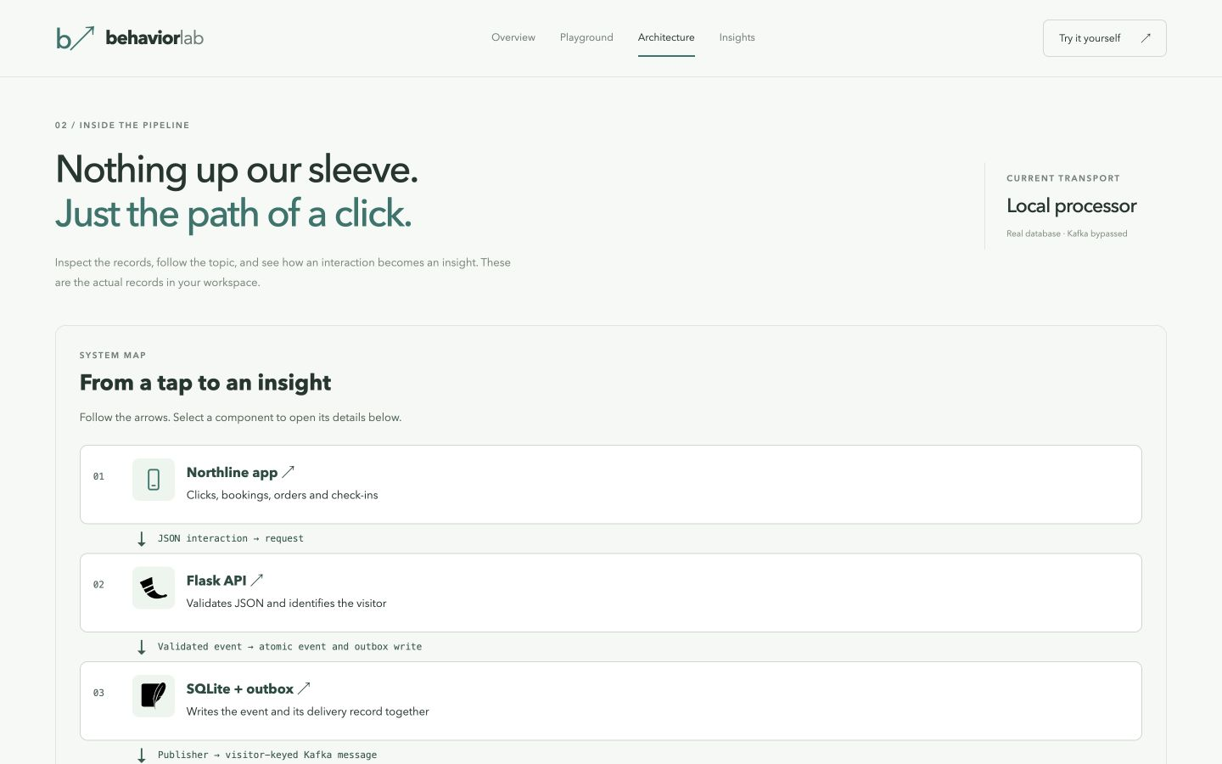
Event processing architecture
Capture and delivery use a transactional outbox
Flask API → SQLite event and outbox → Kafka topics → Python consumer.
The consumer commits its offset after database materialization succeeds.
Aditya Malviya · Portfolio project
04

Slide 5
Data layers and recovery
Raw events support consistent profile reconstruction
Bronze retains raw payloads. Silver records effective contributions.
Gold stores visitor preferences and active saved items.
Unique event IDs support duplicate delivery and capture-sequence replay.
Aditya Malviya · Portfolio project
05

Slide 6
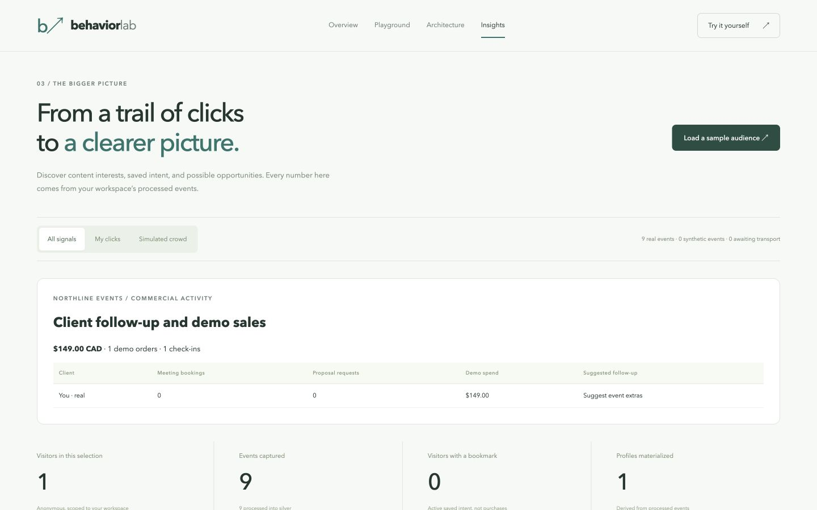
Client evidence and sales
Follow-up suggestions use explicit activity
Meetings and proposal requests identify conversations to prepare for.
Ticket and merchandise orders contribute demo revenue.
Source filters distinguish the synthetic cohort from real demo interactions.
Aditya Malviya · Portfolio project
06

Slide 7
Validation and current scope
Local behavior is verified
17 pipeline tests passed. API checks reconciled CAD 330 in demo purchases.
Browser checks reconciled a ticket order and check-in across the app and reports.
GitHub CI passed a real Kafka smoke test on 5 November 2026.
Public backend hosting remains pending.
Aditya Malviya · Portfolio project
07

Slide 8
Repository and next steps
Run, inspect and extend the project
github.com/adityamalviya04692/Project-BehaviorLab
Python / Flask / SQLite / Kafka integration / Docker / GitHub Actions
Prepared for a Docker deployment with a real-broker smoke test.
Aditya Malviya · Portfolio project
08

