Slide 1
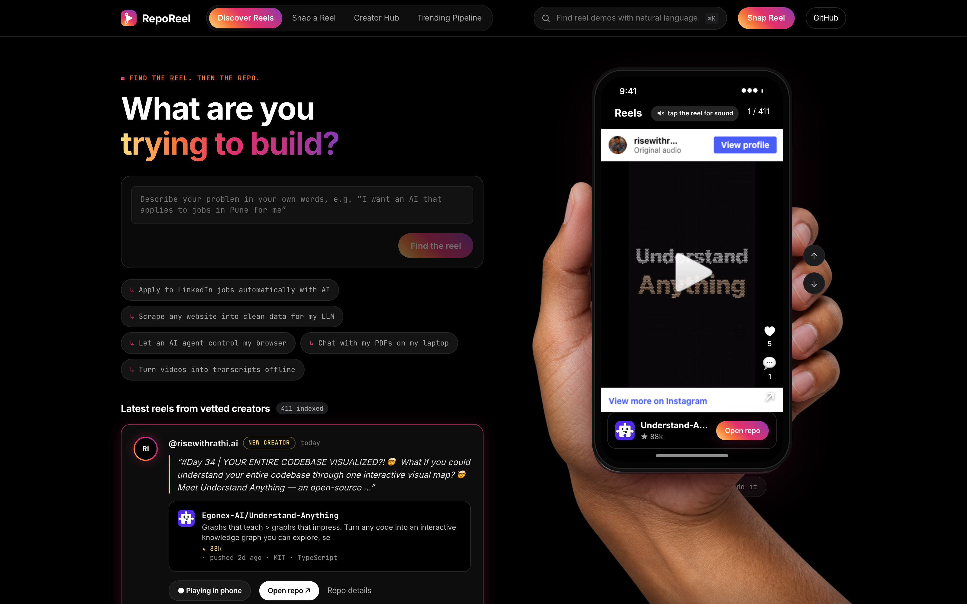
01 / 08
REEL DISCOVERY + REPOSITORY SEARCH
Find the reel.
Then the repo.
Describe what you want to build.
Watch the demo and open the code.
Python / DuckDB / React / ONNX
Notes:
Source: Project-RepoReel README, original RepoReel case-study deck and captured app screenshots. Product: https://adityamalviya04692.github.io/Project-RepoReel/. Snapshot figures are from the source deck, not live counters.

Slide 2
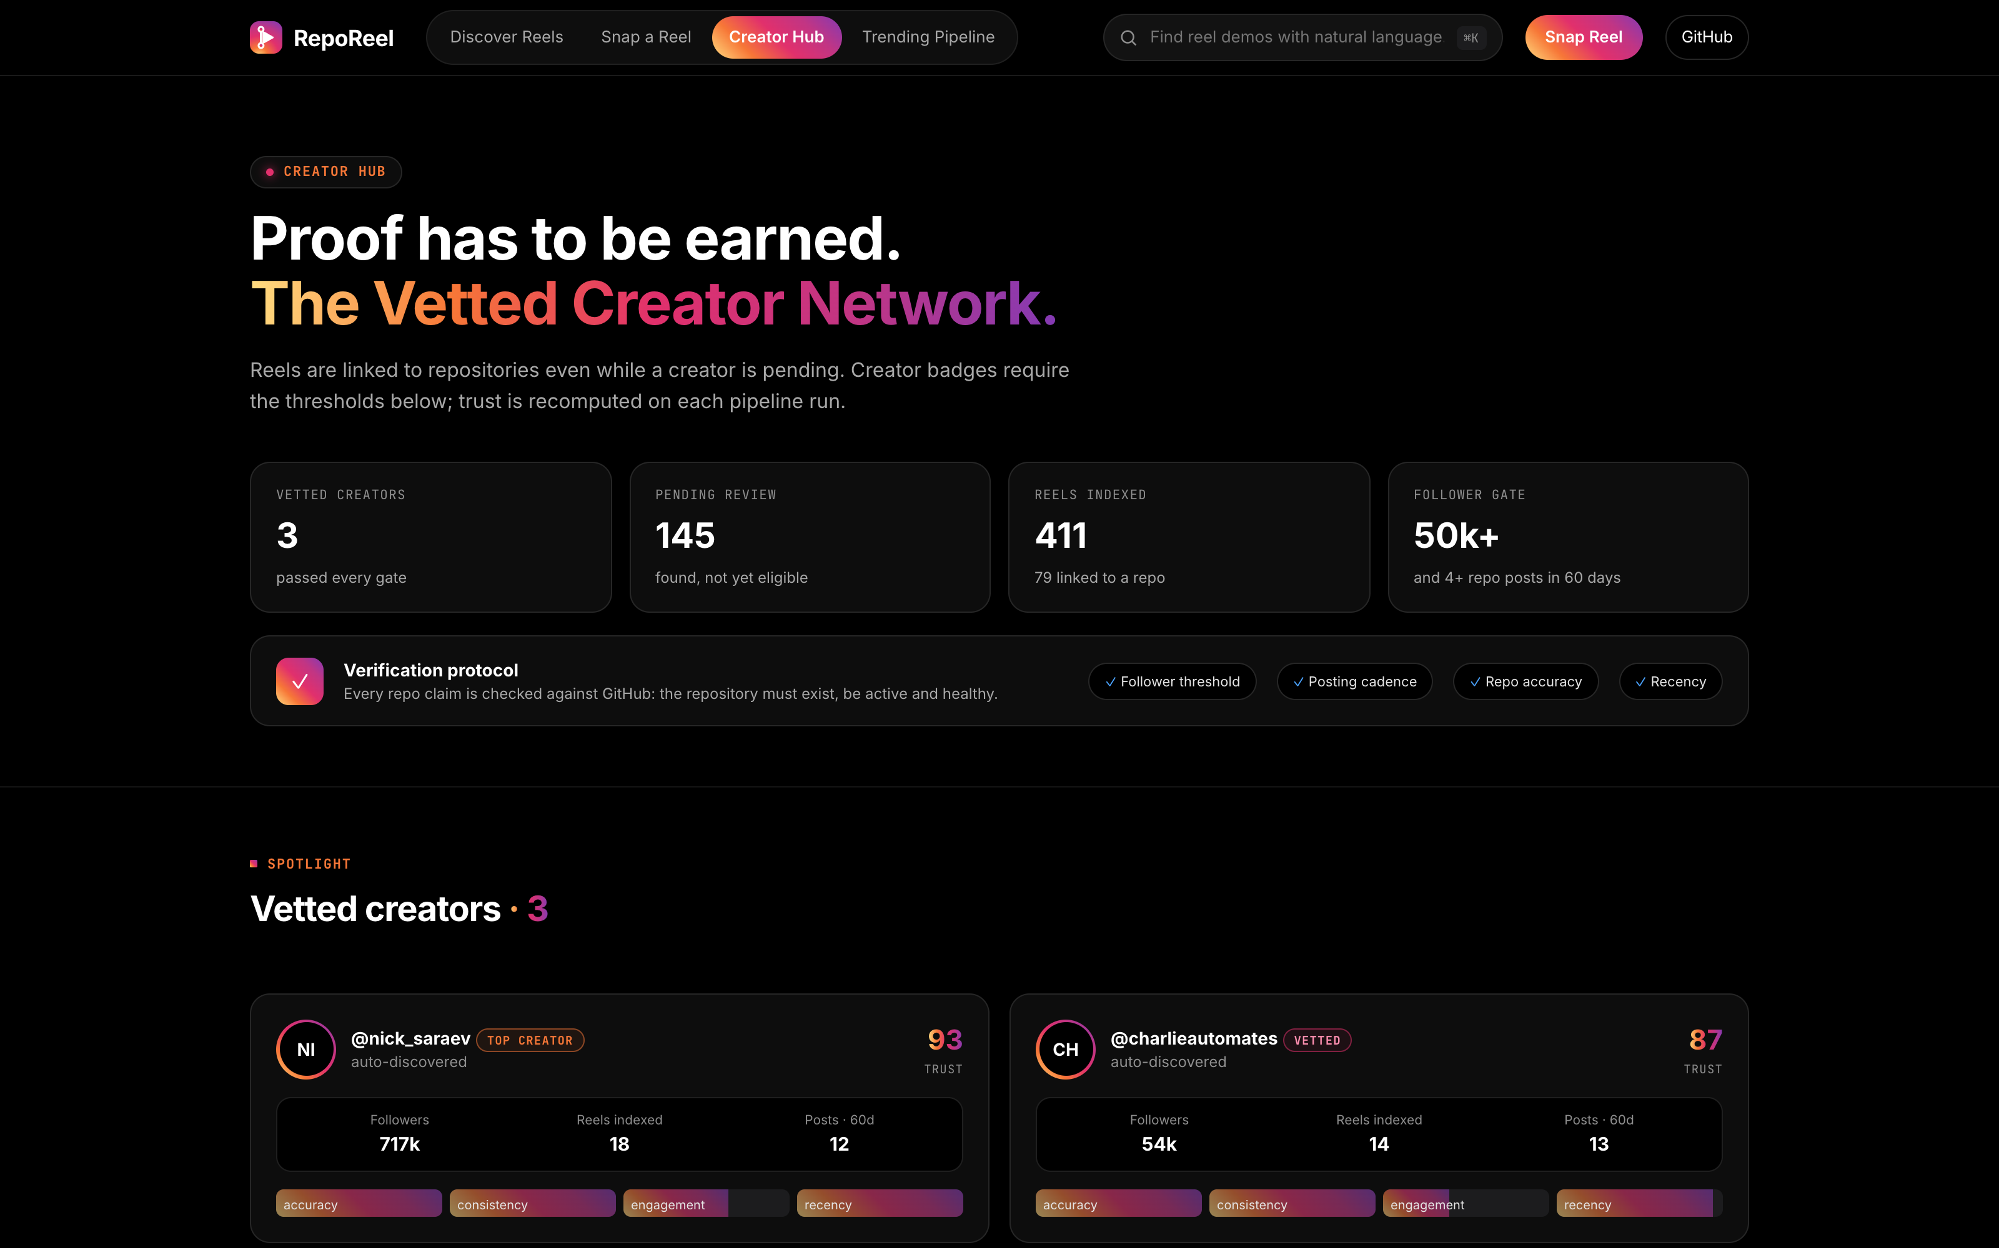
02 / 08
The missing repository link
Engagement gates
The reel asks for a comment or DM before sharing the repository.
Incomplete captions
Many captions never name the repository clearly enough to match.
RepoReel connects the demo to code you can inspect.
Notes:
Source: Project-RepoReel README, original RepoReel case-study deck and captured app screenshots. Product: https://adityamalviya04692.github.io/Project-RepoReel/. Snapshot figures are from the source deck, not live counters.

Slide 3
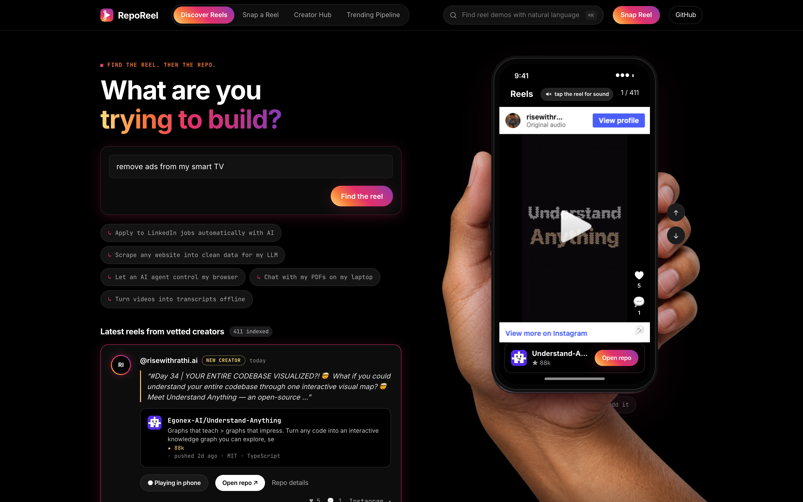
03 / 08
Search in your own words
Semantic retrieval
MiniLM embeds the query in your browser using Transformers.js.
Hybrid ranking
Meaning and BM25 combine with recency, creator trust and repository health.
Notes:
Source: Project-RepoReel README, original RepoReel case-study deck and captured app screenshots. Product: https://adityamalviya04692.github.io/Project-RepoReel/. Snapshot figures are from the source deck, not live counters.

Slide 4
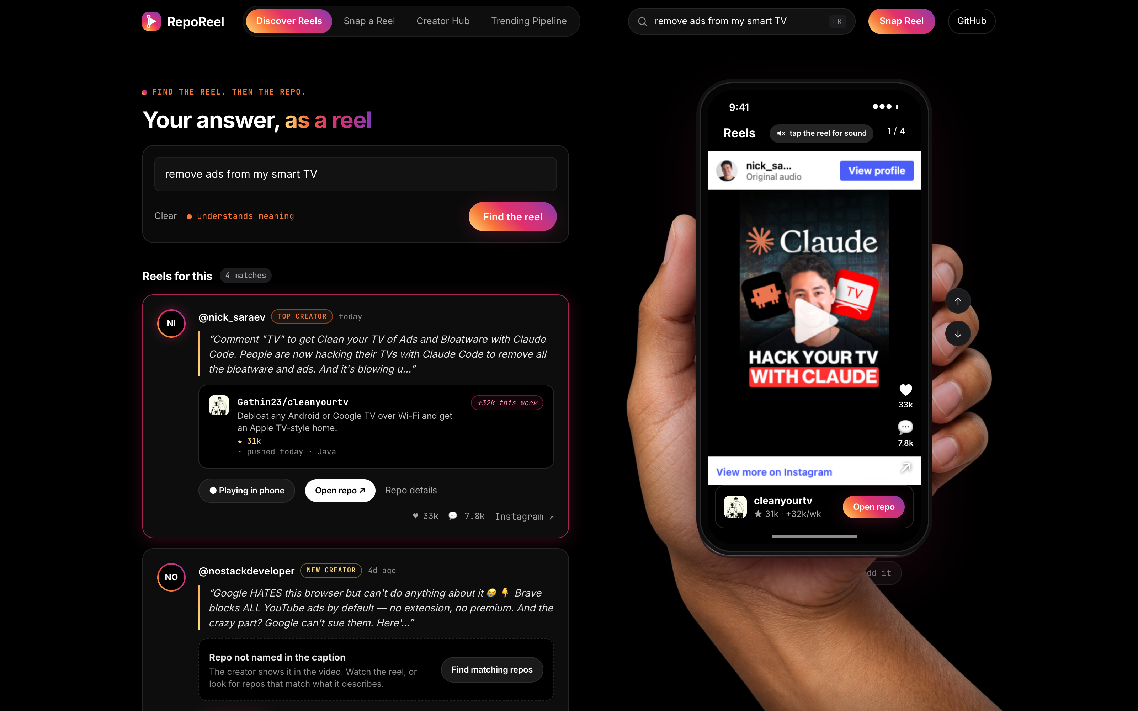
04 / 08
A reel with a route to the code
Official Instagram embeds
Watch the original demo in the phone. Reel media stays with Instagram.
Explicit uncertainty
When the caption does not name a repo, the result offers a matching search.
Notes:
Source: Project-RepoReel README, original RepoReel case-study deck and captured app screenshots. Product: https://adityamalviya04692.github.io/Project-RepoReel/. Snapshot figures are from the source deck, not live counters.

Slide 5
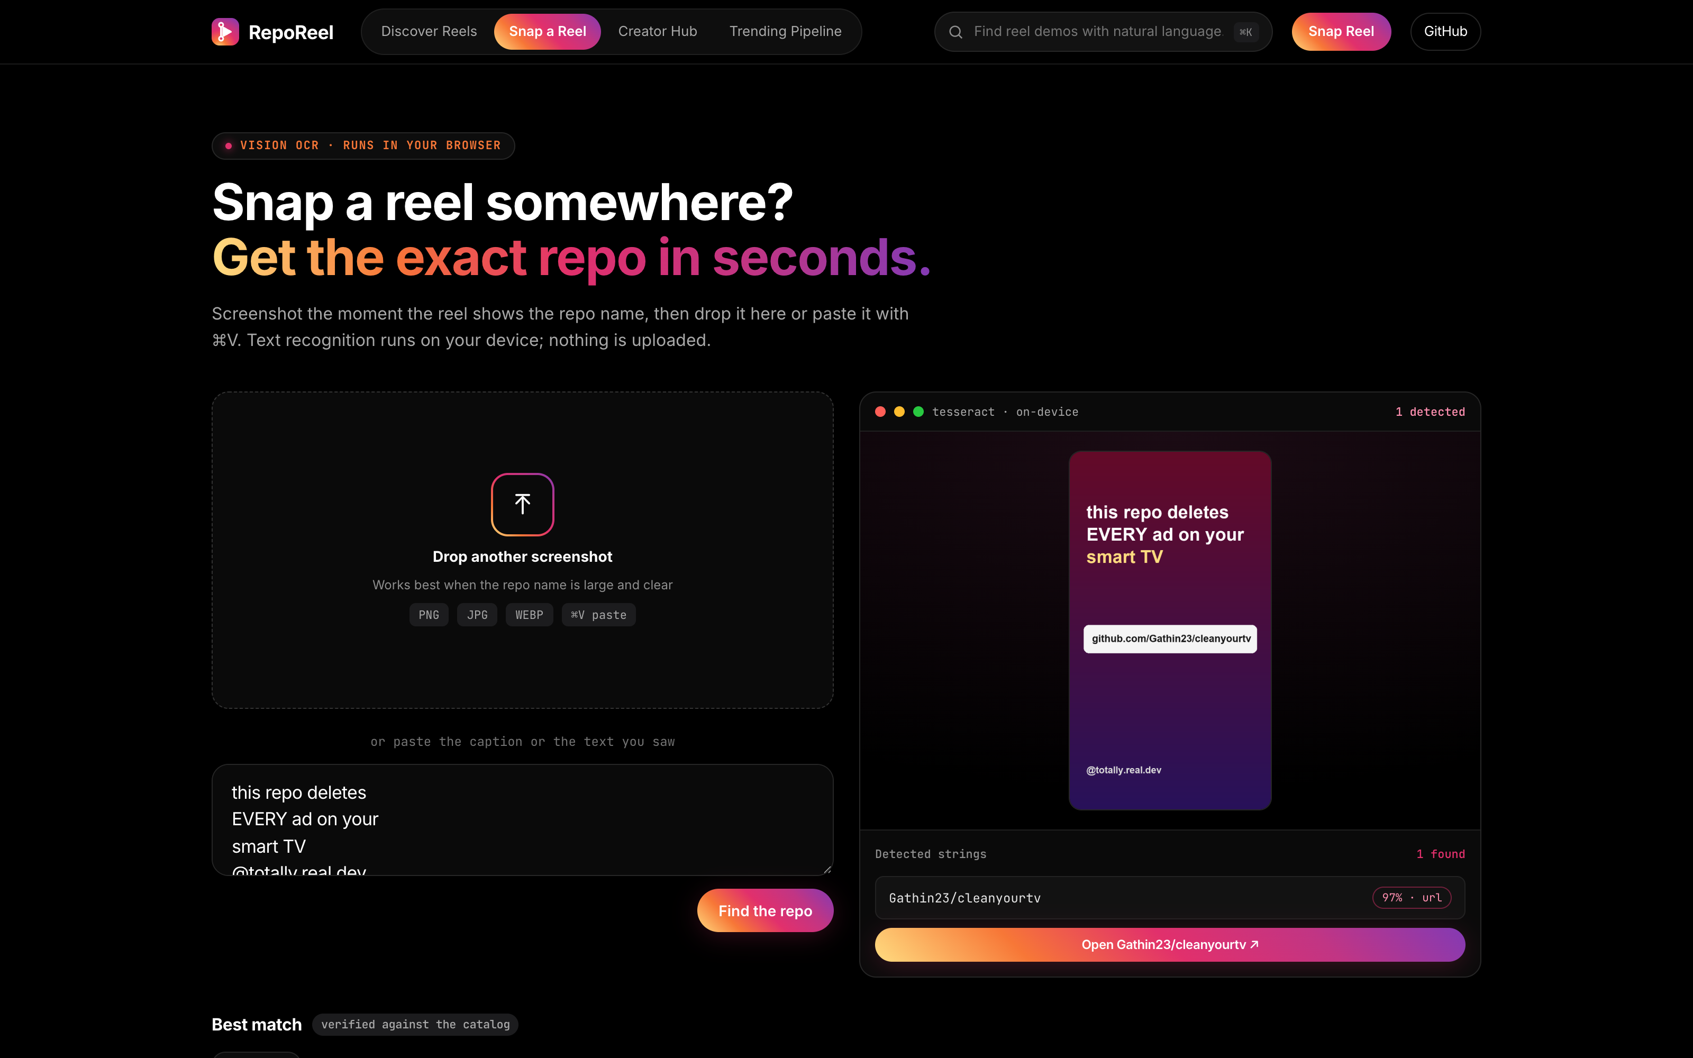
05 / 08
Find a repository from a screenshot
OCR on your device
Tesseract.js reads the uploaded frame inside the browser.
Repository matching
Extract GitHub URLs and owner/repo names, then try fuzzy matching and search.
Notes:
Source: Project-RepoReel README, original RepoReel case-study deck and captured app screenshots. Product: https://adityamalviya04692.github.io/Project-RepoReel/. Snapshot figures are from the source deck, not live counters.

Slide 6
06 / 08
The nightly discovery pipeline
Discover
Classify and match
Validate and publish
Graph API and budget-guarded Apify discovery find candidate reels.
English repo captions, creator expansion and cached OCR produce candidates.
Quality checks protect monthly history and repository shards.
411 reels
79 identified repos
4,309 repositories
Source deck snapshot. Apify budget: $4.50/month, capped at $0.25 per actor run.
Notes:
Source: Project-RepoReel README, original RepoReel case-study deck and captured app screenshots. Product: https://adityamalviya04692.github.io/Project-RepoReel/. Snapshot figures are from the source deck, not live counters.

Slide 7
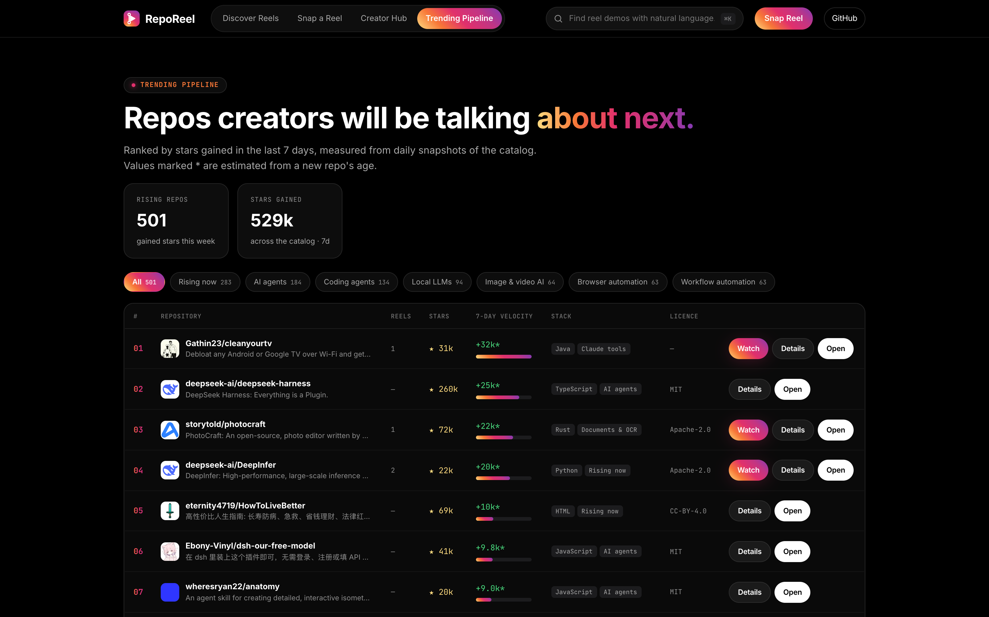
07 / 08
Repository momentum
Daily snapshots measure stars gained over 7 and 30 days.
Creator trust
Accuracy, consistency, engagement and recency contribute to the ranking.
Eligibility checks apply before scoring.
Notes:
Source: Project-RepoReel README, original RepoReel case-study deck and captured app screenshots. Product: https://adityamalviya04692.github.io/Project-RepoReel/. Snapshot figures are from the source deck, not live counters.

Slide 8
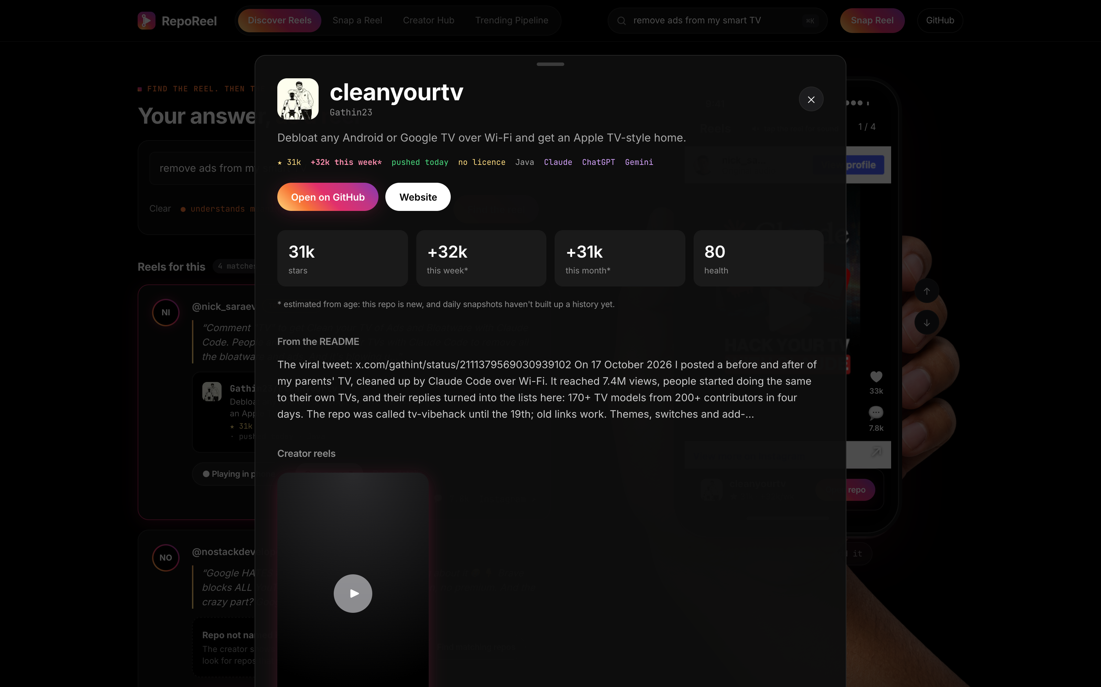
08 / 08
Engineering for repeatable runs
Replay and recovery
Rebuild from recorded raw inputs. Resume runs merge into the latest history.
Quality gates
Unknown creators, orphaned repos and implausible star changes block publishing.
Live demo
adityamalviya04692.github.io/Project-RepoReel/
Notes:
Source: Project-RepoReel README, original RepoReel case-study deck and captured app screenshots. Product: https://adityamalviya04692.github.io/Project-RepoReel/. Snapshot figures are from the source deck, not live counters. Original test snapshot: 49 pipeline tests and 16 web tests. A stale checkout incident prompted branch-tip checkout and recovery of 411 reels without re-spending discovery credit. Code: https://github.com/adityamalviya04692/Project-RepoReel

