Slide 1
Global COVID-19 Impact Dashboard
Regional Comparison and Weekly Trends
By Aditya Manchandani

Slide 2
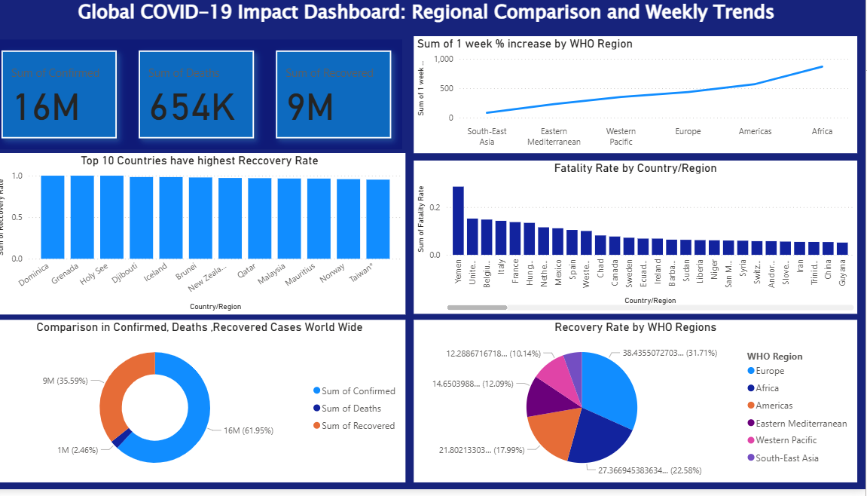
Dashboard

Slide 3
Project Objective
Analyze the global impact of COVID-19 using WHO region-wise data.
Compare confirmed cases, deaths, and recovery rates globally.
Identify trends and high-risk regions based on recent data.

Slide 4
Tools and Data
Tools Used: Microsoft Power BI, DAX, Data Modeling
Data Source: WHO global COVID-19 dataset
Data includes confirmed, death, recovered cases by country/region

Slide 5
Key Global Metrics
16M confirmed cases globally
654K deaths (~4% fatality rate)
9M recovered (~56% recovery rate)

Slide 6
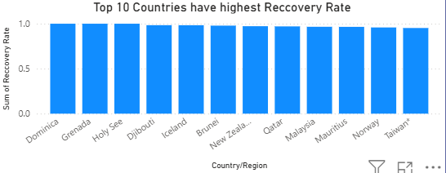
Top 10 Countries with Highest Recovery Rate
Dominica, Grenada, Holy See, Djibouti, Iceland
Brunei, New Zealand, Qatar, Malaysia, Mauritius

Slide 7
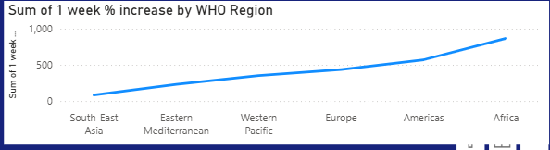
1-Week Case Growth by WHO Region
Highest increase: Africa
Moderate increase: Americas, Europe
Lowest increase: South-East Asia

Slide 8
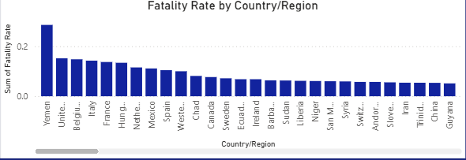
Highest Fatality Rate by Country
Yemen, United Kingdom, Belgium, Italy, France
Fatality rate >5% in these regions

Slide 9
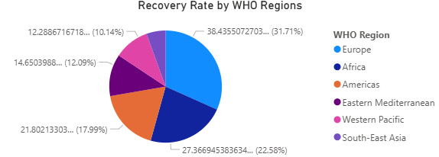
Recovery Rate by WHO Region
Europe: 31.7%
South-East Asia: 22.6%
Americas: 18%
Africa, Eastern Mediterranean, Western Pacific lower

Slide 10
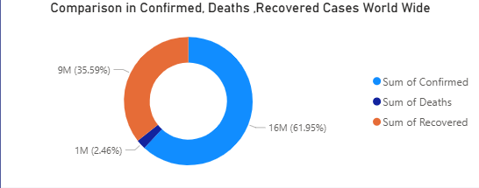
Global Case Distribution
Confirmed: 62%
Recovered: 36%
Deaths: 2%
Data may reflect reporting or time lag differences

Slide 11
Conclusion & Takeaways
Recovered cases outpace deaths, but many active cases remain.
Recovery and fatality trends vary sharply by region.
Demonstrates ability to build actionable, visual insights with Power BI.

Slide 12
About the Creator
Aditya Manchandani
Aspiring Data Analyst skilled in Power BI, Excel, and SQL
Connect on LinkedIn or GitHub for more projects.

