Slide 1
Implementation of Distance Based Approach in Multi Criteria Decision Analysis

Slide 2
Objective
Content and learning objectives:
To learn about MCDA.
To understand the methodology used in solving a MCDA problem.
Use of Distance Based Approach method in solving a MCDA problem.

Slide 3
What is Multi-Criteria Decision Analysis
It is a process of solving problems that are characterized as a choice among alternatives. It is used for:
Dividing the decision into smaller, more understanding parts.
Analyzing each part.
Integrating the parts to produce a meaningful solution.

Slide 4
Components of a MCDA problem
A MCDA problem is compromised of five components:
Goal.
Decision maker or group of decision maker with opinions.
Evaluation criteria.
Outcomes or consequences associated with alternative/interest combination.

Slide 5
MCDA Methodology
The methodology involved in solving a MCDA problem is as follow:
Identify multiple criteria on which to base their decision.
Identify multiple alternative solutions to their decision.
Provide (subjective) ranking or weighting of criteria; and
Provide values, rankings or weighting of alternatives for each criteria.

Slide 6
Common Methods
Some commonly used method that are used for solving a MCDA problem:
SAW (Simple Additive Weighting).
TOPSIS (Technique for Order of Preference by Similarity to Ideal Solution).
AHP (Analytic Hierarchy Process).
ELECTRE (ELimination Et Choix Traduisant la REalité).

Slide 7
What is Distance Based Approach Method
In Distance Based Approach method a problem is solved by:
Defining the Optimal State of overall objective and specifying ideally good value of attributes involved in process.
Finding numerical difference resulting from comparison between each alternative and Optimal State.
Choosing the solution which is most closest to the Optimal State.

Slide 8
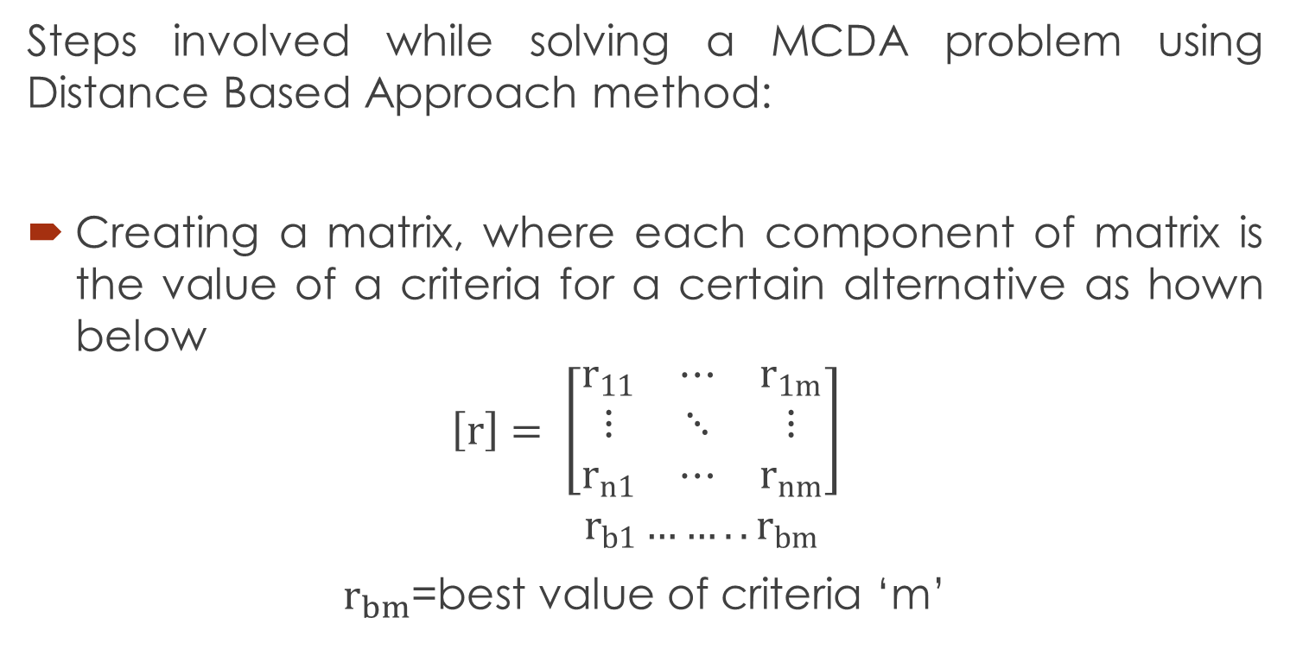
Mathematical Implementation of Distance Based Approach Method
Steps involved while solving a MCDA problem using Distance Based Approach method:
Creating a matrix, where each component of matrix is the value of a criteria for a certain alternative as hown below
$$\left[r\right]= \left[\begin{matrix}r_{11} & ⋯ & r_{1m} \\ ⋮ & ⋱ & ⋮ \\ r_{n1} & ⋯ & r_{nm}\end{matrix}\right] \\ r_{b1}{……..r}_{bm}$$
$r_{bm}$=best value of criteria ‘m’

Slide 9
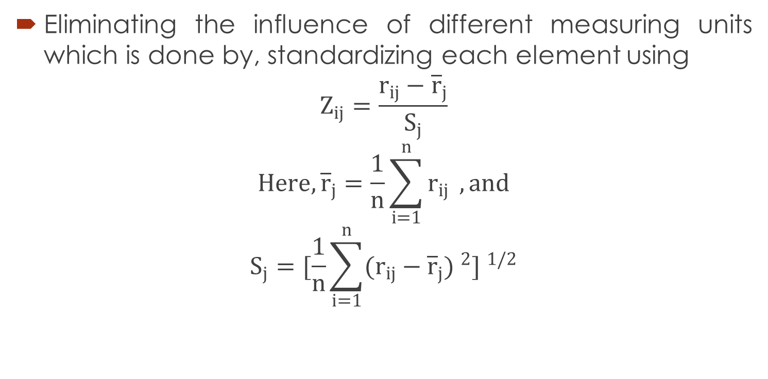
Mathematical Implementation of Distance Based Approach Method
Eliminating the influence of different measuring units which is done by, standardizing each element using
$$Z_{ij}=\frac{r_{ij}−{\overline{r}}_{j}}{S_{j}}$$
$$Here, {\overline{r}}_{j}=\frac{1}{n}\sum_{i=1}^{n}{r_{ij}} , and$$
$$S_{j}=[\frac{1}{n}\sum_{i=1}^{n}{(r_{ij}}−{\overline{r}}_{j}) ^{2}] ^{1/2}$$

Slide 10
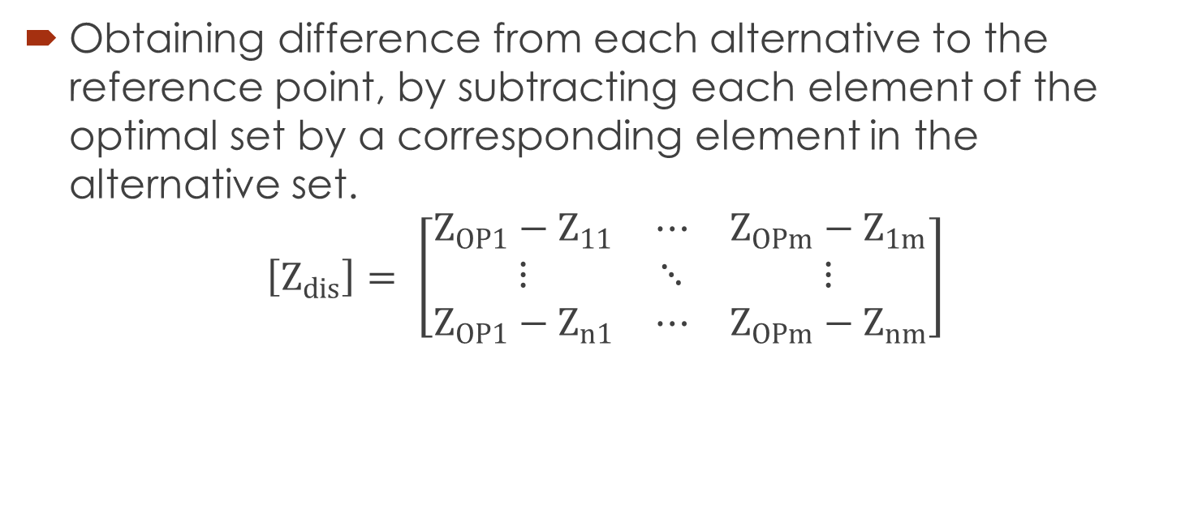
Mathematical Implementation of Distance Based Approach Method
Obtaining difference from each alternative to the reference point, by subtracting each element of the optimal set by a corresponding element in the alternative set.
$$\left[Z_{dis}\right]= \left[\begin{matrix}Z_{OP1}−Z_{11} & ⋯ & Z_{OPm}−Z_{1m} \\ ⋮ & ⋱ & ⋮ \\ Z_{OP1}−Z_{n1} & ⋯ & Z_{OPm}−Z_{nm}\end{matrix}\right]$$

Slide 11
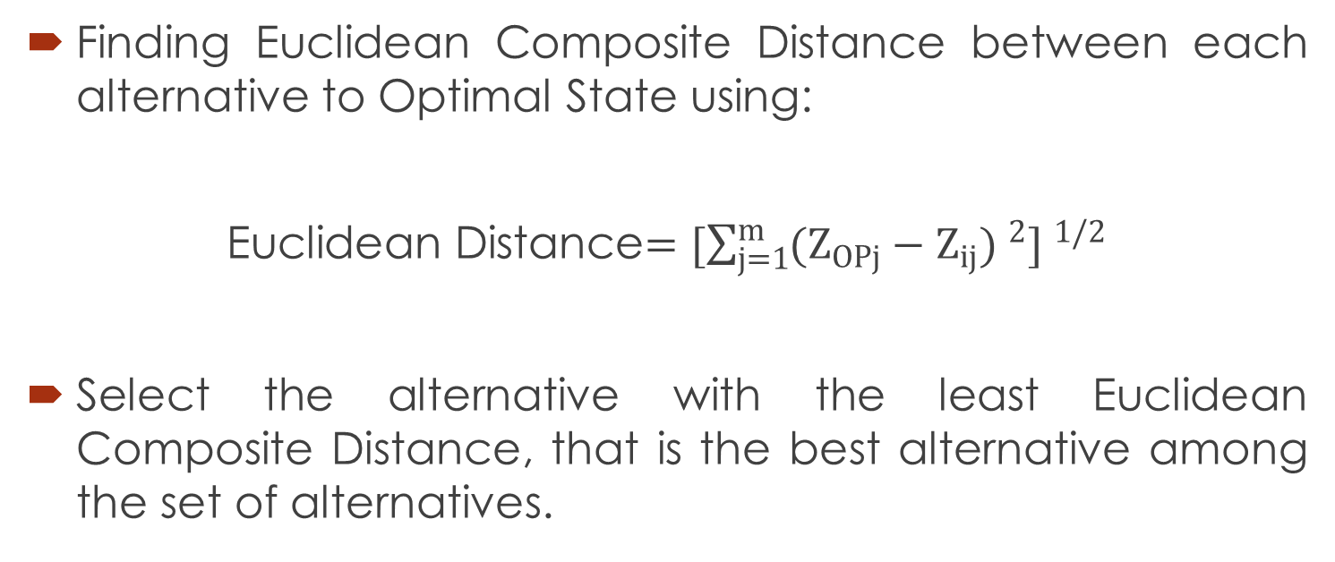
Mathematical Implementation of Distance Based Approach Method
Finding Euclidean Composite Distance between each alternative to Optimal State using:
Euclidean Distance$=[\sum_{j=1}^{m}{(Z_{OPj}}−Z_{ij}) ^{2}] ^{1/2}$
Select the alternative with the least Euclidean Composite Distance, that is the best alternative among the set of alternatives.

Slide 12
Conclusion
This presentation address the issue of optimal selection of the best alternative depending upon various criteria. As soon as a complete set of comparison criteria and alternative are defined, DBA method can be applied to solve the problem. The said method is suitable for ranking alternatives based on number of conflicting criteria, taken all together. The DBA method uses a relatively simple mathematical formulation, for solving complex MCDA problem.

Slide 13
Thank You!

