Slide 1
Group 12
Member: Aditya Tiwari (2016csb1029)
Topic: Optical Character Recognition in scanned documents

Slide 2
Reference: None

Slide 3
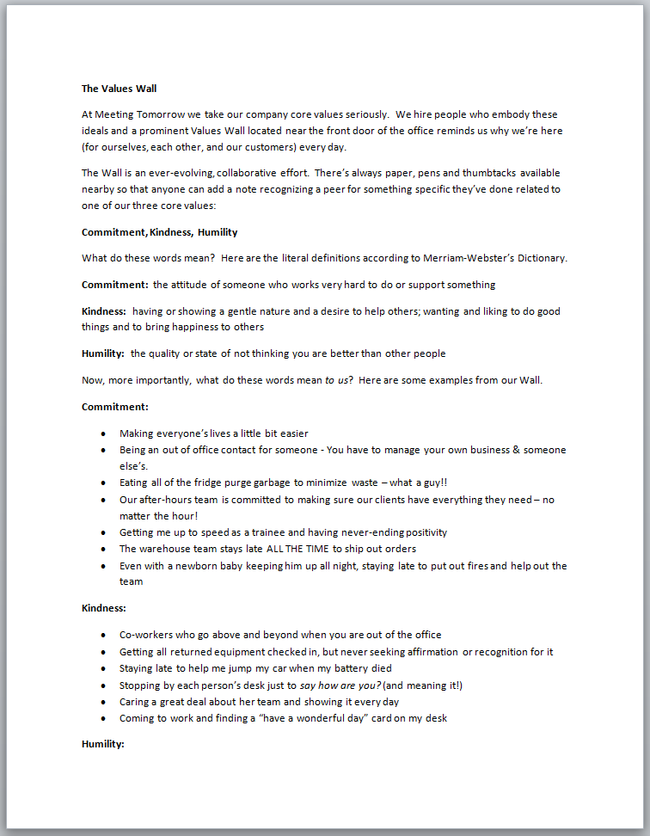
Objective: Given a scanned image of a document, recognize and generate the string as output from the image
Generates:
The Values Wall
At Meeting Tomorrow we take our company core values seriously. We hire people who embody these ideals and a prominent Values Wall located near the front door of the office reminds us why we’re here
(for ourselves,each other and our customers) every day.

Slide 4
Approach intuition :
The basic approach is parse each character separately and then identify each parsed character.
Pre-Processing of image includes
deskewing the image if document wasn’t aligned properly
Smoothen edges
Binarize the image i.e black and white (threshing as done ahead)
Line removal
Segmentation(Parsing) for identifying them

Slide 5
Motivation:
It is common to have articles or printed documents in physical form which are needed in soft form for various purposes(Sending someone in soft form,editing).
Hence text is required from the scanned images of the documents.
That is the main motivation of Optical Character Recognition(OCR).

Slide 6
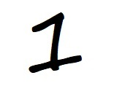



Input forms:
One can provide inputs in form of jpg(strictly) format which have only single character in it out of 0-9 or A-Z not any other character.
Example inputs:

Slide 7
Output
Outputs identified character for the given input image
Example:
1
U
N
X

Slide 8
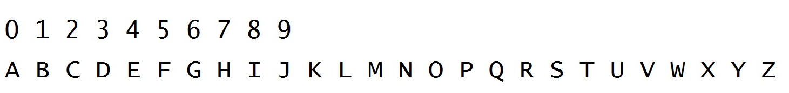
Algorithm:
I have first created a data set of characters 0-9 and A-Z.
Data Set :

Slide 9
Algorithm Continued
For Each input of dataset,I crop it to smallest box that encloses the character and then I thresh and inverse it.
Meaning: if pixel values are less than 200,I make it 0 else 255,So now there are only two pixel values in the image
Then I invert the image : 0->255 and 255->0
Then I generate a mask of that character which some integer values,For mask generation:
Wherever the input character has pixel value 255,mask has a value of 3 at the pixel
Wherever the input character has 4-neighbour pixel value 255, mask has value of 2 at the pixel
Wherever the input character has 8-neighbour pixel value 255,mask has a value 1 at the pixel
Else -1 everywhere

Slide 10
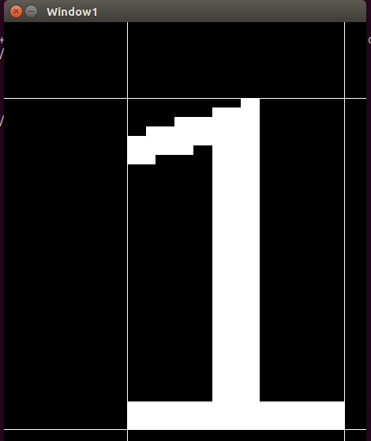
Algorithm Continued
Example Threshed and cropped image.Whatever is inside white lines is in final cropped image.

Slide 11
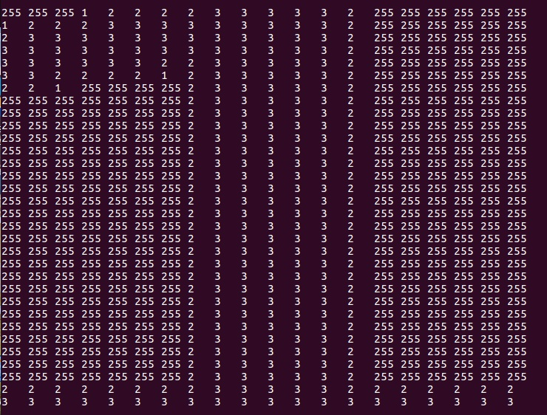
Example Mask :
Character: 1
Wherever it is 255,it is -1, but since uchar data type in opencv c++ doesn’t supports negative integers, I used 255.

Slide 12
Algorithm Continued
Now I resize the input image to the size of mask then I find a integer output by applying the mask on the input image by simply multiplying the input character’s pixel value at a location by mask’s value at that location and adding it all.
Example:
0 | 0 | 0 | 0 | 0
0 | 255 | 255 | 0 | 0
0 | 255 | 0 | 255 | 0
0 | 255 | 255 | 255 | 0
0 | 0 | 0 | 0 | 0
1 | 2 | 1 | 1 | -1
2 | 3 | 3 | 2 | 2
2 | 3 | 2 | 3 | 2
2 | 3 | 3 | 3 | 2
1 | 2 | 2 | 2 | 1
Output:
0x1+0x2+0x1+0x1+0x(-1)+
0x2+255x3+255x3…
… and so on.
=5355
Example Input:
Mask

Slide 13
Algorithm Continued
I store the function output,as well as the character and the mask for each of the character input from data set.
Now given a input character,I find out function output with each of the mask and with whom the answer comes to the closest corresponding function output stored,I return that character.
Intuition of mask:
If the input image is somewhat close to data set,
It shall add to the function output more if it has exactly 255 where the data_set image did i.e multiplier is 3
It shall add less to the function output if it has 255 at a location where data_set had a pixel who had a 4-neighbor with value 255 i.e multiplier is 2. And same 1 for 8-neighbour.
If it has 255 at a location where data set wasn’t even close, it shall decrease function output ,i.e multiplier is -1.

Slide 14
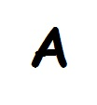
Testing Results(Custom Images Tried):
Successfully Identified as 1 with 40% approx difference to original.
Successfully Identified as 2 with 22.6238% difference to orriginal

Slide 15
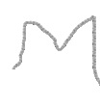

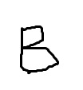
Testing Results Continued:
(Custom Images drawn in paint that aren't identified)
Identified as Y with 83% difference,with M it has 92%
Identified as G with 47% difference ,with E it had 62% approx difference
Identified as 6 with 58% approx difference, with B it has 62% difference.
Note:Above images are drawn by hands in paint and do not belong to any font families

Slide 16
Testing Results
The program identified most of the characters correctly that were of normal fonts with 20-30% difference in some cases 35%. Except for G and C confusions
Most Error are because of inefficient parsing algorithm,it sometimes parses only half of the cropped image,
Example G is cropped to C while creating the data set itself

Slide 17
Improvement Scope
If the images had been pre processed, maybe the above custom images could have been recognized.
Like Dilation to completely connect the image if it wasn’t before like in E above. Dilation could also thicken the image to produce function output more distinct because it now has 255 pixel value at more places,so it will be identified more better.

Slide 18
What I learnt
Number of required pre-processing methods to improve image quality for better identification
Post processing methods like allow words only that belong to english words-match it with set of dictionary and etc.
The Project requires methods of Computer Vision and Deep learning for proper parsing and preprocessing (which is beyond my scope )

