Slide 1
Backup
Notes:
Backup
1

Slide 2
Overview
External backup and restore.
Online backup and restore.
Best Practices.
Notes:
Backup
There are two main backup approaches:
external backup (using third-party OS-level tools)
online backup (using IRIS's built-in mechanism).
2

Slide 3
Items to Backup
Directories:
Database.
External and internal backup options exist.
Installation.
Journal.
Alternate Journal.
Any directory containing external files.
WIJ.
If not under installation directory.
Notes:
Backup
This slide lists everything that should be included in a comprehensive backup strategy. It is not enough to just back up databases — journal files capture all changes to the database in real time, so they are essential for point-in-time recovery. The WIJ (Write Image Journal) is also important as it supports crash recovery. Any external files your application relies on should also be included. If any of these components are stored outside the installation directory, they must be explicitly included.
3

Slide 4

External Backups
Can backup databases using non-InterSystems backup solutions.
Back up IRIS.DAT files only when not being changed.
IRIS.DAT
External Backup
Notes:
Backup
Backup
External backups use non-InterSystems tools — such as OS-level backup software or storage snapshots — to back up the IRIS.DAT database files.
The critical requirement is that IRIS.DAT files must not be actively changing during the backup.
Backing up a live, changing file can result in a corrupted, unrestorable backup. This is why IRIS provides freeze/thaw mechanisms to temporarily pause writes during the backup window.
4

Slide 5
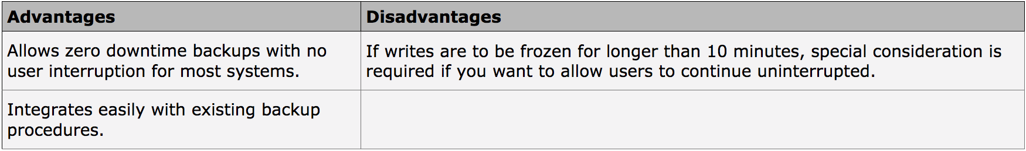
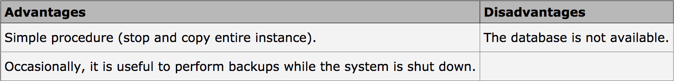
External Backup Approaches
External Backup.
IRIS runs during backup of OS files.
Recommended backup method.
Cold Backup.
IRIS stopped during backup of OS files.
Notes:
Backup
The recommended approach is an External Backup where IRIS continues running — writes are temporarily frozen using the freeze/thaw mechanism, and a snapshot is taken.
A Cold Backup requires stopping IRIS entirely before backing up. While simpler, cold backups cause downtime and are typically only used when necessary, such as during hardware repair.
5

Slide 6
External Backup
Freeze Write Daemon during external backup using methods of Backup.General class.
Use snapshot technology to copy OS files.
Can use with file system copy, if needed.
Allows uninterrupted processing if free global buffers remain during external backup.
1. Prevent writes to database
Backup
2. Do external backup
3. Allow writes
to database
Notes:
Backup
Freeze write daemon using Backup.General class methods, preventing any writes to the database.
While frozen, an external backup tool or file system snapshot captures the IRIS.DAT files.
Once the backup is complete, the Write Daemon is thawed and normal processing resumes.
Depending on free global buffers available, application processing can continue uninterrupted during the freeze, as changes are held in memory until the thaw.
6

Slide 7
External Backup (cont.)
Use methods of Backup.General class:
ExternalFreeze().
ExternalThaw().
Refer to Class Reference for OS examples.
Methods:
Freeze and thaw Write Daemon.
Switch journal file.
Write backup marker to journal file.
Refer to Data Integrity Guide > Backup and Restore for details.
Notes:
The two key methods are ExternalFreeze() and ExternalThaw().
In addition to pausing writes, these methods also switch the journal file and write a backup marker into the journal — both of which are important reference points during a restore. There are OS-specific examples for integrating these calls into backup scripts.
Backup
7

Slide 8
Cold Backup
Only use if application tolerates downtime.
Sometimes used when performing complete system backup as part of repairing faulty hardware.
1. Stop IRIS
Backup
2. Do external backup
3. Start IRIS
Notes:
Backup
A Cold Backup is the simplest form of external backup:
stop IRIS,
copy the files,
restart IRIS.
no risk of the files changing during backup.
However, this approach causes downtime for users. It is typically reserved for situations where the system needs to be taken offline anyway, such as when replacing faulty hardware or performing major system maintenance.
8

Slide 9
Emergency Access During Restoration Process
EA mode ensures no application activity can occur until restore complete.
Windows:
iris start InstanceName /EmergencyId=UserName,Password
UNIX® and Linux: iris start InstanceName EmergencyId=UserName,Password
Can use regular username and any password.
User temporarily escalated into %All role.
Notes:
Emergency Access mode is a special startup mode that prevents regular users from connecting to IRIS while restoration work is being performed. This ensures no application activity can interfere with the restore process.
When started in Emergency Access mode, the specified user is temporarily granted the %All role, giving full administrative access regardless of their normal permissions.
Backup
9

Slide 10
How To: Full Restore Using External Backup
1. Begin with IRIS down.
2. Restore all databases and WIJ from
external backup files.
Replaces all IRIS.DATs and IRIS.WIJ files.
Assumes WIJ backed up with IRIS.DATs.
3. Start in Emergency Access mode.
Instance performs WIJ and journal restore.
Restore any newer journals.
Perform backup validation. (optional)
Perform any other tasks needed. (optional)
4. Restart normally and allow users to
connect.
Notes:
Starting with IRIS down
restore all database files and the WIJ from the backup
Start IRIS in Emergency Access mode, it automatically uses the WIJ to recover any in-flight writes, then applies journal files to bring the databases to a consistent state. Any journals created after the backup was taken can also be applied to minimize data loss. Optional validation and cleanup steps can be performed
Restart IRIS in normal mode
Backup
10

Slide 11
How To: Partial Restore Using External Backup
1. Start in Emergency Access mode.
2. Restore appropriate databases from
external backup files.
Replace appropriate IRIS.DAT files.
3. Restore journals for restored databases.
Determine correct journal file to start with.
Check Messages Log for recommended file.
Perform backup validation. (optional)
Perform any other tasks needed. (optional)
4. Restart normally and allow users to
connect.
Notes:
A partial restore is used when only some databases have been lost or corrupted, while others remain intact.
The process is similar to a full restore, but you only replace the affected IRIS.DAT files. When restoring journals, you need to carefully determine the correct starting journal file — the Messages Log will indicate the recommended file. It is important not to apply journals intended for the surviving databases, as this could cause inconsistencies.
Backup
11

Slide 12
WIJ in External Backup Restores
Full System Restore:
If WIJ available:
Can automatically restore journals based on WIJ pointers.
If WIJ unavailable:
Must manually restore journals.
Refer to Data Integrity Guide > Backup and Restore.
Partial System Restore:
Databases that survived crash require current WIJ for proper recovery.
Do not apply current WIJ to restored databases.
Do not restore backed-up WIJ.
Notes:
Backup
Backup
In a full system restore where the WIJ is available, IRIS can use the pointers in the WIJ to automatically determine which journals to apply.
If the WIJ was lost, journal restoration must be done manually.
For partial restores, the situation is more complex — databases that survived the crash already have the current WIJ applied to them, so you must not apply the current WIJ or the backed-up WIJ to the restored databases, as this would cause conflicts.
12

Slide 13
Restore and Transactions
For transactional consistency, must apply journals after database restore.
Without restoring journals, can have open transactions.
If post-backup journal files not available, apply pre-backup journal files.
Allows IRIS to determine open transactions starting with those journal files.
Permits rollback of those open transactions.
Determine number of pre-backup journal files to apply based on application.
Usually no more than one day prior to backup.
Notes:
Simply restoring a database from backup is not sufficient for transactional consistency. Any transactions that were open at the time of the backup would be incomplete in the restored database. By applying journal files after the restore, IRIS can identify and roll back those open transactions, leaving the database in a clean, consistent state. If post-backup journals are not available, applying pre-backup journal files still allows IRIS to identify open transactions. The number of pre-backup journal files to apply depends on the application, but is typically no more than one day's worth.
Backup
13

Slide 14
Online Backup
InterSystems backup mechanism.
Application continues to run during backup.
Only backs up IRIS.DAT files.
Backup and restore slower than external backup.
IRIS.DAT
Backup
File
Backup
Notes:
Backup
Online Backup is IRIS's built-in backup mechanism. Unlike external backup, it does not require any special OS-level tools or freeze/thaw scripting — it is entirely managed within IRIS. The application continues running normally during the backup. The trade-off is that online backup is slower than external backup because it works at the database block level rather than at the file system level. It only backs up IRIS.DAT files and writes the backup to a .cbk file.
14

Slide 15
Multiple Backup Passes
Allow consistent snapshot of database at point in time.
Users continue uninterrupted.
First pass backs up all blocks.
Begin tracking any blocks changing from this point.
Second…nth pass, including final pass.
Backup blocks changed during previous pass.
During final pass, Write Daemon freezes, and thaws after final pass completes.
Typically, three passes are sufficient.
Notes:
Backup
Online backup uses a multi-pass approach to ensure a consistent snapshot of the database while users continue working.
In the first pass, all currently allocated blocks are backed up. From that point, IRIS tracks any blocks that are modified.
Subsequent passes back up those changed blocks. This continues until the number of changed blocks is small enough that a final pass can complete quickly.
During the final pass, the Write Daemon briefly freezes to ensure the last set of changes is captured cleanly, then immediately thaws. In practice, three passes are usually sufficient.
15

Slide 16
Types of Backup
Full.
Complete backup of database.
Cumulative.
Tracks all changes since last full backup.
Incremental.
Tracks all changes since last backup, regardless of previous backup type.
Notes:
Backup
IRIS online backup supports three types. A Full backup captures all allocated blocks in the selected databases and is self-contained — you only need it to restore. A Cumulative backup captures all changes since the last Full backup, so it grows over time as more changes accumulate. An Incremental backup captures only changes since the last backup of any type, making it the smallest and fastest — but to restore, you need the full chain of incrementals since the last Full or Cumulative.
16

Slide 17
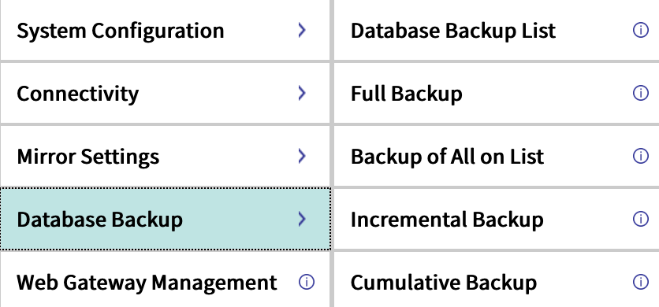
How To: Configure Backup
Create Database List.
System Administration > Configuration > Database Backup > Database Backup List.
%SYS>do ^BACKUP.
Notes:
Backup
Before running a backup, you need to configure which databases to include. This is done by creating a Database Backup List through the Management Portal. Alternatively, the ^BACKUP routine can be run directly from the terminal in the %SYS namespace. The backup list allows you to define a subset of databases rather than backing up everything.
17

Slide 18
How To: Configure Backup (cont.)
Configure location for backup file.
System Administration > Configuration > Database Backup > Choose appropriate type of backup.
^BACKUP routine prompts for location.
Notes:
Backup
Once the database list is configured, you need to specify where the backup file should be saved. This is done through the Management Portal under the appropriate backup type configuration. When using the ^BACKUP terminal routine, it will interactively prompt you for the backup file location. Make sure the target directory exists and has sufficient disk space before running the backup.
18

Slide 19
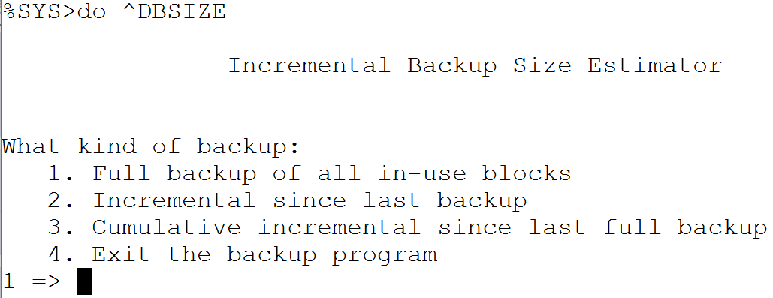
How To: Estimate Backup Size
%SYS>do ^DBSIZE.
Notes:
Backup
Before running a backup, it is good practice to estimate how large the backup file will be so you can ensure sufficient disk space is available in the target directory. The ^DBSIZE routine provides this estimate. Run it from the %SYS namespace and it will calculate the estimated size based on the current contents of the selected databases.
19

Slide 20
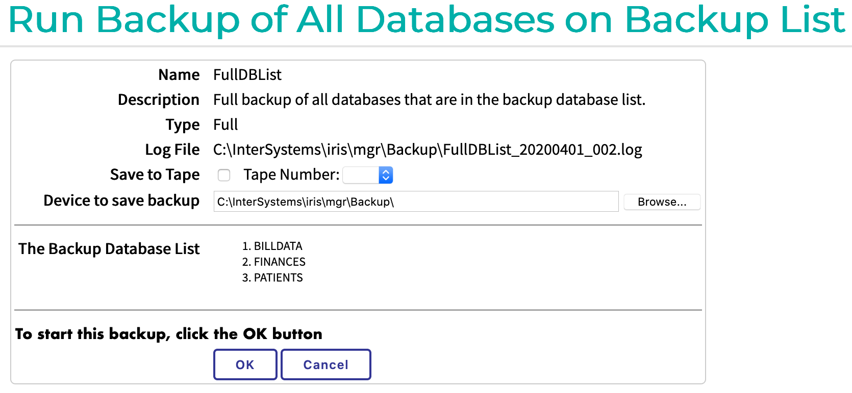
How To: Run a Backup
System Operation > Backup > Choose appropriate type of backup.
%SYS>do ^BACKUP.
Notes:
Backup
Once the backup is configured, it can be run either through the Management Portal under System Operation > Backup, or directly from the terminal using the ^BACKUP routine. Both methods will execute the backup based on the previously configured settings. For scheduled or automated backups, the Task Manager can be used to run these on a regular schedule.
20

Slide 21
How To: Review Backup Results
Management Portal.
While running:
System Operation > Backup > Run Backup > Click here to view status.
After backup:
System Operation > Backup > Backup History > Click View for backup.
Log created during backup.
Using %SYS>do ^BACKUP:
No log provided but can turn on logging for Terminal session.
File > Logging.
Notes:
Backup
After a backup runs, you should verify it completed successfully. Through the Management Portal, you can view the status while a backup is running, or review the history of completed backups afterward. Each backup generates a log that details what was backed up, any warnings, and whether it completed successfully. When running ^BACKUP from the terminal, logging is not enabled by default, but you can turn on session logging via the File > Logging menu option to capture the output.
21

Slide 22
Backup Files
TypeofBackup_Date_Number.cbk
FullDBList_20250401_001.cbk
Backup files not automatically purged from OS.
Monitor available space in backup directory.
Delete or move files as needed.
Notes:
Backup files are named using a standard convention that includes the backup type, date, and a sequence number — for example, FullDBList_20250401_001.cbk. The .cbk extension stands for Cache/IRIS BacKup. Importantly, IRIS does not automatically delete old backup files — it is your responsibility to monitor the backup directory and manage disk space by deleting or archiving old files according to your retention policy.
Backup
22

Slide 23
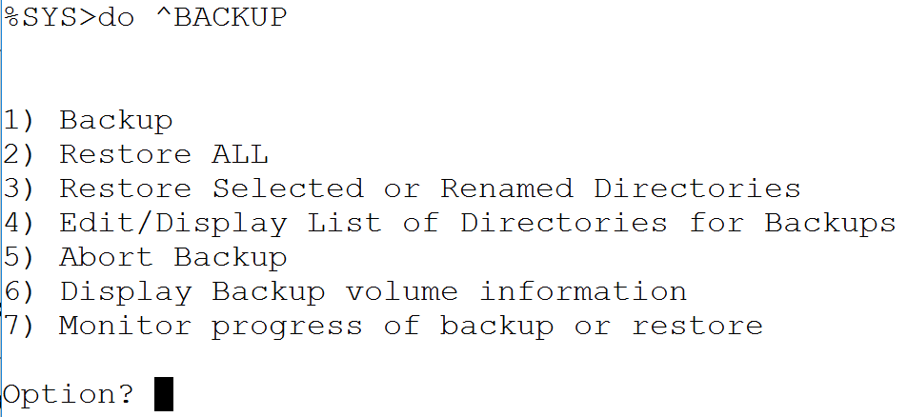
How To: Restore using ^BACKUP
%SYS>do ^BACKUP.
Select option:
Restore ALL.
Restore Selected.
Notes:
Backup
To restore from an online backup, run the ^BACKUP routine from the %SYS namespace and select one of the restore options. Restore ALL will restore all databases contained in the backup file. Restore Selected allows you to choose specific databases to restore, which is useful for partial restores where only some databases need to be recovered.
23

Slide 24
Restoring from Online Backup
No users should be on system.
Restore backups:
Last full backup of each database that is no longer accessible.
Last cumulative backup since full backup.
All incremental backups since full backup or last cumulative backup in the order in which backups were performed.
Notes:
Backup
Before starting a restore from an online backup, ensure no users are connected to the system to prevent interference. The restore process follows a specific order: first apply the last full backup of each affected database, then the last cumulative backup since that full backup, and finally all incremental backups in the order they were taken. Skipping any file in the incremental chain will result in an incomplete restore.
24

Slide 25
Restoring from Online Backup (cont.)
Apply changes in journal files for restored databases.
Without restoring journals, can have open transactions.
Perform database and application integrity checks.
Perform full backup of restored system.
Notes:
Backup
Restoring the backup files alone is not enough. Just as with external backup restores, journal files must be applied to ensure transactional consistency and to roll back any open transactions that existed at the time of the backup. After journals are applied, database and application integrity checks should be run to confirm the restored data is valid. Finally, a fresh full backup should be taken of the newly restored system to establish a clean new baseline.
25

Slide 26
Online Restore Process
To begin, restore process will prompt for:
Whether to suspend processes while restoring takes place.
Recommended.
Full backup file from which to restore.
Can restore database to:
Original directory.
Different directory.
Notes:
Backup
When the restore process begins, it will ask whether to suspend other processes during the restore — this is recommended to prevent any interference. It will then prompt for the full backup .cbk file to start from. The restore process is flexible in that it can restore databases to their original directory path or to a different directory, which is useful if you are restoring to a different server or a different disk location.
26

Slide 27
Online Restore Process (cont.)
After full backup file restored, restore process will prompt for:
Next backup file(s) to restore.
Uses backup history to suggest next logical backup file.
After all backup files are restored, restore process will prompt for:
Databases for journal restore.
Name of first journal file to restore.
Can choose to restore only some globals from journal file.
Name of last journal file to restore.
Notes:
Backup
After the full backup file is restored, the process will guide you through restoring subsequent backup files. IRIS uses its backup history to suggest the next logical file in the chain, helping to ensure you apply them in the correct order. After all backup files are restored, the process moves to journal restore — you will be prompted for the first and last journal files to apply. You can also choose to restore only specific globals from the journal files if needed.
27

Slide 28
Online Restore Process (cont.)
If any open transactions still exist after all journal files are restored, restore process will prompt:
To rollback open transactions.
Notes:
Backup
If there are still open transactions remaining after all journal files have been applied, the restore process will detect this and prompt you to roll them back. Rolling back open transactions is necessary to leave the database in a clean, consistent state. This is an automatic part of the restore process — IRIS identifies the incomplete transactions from the journal files and reverses their changes.
28

Slide 29
How To: Full Restore Using Online Backup
Used when all or most storage is unusable.
Requires secondary instance of IRIS.
Cannot perform full restore on running instance.
Recommended to install secondary instance ahead of time.
Shut down unless needed for restore.
Notes:
A full online restore cannot be performed on a running IRIS instance — you need a secondary IRIS instance to perform the restore on behalf of the primary instance. It is recommended to set up this secondary instance in advance and keep it on standby, shutting it down when not needed for a restore. This approach is used when all or most storage for the primary instance is unusable and needs to be rebuilt from backup.
Backup
29

Slide 30
How To: Full Restore Using Online Backup (cont.)
1. Restore file system.
2. Using secondary instance, perform restores for databases and journals for primary instance.
3. Shut down secondary instance.
4. Remove WIJ for primary instance.
5. Start primary instance in Emergency Access mode.
Perform backup validation. (optional)
Perform any other tasks needed. (optional)
6. Restart primary instance normally and allow users to connect.
Notes:
This slide walks through the full restore procedure using a secondary IRIS instance. The file system is restored first, then the secondary instance performs the database and journal restores for the primary instance's files. The secondary instance is then shut down, the primary instance's WIJ is removed, and the primary is started in Emergency Access mode to finalize recovery. Optional validation steps can be performed before restarting normally to allow users to connect.
Backup
30

Slide 31
How To: Partial Restore Using Online Backup
1. Start in Emergency Access mode.
2. Restore databases and journals.
Perform backup validation. (optional)
Perform any other tasks needed. (optional)
3. Restart normally and allow users to
connect.
Notes:
A partial online restore is simpler than a full restore. Because only some databases are affected, IRIS can still be running — you start in Emergency Access mode to prevent user interference, restore only the affected databases and their journals, perform any validation, then restart normally. This is appropriate when a subset of databases has been lost or corrupted but the rest of the system is intact.
Backup
31

Slide 32
Good Backup Practices
Clearly mark backups.
Define backup strategy, such as:
Keep daily backups for two weeks.
Keep weekly backups for two months.
Keep monthly backups for six months.
Keep quarterly backups for nine months.
Test restores on regular basis.
Restore full, incremental and/or cumulative to alternate server.
Run integrity check.
For Disaster Recovery:
Store backups in secure off-site location.
Notes:
Backup
This slide summarizes best practices for maintaining a reliable backup strategy. Backups should be clearly labelled so they can be quickly identified during a recovery situation. A retention policy should define how long different backups are kept — a common tiered approach keeps daily backups for two weeks, weekly for two months, monthly for six months, and quarterly for nine months. Critically, restores should be tested regularly on an alternate server to confirm that backups are actually recoverable. For disaster recovery, backup media should be stored in a secure off-site location.
32

Slide 33
Suggested Readings
Developer Community Article:
InterSystems Data Platforms and performance – VM Backups and Caché freeze/thaw scripts
Data Integrity Guide > Backup and Restore.
High Availability Guide > Failover Strategies for High Availability.
Notes:
This slide points to additional reading materials. The Developer Community article covers VM-level backup considerations and freeze/thaw scripting. The Data Integrity Guide Backup and Restore chapter is the authoritative reference for all the topics covered in this module. The High Availability Guide Failover Strategies chapter provides context on how backup fits into a broader availability and disaster recovery strategy.
Backup
33

Slide 34
Summary
What are the key points for this module?
Notes:
Backup
This is the summary slide for the module. Key takeaways include: the difference between external and online backup approaches; the importance of journaling for transactional consistency during restores; the three types of online backup (full, cumulative, incremental) and how they chain together for restore; how to configure, run, and verify backups in IRIS; and best practices for maintaining a trustworthy backup and recovery strategy.
34

