Slide 1
Project:
Text Emotion Detection
PRESENTED BY:
Aditya Menariya

Slide 2

TEXT EMOTION DETECTION
What is emotion ?
Emotion is a strong feeling, such as happiness, sadness, anger, or fear, that comes from a person's mood, experiences, or relationships. It affects how we think, act, and communicate with others.

Slide 3
Objective
Text Emotion Detection is a focused on identifying and analyzing the emotions expressed in textual data. By examining words, phrases, and sentence structures, this process aims to determine the emotional tone—such as happiness, anger, sadness, fear, or surprise—embedded in the text.
This project focuses on analyzing text data to detect and classify emotions using machine learning techniques

Slide 4
Libraries Used:
- pandas
- numpy
- matplotlib
- seaborn
- wordcloud
- nltk
- sklearn

Slide 5
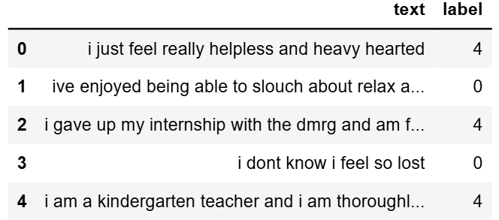
Dataset Overview
Label description
Sadness 0
Joy 1
Love 2
Anger 3
Fear 4
surprise 5
The dataset consists of:
- Text data (phrases/sentences)
- Emotion labels (e.g., happy, sad, angry).

Slide 6
Exploratory Data Analysis
EDA includes:
- Distribution of emotions
- Word clouds for each emotion category Frequency .

Slide 7
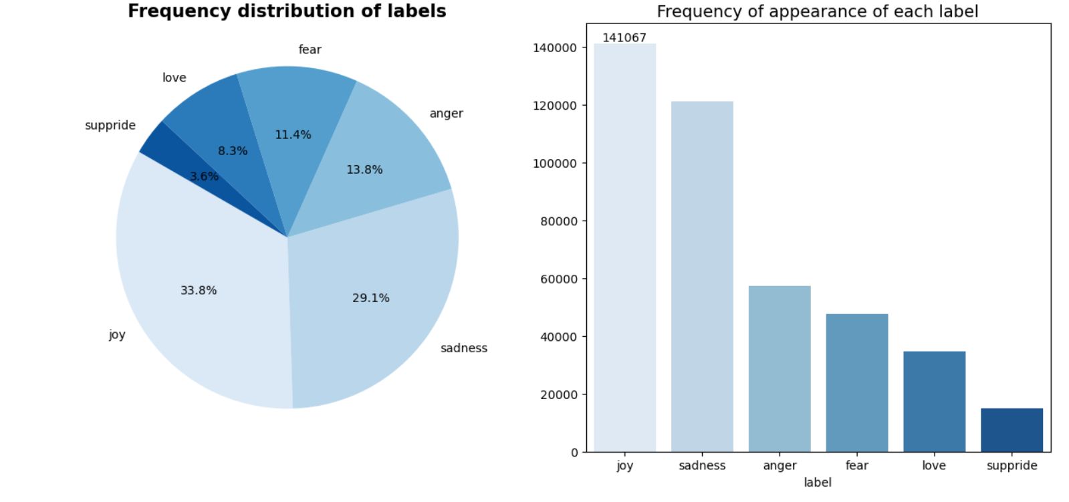
Visualize the frequency of each label

Slide 8
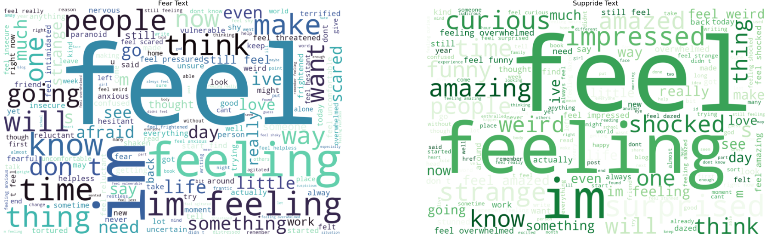
Visualize Word Cloud A Word Cloud is a visual representation of textual data where the size of each word indicates its frequency or importance in the text.

Slide 9
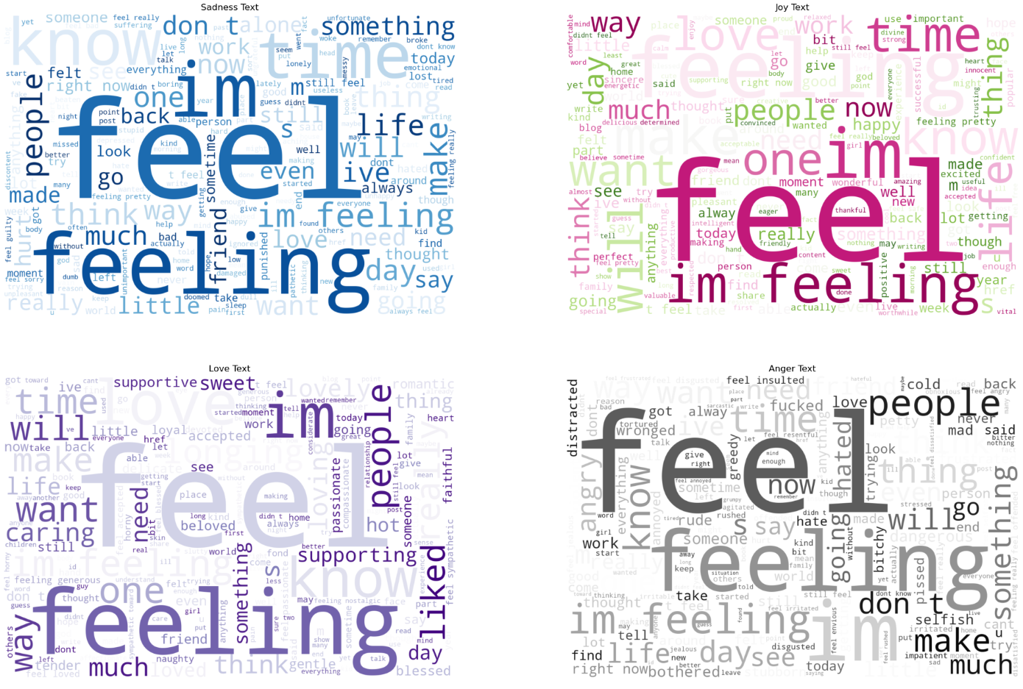

Slide 10
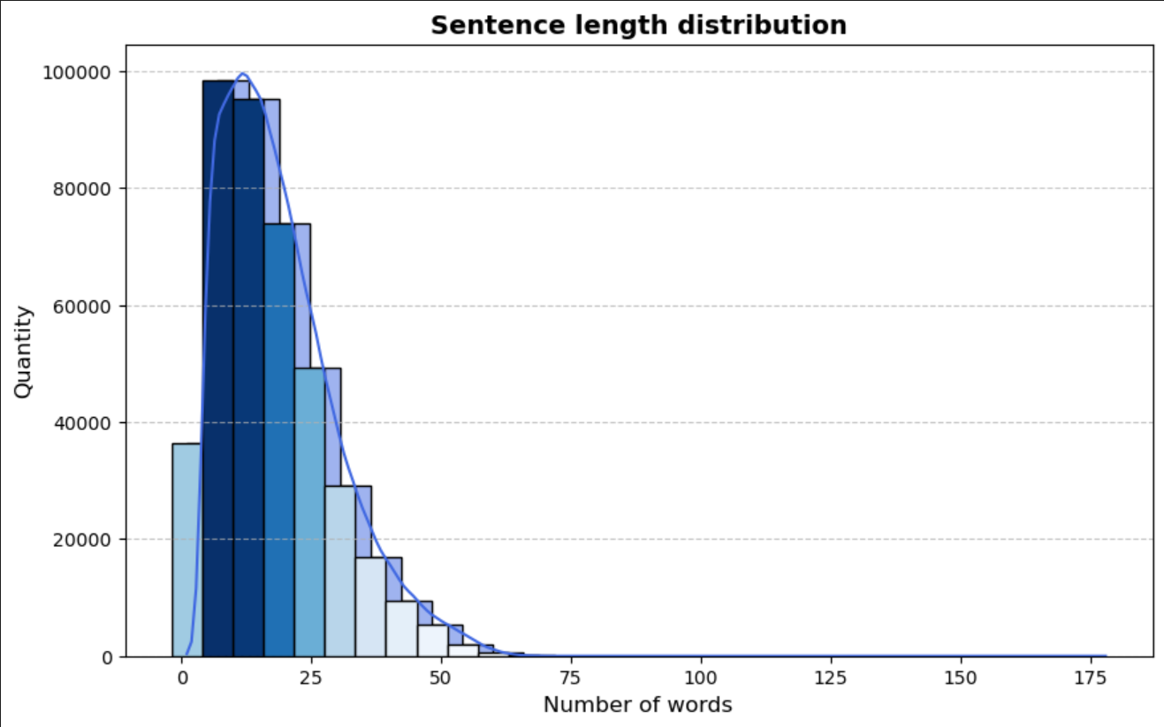
Sentence Length Distribution

Slide 11
Data Cleaning and Preprocessing
The text data undergoes:
Conversion to lowercase.
Remove punctuation
Tokenization
Stopword removal
Lemmatization
Vectorizer Tf-idf

Slide 12
Model Approach
Machine Learning algorithms:
- Logistic Regression
- Naïve Bayes Classifier
- LinearSVC

Slide 13
Model Selection
Linear SVC
Accuracy : 89%
Naïve Bayes classifier
Accuracy :79%
Logistic Regression
Accuracy :90%

Slide 14
Model Evaluation
Each model was evaluated based on metrics such as accuracy, precision, and recall.
Key insights from evaluation:
- Highest accuracy achieved by [Logistic Regression]
- Detailed analysis of model performance

Slide 15
Conclusion
Emotion detection is feasible with NLP.
Results depend on data quality and preprocessing.
NLP makes it easier to analyze large amounts of text data for emotions.

Slide 16


