Slide 4



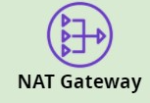


AWS
VPC
ALB
Public Route Table
Public Route Table
ASG
Public subnet-1
Public subnet-2
Private Route Table
Private Route Table
Private subnet-1
Private subnet-2
Availability zone -1
Availability zone -2
AWS Region

