Slide 1





PRESENTS
A Fest Where the Universe Comes Alive
18th–21st February 2027
A Masters' Union University Fest
Masters' Union University, Gurugram · Yashobhoomi Convention Centre, Delhi
SPONSORSHIP 2027
Notes:
Milky Way, presented by Masters' Union University. A Fest Where the Universe Comes Alive. 18th–21st February 2027: 18th–19th February 2027 at Masters' Union University, Gurugram, India; 20th–21st February 2027 at Yashobhoomi Convention Centre, Delhi, India.

Slide 2


1L+ GenZs,
Under One Sky,
And You Light it Up.
LANDING AT
YASHOBHOOMI, DELHI
Notes:
1L+ GenZs, Under One Sky, And You Light it Up. The festival lands at Yashobhoomi, Delhi.

Slide 3

We are Building Asia's Largest College Festival, and We Want You to Shape it With Us.
MASTERS' UNION UNIVERSITY'S CULTURAL FEST
From our classrooms to a cultural experience like never before
2L+
250+
70+
7
student registrations
target colleges
events
cities
Notes:
Masters' Union University's Cultural Fest. We are Building Asia's Largest College Festival, and We Want You to Shape it With Us. From our classrooms to a cultural experience like never before.

Slide 4





It's bands, gaming, performing arts and informals all day long.
And when the sun goes down, the pronites begin.
BANDS
GAMING
PERFORMING ARTS
INFORMALS
PRONITES
We are bringing the brightest stars from across India into one arena of music, competition and culture.
Notes:
It's bands, gaming, performing arts and informals all day long. And when the sun goes down, the pronites begin. We are bringing the brightest stars from across India into one arena of music, competition and culture.

Slide 5
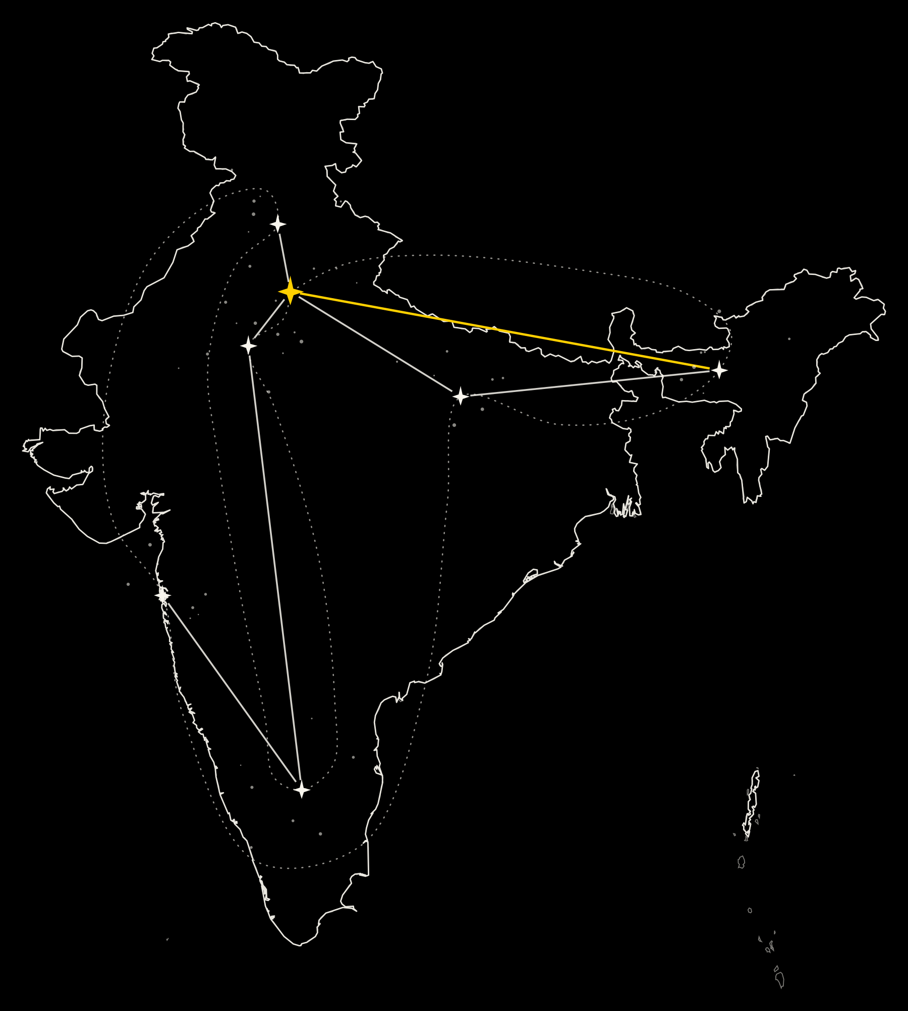
The Journey
ROAD TO MILKY WAY
Before Delhi, there's a whole universe to cover
04 CHANDIGARH
01 DELHI
Road to Milky Way brings one signature experience to each city on the map, free for UG students across India.
02 JAIPUR
07 GUWAHATI
06 VARANASI
Seven cities. Seven nights nobody forgets. Then everyone meets in Delhi.
05 MUMBAI
03 BANGALORE
Ride the full journey with us, from the first city to the final night in Delhi.
Notes:
Road to Milky Way brings one signature experience to each city on the map, free for UG students across India. Seven cities. Seven nights nobody forgets. Then everyone meets in Delhi. The cities, in order: Delhi, Jaipur, Bangalore, Chandigarh, Mumbai, Varanasi, Guwahati; then everyone meets in Delhi, at Yashobhoomi.

Slide 6
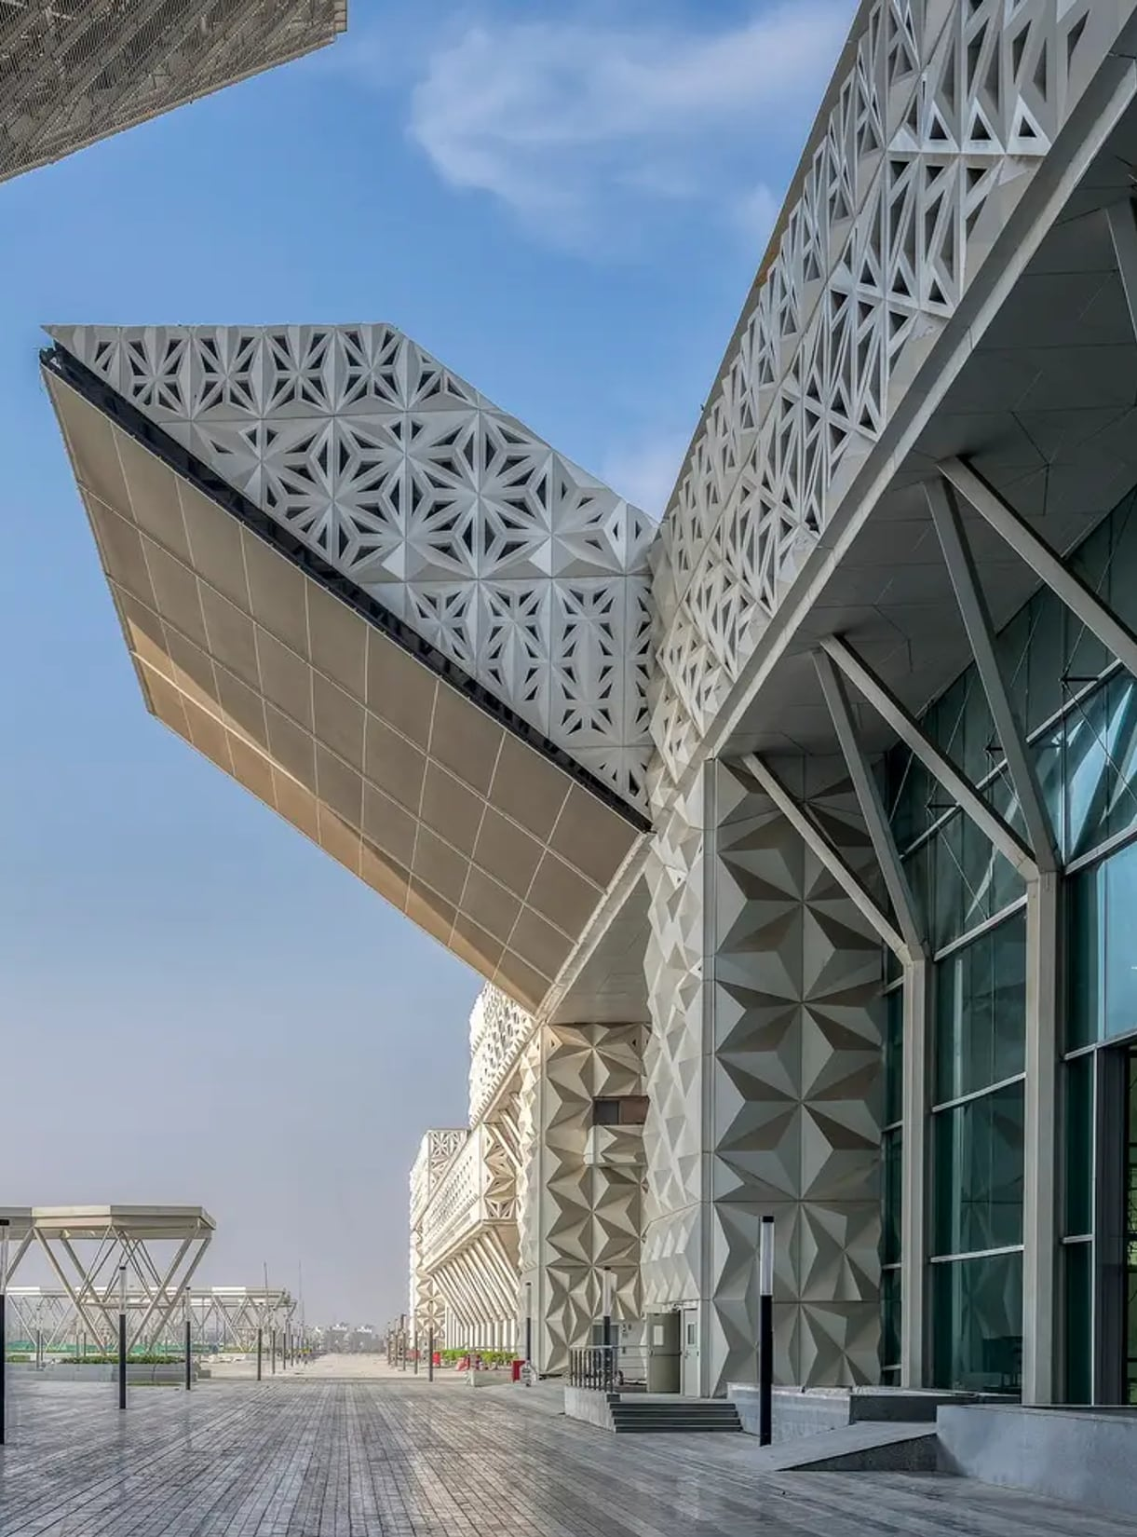
The Venue
THE MAIN FESTIVAL
Yashobhoomi, Delhi
Booked for 20th–21st February 2027
One of India's Most Sought After Spaces
Notes:
The main festival: Yashobhoomi, Delhi. Booked for 20th–21st February 2027. One of India's Most Sought After Spaces.

Slide 7

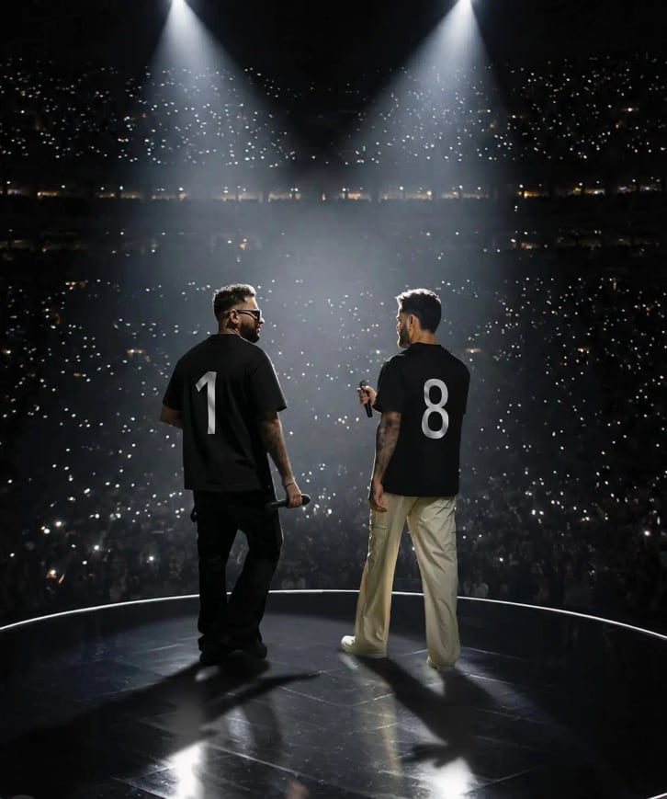
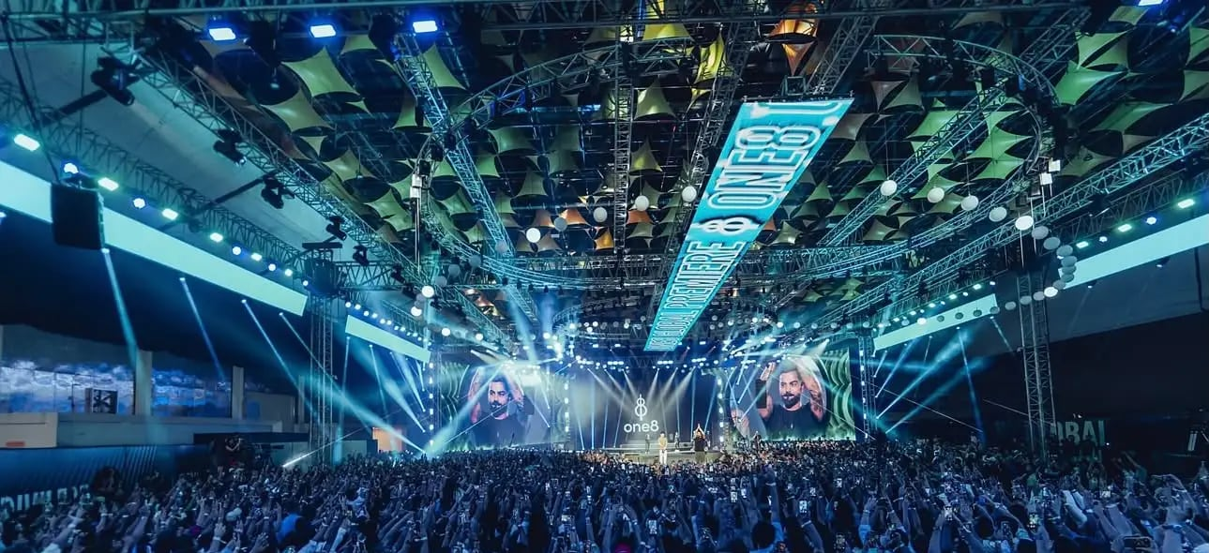
We are making room for something memorable
With competitions, performances, branded experiences that draw students in.
Notes:
We are making room for something memorable. With competitions, performances, branded experiences that draw students in.

Slide 8
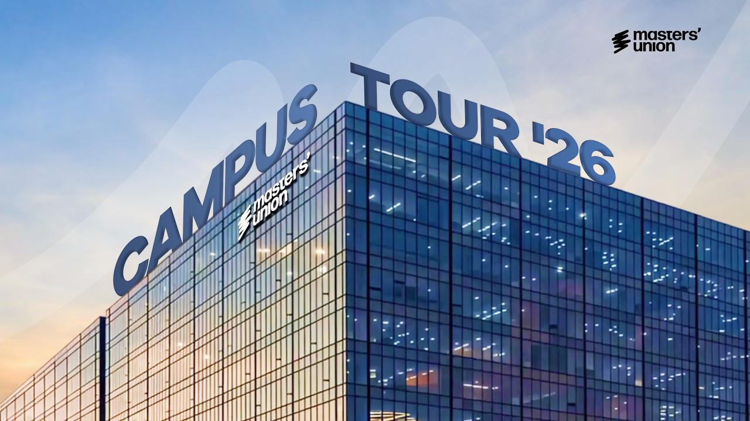

18th–19th February 2027
TWO DAYS ON CAMPUS
MASTERS' UNION UNIVERSITY ✱ GURUGRAM, INDIA
TWO DAYS ON CAMPUS
18TH–19TH FEBRUARY 2027
MASTERS' UNION UNIVERSITY ✱ GURUGRAM, INDIA
THE MAIN FESTIVAL
20TH–21ST FEBRUARY 2027
YASHOBHOOMI CONVENTION CENTRE ✱ DELHI, INDIA
Masters' Union Campus Tour 2026 · watch on YouTube
Notes:
Two days on campus: 18th–19th February 2027 at Masters' Union University, Gurugram, India. The campus tour: youtube.com/watch?v=N5Crw6YCkSU

Slide 9
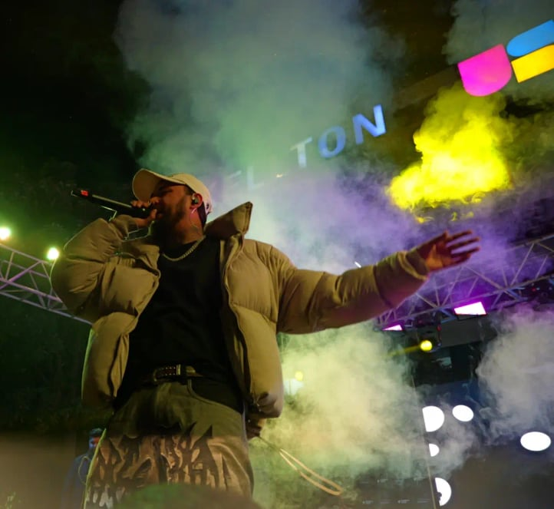
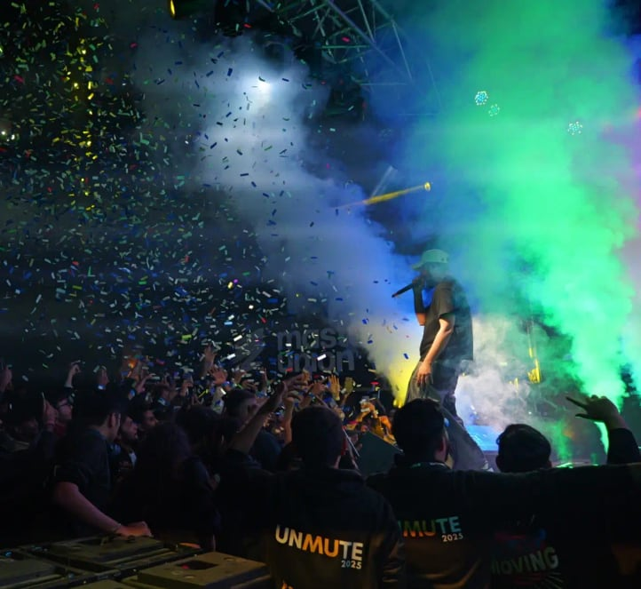
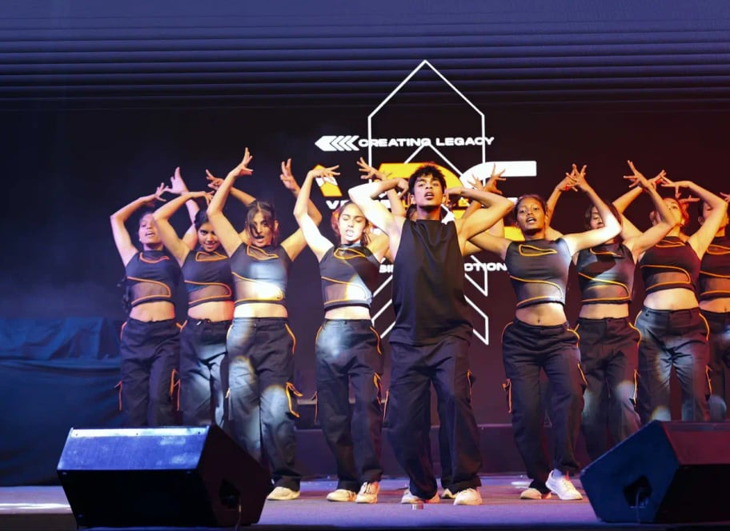
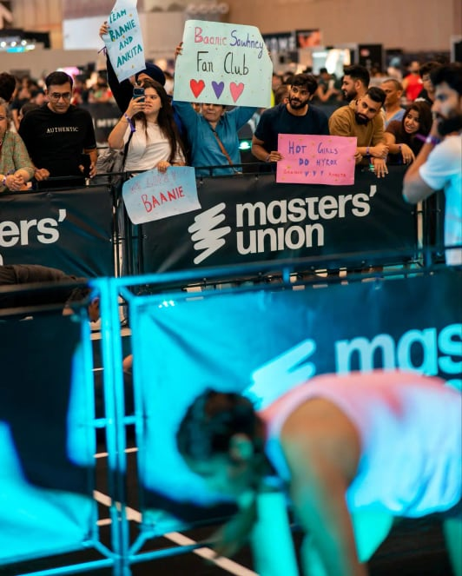
The Audience
They’re finding themselves.
Their tastes.
Their next favourite brands.
College students between 18 to 22 are coming together around what they love.
Notes:
They’re finding themselves. Their tastes. Their next favourite brands. College students between 18 to 22 are coming together around what they love.

Slide 10

Your brand can be part of their experience
THROUGH A PRODUCT THEY TRY,
AN EXPERIENCE THEY JOIN
OR A COMPETITION YOU HELP BRING TO LIFE.
Notes:
Your brand can be part of their experience, through a product they try, an experience they join or a competition you help bring to life.

Slide 11
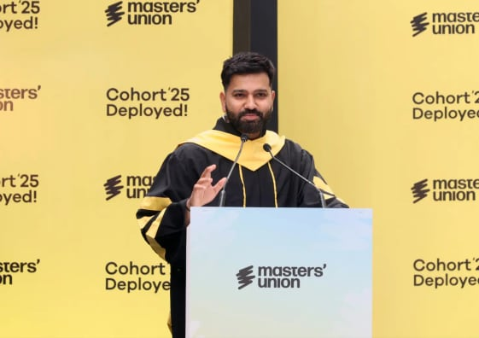
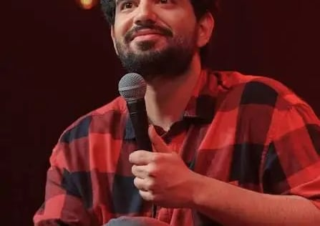
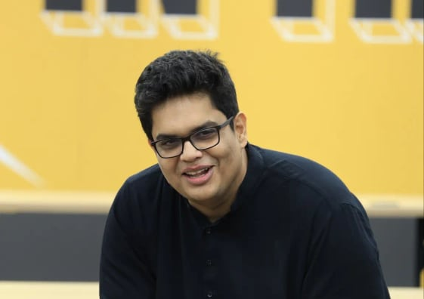
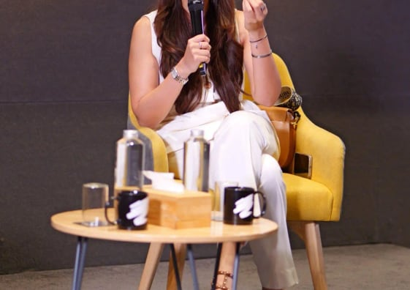

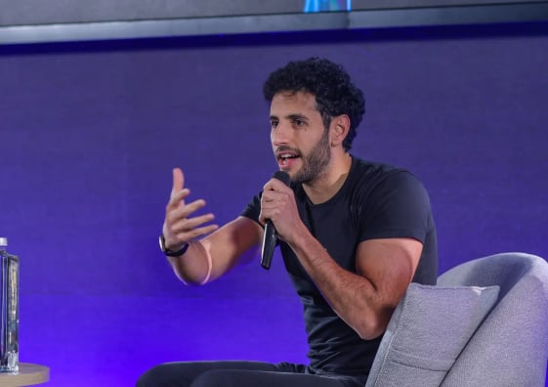
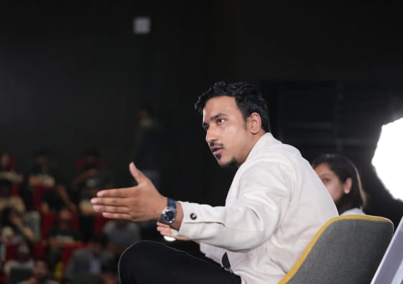
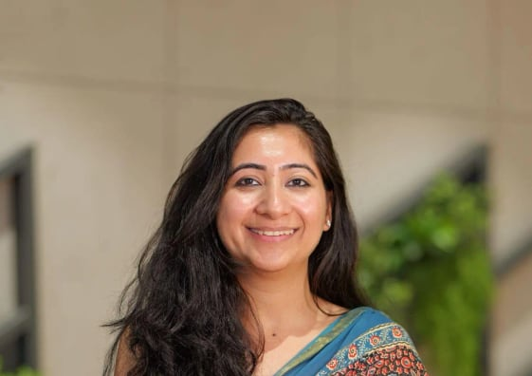
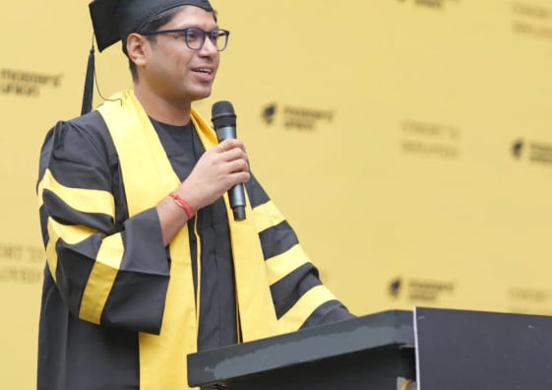
We’ve Learned From the Best
Guests who have spoken at Masters' Union
Rohit Sharma
Samay Raina
Tanmay Bhat
Sahiba Bali
Nuseir Yasin
Ganeshprasad Sridharan
Dr. Nandini Seth
Peyush Bansal
Notes:
Guests at Masters' Union: Rohit Sharma, Samay Raina, Tanmay Bhat, Sahiba Bali, Nuseir Yasin, Ganeshprasad Sridharan, Dr. Nandini Seth, Peyush Bansal.

Slide 12
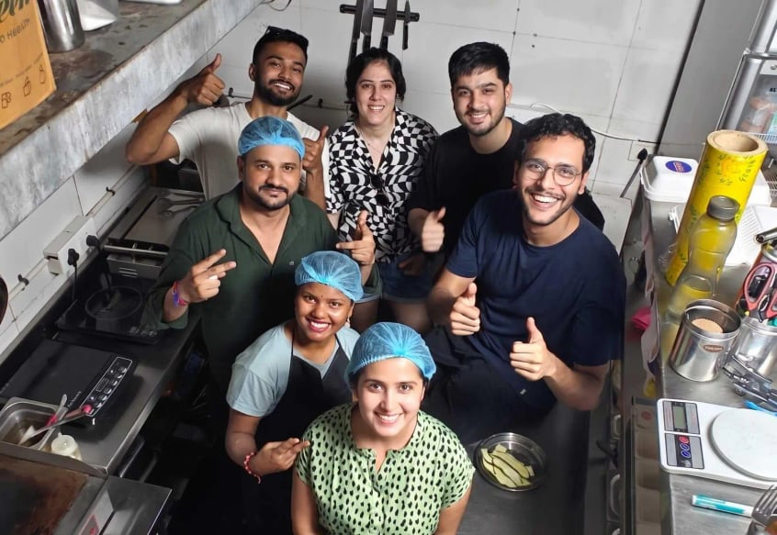
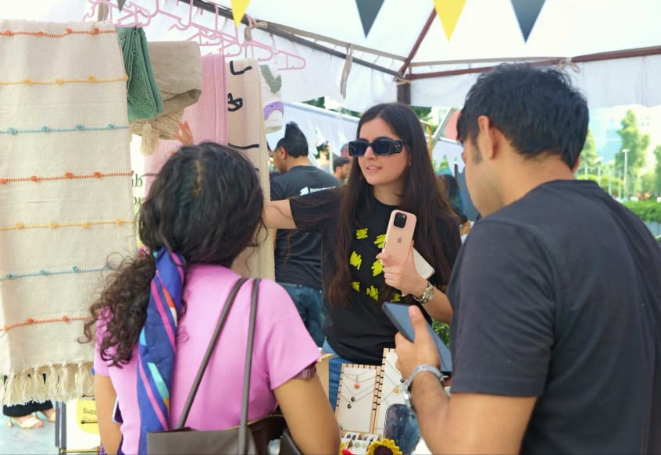
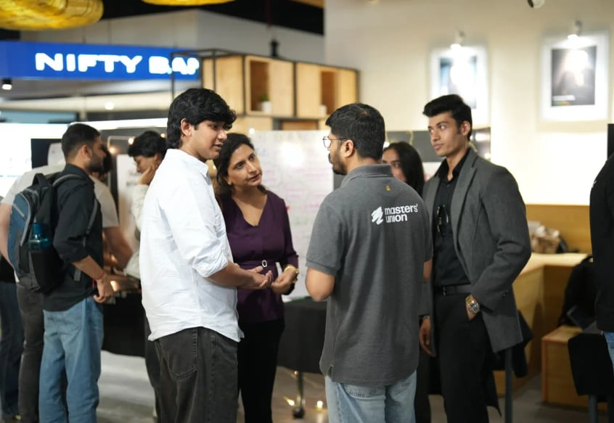
Pulled Off Our Firsts
Lexi's Gourmet Sandwiches
The Dropshipping Mela
Masters' Union Investment Fund
40+
₹1.2 crore+
₹5 crore
Student-built startups
Cumulative revenue through Dropshipping Melas
Live student-managed investment fund
Notes:
40+ Student-built startups (Lexi's Gourmet Sandwiches). ₹1.2 crore+ Cumulative revenue through Dropshipping Melas (The Dropshipping Mela). ₹5 crore Live student-managed investment fund (Masters' Union Investment Fund).

Slide 13
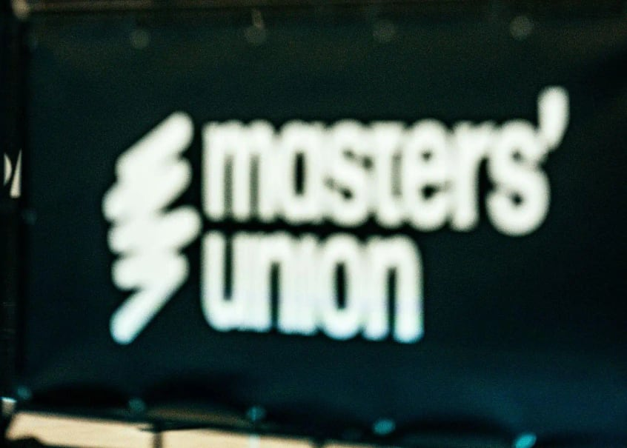
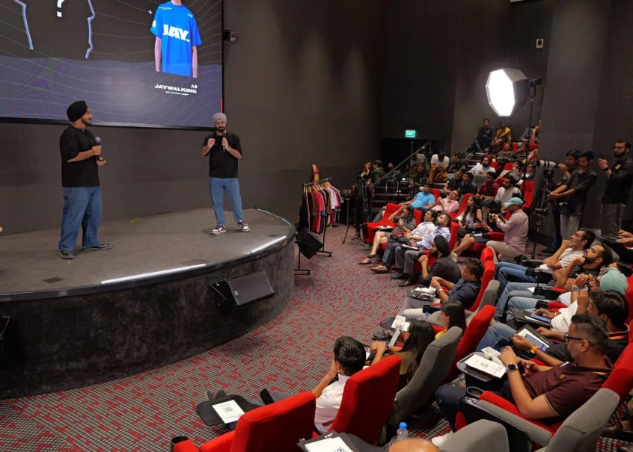
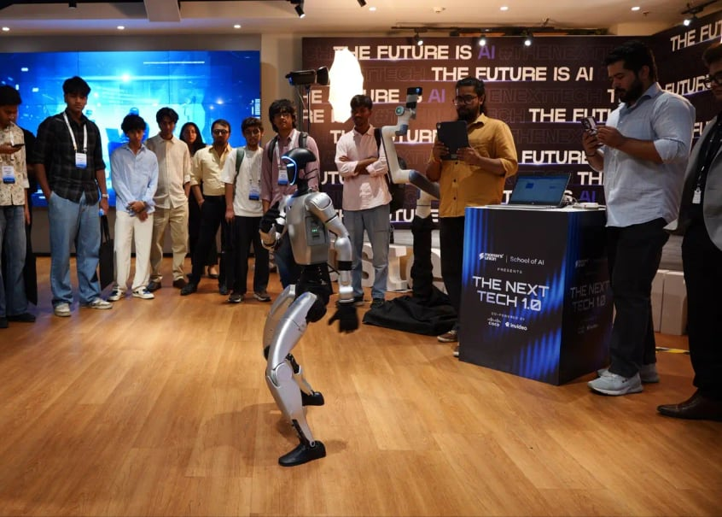
And Crafted the Biggest Moments
MASTERS' UNION UNIVERSITY
HYROX Delhi & Mumbai
Demo Day
AI Summit
Masters' Union University as Title Sponsor. 25K+ athletes across both cities.
₹60.5 crore in investment committed to student ventures in a single hour.
Bringing together Nas Daily, NVIDIA, Google Cloud and IndiaAI Mission.
Notes:
HYROX Delhi & Mumbai: Masters' Union University as Title Sponsor. 25K+ athletes across both cities. Demo Day: ₹60.5 crore in investment committed to student ventures in a single hour. AI Summit: Bringing together Nas Daily, NVIDIA, Google Cloud and IndiaAI Mission.

Slide 14
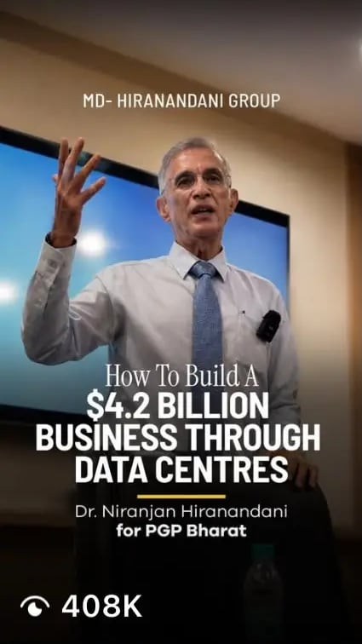
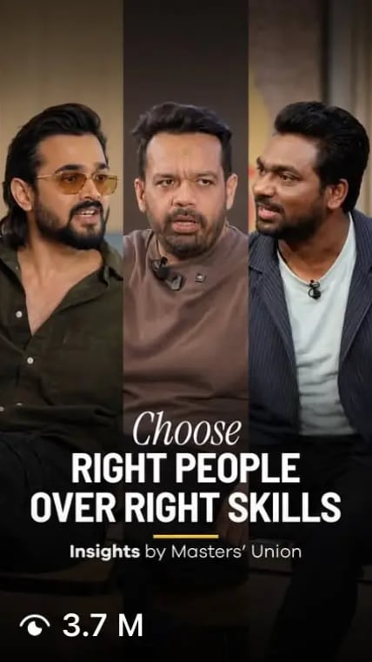
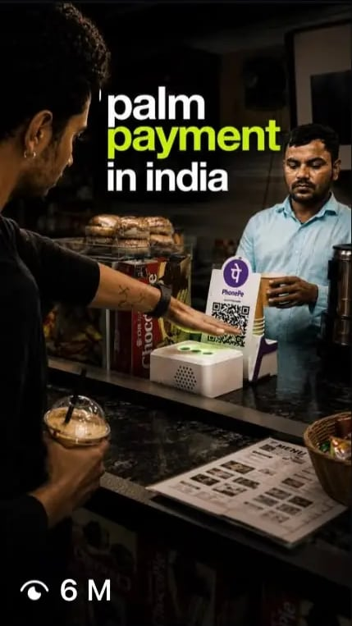



Enter Our Digital Multiverse
200M+
views @masters.union
112M
lifetime views
139K
followers
Notes:
Instagram: 200M+ views (@masters.union). YouTube: 112M lifetime views. LinkedIn: 139K followers.

Slide 15

























Join Our Remarkable Company
Brands we’ve worked with.
Relationships we’re proud to build on.
Across Masters’ Union University’s events, programmes and partnerships.
Notes:
Brands we’ve worked with. Relationships we’re proud to build on. Across Masters’ Union University’s events, programmes and partnerships. PwC, HYROX, Bloomberg, PokerBaazi, boAt, NIVIA, Zerodha, SuperYou, Red Bull, Illinois Institute of Technology, Shark Tank India, ITC Limited, Philips, Ferrari, Snitch, Peakst8, Reebok, Your Space, Hero, Agoda, MakeMyTrip, Meesho, NVIDIA, upGrad, Myntra.

Slide 16

Mark Your Place in the Milky Way
SPONSORSHIP 2027
Four orbits around one festival.
01
02
03
04
TITLE PARTNER
POWERED BY
ASSOCIATE
CO-SPONSOR
Title integration with Milky Way
“Powered By” association
Associate designation
Co-Sponsor designation
Notes:
Title Partner: Title integration with Milky Way. Powered By: “Powered By” association. Associate: Associate designation. Co-Sponsor: Co-Sponsor designation.

Slide 17
What Each Orbit Carries (1/2)
DELIVERABLE | TITLE PARTNER | POWERED BY | ASSOCIATE | CO-SPONSOR
01 Brand Association | Title integration with Milky Way | “Powered By” association | Associate designation | Co-Sponsor designation
02 Category Exclusivity | ✓ | Available where agreed | — | —
03 Road to Milky Way | Pan-city presence across all 7 cities | Pan-city presence across all 7 cities | Select city / RTM touchpoints | —
04 Main Festival Branding | Highest visibility across key festival touchpoints | Extensive visibility | Prominent visibility across select touchpoints | Select branding: sponsor walls, standees & common areas
05 Stage & Programming Visibility | Primary main-stage visibility + branded AV opportunities | Prominent stage / programming-zone visibility + AV opportunities | Select stage / programming-zone visibility | —
06 Emcee Mentions | Priority mentions | Multiple scheduled mentions | Select mentions | —
07 Experience Zone | First choice of placement + premium space | Priority placement + customisation support | Standard activation / booth space | Booth space
08 Curated Brand Activation | Up to 2 bespoke experiences | Up to 1 bespoke experience | 1 activation opportunity | Booth-led engagement
Notes:
Brand Association: Title Partner Title integration with Milky Way; Powered By “Powered By” association; Associate Associate designation; Co-Sponsor Co-Sponsor designation. Category Exclusivity: Title Partner ✓; Powered By Available where agreed; Associate —; Co-Sponsor —. Road to Milky Way: Title Partner Pan-city presence across all 7 cities; Powered By Pan-city presence across all 7 cities; Associate Select city / RTM touchpoints; Co-Sponsor —. Main Festival Branding: Title Partner Highest visibility across key festival touchpoints; Powered By Extensive visibility; Associate Prominent visibility across select touchpoints; Co-Sponsor Select branding: sponsor walls, standees & common areas. Stage & Programming Visibility: Title Partner Primary main-stage visibility + branded AV opportunities; Powered By Prominent stage / programming-zone visibility + AV opportunities; Associate Select stage / programming-zone visibility; Co-Sponsor —. Emcee Mentions: Title Partner Priority mentions; Powered By Multiple scheduled mentions; Associate Select mentions; Co-Sponsor —. Experience Zone: Title Partner First choice of placement + premium space; Powered By Priority placement + customisation support; Associate Standard activation / booth space; Co-Sponsor Booth space. Curated Brand Activation: Title Partner Up to 2 bespoke experiences; Powered By Up to 1 bespoke experience; Associate 1 activation opportunity; Co-Sponsor Booth-led engagement.

Slide 18
What Each Orbit Carries (2/2)
DELIVERABLE | TITLE PARTNER | POWERED BY | ASSOCIATE | CO-SPONSOR
09 Website Presence | Premium placement across key pages | Prominent placement | Sponsor section + select pages | Sponsor section
10 Social Media | Integrated visibility across the owned digital ecosystem | Extensive planned coverage | Planned social coverage | Select stories, reels & sponsor content
11 Email & Direct Channels | Extensive integration | Select integration | Select inclusion | —
12 Artist / Headliner Integration | Priority opportunities, subject to rights & availability | Select opportunities, subject to rights & availability | — | —
13 PR & Communications | Inclusion across key festival communications | Select PR inclusion | Sponsor acknowledgement where relevant | —
14 Festival Collateral | Premium placement across key collateral | Prominent placement across key collateral | Select collateral | Sponsor wall / select collateral
15 Post-Event Value | Detailed impact report + bespoke brand content / film | Impact report + brand-film integration | Performance summary + event content | Aftermovie inclusion
16 Partner Access Passes | 10+ | 8 | 5 | 3
*The deliverables can be further curated specific to the company.
Notes:
Website Presence: Title Partner Premium placement across key pages; Powered By Prominent placement; Associate Sponsor section + select pages; Co-Sponsor Sponsor section. Social Media: Title Partner Integrated visibility across the owned digital ecosystem; Powered By Extensive planned coverage; Associate Planned social coverage; Co-Sponsor Select stories, reels & sponsor content. Email & Direct Channels: Title Partner Extensive integration; Powered By Select integration; Associate Select inclusion; Co-Sponsor —. Artist / Headliner Integration: Title Partner Priority opportunities, subject to rights & availability; Powered By Select opportunities, subject to rights & availability; Associate —; Co-Sponsor —. PR & Communications: Title Partner Inclusion across key festival communications; Powered By Select PR inclusion; Associate Sponsor acknowledgement where relevant; Co-Sponsor —. Festival Collateral: Title Partner Premium placement across key collateral; Powered By Prominent placement across key collateral; Associate Select collateral; Co-Sponsor Sponsor wall / select collateral. Post-Event Value: Title Partner Detailed impact report + bespoke brand content / film; Powered By Impact report + brand-film integration; Associate Performance summary + event content; Co-Sponsor Aftermovie inclusion. Partner Access Passes: Title Partner 10+; Powered By 8; Associate 5; Co-Sponsor 3.

Slide 19

Let's Build Something Out Of This World
Send us a signal.
Let's Connect ↗
SPONSORSHIP TEAM
Ananya Singh
Chirag Naryani
ananya.singh1@mastersunion.org
chirag.naryani_UGTBM2028@mastersunion.org
For further queries write to us at
milkyway@mastersunion.org
Masters' Union University, Gurugram, Haryana.
Notes:
Send us a signal. Sponsorship Team: Ananya Singh, ananya.singh1@mastersunion.org; Chirag Naryani, chirag.naryani_UGTBM2028@mastersunion.org. For further queries write to us at milkyway@mastersunion.org. Masters' Union University, Gurugram, Haryana.

Slide 20

THE UNIVERSE IS YOURS
A Masters' Union University Fest
Notes:
Milky Way: The universe is yours. A Masters' Union University Fest.

