Slide 1
Student Name: Aditya M CWC ID: 26CWCA3412
School: Sharada Vidyalaya Track: Eat Real #FixYourPlate
Mission 2 Submission
Record your change with a number. Then explain the story behind it because a number without context could just be luck, not real change. Pledged to cut plastic in your canteen? Now go measure it, cut it, and measure it again.
Every Mission 2 submission needs: No number = incomplete. No proof = incomplete. This is the one rule with zero flexibility.

Slide 2
Your Problem Statement
1. What is the Problem?
Dietary habits of school children will require a strong foundation. Many of them are attracted to colourful packaged food and junk food. School canteens have a major role in breaking this bad habit. School canteens should offer healthy food.
Not only my school canteen but most of the canteens in various schools do not have easily(quickly) eatable and tasty healthy eating options. This indirectly has built the habit of children to eat junk food. This is what I saw. Hence, we decided to make healthy, tasty, easily(quickly) eatable food items available in the canteen menu.

Slide 3
Before Observation: Why does it happen Before Number | Photographs, video or Links
Students want to have tasty and quickly eatable food items and Sip-Ups at canteens. In order to cater to students’ likes the following food items were available in canteen. Many of them are not healthy options. They contain lot of oil and carbohydrates. These food items were apart from other healthy options like: sandwich, dosa, idli, rice, chapati.
I noticed the following food items were eaten as snacks. So snacking habit and food options had to be changed. Main meals available in the canteen was healthy. I wanted to make snacking also healthy and tasty
Name of food item | Quantity produced | Quantity sold
Samosa | 95-100 | 95-100
Veg Puff | 50 | 50
Bread Pakoda | 40 | 40
Sip-Ups | 400 | 400

Slide 4
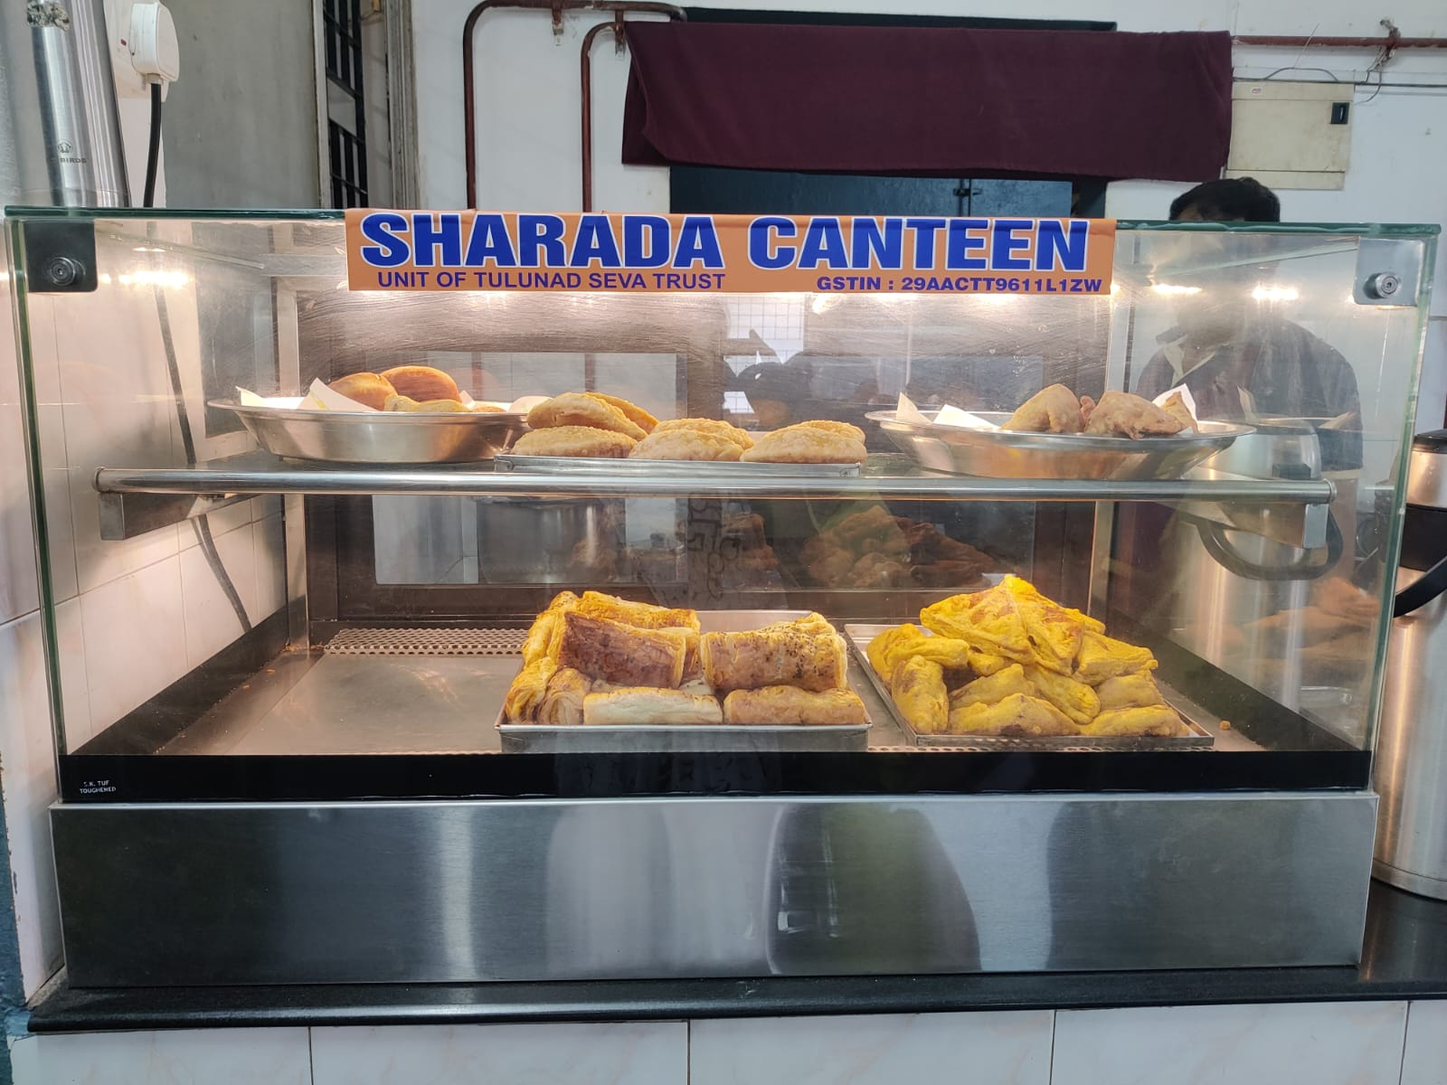
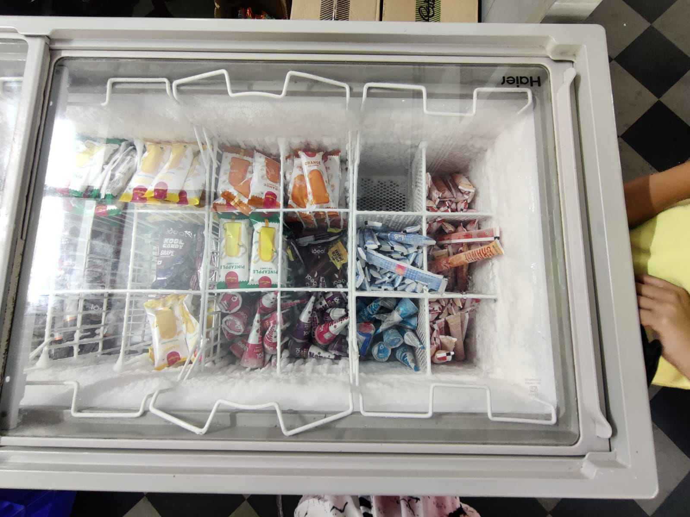
Before Observation: Why does it happen
Before Number | Photographs, video or Links

Slide 5
After Observation: Why does it happen
After Number | Photographs, video or Links
As we learnt that students want tasty and easily eatable food, we decided to look for other healthy items that are palatable and quickly eatable and also tasty. We came to two choices: Boiled corn and Fruit popsicles
Boiled corn was sold out like a fire, by afternoon lunch, 2/3 of the quantity prepared was empty.
Popsicles were no match. By afternoon fully sold out
Name of item | Quantity of items produced | Quantity of items sold
Samosa | 95 | 95
Veg Puff | 50 | 50
Corn | 12 | 10
Bread Pakoda | 50 | 50
Sip Ups | 300 | 300
Corn Whole | 12 | 12
Corn Peeled(in paper cups) | 30 | 30
Popsicles-Watermelon/Muskmelon | 15 | 15
You can add more slides for more pictures, observation

Slide 6
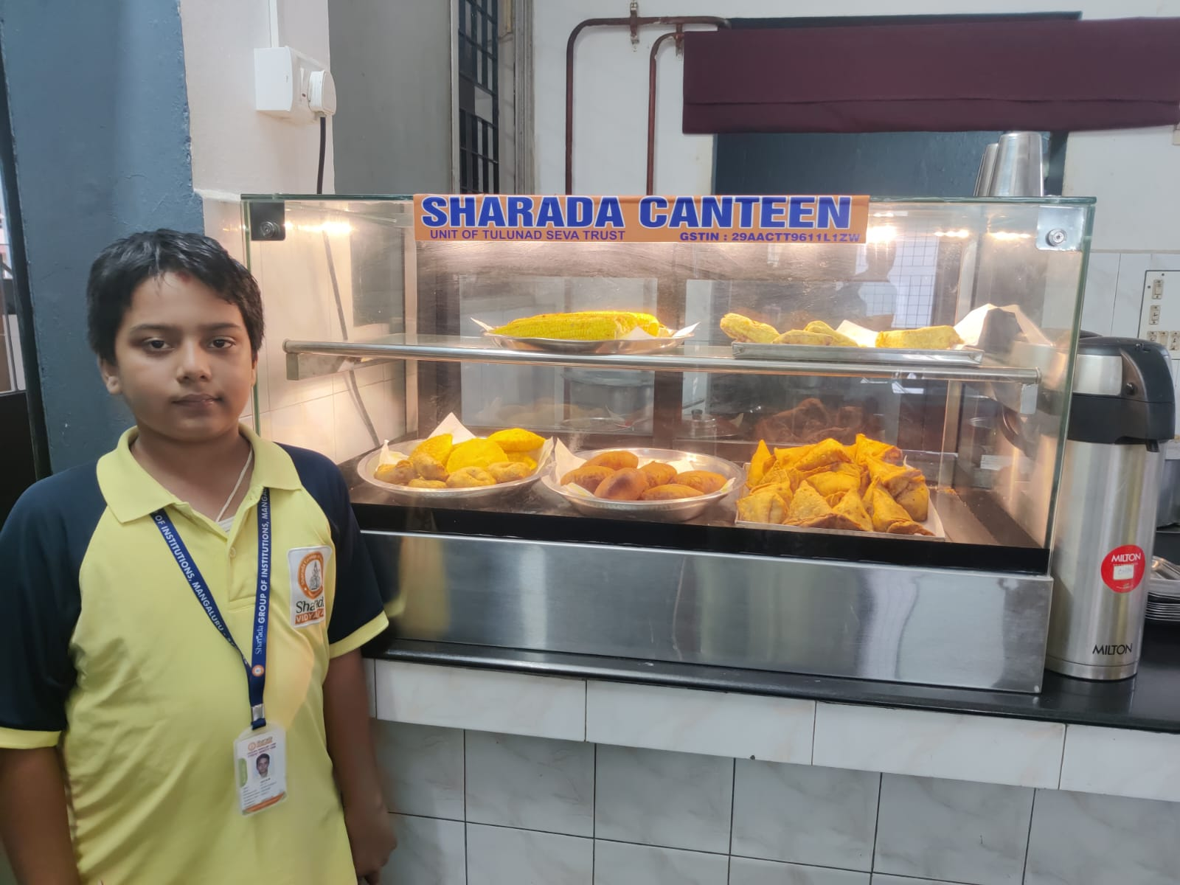
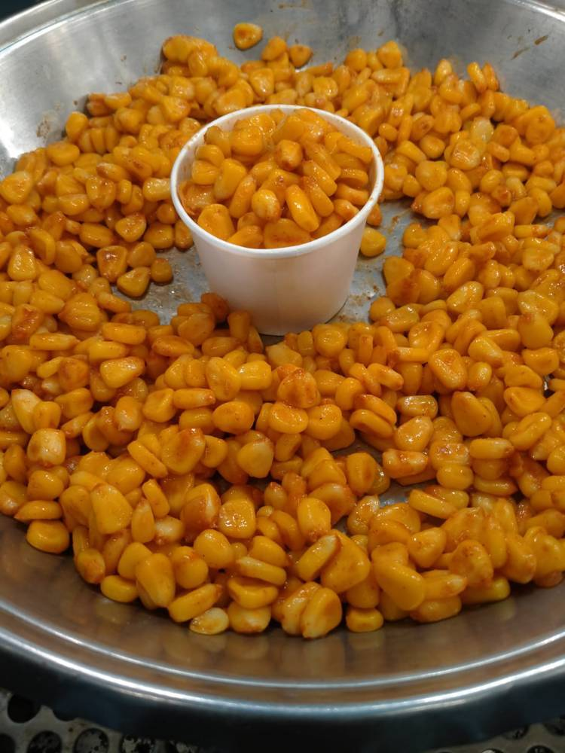
After Observation: Why does it happen After Number | Photographs, video or Links

Slide 7
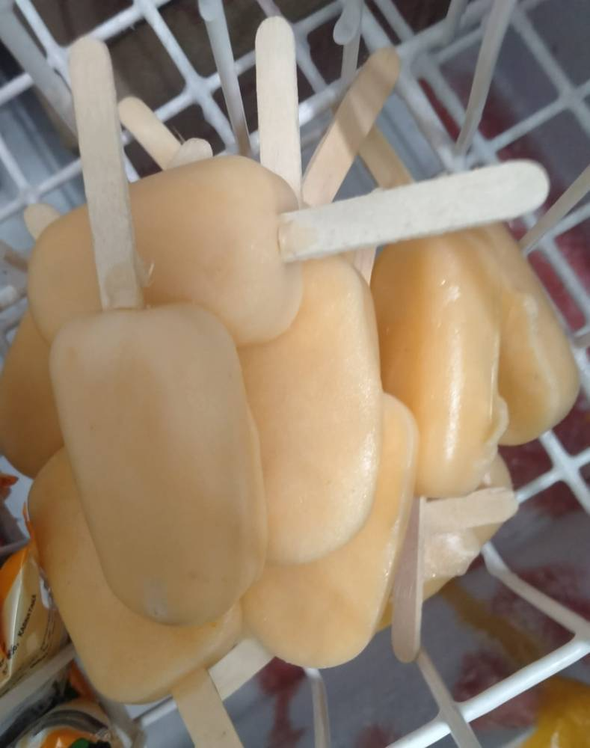
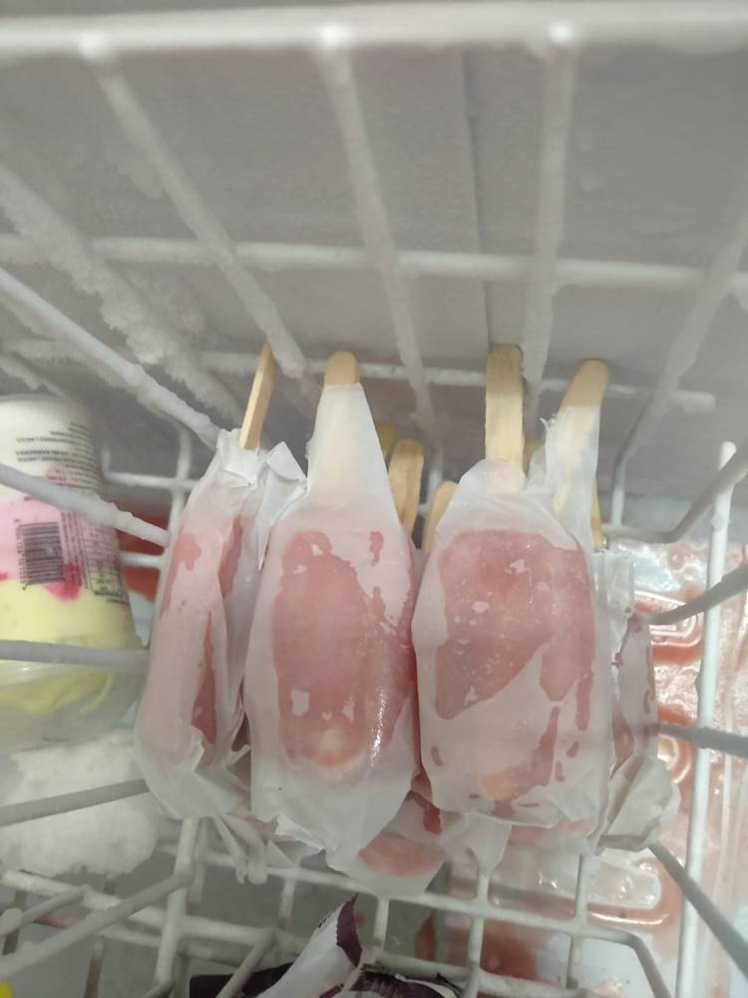
After Observation: Why does it happen After Number | Photographs, video or Links

Slide 8
After Observation: Why does it happen
After Number | Photographs, video or Links
What we noticed after availability of healthy food options, students started to buy healthy tasty food.
Though the sale of junk food did not come down, the healthy food options were accepted by children graciously.
This demonstrates that replacing the junk with healthy food option is not going to be difficult.
But the change will happen slowly. Not overnight.

Slide 9
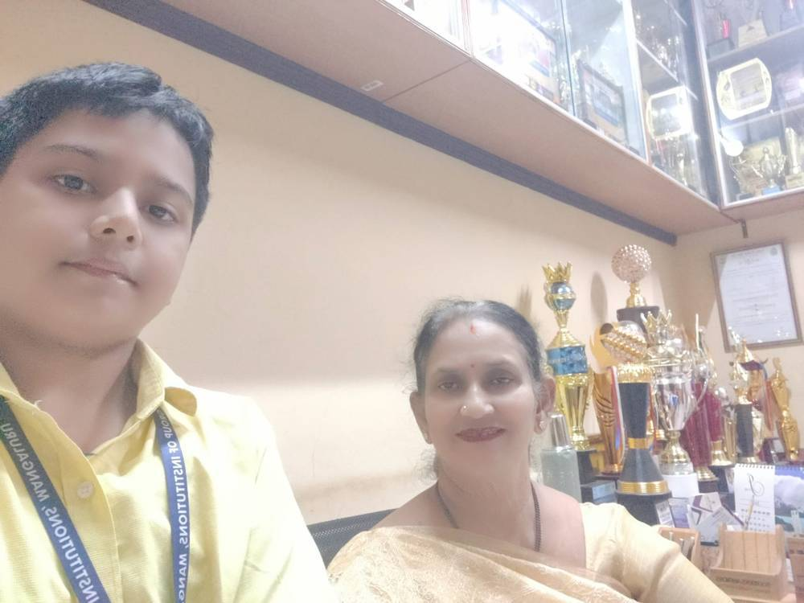
Who's agreed to keep it going?
(photo or written proof a signature, a note, anything showing it continues without you)
Our school is run by Sharada Group of Institutions also known as Tulunadu Education Trust(T.E.T). The Director and Trustee of T.E.T, Sameer Puranik sir, Academic Principal of Sharada Vidyalaya, Chandrika Bhandary Maam and Administrative Principal of Sharada Vidyalaya, Dayanand Kateel Sir have assured that these changes are permanent and shall not be removed from our canteen
Links:-
Interview of Sameer Puranik sir: https://drive.google.com/file/d/1v45AK-J_yHxNy9QDySQ19-L-nQeiTEIr/view?usp=drive_link
Interview of Chandrika Bhandary Maam: https://drive.google.com/file/d/1UAon4S12f-0vgeNLk4Gt6KPl3Zzl5JPh/view?usp=sharing
Interview of Dayanand Kateel Sir: https://drive.google.com/file/d/1OyzaEwnHrNaja4pqwoyqDbvjU8BzwBOs/view?usp=drive_link

Slide 10
The Story
1. What you did?
Ans: Spoke to the principals and school management and requested them to add healthy options like boiled corn and fruit popsicles to the canteen menu. Then we displayed posters of FoodMan and nutritional value of boiled corn in the canteen. Then we also found out how many junk food items are being sold in the canteen. We also kept a track of the sale of corn and fruit popsicles.
2. How you did?
Ans: We spoke to the canteen manager, bought him popsicle moulds for fruit popsicles. We instructed them to prepare fruit popsicles by freezing fresh fruit juices without any extra sugar. We requested him to make boiled corn in peeled form available. We asked him to place it in such a manner that it is easily visible.
3. What changed?
Ans: Students bought the corn and popsicles. This meant that they liked it because the entire corn and popsicles were sold out.
4. Will it last?
Ans: Yes, it will because
School authorities are excited about this.
Canteen manager is happy about sales.
Most importantly my friends have happily accepted this.

