Slide 1
AN INTELLIJ PLATFORM PLUGIN
Solr Support for
IntelliJ IDEA
Configsets, live servers and the Java and Kotlin that query them — completion, navigation,
inspections, drift and queries, over one shared model of what a field is and what it can do.
Solr Support · IntelliJ Platform Plugin
1
Notes:
Welcome. Three acts. Act one walks eighteen editor features, one slide each, one claim each — every slide answers the same four questions: what it shows, what a reader does today without it, where its data actually comes from, and the platform mechanism underneath. Act two is IntelliJ plugin development for a Java engineer who has never written one. Act three is the codebase's own layout and the rules that keep it that way. Repository: github.com/adityamparikh/solr-intellij-plugin, branch feat/solrconfig-structure-completion, level with main.

Slide 2
ACT 1 · FEATURES
One shared model, read from a repository nothing else can see into
Solr development spans three surfaces that share only a vocabulary — field names.
Configuration files (managed-schema.xml / schema.xml, solrconfig.xml) — hand-edited XML with no language support today.
A running Solr server — reached only through the Admin UI or curl.
Java/Kotlin client code — field names passed as unchecked string literals.
This plugin reads the first surface into one model of what a field is and what it can do, and puts that model to work in the editor. Acts 4 and 5 carry the same model to the other two: a live server, and the code that queries it.
Source: specs/0002-solr-intellij-plugin.md “Overview”; README.md:1-13
2
Notes:
Set the frame once, briefly, then get out of the way — Act 1 is eighteen feature slides and each one needs to breathe. The three-surfaces framing is the spec's own: configuration files, a live server, Java/Kotlin code, unified by a single model of what fields exist and what they can do. Only the first surface is built. That is not a caveat to bury — it is honestly stated here and again at the very end, so nobody in the room mistakes eighteen real screenshots for a finished three-surface product.

Slide 3
01
Eighteen slides,
eighteen claims
FEATURES
Every slide: one screenshot, one claim
What it shows · what it costs without it
Where the data actually comes from
The platform mechanism underneath
3
Notes:
Every one of the next eighteen slides is built the same way, on purpose, so the room can pattern-match after the second one: a single bold claim as the title, four short labeled pointers (what it shows, what a reader does today without it, where the data comes from, the mechanism), one real screenshot, and everything else — the interesting explanation — in these speaker notes. The through-line worth stating once and then letting the slides prove repeatedly: almost nothing here reads an index or contacts a server. A configset is text, and the reference data behind most of these features was generated once, at build time, from Solr's own artifacts.

Slide 4
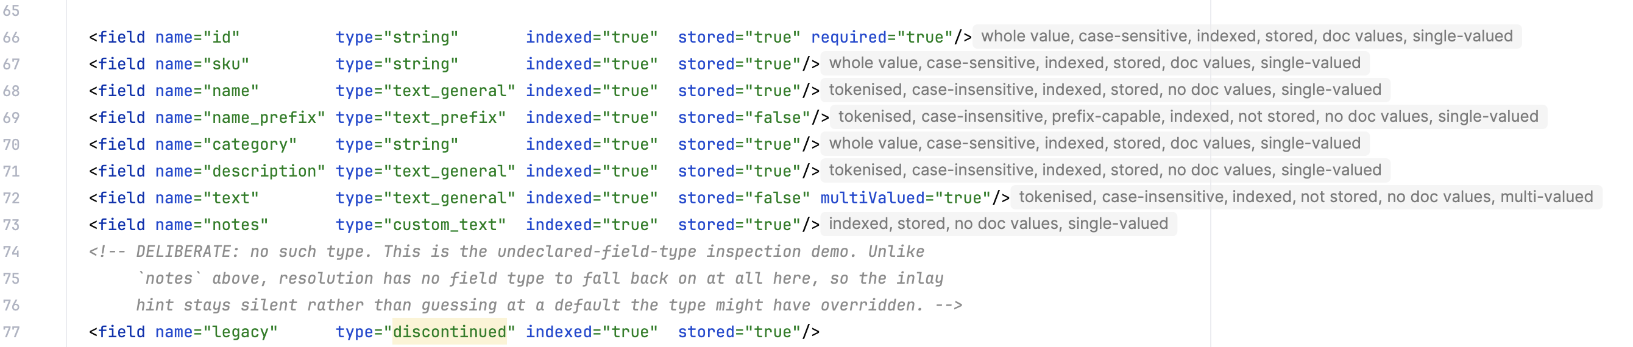
DEEP DIVE 1 OF 18 · INLAY HINTS
Every field says what it can actually match — before you run a query
WHAT IT SHOWS
Grey inline text beside each field declaration: whole-value or tokenised, case-sensitive or not, plus storage shape.
WITHOUT IT
A reader reads the analyzer chain by hand to guess what a field can match, or ships a query against it and finds out from empty results.
DATA SOURCE
The field's own index-time analyzer chain. No index, no server, no network. The deciding factories are named directly in code, not read from the generated catalog — that set defines Solr's matching semantics.
MECHANISM
codeInsight.declarativeInlayProvider — SolrMatchInlayHintsProvider, reading SolrMatchAnalysis.
managed-schema.xml:66-77, no interaction — the hints render themselves.
Source: model/schema/SolrMatchAnalysis.kt; plugin.xml:38-45; docs/glossary.md “factory”, “analyzer chain”; docs/screenshots.md entry 1
4
Notes:
This is the plugin's signature output — the one most likely to be quoted back at a maintainer, which is exactly why it says nothing rather than guess when analysis is not confident. An inlay rather than a tooltip on purpose: a user who does not already suspect their field can't match a prefix will never hover to find out, so the plugin says it unprompted. The deciding factories — which tokenizer or filter class means 'prefix-capable', which means 'case-folds' — are hand-named in SolrMatchAnalysis rather than read from the generated class catalog, because that set of decisions defines what 'matching' even means in Solr and has stayed stable across major versions while the surrounding catalog has not. Storage-shape phrases (stored, multi-valued) ride beside the match claim and survive even when the match claim itself goes silent for an unrecognised factory — silence is per-claim, not per-hint.

Slide 5
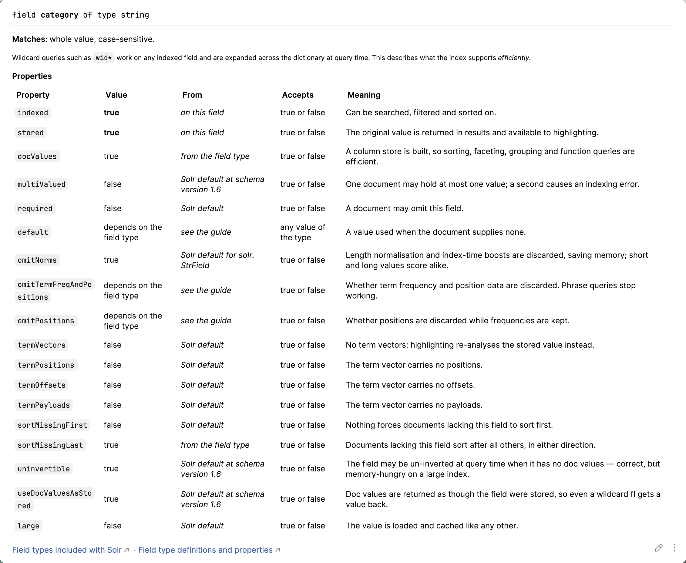
DEEP DIVE 2 OF 18 · QUICK DOCUMENTATION
Every property's value — and whether it came from the field, its type, or Solr's default
WHAT IT SHOWS
Hover or F1 on a field resolves a full property table: value, origin, what it means in plain language.
WITHOUT IT
A reader checks the Reference Guide, which cannot know this file's state, or reads the field type declaration by hand to work out whether omitNorms is really on here.
DATA SOURCE
Three-tier resolution — field, then field type, then Solr's own default — resolved at the schema's declared version, since some defaults depend on it.
MECHANISM
lang.documentationProvider — SolrSchemaDocumentationProvider, reading a hand-maintained property table (SolrFieldProperties).
Caret in name="category" at managed-schema.xml:70, Quick Documentation.
Source: model/schema/SolrFieldProperties.kt; docs/glossary.md “schema version”, “documentation provider”; docs/screenshots.md entry 2
5
Notes:
This popup is what the whole model exists to answer, and it is the deep-dive worth dwelling on if time allows. Every legal property resolves through three tiers, and where a default is genuinely type-dependent — docValues on some field types — the popup reports UNDETERMINED rather than a guess. The Meaning column states the consequence in the Reference Guide's own neutral vocabulary ('whether the original value can be returned in results' beside stored: false) rather than the plugin inventing its own phrasing. Links point at the Reference Guide page for the Solr line this configset declares; nothing on the editor path ever fetches a URL.

Slide 6
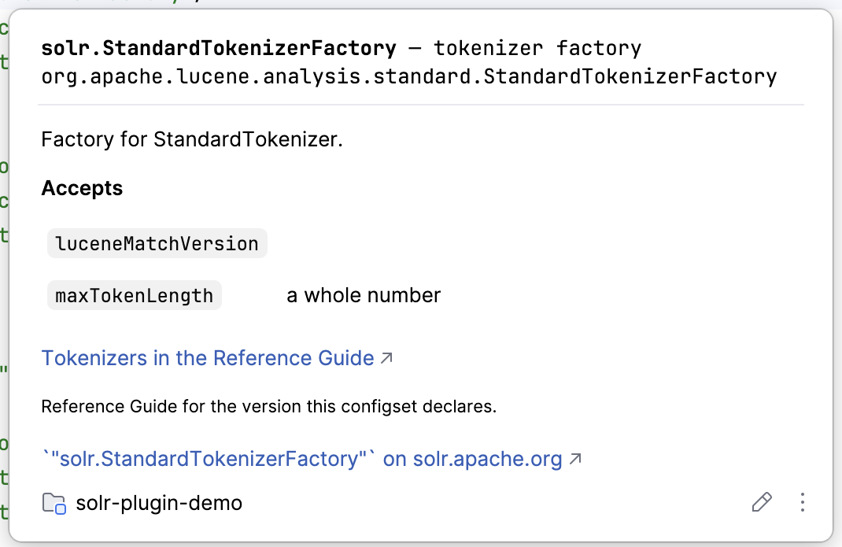
DEEP DIVE 3 OF 18 · QUICK DOCUMENTATION
One popup answers what a class is and what it accepts — without opening a jar
WHAT IT SHOWS
Hover a class="solr...." value: short name and kind, the FQCN, a one-sentence Javadoc summary, and its accepted attributes.
WITHOUT IT
A reader opens Solr or Lucene's source, or searches the Javadoc site, to learn what StandardTokenizerFactory takes.
DATA SOURCE
Generated at build time from Solr's own jars — identity by reading the class files, the summary from the sources jar's Javadoc. Nothing fetched at edit time.
MECHANISM
Same documentation provider, reading the generated SolrClassCatalog — 735 entries on Solr 9, 724 on Solr 10, across 22 kinds of class a configset may name.
Caret in class="solr.StandardTokenizerFactory" at managed-schema.xml:33.
Source: model/vocabulary/SolrClassCatalog.kt (SolrClassKind, 22 entries, verified against source this session); build/generated/solr-catalog-resources/solr-catalog/solr-{9,10}.tsv; docs/screenshots.md entry 3
6
Notes:
This is the catalog pipeline's first visible payoff, and the pipeline starts in buildSrc, not in the running plugin. A Gradle task reads Solr's own jars with ASM — reading bytecode rather than loading classes, so no static initializer ever runs during a build — recovering not just tokenizers and filters but request handlers, query parsers, search components, caches, listeners and more: SolrClassKind names 22 distinct kinds a configset may reference in a class attribute, verified by reading the enum directly rather than trusting an older doc's rounder number. The catalog totals 735 classes on Solr 9 and 724 on Solr 10, counted from the generated TSVs this session rather than copied from a stale figure elsewhere in the docs.

Slide 7
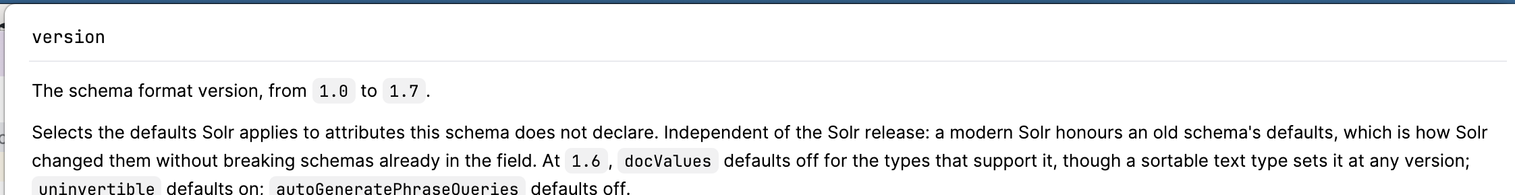
DEEP DIVE 4 OF 18 · QUICK DOCUMENTATION
The schema's own version number, and exactly what it changes in this file
WHAT IT SHOWS
Hover version on <schema version="1.6">: the general rule (1.0 to 1.7, what it selects), then this file's own resolved values.
WITHOUT IT
A reader does not know Solr 9.7 flipped docValues and uninvertible defaults at schema version 1.7, and silently assumes modern behaviour on an old, still-running schema.
DATA SOURCE
SolrSchemaVersion — a hand-maintained rule table keyed to the declared version, since upgrading the Solr server does not rewrite this attribute.
MECHANISM
Same documentation provider, answering at a structural attribute's own name rather than its value.
managed-schema.xml:27, <schema version="1.6">, Quick Documentation (Ctrl+J).
Source: model/schema/SolrSchemaVersion.kt; docs/glossary.md “schema version”; docs/screenshots.md entry 16
7
Notes:
The schema version is a third, independent version number beside the Solr line and luceneMatchVersion, and this codebase's own KDoc explicitly warns against conflating the three. The demo pins version="1.6" on purpose so this capture shows a version-dependent default actually being resolved rather than assumed. Small reproducibility note: F1 opens platform Help on the default macOS keymap, not Quick Documentation — Ctrl+J is what raises this popup, and on this sandbox it rendered as a docked panel rather than a floating box, which is a platform-version cosmetic difference, not a regression.

Slide 8
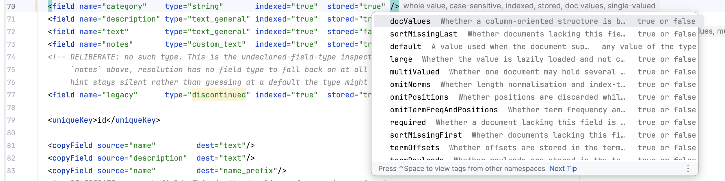
DEEP DIVE 5 OF 18 · COMPLETION
Attribute completion that already knows what's on the tag
WHAT IT SHOWS
Ctrl+Space inside an opening <field> tag offers every legal attribute with a one-line summary — attributes already written are omitted.
WITHOUT IT
A reader learns the property vocabulary by trial and error, or keeps the Reference Guide's field-properties page open beside the editor.
DATA SOURCE
A hand-maintained property table (SolrFieldProperties). Only closed sets are completed — where any value is legal, the plugin contributes nothing.
MECHANISM
completion.contributor, order="first" — SolrSchemaCompletionContributor, ahead of the platform's own XML completion.
Caret after stored="true" at managed-schema.xml:70, before the /, space typed.
Source: configset/schema/completion/SolrSchemaCompletionContributor.kt; docs/glossary.md “completion contributor”; docs/screenshots.md entry 5
8
Notes:
The design rule worth stating out loud: only closed sets are completed. A partial list implies everything absent from it is wrong, so a position where any string is legal gets no contribution at all rather than a half-answer. order="first" matters mechanically: this contributor runs ahead of the platform's own XML completion and can drop the bare duplicate entries the platform would otherwise also offer, leaving one clean list with summaries instead of two overlapping ones.

Slide 9
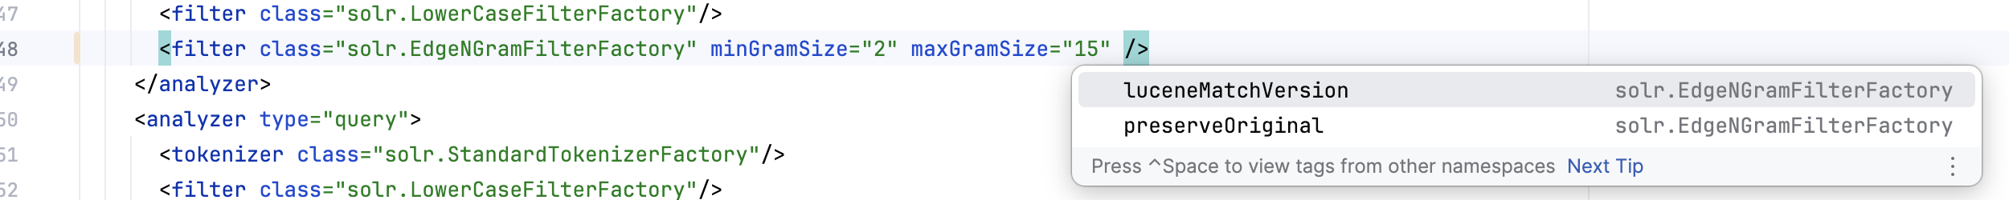
DEEP DIVE 6 OF 18 · COMPLETION
A factory's own attributes, offered by name — not guessed from its neighbours
WHAT IT SHOWS
Completion inside a <filter class="..."> tag offers that exact factory's real attributes, each labelled with the factory it came from.
WITHOUT IT
A reader reads the factory's constructor source, or trial-and-errors what Solr will silently ignore, to learn EdgeNGramFilterFactory accepts preserveOriginal.
DATA SOURCE
Recovered from each factory's own constructor bytecode with ASM — a factory reads its arguments there and nowhere else, so reflection alone cannot see them.
MECHANISM
Same completion contributor, reading the generated class catalog's attribute column.
managed-schema.xml:48, caret before the closing /, space typed.
Source: buildSrc GenerateSolrCatalogTask (ASM); docs/glossary.md “ASM”, “factory”; docs/screenshots.md entry 6
9
Notes:
The same lookup this completion reads also backs the class quick-documentation popup two slides back and the per-attribute hover — one generated fact, several places it surfaces, because the completion contributor is a thin adapter over the same catalog rather than its own data source. Attributes already written on the tag (minGramSize, maxGramSize here) are omitted, the identical rule feature 5 demonstrates for schema attributes.

Slide 10
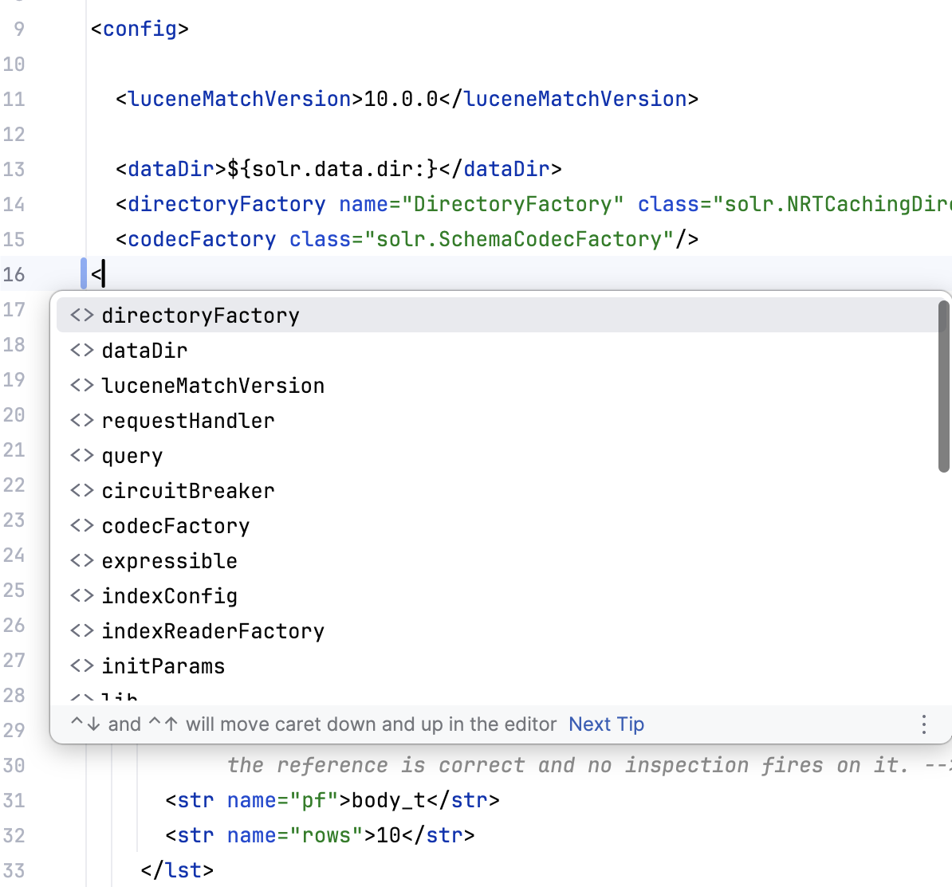
DEEP DIVE 7 OF 18 · COMPLETION
solrconfig.xml finally has its own structure, not an echo of the schema
WHAT IT SHOWS
Typing < inside <config> offers Solr's real top-level vocabulary — directoryFactory, dataDir, luceneMatchVersion, requestHandler, query, updateHandler, codecFactory and more.
WITHOUT IT
The platform's schema-less guess offers whatever sibling tags happen to already be written — actively misleading in a file made mostly of same-named tags.
DATA SOURCE
An element vocabulary read out of SolrConfig's own reading code, keyed to each element's parent path.
MECHANISM
xml.elementDescriptorProvider — SolrConfigElementDescriptorProvider, a second, file-specific descriptor.
Typing < inside <config> in the sandbox's solrconfig.xml, line 16 (reshot capture, post element-placement fix).
Source: configset/solrconfig/descriptor/SolrConfigElementDescriptorProvider.kt; model/vocabulary/SolrElementCatalog.kt; docs/screenshots.md entry 10
10
Notes:
This screenshot is the reshoot — the first capture of this popup briefly showed a real bug (cache, featureVectorCache and HashDocSet offered at the document root, where Solr does not actually read them), caught and fixed the same session, and this image is from a sandbox rebuilt after that fix. That episode is worth telling exactly as a caution about generated evidence: a running sandbox does not reload a regenerated catalog resource, so the first reshoot attempt reproduced the old, wrong popup and looked like the fix had failed. The vocabulary itself comes from three joined sources: SolrConfig's own public plugins list, a shipped JSON describing updateHandler/query/requestDispatcher's typed attributes, and a pass reading SolrConfig's own config-reading calls as literal arguments for the handful of elements — <config> itself, luceneMatchVersion, dataDir — that appear in neither prior list.

Slide 11
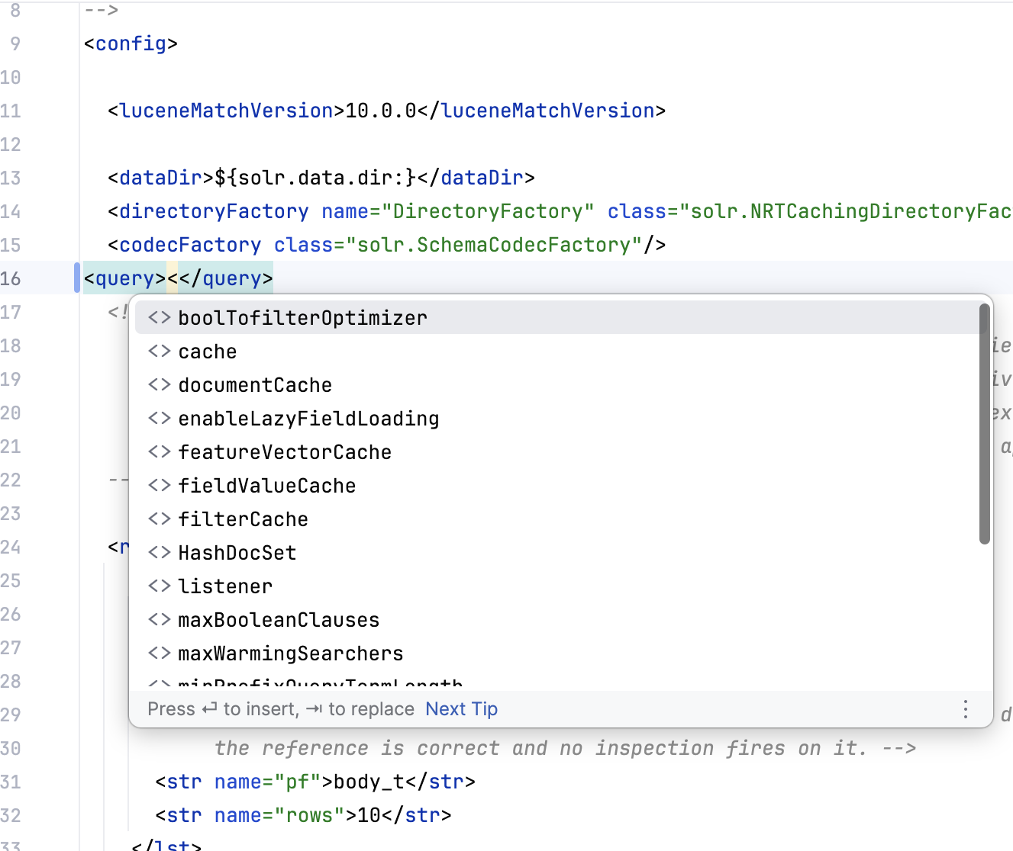
DEEP DIVE 8 OF 18 · COMPLETION
The vocabulary changes with position — cache lives under <query>, not at the root
WHAT IT SHOWS
Typing < inside <query> offers eighteen elements — cache, filterCache, listener, maxBooleanClauses and more — none of which the document root offers.
WITHOUT IT
The failure mode a schema-less guess can never fix by construction: advice that is not just wrong but wrong about *where* something belongs.
DATA SOURCE
The same generated element vocabulary as the previous slide, keyed by parent path — this time the parent is query, not the document root.
MECHANISM
Same descriptor, same SolrElementCatalog.offerableChildrenOf, a different parent path.
<query></query> added inside <config>, caret between the tags, typing <.
Source: model/vocabulary/SolrElementCatalog.kt (parent-path keying); docs/screenshots.md entry 17
11
Notes:
This is the capture that closes a real gap the rest of the evidence left open. Every other artifact verifying the element-placement fix — the tests, the whole-catalog diff, the previous slide's <config> popup — observes only what left the document root. Had those elements left without arriving anywhere, all of that evidence would still read green. This screenshot is the only thing that shows they actually arrived at <query>, and dataDir is conspicuously not among the eighteen offered here, which is the other half of the claim: the vocabulary is genuinely partitioned by position, not merged.

Slide 12
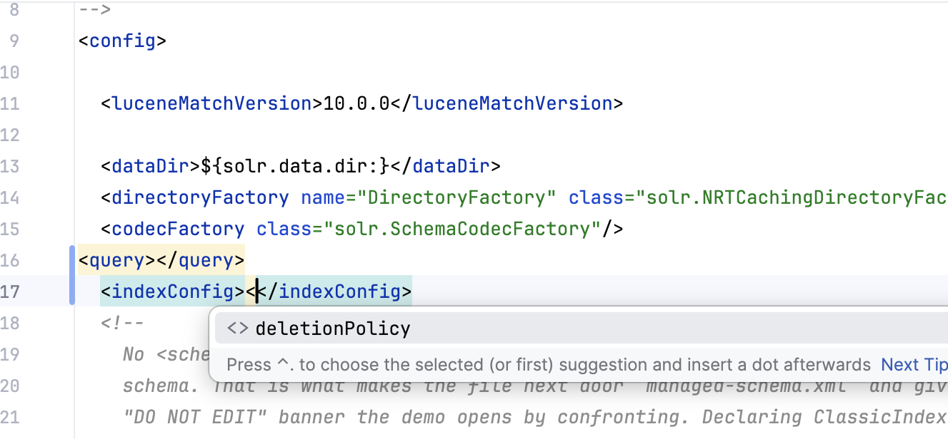
DEEP DIVE 9 OF 18 · COMPLETION
Knowing where an element belongs and recommending it are different questions
WHAT IT SHOWS
<indexConfig> offers exactly one child, deletionPolicy — nrtMode and unlockOnStartup are known to belong there and are still never offered.
WITHOUT IT
Without this distinction, a reader could be offered an element name Solr will refuse to start with.
DATA SOURCE
The same generated catalog, cross-referenced against a discontinued-elements list read from the same SolrConfig source.
MECHANISM
SolrElementCatalog.offerableChildrenOf filters to what Solr still accepts, even for a parent path it otherwise fully recognises.
<indexConfig></indexConfig> added inside <config>, same gesture as the previous slide.
Source: model/vocabulary/SolrElementCatalog.kt; configset/solrconfig/inspection (discontinued-element check); docs/screenshots.md entry 18
12
Notes:
Set beside the previous slide's eighteen, this one element is the point: nesting and correctness are two separate mechanisms working together rather than one broad guess. nrtMode and unlockOnStartup are demonstrably known to the catalog — they are keyed to exactly this parent path and the discontinued-element inspection fires on them when written here — and they are still withheld from completion, because Solr itself no longer accepts them. Worth flagging honestly rather than papering over: lockType, httpCaching and infoStream appear in Solr's own shipped configsets and in neither catalog at all, because SolrConfig's own reading code never touches them — a real, pre-existing completeness gap, not a regression from anything shown today.

Slide 13
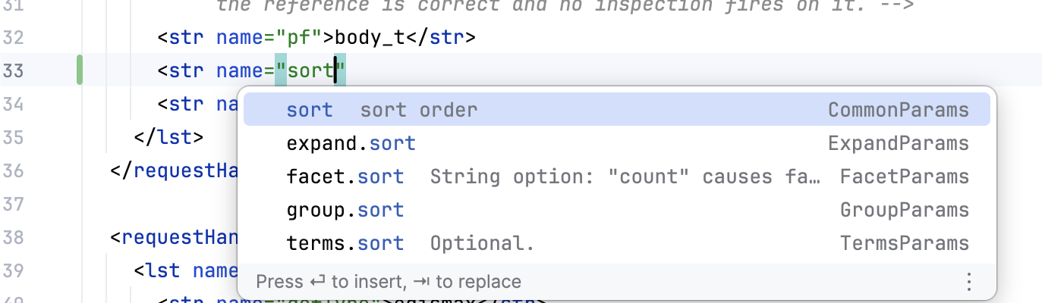
DEEP DIVE 10 OF 18 · COMPLETION
Hundreds of request-parameter names, each with Solr's own one-line explanation
WHAT IT SHOWS
A new <str name="..."> inside <lst name="defaults"> offers Solr's own parameter names, each labelled with its declaring Params class.
WITHOUT IT
A reader greps the Reference Guide's parameter reference by hand, or copies a name from another handler and hopes it still applies here.
DATA SOURCE
Read from Solr's own Params classes' public constants — 349 names on Solr 9, 344 on Solr 10, plus 44 query-parser names on both, counted from the generated catalog this session.
MECHANISM
completion.contributor — SolrParameterNameCompletionProvider and SolrParserNameCompletionProvider.
A new <str name="..."> inside /select's <lst name="defaults">, typed sort, Ctrl+Space.
Source: model/vocabulary/SolrParameterCatalog.kt; build/generated/solr-catalog-resources/solr-catalog/parameters-{9,10}.tsv (counted this session); docs/screenshots.md entry 15
13
Notes:
A genuine finding surfaced while capturing this, worth telling as evidence the completion is doing real work rather than dumping a flat list: a parameter already set elsewhere in the same defaults block is withheld from the offered list. Typing qf at this position in the demo offers only mlt.qf and hl.queryFieldPattern, because plain qf is already declared on an earlier line of the same list — an apparently sparse, generic-looking popup at this position is usually that rule firing correctly, not a broken capture. The counts themselves were verified directly against the generated TSV files this session rather than repeated from an older, rounder figure in the plan.

Slide 14
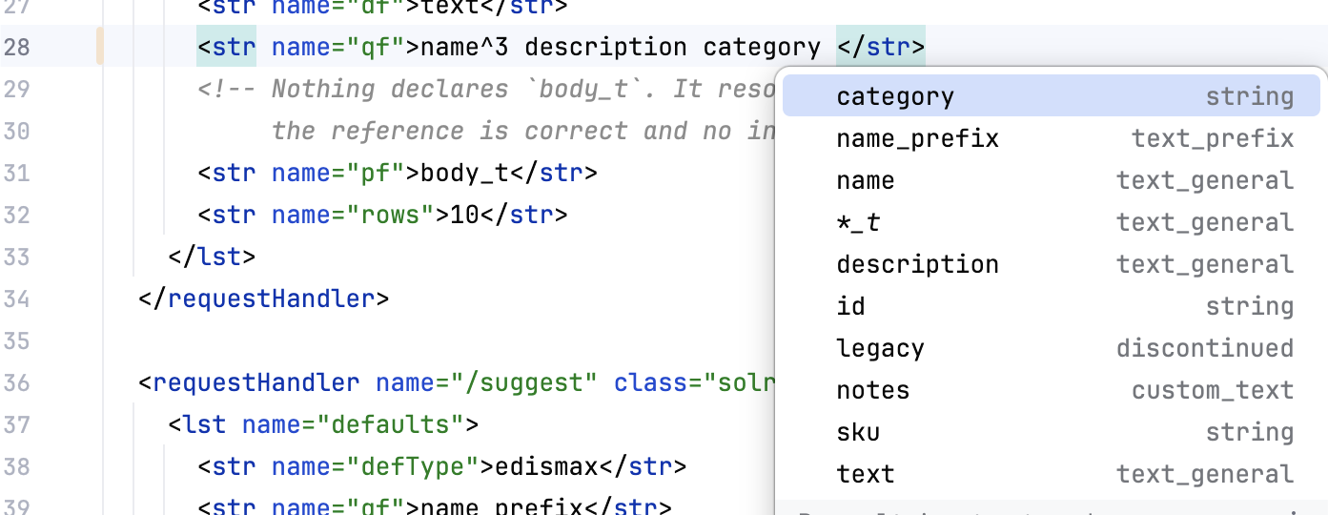
DEEP DIVE 11 OF 18 · COMPLETION
The schema's own fields, offered exactly where a parameter needs one
WHAT IT SHOWS
Completion inside qf (and fifteen other parameters known to hold field names) offers the schema's declared fields, dynamic patterns included.
WITHOUT IT
A reader misspells a field name inside qf and finds out only when relevance quietly degrades — the precise inverse of the unknown-field inspection.
DATA SOURCE
The same parsed field model schema completion reads (feature 5), scoped to exactly the parameters proven to hold field names.
MECHANISM
SolrParameterFieldCompletionProvider, reading SolrConfigParameters' known-parameter list.
solrconfig.xml:28, caret after category inside <str name="qf">, space, Ctrl+Space.
Source: configset/solrconfig/completion/SolrParameterFieldCompletionProvider.kt; configset/solrconfig/SolrConfigParameters.kt; docs/screenshots.md entry 13
14
Notes:
This is deliberately scoped to sixteen parameters rather than offered everywhere a string appears in this file — offering it inside rows or defType would be actively wrong, since those hold numbers and parser names respectively. It also respects boost and sort syntax rather than treating the whole attribute value as one opaque field-name slot: qf offers name, not name^3, because a caret after name^ is understood to be inside a boost expression. One easy-to-miss reproducibility detail: completion did not fire with the caret directly adjacent to existing text and no trailing space — the same rule feature 5 documents for schema attribute completion, confirmed true here too.

Slide 15
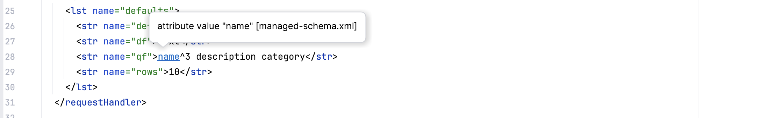
DEEP DIVE 12 OF 18 · REFERENCES & NAVIGATION
A qf parameter's field names are clickable, straight into their schema declaration
WHAT IT SHOWS
Ctrl-click or hover on any name inside qf jumps to that field's <field> declaration in the schema.
WITHOUT IT
A reader greps the schema by hand for a field name typed in a completely different file, with no compiler and no IDE to catch a typo before it costs a relevance regression.
DATA SOURCE
No new data — a reference resolved over the model both files already share.
MECHANISM
psi.referenceContributor — SolrConfigReferenceContributor. One implementation buys Ctrl-click, Find Usages and rename together.
solrconfig.xml:28, <str name="qf">name^3 description category</str>, hover on name.
Source: configset/solrconfig/reference/SolrConfigReferenceContributor.kt; docs/glossary.md “reference”; docs/screenshots.md entry 8
15
Notes:
This screenshot is close to this whole plugin's thesis statement in one frame — the exact cross-file silent-failure class the project exists to catch, made visible before it ever fails. Each name in name^3 description category navigates independently; boost syntax does not confuse it. Architecturally this reference lives in configset.solrconfig.reference and resolves into the schema aspect's own declarations, which is exactly the kind of cross-file capability that belongs at the shared layer rather than inside either aspect — see Act 3.

Slide 16
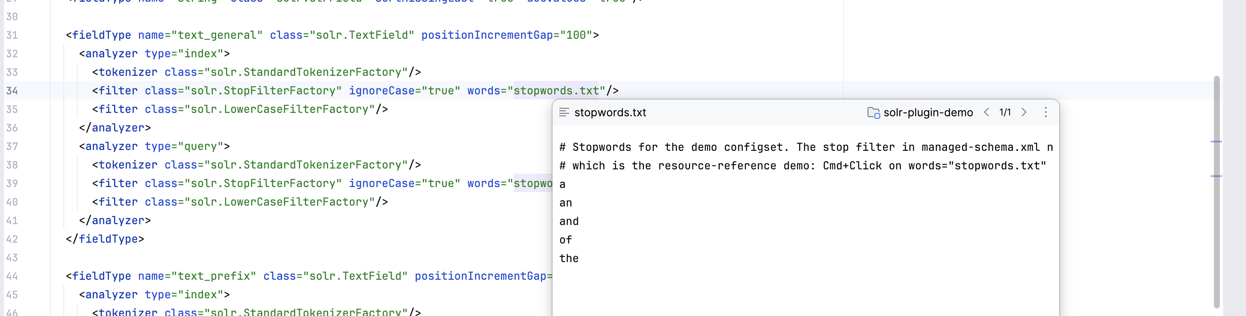
DEEP DIVE 13 OF 18 · REFERENCES & NAVIGATION
A filter's resource path opens the actual file it names
WHAT IT SHOWS
Quick Definition on words="stopwords.txt" opens that file's real contents, resolved through lang/ where needed.
WITHOUT IT
A reader hunts for the file by eye in the project tree, guessing at subdirectories.
DATA SOURCE
No new data — the same reference mechanism resolving to a filesystem resource instead of a PSI declaration.
MECHANISM
SolrSchemaReferenceContributor's resource-attribute handling.
managed-schema.xml:34, caret on the resource path, Quick Definition.
Source: configset/schema/reference/SolrSchemaReferenceContributor.kt; docs/screenshots.md entry 9
16
Notes:
A smaller capability, included because the reference abstraction covering it is architecturally the same one covering the field-name navigation on the previous slide — it does not care what kind of target it resolves to, only that resolve() returns something Ctrl-click and Find Usages can both understand. Cmd-hover shows the same resolution as an absolute path, which is the right gesture for checking this by hand and the wrong one to publish, since the path is someone's home directory.

Slide 17
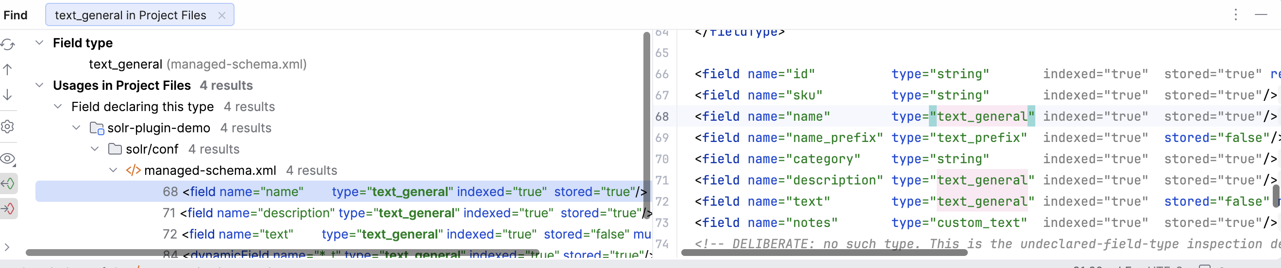
DEEP DIVE 14 OF 18 · REFERENCES & NAVIGATION
Every reference to a type, found starting from the declaration itself
WHAT IT SHOWS
Alt-F7 on a <fieldType> declaration lists every field that uses it, across every file in the configset.
WITHOUT IT
A reader greps the whole configset by hand to know what depends on a type before changing it, and misses whatever a dynamic field pattern quietly supplies.
DATA SOURCE
No new data — the reference graph already built for navigation, traversed backward from a declaration rather than forward from a use site.
MECHANISM
pom.declarationSearcher — SolrDeclarationSearcher, needed because a caret on a bare declaration is not naturally something the platform can search for.
Caret in the <fieldType name="text_general"> declaration at managed-schema.xml:31, ⌥F7.
Source: configset/navigation/SolrDeclarationSearcher.kt; docs/glossary.md “Find Usages”; docs/screenshots.md entry 7
17
Notes:
Before this searcher existed, Ctrl-click already worked (references anchor at use sites and resolve to declarations) but Alt-F7 on the declaration itself refused outright — nothing turned a caret sitting on a declaration into something the platform's TargetElementUtilBase would search for. Two smaller hooks make the result readable rather than merely correct: without a description provider the header would read the target's own class name; without a usage-type provider every hit would land under an unlabelled 'Unclassified' group. A dynamic field's Find Usages also reports the concrete names its pattern actually supplies, not only literal spellings of the glob, because the platform's word index alone cannot match a name sharing no literal word with a pattern like *_t.

Slide 18
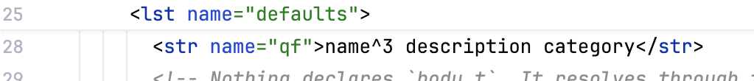
DEEP DIVE 15 OF 18 · REFERENCES & NAVIGATION
Renaming a field updates every file that mentions it — one operation, one Undo
WHAT IT SHOWS
Shift+F6 on a field updates its schema declaration and the qf line in solrconfig.xml together, no separate edit.
BEFORE — solrconfig.xml:28, category still spelled out
WITHOUT IT
A reader renames by hand, greps for the old spelling, and hopes every mention was found — the exact silent-breakage shape this plugin exists to prevent.
DATA SOURCE
No new data — built on the same reference graph as Find Usages.
AFTER — Shift+F6 on the declaration renamed it here too
MECHANISM
The platform's rename refactoring, built on SolrDeclarationSearcher's target. Lives in configset.navigation, not configset.schema, because it must reach across the file boundary.
managed-schema.xml:70, category renamed to product_category via Shift+F6; solrconfig.xml:28 updates with no separate action. A single Cmd+Z reverted both files as one refactoring.
18
Notes:
The qf line updating with no separate action is the single clearest illustration in this deck of what 'one shared model across files' buys a reader in practice. A single Cmd+Z reverted both files as one refactoring, confirmed via the platform's own 'Undo Renaming field category to product_category?' dialog. One deliberate limit, tested rather than accidental: a dynamic field rewrites only the references that literally spell it — rewriting a pattern-supplied name like body_t would substitute into the glob itself and write an invalid pattern where a field name belongs. The name left behind is not silently orphaned: the unknown-field-reference inspection flags it from the same position. Rename needed the declaration-target work from the Find Usages slide as a genuine prerequisite, not a nice-to-have — renaming a bare declaration used to throw 'element not found in file', resolving the same null target Alt-F7 used to hit.

Slide 19
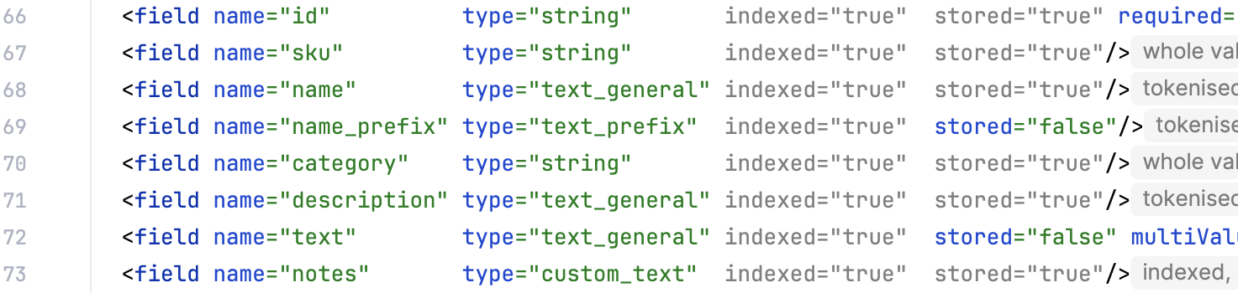
DEEP DIVE 16 OF 18 · ANNOTATOR + INTENTION
A written value that changes nothing gets dimmed, not underlined
WHAT IT SHOWS
indexed="true" and stored="true" render fully grey — name and value both — when they only restate what Solr would supply anyway.
WITHOUT IT
A reader cannot tell load-bearing attributes from decorative ones without hovering each one in turn.
DATA SOURCE
The same property table quick documentation reads, comparing the written value to the resolved default.
MECHANISM
annotator, not inspection — a restated default is correct Solr. SolrRestatedDefaultAnnotator, paired with a removal intention.
managed-schema.xml:66-73, untouched — the dim renders itself, no interaction.
Source: configset/schema/annotator/SolrRestatedDefaultAnnotator.kt; configset/schema/intention/SolrRemoveRestatedAttributeIntention.kt; docs/glossary.md “annotator”; docs/screenshots.md entry 11
19
Notes:
The standing rule that inspections must not fire on a correct file forced this into a different mechanism entirely — an annotator at information severity, reaching neither an underline nor the Problems view, which is the platform's own idiom for 'true but removable' code. stored="false" on name_prefix stays full-strength in the same frame, which is the contrast that makes the claim visible: it changes something, so it is load-bearing. The dim and its removal intention share one predicate so they cannot disagree about which attributes qualify, and the intention is proven, not assumed, to leave the parsed model identical before and after.

Slide 20
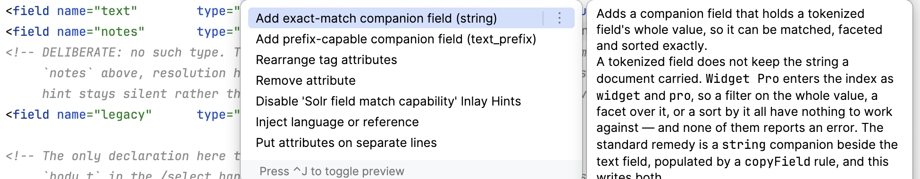
DEEP DIVE 17 OF 18 · INTENTIONS
Alt-Enter offers to add the exact-match or prefix field a tokenised field lacks
WHAT IT SHOWS
Alt-Enter on a tokenised field offers to generate a StrField-backed *_exact or EdgeNGram-backed *_prefix companion field, plus its copyField.
WITHOUT IT
A reader hand-writes the companion field, its field type, and the copyField rule — three coordinated edits done from memory instead of one gesture.
DATA SOURCE
The model's own match-capability analysis — the same one behind the inlay hint on slide 1 — decides what capability is missing.
MECHANISM
intentionAction — SolrAddExactCompanionIntention / SolrAddPrefixCompanionIntention. An intention, not a quick-fix: the field being incomplete is not wrong.
Alt-Enter on description (a tokenised text_general field) at managed-schema.xml:71.
Source: configset/schema/intention/SolrAddExactCompanionIntention.kt, SolrAddPrefixCompanionIntention.kt; docs/screenshots.md entry 12
20
Notes:
This is the first time in the whole feature set that the plugin edits a configset rather than only explaining or completing one. The availability rules live in pure functions over the model rather than inside the IntentionAction class, specifically so the cases that decide NOT to offer can be tested without booting an IDE — an intention offered where it does not apply gets acted on, which is worse than one simply missing. Reuse of an existing declared type matches the implementing class, not the type's name — every unanalysed numeric or date type qualifies for exact-match reuse, and borrowing the wrong class would fail silently at index time rather than in the editor.

Slide 21
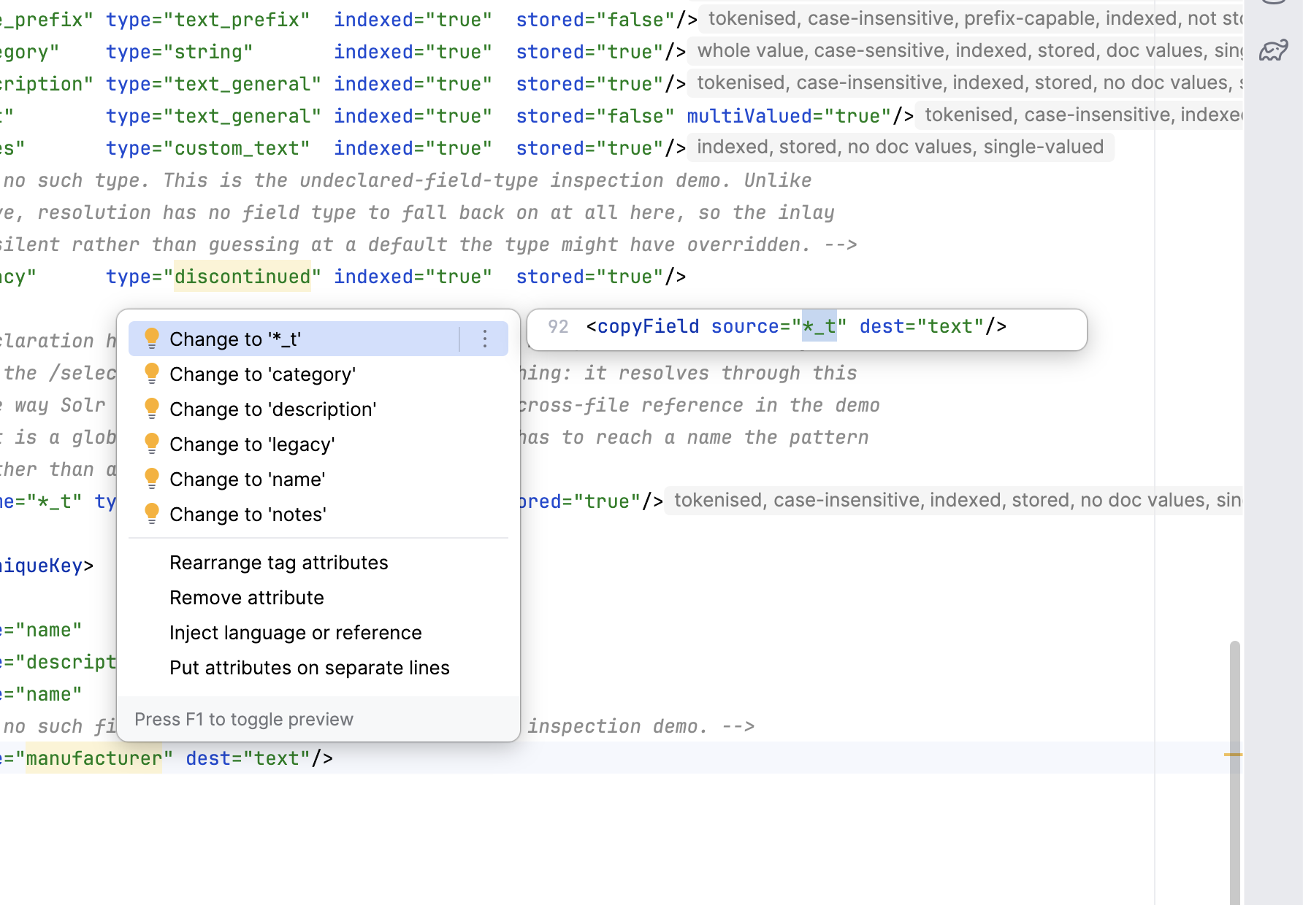
DEEP DIVE 18 OF 18 · INSPECTIONS
Eleven inspections, and the one rule that keeps every one of them honest
WHAT IT SHOWS
A dangling copyField draws a warning underline with Alt-Enter quick-fixes ranked by edit distance to the typo.
WITHOUT IT
A reader finds a dangling copyField only when the core fails to reload — in Solr's error language, in production, not in the editor a moment after typing it.
DATA SOURCE
The parsed configset model. Never a running server, never an index.
MECHANISM
localInspection, level="WARNING" always. Eleven registered; ten held to a zero-findings gate against Solr's own shipped configsets.
managed-schema.xml:92, caret on manufacturer, Alt-Enter.
Source: plugin.xml (11 localInspection registrations, counted directly); SolrShippedConfigsetTest.kt; docs/glossary.md “inspection”; docs/screenshots.md entry 4
21
Notes:
The rule this codebase cares about most, stated in its own words: an inspection must not fire on a correct file, because Solr configuration is full of syntax that resembles a field name without being one — fl legitimately holds score, *, [docid], max(price,0). Every registration uses level="WARNING" rather than ERROR, because the plugin's model of a half-typed file is never treated as authoritative enough to claim a hard error. Proof rather than assertion: SolrShippedConfigsetTest runs the whole rule set against Solr's own _default and sample_techproducts_configs configsets, on both supported lines. Ten of the eleven report nothing. The eleventh, the unused-field-type rule, is held out of that gate by name, because Solr's own shipped configsets declare spare field types deliberately — a separate assertion pins that it does fire, so silencing it is not a way to pass. Quick-fix candidates are ranked by edit distance and capped at six, because the inspection already computed the valid set in order to decide it was wrong, and discarding that list would be the difference between an editor that helps and one that only complains.

Slide 22
ACT 1 · RECAP
Eighteen slides, eighteen real screenshots
Every feature slide traces to a real capture in docs/images/ and a real plugin.xml registration.
Match hints · quick doc (field, class, version) · schema completion · factory-attribute completion · solrconfig structure at the root and nested in <query>/<indexConfig> · parameter-name completion · field names inside parameters · solrconfig→schema navigation · resource navigation · Find Usages · rename across files · dimmed restated defaults · companion-field intentions · inspections
Shipped since, each with its own act: the Server track (Act 4) and the Code track (Act 5).
Almost nothing shown here reads an index or contacts a server. A configset is text, and the reference data behind most of these features was generated once, at build time, from Solr's own artifacts.
Source: docs/screenshots.md; docs/images/ (18 catalog entries, 20 files); specs/plans/0002-solr-intellij-plugin-plan.md
22
Notes:
Restate the honesty framing once more before leaving features behind: this is not a finished three-surface product, it is the Editor track, documented completely, with receipts. Transition into Act 2: everything just shown is built on a handful of IntelliJ Platform mechanisms — extension points, PSI, dumb mode, a declared-dependency cache — and Act 2 explains each of those from zero, in the vocabulary a Java engineer already has, using this exact codebase as the worked example throughout.

Slide 23
02
IntelliJ plugin development,
in a Java engineer's own vocabulary
PLUGIN DEV
Extension point — an SPI the platform calls into
plugin.xml — the only wiring there is
PSI — a live, mutable AST
Dumb mode — an index still importing
CachedValuesManager — declared invalidation
Testing — @SpringBootTest, with a trap
23
Notes:
Everything in this act is grounded in docs/glossary.md, a 54-term reference this team wrote specifically to give a Java engineer a Java analogue for every IntelliJ Platform and Solr term used in this deck — read it directly rather than the toy dev.example.solrconfig tutorial elsewhere in the repo. Every analogue in this act comes from that document's own 'In Java terms' callouts, chosen because they are accurate enough to reason from, with the point where each analogy breaks stated explicitly rather than glossed over.

Slide 24
ACT 2 · PLUGIN DEV
An extension point is an SPI — plugin.xml is your META-INF/services
Java SPI
plugin.xml
=
META-INF/services/*
ServiceLoader finds it
names interface + class,
as a STRING
IntelliJ Platform
@RestController
Your extension
reads plugin.xml,
owns the editor loop,
calls you when it fires
=
Spring calls it —
no socket, no accept loop
CompletionContributor,
Inspection, Reference...
A class renamed without updating its plugin.xml string compiles clean and loads nothing. Nothing warns you.
Source: docs/glossary.md “extension point”, “plugin.xml”; src/main/resources/META-INF/plugin.xml
24
Notes:
The glossary's own words: 'An extension point is the platform's term for a named slot a plugin can register an implementation into... plugin.xml plays the role META-INF/services/* plays for ServiceLoader — it names an interface and the class that implements it — and the platform, not this plugin, decides when to call in.' The reframe worth landing: think about what you do NOT write in a Spring controller — no socket, no accept loop, no thread pool — you write one method, tell the framework where it belongs, and it calls you when a request shows up. Plugin development is the identical deal with the IDE playing Tomcat's role. Where the analogy sharpens rather than just holds: plugin.xml registrations are strings, so a class renamed without updating its registration compiles cleanly and silently loads nothing — exactly the failure SolrPluginDescriptorTest exists to catch, by reflecting over every class name the file lists.

Slide 25
ACT 2 · PLUGIN DEV
PSI is a live, mutable AST — not a DOM tree you parsed yourself
javac AST
A DOM tree
PSI
CompilationUnitTree —
throwaway, per compile
mutable, held onto —
closer, but still not live
live AND mutable —
stays current as you type
Because PSI can go stale mid-edit, this plugin's OWN model holds none of it:
SolrFieldModel
SolrSchemaPsi
plain data — field names,
types, properties.
NO PsiElement anywhere in it.
re-derives “where was this
written” from live PSI,
on demand, when navigation asks.
val schema: XmlTag? = xmlFile.rootTag // a live node, not a copy
Source: docs/glossary.md “PSI”; configset/navigation/SolrSchemaPsi.kt:16 (KDoc)
25
Notes:
Glossary, verbatim on the limit of the analogy: 'A live, mutable AST — closer to a DOM tree you can safely hold a reference into than to javac's throwaway CompilationUnitTree. The limit of the analogy is exactly that liveness: PSI stays live and mutable while the user types, so a PsiElement reference can go stale mid-edit.' That liveness is why this plugin's own field model is a plain data structure holding NO PSI at all — SolrSchemaPsi's own comment says so directly. The model can say a field type named text_general exists, but not where it was written; navigation re-derives that from PSI on demand rather than the model caching a reference that could go stale. Why not just parse the XML with a favourite library instead, the way a batch job would? Three reasons worth stating in order: the file on disk is stale the instant the user types (PSI reflects the buffer, not the saved file); parsing per keystroke would make the plugin a space heater; and every other plugin would be doing the identical parse, redundantly. PSI is the platform solving this once, for everybody, and sharing it.

Slide 26
ACT 2 · PLUGIN DEV
Dumb mode is an index still importing — queries against it are skipped, not queued
While a project's indexes build, IntelliJ is “dumb” — it runs, but nothing backed by an index can answer.
A contribution that has not declared itself DumbAware is SKIPPED ENTIRELY while indexing runs. Silent — no log, no error.
This plugin reads no index at all, so every contribution declares dumb-awareness — and the opt-in is NOT uniform:
  LocalInspectionTool / CompletionContributor → override isDumbAware()
  DocumentationProvider / inlay providers → the DumbAware marker interface
  A wrong guess on the marker-interface cases compiles clean and silently does nothing — forever.
The hard-won rule, from a defect this project actually shipped: a contribution must BOTH decline the declaration AND guard index access with DumbService.
An earlier version of this rule said OR. Declining alone keeps a feature out of the paths the flag gates — but its resolve() can still be called directly by something walking references at a caret, and unguarded, that throws during indexing and can take an unrelated popup down with it.
Source: docs/glossary.md “dumb mode”; docs/platform-mechanisms.md; CLAUDE.md “Rules no build gate enforces”
26
Notes:
Tell this as a real incident, not an abstract rule, because it is one. For months, completion, the original inspections, quick documentation and the inline match hints did nothing at all while a project indexed, then started working, with nothing logged and no visible cause — the worst possible failure shape for an editor plugin, because it is not a crash and not a wrong answer, it is absence, in the exact window when someone opening a Solr project for the first time is most likely to be opening configset files for the first time too. The fix, stated as CLAUDE.md now states it: every contribution that CAN declare dumb-awareness does, because nothing here reads an index. The one exception, and the one place both halves of the AND rule are actually exercised: resolving a class= attribute reaches JavaPsiFacade, the single index-touching contribution in the whole plugin.

Slide 27
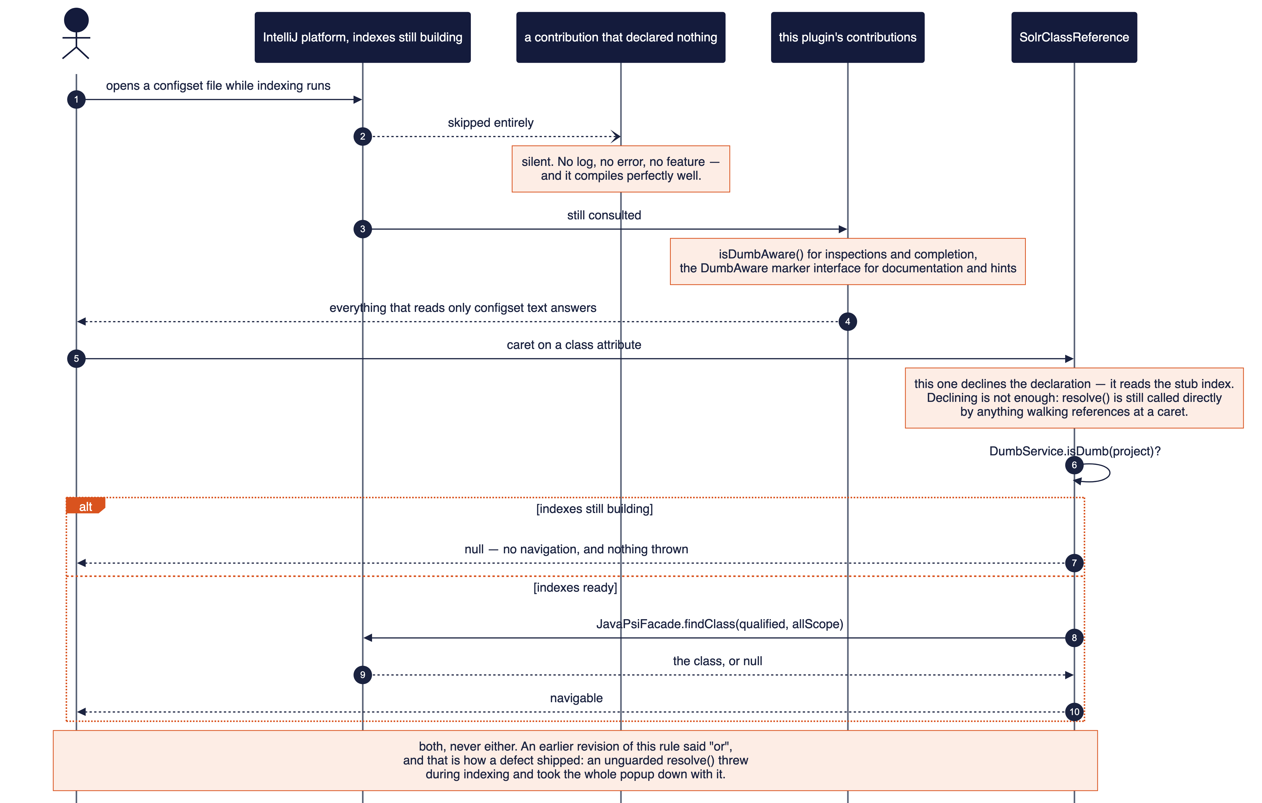
ACT 2 · PLUGIN DEV
Declaring dumb-awareness is half the contract — the guard is the other half
Source: docs/platform-mechanisms.md “Dumb mode, and DumbAware”; configset/navigation/SolrClassReferenceContributor.kt
27

Slide 28
ACT 2 · PLUGIN DEV
Invalidation is declared up front, not triggered by hand
The Java instinct
CachedValuesManager
ConcurrentHashMap<Path, Model>
you populate and evict by hand
a Caffeine cache with a declared
Expiry — invalidation is configuration
SolrConfigsetReader.modelFor — the one place this plugin uses it:
Hangs on the PsiDirectory
Deps: both files’ PSI + VFS count
not a map this class owns —
a path-keyed map outlives the
configset it once named
NOT PsiModificationTracker—
that fires on ANY PSI change
anywhere in the project
“Never build a cache in front of SolrConfigsetReader.modelFor — a fact it doesn’t already read must join its dependency list.” — CLAUDE.md
Source: docs/glossary.md “CachedValuesManager”; configset/reading/SolrConfigsetReader.kt; docs/platform-mechanisms.md
28
Notes:
Glossary, on the instinct this corrects: 'The instinct a Java engineer brings here — I'll just keep a ConcurrentHashMap<Path, Model> and invalidate it myself — is exactly the wrong move in this codebase.' CachedValuesManager is closer to a Caffeine cache configured with a custom Expiry you define once than to a bare map you populate and clear by hand — you supply a computation and a list of dependencies, and the platform owns storage, thread-safety, eviction and recomputation. SolrConfigsetReader.modelFor is the one place this plugin uses it, and both choices there were arrived at by being wrong first, which is worth telling as the real story: the cache hangs on the configset's PsiDirectory rather than in a map this class owns, because a map keyed by path outlives the thing it names — a configset deleted and recreated at the same path would find a stale entry pointing at files that no longer exist. And its dependency list is the two source files' PSI PLUS the VFS structure-modification count, not the reflex choice of PsiModificationTracker.MODIFICATION_COUNT, which advances on ANY PSI change in the whole project and would reparse both configset files on an unrelated keystroke in some other file entirely. CLAUDE.md states the resulting rule outright: never build a cache in front of SolrConfigsetReader.modelFor — it already caches through the platform, and a fact read from a file the reader does not already read must join its dependency list, or the model goes stale after the first edit.

Slide 29
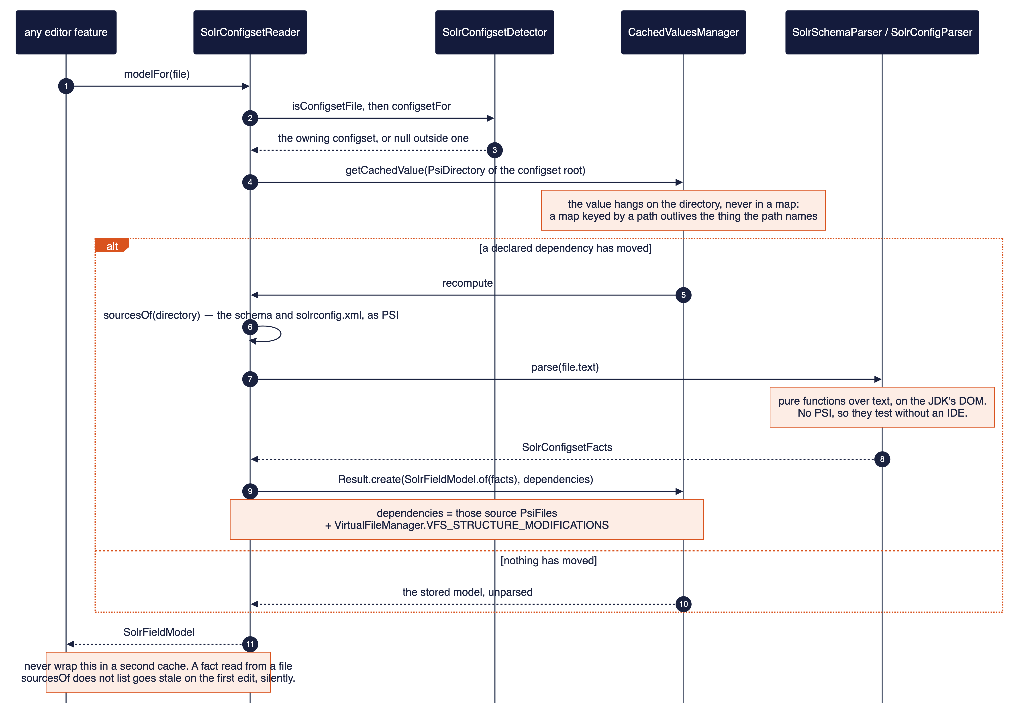
ACT 2 · PLUGIN DEV
One model, every feature — and the platform decides when to throw it away
Source: docs/platform-mechanisms.md “Caching the field model”; configset/reading/SolrConfigsetReader.kt
29

Slide 30
ACT 2 · PLUGIN DEV
BasePlatformTestCase is @SpringBootTest, not a plain unit test — and its JUnit version is a trap
Anything with PSI in it boots a real, headless IDE — closer to @SpringBootTest than to a mock.
Despite the JUnit 4 dependency, it is JUnit-3-STYLE: methods must be named testSomething() and are found by that prefix, not by @Test. An @Test method with a different name silently does not run.
Anything importing nothing from the platform is plain JUnit 4 — roughly a third of this suite, 25 of 74 test classes.
No container to boot, milliseconds instead of a second per test — this is what model importing zero IntelliJ types buys, concretely (see Act 3).
A green ./gradlew build is not the same as a working feature.
Every fixture test builds its subject directly and never touches plugin.xml. A package rename once left three inspection registrations pointing at a deleted package: the build was green, all three were dead in the real IDE. SolrPluginDescriptorTest — plain JUnit, reflection over every plugin.xml class name — closes exactly that gap in milliseconds.
Source: docs/glossary.md “BasePlatformTestCase”, “plugin.xml”; docs/how-to/testing-and-the-build-gates.md
30
Notes:
Land this as the payoff slide for the act. The @SpringBootTest analogy is precise and worth dwelling on: BasePlatformTestCase boots a real container — a light in-memory IDE project — rather than mocking collaborators, exactly the same trade a Spring integration test makes over a sliced unit test. The JUnit-version trap is real and specific to this platform: the class depends on JUnit 4 yet is JUnit-3-style underneath, so an @Test-annotated method with the wrong name compiles, appears in the test report as a class with fewer tests than expected, and nobody notices. The 25-of-74 figure was computed directly this session — not copied from an older doc — by partitioning every test file three independent ways (extends a platform base class, imports org.junit.Test, imports com.intellij directly) and confirming the first two partition without overlap.

Slide 31
ACT 2 · RECAP
Four ideas that explain almost everything in Act 1
1. Extension point = SPI — you implement an interface, plugin.xml names it, the platform calls you.
2. PSI is a live, mutable AST — which is exactly why this plugin's own model holds none of it.
3. Dumb mode is an index still importing — decline AND guard, not decline OR guard.
4. CachedValuesManager wants declared dependencies, not a hand-rolled map you evict yourself.
Contributions thin, services fat — every fact Act 1 displayed traces back to a plain function over parsed text or bytecode, tested without booting anything. Act 3 is that services layer.
Source: docs/glossary.md
31
Notes:
Bridge into Act 3: everything just covered is the platform's half of the deal — the contract a contribution has to honour to get called at all. It says nothing about where the actual Solr knowledge should live, which is exactly the question Act 3 answers, with a package tree that mirrors these same four ideas almost exactly: model/ is the domain layer with zero platform imports, configset/ is where the platform-facing adapters live, one subpackage per extension point kind.

Slide 32
03
What lives where,
and the rules that keep it there
CODE LAYOUT
The organizing principle — the caret test
The tree, by weight
model/ — a domain layer with zero platform imports
The one prohibition the whole tree protects
The shared layer — parsing vs. reading
server/ and where later work goes
32
Notes:
Act 3 walks src/main/kotlin/org/apache/solr/ide/ using docs/code-organization.md as the primary source, which is explicitly the human-facing account of a structure Dokka also renders from the same KDoc — and which itself says the plan, not this document, owns what is built. Two rules recur constantly through this act and are worth flagging now so the room recognises them each time: model imports no IntelliJ type (which is what makes roughly a third of the test suite plain JUnit, from Act 2), and schema and solrconfig may never import each other.

Slide 33
ACT 3 · CODE LAYOUT
The caret test: which file is the user's cursor in when this fires?
Surface
Subject
Gesture
configset · server · (code)
which Solr thing — schema, solrconfig
inspection, completion...
“A capability falls under an aspect when the caret that triggers it is always in that aspect's file.”
Single-file capability
Cross-file capability
inspection · completion · reference
lives inside schema/ or solrconfig/
Find Usages · rename
lives at the configset ROOT —
configset.navigation
configset.schema ↔ configset.solrconfig — never import each other, either direction
Source: docs/code-organization.md “The organising principle”
33
Notes:
Read the rule exactly as the document states it, because the precision is the point: 'A capability falls under an aspect when the caret that triggers it is always in that aspect's file.' An inspection visits tags in one file and reports there; a completion provider answers at a caret in one file; a reference contributor decides which tags in which file carry references — all three single-file by nature, so they sit inside schema/ or solrconfig/. A capability that traverses the configset by NATURE does not pass this test: Find Usages starts on a schema declaration and must reach solrconfig.xml; rename must update the qf line there too. Those live at the configset ROOT, in configset.navigation, specifically because filing them under schema would make configset.schema import configset.solrconfig — the one prohibition the whole tree exists to protect, covered on its own slide next. In Java terms this is a dependency rule enforced by review, not the compiler — the same discipline as a hexagonal-architecture port boundary between two adapters that must not know about each other.

Slide 34
ACT 3 · CODE LAYOUT
org.apache.solr.ide, by weight
model — zero IntelliJ types anywhere.
schema/ what a field IS · vocabulary/ what a FILE may contain
configset — the files in the repository.
activation, reading, editing, navigation (shared) · schema/ (9 leaf packages) · solrconfig/ (6, catching up)
server — connection settings only, today.
org.apache.solr.ide
├─ model/ schema, vocabulary (no IJ types)
├─ configset/
│ ├─ activation/ is this even a Solr project?
│ ├─ reading/ directory → one model, cached
│ ├─ editing/ guard rails, both aspects share
│ ├─ navigation/ Find Usages, rename (shared)
│ ├─ schema/ inspection·completion·intention·
│ │ reference·documentation·hint·
│ │ descriptor·annotator·parsing
│ └─ solrconfig/ parsing·inspection·completion·
│ reference·descriptor·documentation
└─ server/
└─ connection/ settings only — no client yet
Counts are files, to show weight, not to be kept current — and were counted directly against the source tree this session (75 .kt files under org.apache.solr.ide) rather than copied from an older figure.
Source: docs/code-organization.md “The tree”; src/main/kotlin/org/apache/solr/ide/ (counted this session)
34
Notes:
Two things worth pointing out live, both verified directly against the source tree rather than an older doc figure: schema/ has nine leaf packages (parsing, inspection, intention, completion, reference, documentation, hint, descriptor, annotator) while solrconfig/ has six (parsing, inspection, completion, reference, descriptor, documentation) and is still catching up — not an oversight, it is the most-edited file in a configset catching up on tooling, exactly the story Act 1's nesting and parameter-completion slides told. solrconfig/descriptor and solrconfig/documentation are the two packages behind the structure-completion and version-hover capabilities Act 1 spent three slides on — worth naming explicitly, since a tree that omitted them would show no home for capabilities just demonstrated. And notice what is absent by design: no service package, no util, no impl anywhere in this tree — every leaf is named for a platform extension-point kind.

Slide 35
ACT 3 · CODE LAYOUT
model — a domain layer with zero platform imports, the way a POJO domain stays free of @Entity
“Nothing in model imports an IntelliJ type.”
Load-bearing, not stylistic: 25 of the repo's 74 test files — roughly a third — are plain JUnit 4 precisely because of it. No fixture, no headless IDE, milliseconds instead of a second per test.
model.schema — what a field IS, whichever source described it.
SolrFieldModel merges a repository half and a server half into one SolrFact per property, reporting how they agree rather than resolving the disagreement away — filed here because it belongs to BOTH surfaces equally.
model.vocabulary — what a FILE may legally contain.
SolrClassCatalog, SolrElementCatalog, SolrParameterCatalog — all generated at build time, never hand-written.
Source: docs/code-organization.md “The organising principle”; docs/glossary.md “data class”; model/SolrFieldModel.kt
35
Notes:
In Java terms, straight from the glossary: this is the same discipline as a domain layer that imports no Spring or JPA type — model is SolrFieldModel and friends staying plain data, the same way a domain Order class stays a POJO instead of an @Entity. It buys the same thing a POJO domain model buys: those classes are testable with plain JUnit and no container, rather than needing BasePlatformTestCase just to construct one. The 25-of-74 count is the same one Act 2's testing slide gave, verified the same way — directly, this session, not copied. model earns its position outside the surface split twice over: it is what BOTH the repository reader and the future server reader need to produce, so filing it under either configset or server would be wrong either way; and it is the only tree with zero IntelliJ types anywhere in it, the concrete payoff of Act 2's 'contributions thin, services fat' principle — every fact Act 1's screenshots displayed ultimately traces back to a pure Kotlin function over parsed text or bytecode.

Slide 36
ACT 3 · CODE LAYOUT
The same completion contributor shape, enforcing a boundary neither aspect may cross
configset.schema.completion
configset.solrconfig.completion
THE ARGUMENT, IN THE SOURCE'S OWN WORDS
“configset.schema and configset.solrconfig must never import each other — one-directional, not a ban on the two appearing together.”
Completion answers the identical question — “what may legally be written here?” — in both files, from two separate contributors that share no import between them.
Left: attribute completion inside <field> (schema aspect). Right: element completion inside <config> (solrconfig aspect). Same shape of capability, same caret-in-one-file test — filed on opposite sides of a wall neither may cross.
configset.schema ↔ configset.solrconfig — never import each other
Source: docs/code-organization.md “configset.schema.completion and configset.solrconfig.completion”; SolrSchemaCompletionContributor.kt; SolrConfigElementDescriptorProvider.kt
36
Notes:
This slide is built directly from the completion section's own argument in code-organization.md, paired with two real screenshots already shown in Act 1 rather than a fresh capture — the point is that the SAME shape of capability appears on both sides of a boundary those two packages may never cross. Left is feature 5 (attribute completion inside a schema <field> tag); right is feature 7 (element completion inside solrconfig's <config>). Both answer the identical underlying question — what may legally be written at this caret — and both are implemented as completion contributors, yet SolrSchemaCompletionContributor and SolrConfigElementDescriptorProvider share no import between them. Neither may reach sideways into the other; both may be reached from the shared layer beneath them — model, configset.reading, configset.navigation — because composing them is what that shared layer exists to do. The test throughout is direction, not co-occurrence: sideways between the two aspects is forbidden, downward from the shared layer into both is the design. Concretely, in code: SolrNonIndexedRelevanceFieldInspection lives in configset.solrconfig.inspection and needs to know whether a field is indexed — it reads that fact from model, never by reaching sideways into configset.schema.

Slide 37
ACT 3 · CODE LAYOUT
parsing vs. reading: the boundary is exactly where the platform enters
managed-schema.xml
SolrSchemaParser
pure fn, no IJ types
SolrConfigsetFacts
SolrFieldModel
solrconfig.xml
SolrConfigParser
fields, types, copyFields,
uniqueKey, luceneMatchVersion
repository ⊕ server
(server empty today)
pure fn, no IJ types
SolrConfigsetReader.modelFor(PsiFile)
CachedValuesManager, hung on the configset’s PsiDirectory
deps: both source PsiFiles + VFS_STRUCTURE_MODIFICATIONS
read by: inspection · completion · reference · documentation · hint — never memoized a second time
Source: docs/code-organization.md “From files to the model”, “parsing and reading”; docs/glossary.md “CachedValuesManager”
37
Notes:
code-organization.md's own words: 'parsing and reading are two words for what looks like one job, and the difference is the most useful thing in this tree.' A parser turns ONE file's text into facts and knows nothing else — no directory, no caching, no IntelliJ types at all — which is what lets SolrSchemaParser and SolrConfigParser be tested as plain JUnit over a string. reading is the job above them: locate the configset's files, hand each to the right parser, merge the results into one model, and cache it through the platform — full of Project, VirtualFile and Service, and the only place that needs to be. SolrConfigsetReader.modelFor deliberately lives in configset.reading rather than beside any one feature, because otherwise four different features would each have to import a fifth. The cache itself is the CachedValuesManager story from Act 2, applied here concretely: hung on the configset's PsiDirectory, with a two-part dependency list — both source files' PSI catches an edit to THIS configset, and the VFS structure-modification count catches a solrconfig.xml appearing later in a configset that had none.

Slide 38
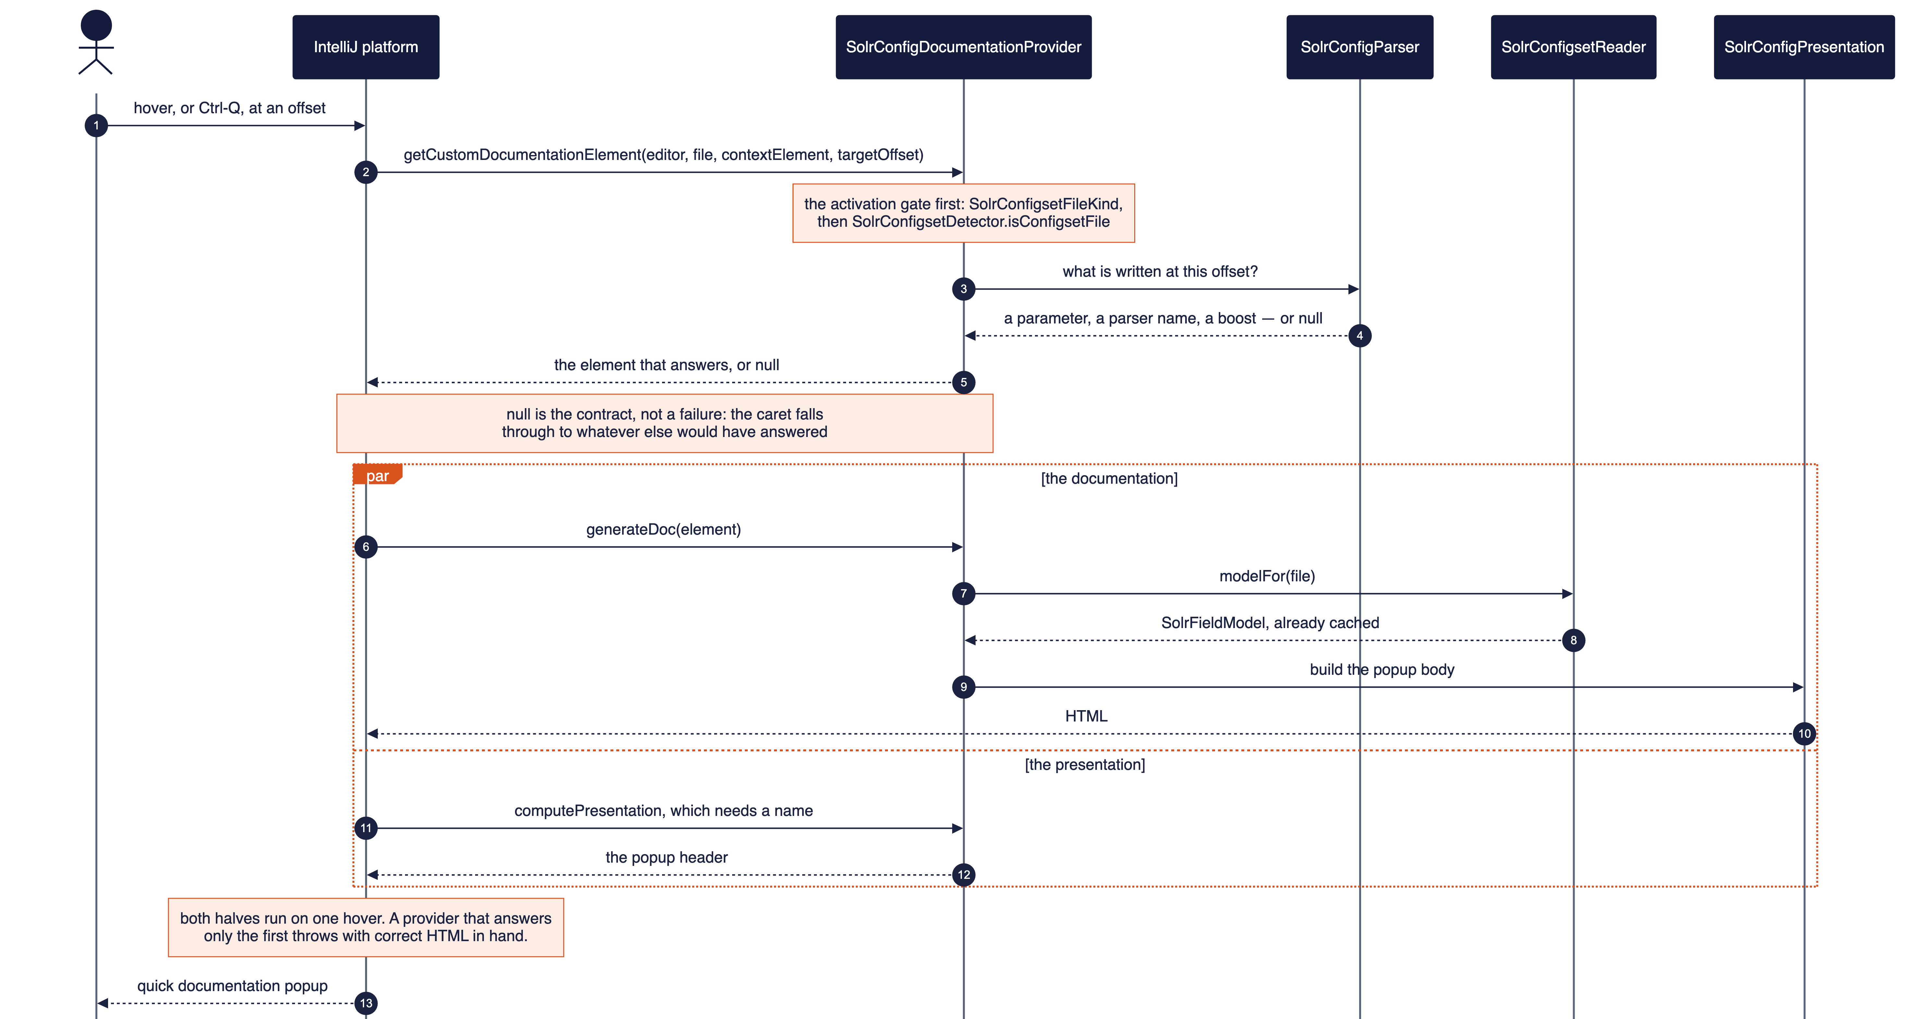
ACT 3 · CODE LAYOUT
One hover, two questions — a provider answering only the first still crashes
Source: docs/how-to/add-an-editor-feature.md “Quick documentation”; configset/solrconfig/documentation/SolrConfigDocumentationProvider.kt
38

Slide 39
ACT 3 · CODE LAYOUT
server/ — six packages, and a test that enforces the boundary
connection · transport · reading · topology · query · drift.
An HTTP client, a collections tool window, queries through the IDE's own HTTP Client, and a drift view that compares a configset against a collection. Nothing on the editor path may reach any of it — configset editing works with zero connection configured, by design.
The distinction that governs it: WHERE state may be written.
A configset root is a fact about the project and is shared (persisted through solr.xml, path-macro-collapsed). A connection is a fact about one developer's machine — workspace-local storage, credentials in PasswordSafe, never a committed file.
Where later work goes, stated plainly rather than left to guesswork:
SolrServerBoundaryContractTest walks the source tree and fails on any package outside server/ that imports it — an allowlist of consumers, not a denylist of editor packages, because a list of what to forbid is wrong the day someone adds a package. Indexing test documents is the one server step not yet built.
Source: docs/code-organization.md “The server surface”; server/SolrServerBoundaryContractTest.kt
39
Notes:
Close the architecture tour by being honest about scope one more time — it rhymes deliberately with the opening status slide. server/ today is exactly one file: connection settings, persisted per-developer rather than per-project because reaching a server is a fact about a machine, not about the repository. Nothing else exists yet, and the document is explicit that packages get created when they have a file to hold, not in advance — there is no empty server.query or server.driftview sitting around as a placeholder. That is the same 'contributions thin, services fat, and do not build ahead of what you need' instinct from Act 2, applied to the package tree itself.

Slide 40
04
The live server,
and what it declines to do
SERVER
Nothing on the editor path contacts a server — a test enforces it
A connection is a fact about one machine, never a commit
Disagreement is shown, never resolved on your behalf
After every write, read back — a 2xx is not agreement
40

Slide 41
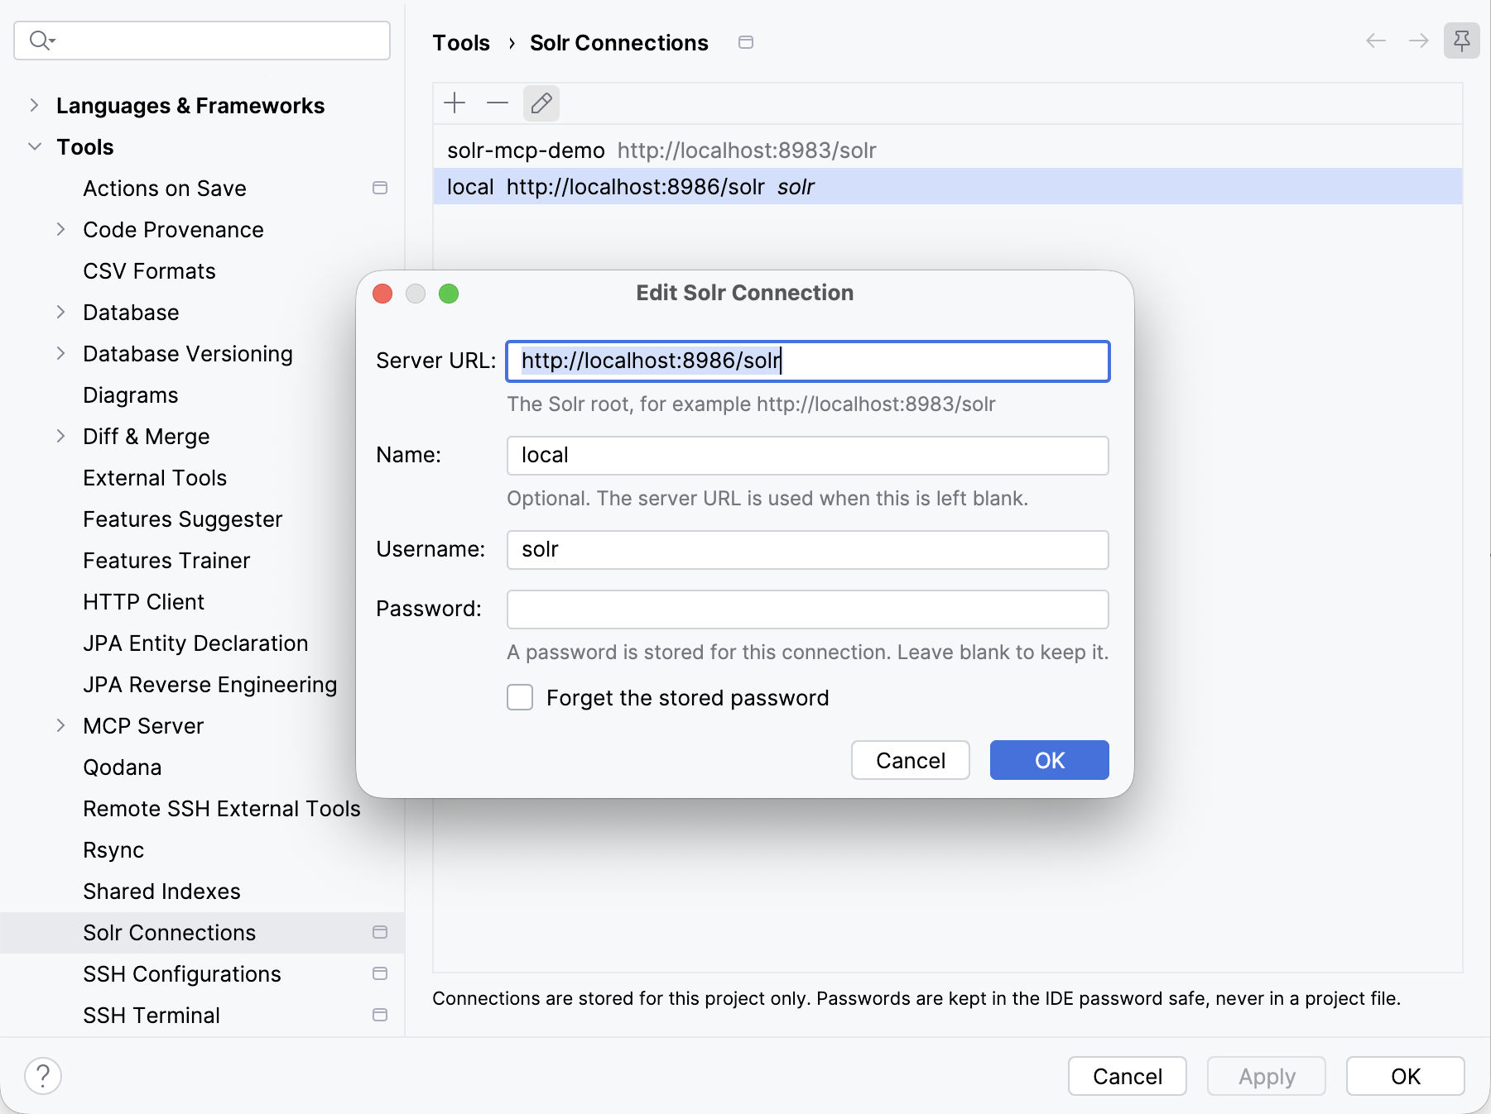
ACT 4 · 1 OF 8 · CONNECTIONS
A connection is one developer’s fact — never something a commit could carry
WHAT IT SHOWS
Settings → Tools → Solr Connections with one connection open: the password field empty, and saying a password is stored.
WITHOUT IT
Credentials land in a committed file — or a page shows an empty field and quietly treats it as “no password”.
DATA SOURCE
The workspace file for the URL and username; the IDE password safe for the secret. SolrConnection has no password field at all.
MECHANISM
SolrConnectionsConfigurable over SolrConnectionSettings. Saving without a new password leaves the stored one untouched.
Settings → Tools → Solr Connections, editing “local”. Captured in the 2026-09-26 sandbox pass.
Source: server/connection/SolrConnectionSettings.kt; plugin.xml projectConfigurable; docs/screenshots.md entry 22
41

Slide 42
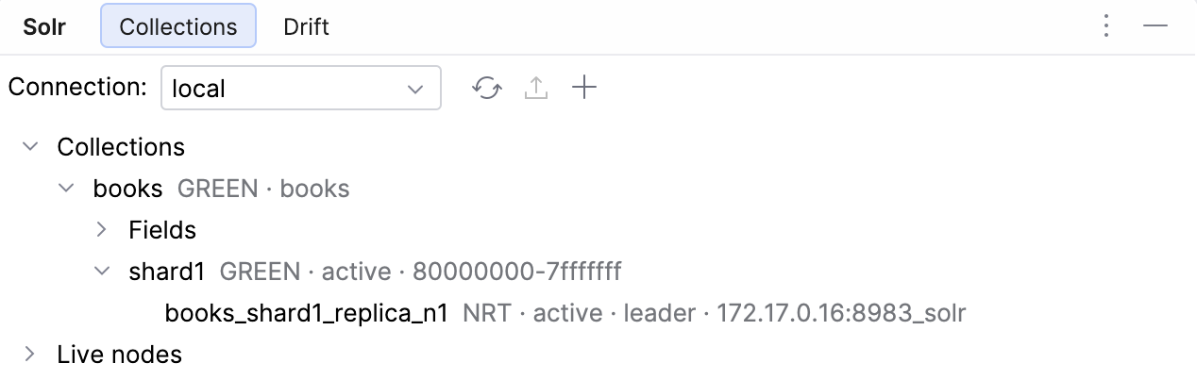
ACT 4 · 2 OF 8 · TOPOLOGY
The server’s own vocabulary — read first, never guessed
WHAT IT SHOWS
The Solr tool window on a SolrCloud server: a collection, its shard, and the shard’s replica marked leader.
WITHOUT IT
Assume the cloud vocabulary and every standalone Solr answers HTTP 400 — a hard failure reported against a healthy server.
DATA SOURCE
System info first, for the mode; then CLUSTERSTATUS for SolrCloud or core STATUS for standalone. Never on a timer.
MECHANISM
SolrCollectionsToolWindowFactory; SolrServerReader.topology, a suspending read off the UI thread.
A SolrCloud 10.0.0 container: books → shard1 → its leader replica.
Source: server/reading/SolrServerReader.kt; server/topology/; docs/screenshots.md entry 23
42

Slide 43
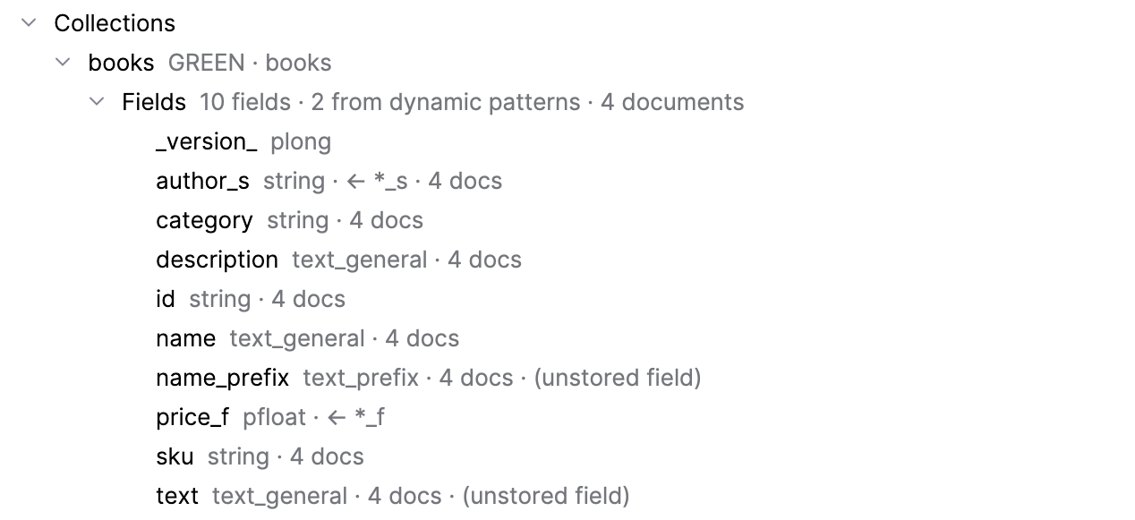
ACT 4 · 3 OF 8 · THE INDEX
What the index actually holds — including fields no configset names
WHAT IT SHOWS
A collection’s Fields row: author_s marked as coming from *_s, and price_f with no document count.
WITHOUT IT
The schema view cannot show author_s at all — it exists only because a dynamic pattern matched at index time.
DATA SOURCE
Solr’s Luke handler, read when the row is expanded — one request per collection, and only when asked.
MECHANISM
SolrLukeReader. Kept out of the field model on purpose: folded in, every dynamic field’s instances would read as drift.
10 fields, 2 from dynamic patterns. A point field reports no count — it has no inverted index to count from.
Source: server/reading/SolrLukeReader.kt; docs/screenshots.md entry 24
43

Slide 44
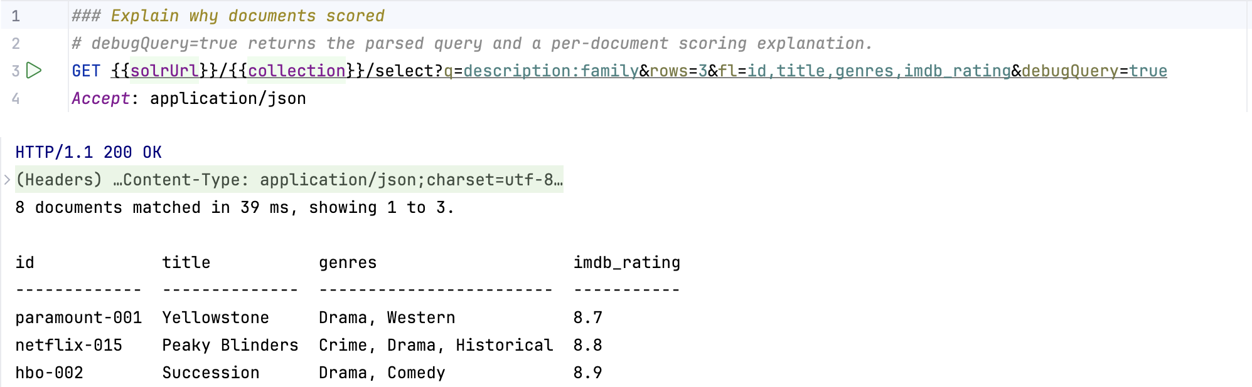
ACT 4 · 4 OF 8 · QUERIES
No console of its own — Solr’s knowledge added to the IDE’s HTTP Client
WHAT IT SHOWS
A request written against {{solrUrl}}/{{collection}}, run through the local environment, with a summary above the raw JSON.
WITHOUT IT
A committed query names localhost:8983 and works only for its author; the answer is a wall of JSON.
DATA SOURCE
The .http file and http-client.env.json — the host comes from the environment, never from the file.
MECHANISM
addRequestTemplateProvider and responseCustomPresentation — another plugin’s extension points, held by a contract test.
An explain request against a collection of 61 TV shows.
Source: server/query/SolrRequestTemplateProvider.kt, SolrQueryResponsePresentation.kt; docs/screenshots.md entry 25
44

Slide 45
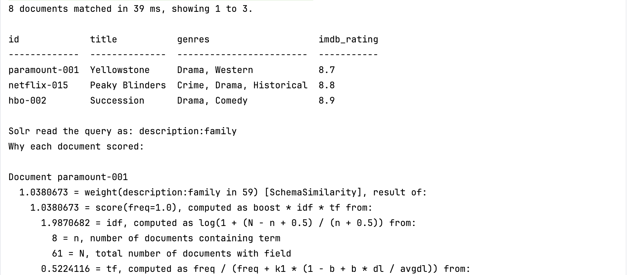
ACT 4 · 5 OF 8 · READING AN ANSWER
Matches and returned rows, stated separately
WHAT IT SHOWS
“8 documents matched in 39 ms, showing 1 to 3.” — then the table, the parsed query, and each document’s explanation.
WITHOUT IT
Someone concludes their query found three documents when it found nine thousand and showed three.
DATA SOURCE
The response body alone, recognised by its shape rather than its URL — Solr behind a proxy lives at any path.
MECHANISM
SolrQueryResultReader and SolrQueryResultRenderer. The explanation keeps Solr’s indentation: the nesting is the information.
The same response as the previous slide, lower down.
Source: server/query/SolrQueryResultReader.kt, SolrQueryResultRenderer.kt; docs/screenshots.md entry 25
45

Slide 46
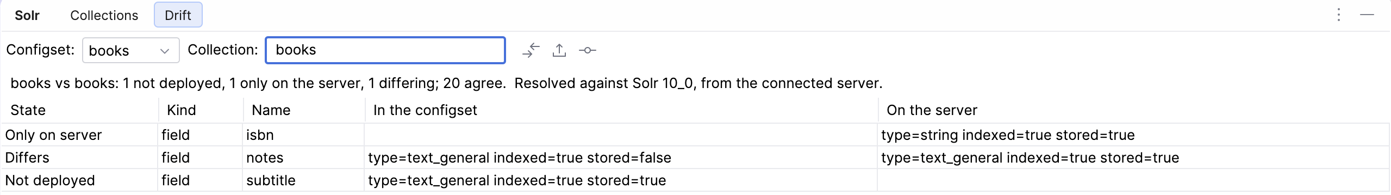
ACT 4 · 6 OF 8 · DRIFT
Three kinds of difference, and both sides of each
notes: stored=false in the configset, stored=true on the server — widen the columns, or both read alike.
WHAT IT SHOWS
A configset compared with the collection built from it: one field only on the server, one differing, one not deployed.
DATA SOURCE
The repository’s facts and the server’s schema, passed as two separate halves so neither can be resolved away.
WITHOUT IT
A Differs row showing one side — the convenient accessor prefers the repository and hides the disagreement.
MECHANISM
SolrDrift over SolrConfigsetReader.factsFor and SolrServerReader. SolrFact.effective is never called — six tests fail if it is.
Source: server/drift/SolrDrift.kt; specs/0002-solr-server-integration.md FR-9; docs/screenshots.md entry 19
46

Slide 47
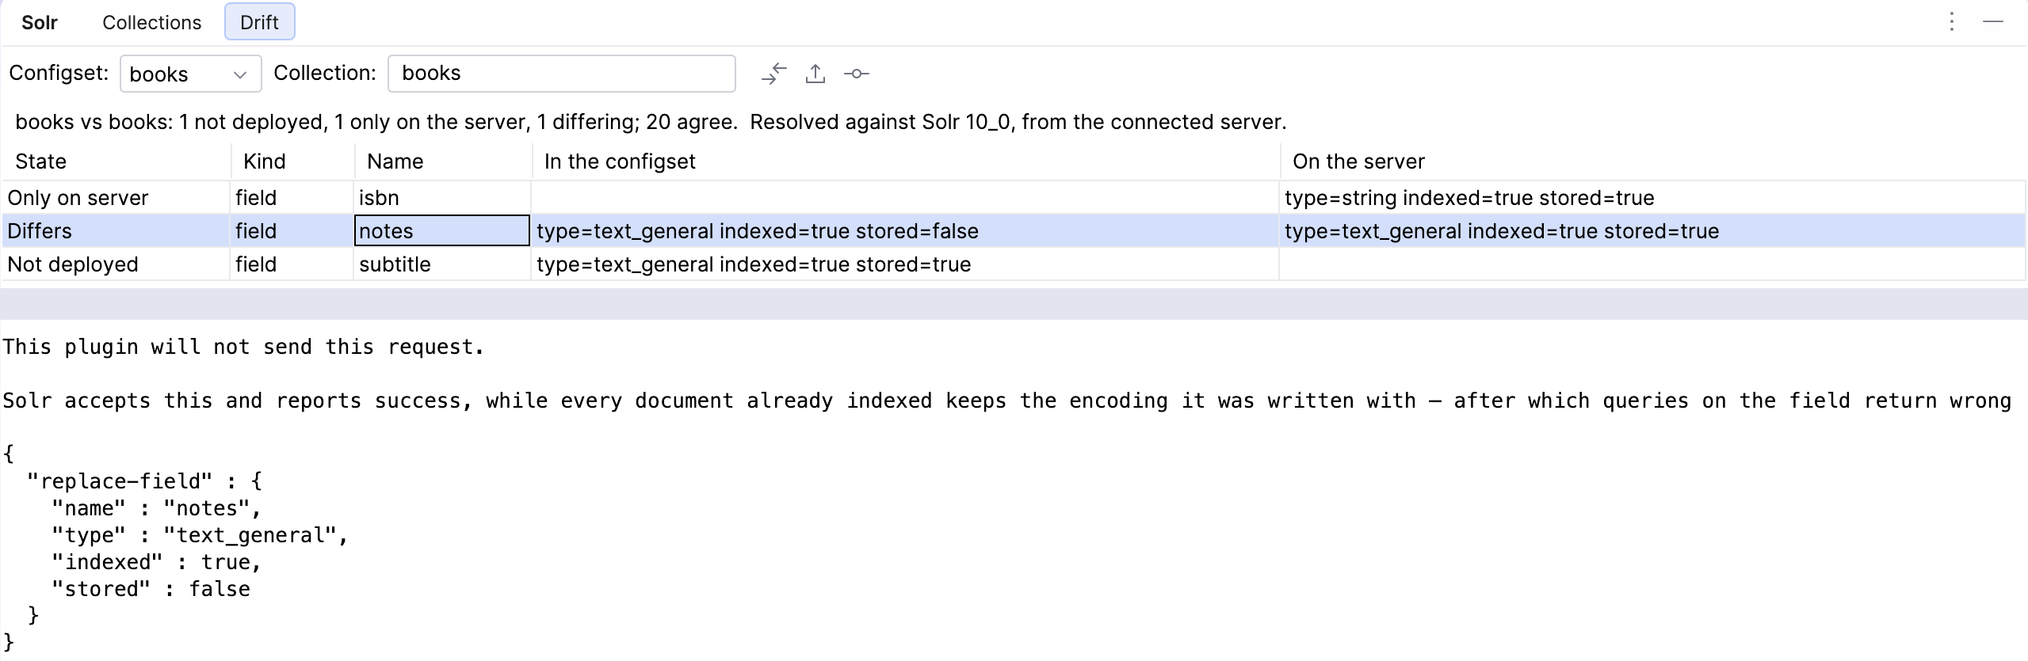
ACT 4 · 7 OF 8 · THE REFUSAL
The button that must not exist
The reason comes before the JSON, so nobody copies the request before reading why it is refused. The empty band between table and pane is cut for the slide.
WHAT IT SHOWS
A Differs row selected: “This plugin will not send this request.”, the reason, then the replace-field request.
DATA SOURCE
Verified against Solr 10.0.0, a string field changed to pint. Nothing in Solr’s reply to the write hints at it.
WITHOUT IT
Solr accepts a type change and reports success — then a stored value stops matching, and naming the field in fl fails with HTTP 500.
MECHANISM
SolrSchemaApi sends additions only. The refused request is still shown, reason first, for a reader ready to reindex.
Source: server/drift/SolrSchemaApi.kt; docs/user-guide.md “Closing a difference”; docs/screenshots.md entry 20
47

Slide 48
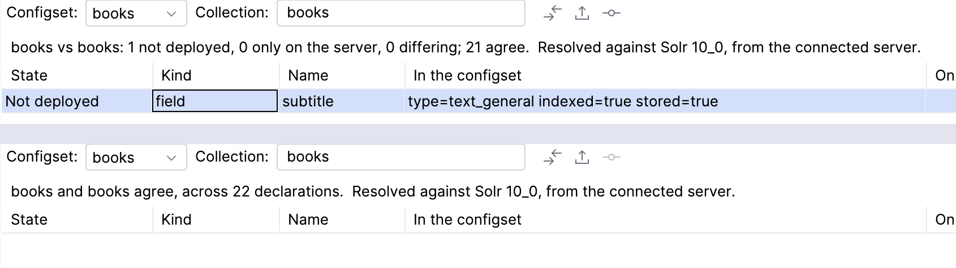
ACT 4 · 8 OF 8 · READ BACK
A 2xx is not agreement — the view shows what it read back
WHAT IT SHOWS
Top: one field not deployed. Bottom: after Apply, the collection re-read — “books and books agree, across 22 declarations”.
WITHOUT IT
A success code clears the table while the server still disagrees — an upload missing _version_ returns status 0 and builds nothing.
DATA SOURCE
A fresh read of the collection after every write — never the write’s own response.
MECHANISM
SolrDriftPanel re-fetches after upload, reload and apply; the confirmation names the count, the collection and the server first.
Before and after Apply Additive Changes, in the same view, choosers untouched.
Source: server/drift/SolrDriftPanel.kt; specs/0002-solr-server-integration.md FR-10; docs/screenshots.md entry 21
48

Slide 49
ACT 4 · RECAP
Eight slides, pressed in a running IDE
Every screen above was captured during the server track’s first sandbox pass, against a real SolrCloud 10.0.0.
Connections · the topology · the index’s own fields · queries through the HTTP Client · a readable answer · drift in three states · a refused change · an applied one, read back.
Three claims in the specification did not survive a running Solr — each found by checking, not by a bug report.
verifyPlugin reports Compatible for an extension point that does not exist · the named body injector was about request bodies, not completion · the coverage gate measures changed lines, line and branch.
Source: docs/presentation/server-track-outline.md; docs/manual-test-suite.md pass log, 2026-09-26; docs/screenshots.md entries 19–25
49

Slide 50
05
Field names in Java and Kotlin,
checked against the schema
CODE
One recognizer for both languages, written against UAST
Silent wherever it cannot resolve — precision over recall
Navigation crosses from Java into the XML that declares a field
A query runs from the line that writes it
50

Slide 51
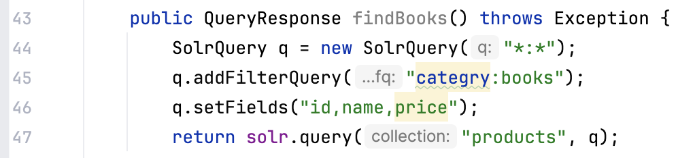
ACT 5 · 1 OF 4 · THE CHECK
A field name typo compiles, deploys, and returns nothing — until now
WHAT IT SHOWS
categry in a filter query and price in a field list, each marked at the name — id and name in the same string left alone.
WITHOUT IT
Solr answers a query on a missing field with zero results, not an error — the typo arrives as an empty page in production.
DATA SOURCE
Every configset in the project. Where there is none — a schema in another repository — the check says nothing.
MECHANISM
SolrUnknownCodeFieldInspection over SolrJRecognizer, written against UAST so Java and Kotlin share one implementation.
ProductSearch.java:43–47 in the demo, where both defects are planted.
Source: code/inspection/SolrUnknownCodeFieldInspection.kt; code/solrj/SolrJRecognizer.kt; docs/screenshots.md entry 26
51

Slide 52
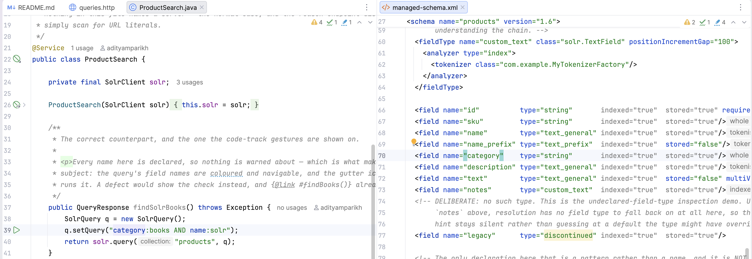
ACT 5 · 2 OF 4 · NAVIGATION
Ctrl-click a name in Java, land on the XML that declares it
Two files, one boundary: the query at line 39 on the left, the declaration it reached at line 70 on the right.
WHAT IT SHOWS
ProductSearch.java and managed-schema.xml side by side — the caret landed on <field name="category">.
DATA SOURCE
The same recognizer the check reads — so the reference is silent exactly where the check is silent.
WITHOUT IT
A name in code and its declaration in XML are related by convention, and by nothing the tooling can see.
MECHANISM
SolrCodeFieldReferenceContributor, resolving through the configset’s own schema.
Source: code/navigation/SolrCodeFieldReferenceContributor.kt; docs/screenshots.md entry 28
52

Slide 53
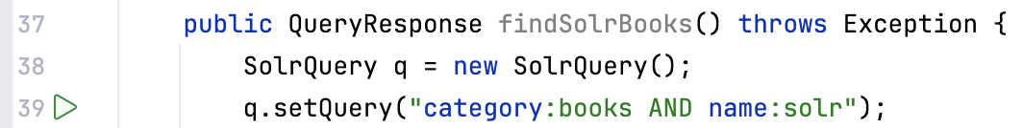
ACT 5 · 3 OF 4 · QUERY SHAPE
The fields and the operators, told apart — colour, not a parser
WHAT IT SHOWS
setQuery("category:books AND name:solr") with the two fields and AND picked out from the terms.
WITHOUT IT
A query read character by character — and a lowercase and taken for an operator when Solr reads it as a term.
DATA SOURCE
The same scan the check uses, so the two can never disagree about which characters are a field.
MECHANISM
An annotator over the recognizer’s query positions. No grammar, no injected language, no folding — chosen, and said plainly.
Default light theme: the colours are the platform’s own keys.
Source: code/highlighting/SolrQueryHighlightAnnotator.kt; docs/screenshots.md entry 27
53

Slide 54
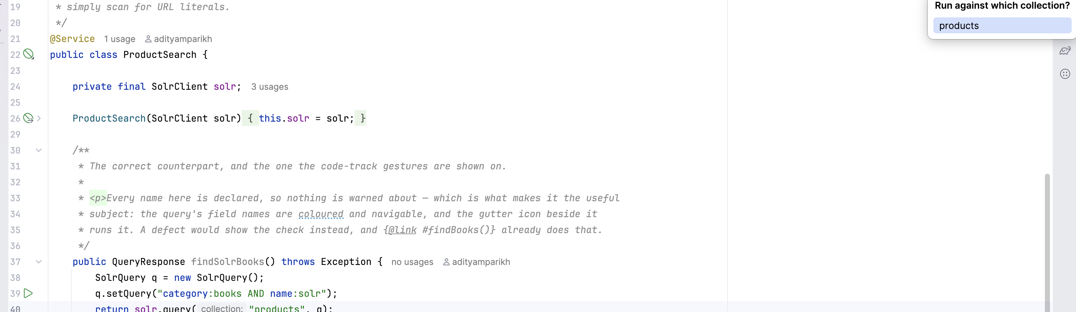
ACT 5 · 4 OF 4 · RUN IT
Running a query from where it is written
The chooser opens at the editor’s top-right corner, not beside the icon — hence the wide crop.
WHAT IT SHOWS
A gutter icon beside setQuery — and beside nothing else — with the collection chooser open.
WITHOUT IT
The query pasted into another tool, and the collection guessed — code names none; the client chose it.
DATA SOURCE
The selected connection’s own list of collections, asked when the icon is clicked.
MECHANISM
SolrRunQueryLineMarkerProvider → SolrQueryRunner: the one code path that reaches a server, allowlisted by a test.
Source: code/run/SolrRunQuery.kt; SolrServerBoundaryContractTest; docs/screenshots.md entry 29
54

Slide 55
ACT 5 · RECAP
One question, asked four ways: does this field exist?
Three surfaces now — the files you edit, the server you talk to, the code that names fields — over one model.
The check · navigation across the Java–XML boundary · a query’s structure in colour · a query run from its own line.
Every defect this track shipped and then fixed had one shape: a rule written down twice.
A test agreeing with the code about a template’s text while the platform read it as a key · a scanner where “-” was both a separator and a legal name character — Solr settled it in one query.
Source: docs/presentation/code-track-outline.md; docs/screenshots.md entries 26–29
55

Slide 56
In one sentence
Three surfaces, one model: the configset you edit, the server you deploy it to, and the code that names its fields — each checked against the same idea of what a Solr field is.
Getting there took a small, consistent set of platform ideas — extension points, PSI, dumb-awareness, declared cache invalidation — through a package tree whose domain model imports nothing from the IDE.
Every screen in Acts 1, 4 and 5 is a real capture. The server track’s were taken during its first sandbox pass against a real SolrCloud — twelve checks pressed, and one defect found that no test could have.
github.com/adityamparikh/solr-intellij-plugin · branch main
56
Notes:
Closing framing: this deck's job was to prove the shipped claims true with receipts, not to sell a finished product. Every Act 1 claim traces to a plugin.xml registration and a screenshot in docs/images/. Every Act 2 analogy traces to docs/glossary.md. Every Act 3 claim traces to docs/code-organization.md and the actual source tree; every Act 4 and 5 screen is a capture in docs/images/. Open the floor for questions — likely topics: what the server track’s first sandbox pass found that no test could, and why the Code track stops at SolrJ for now; the dumb-mode incident and what it actually cost before it was fixed; and the solrconfig.xml element-placement fix this session found and corrected, and what it took to reshoot the evidence honestly afterward.

