Slide 1
BE PROJECT
ANDROID VENDOR TRAINING
BE IT - A
Group Members
Name | Roll No.
Varsha Jha | 28
Aditya Nalge | 42
Rushabh Patel | 69

Slide 2
WHAT IS OUR PROJECT?
Our Project is an Android Application for Urbanity Multisolutions Private Limited (brand name DIDI) which is a start-up in the vocational education and service delivery space.
Our application will help the vendors teach their technicians new hard and soft skills in order to improve their service delivery.

Slide 3
ABSTRACT
The startup aspires to provide vocational training in all women centered services like house-keeping, beauticians, chef etc. and then create a marketplace for discovery of these services by end users.
The main objective of this app is to create an encyclopedic data for technicians which would contain a large number of skill enhancing tools.
A technician who uses the app would be able to learn about the different tasks he has to perform.
The tools required for these tasks, as well as the names of these tools along with the method of using these tools will be listed.
Another section of the app would help them learn basic English phrases which they can use while conversing with the clients.

Slide 4
WHAT IS PROBLEM DEFINITION?
THE WHO?
THE WHAT?
THE WHY?

Slide 5
OUR PROBLEM DEFINITION
Technicians employed by the start up need an android application which would help them to learn new skills while improving their existing skills.

Slide 6
METHEDOLOGY TO BE FOLLOWED
AGILE METHEDOLOGY

Slide 7
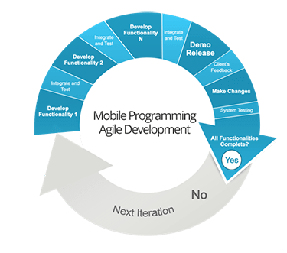

Slide 8
ADVANTAGES OF AGILE METHEDOLOGY
Customer Satisfaction by rapid, continuous delivery of useful software.
People and interactions are emphasized rather than process and tools.
Regular adaption to changing circumstances.
Even late changes in requirements are welcomed.

Slide 9
TECHNOLOGY REQUIRED
Android Studio
Java SDK Manager
SQL
Miscellaneous (E.g. - Microsoft Office)

Slide 10
DATA FLOW DIAGRAMS

Slide 11
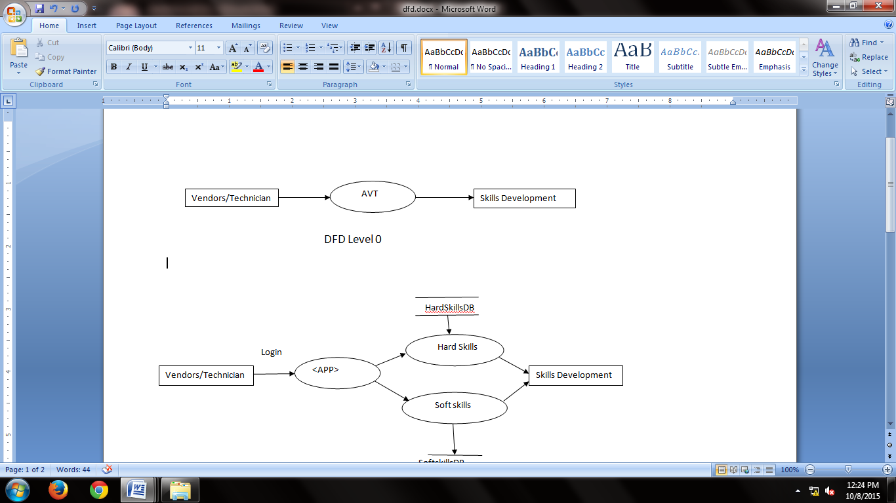
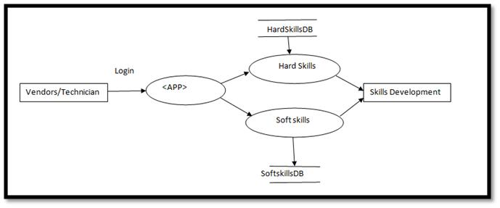
Level 0 Data Flow Diagram
Level 1Data Flow Diagram

Slide 12
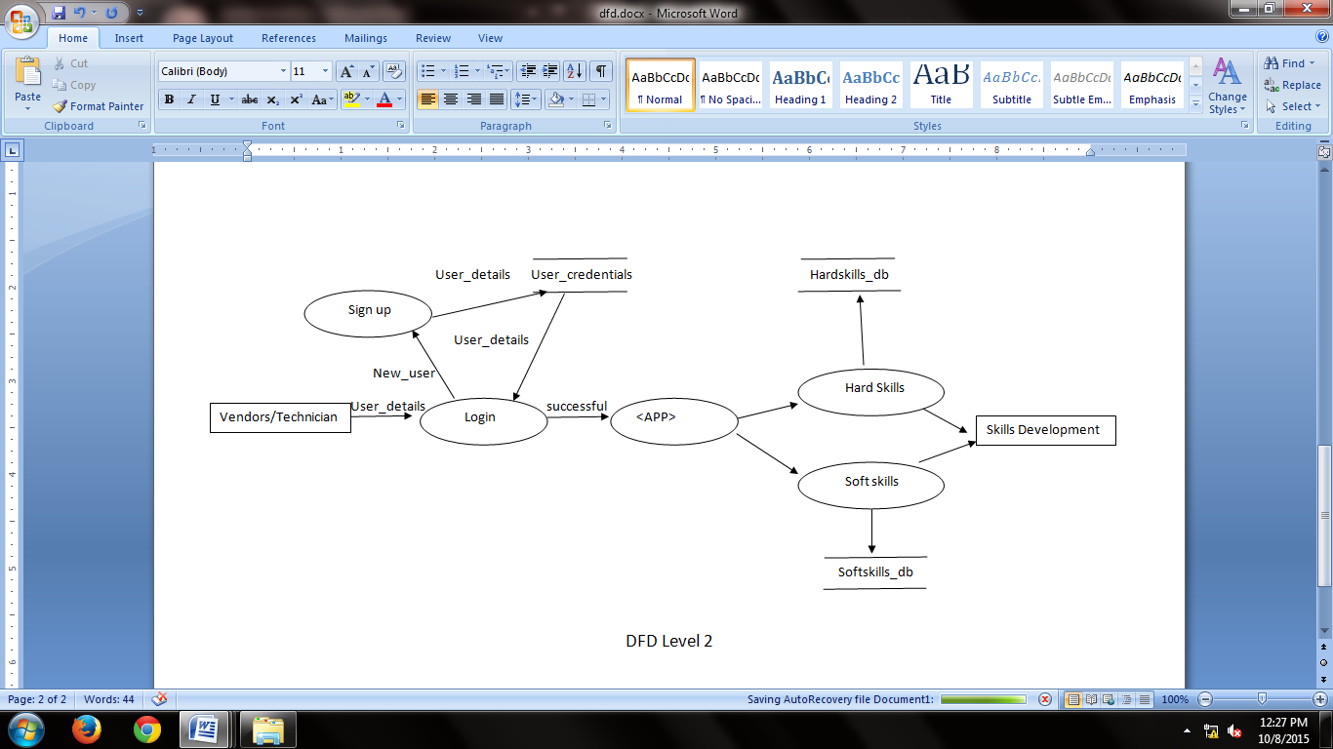
Level 2 Data Flow Diagram

Slide 13
USE CASE DIAGRAM

Slide 14
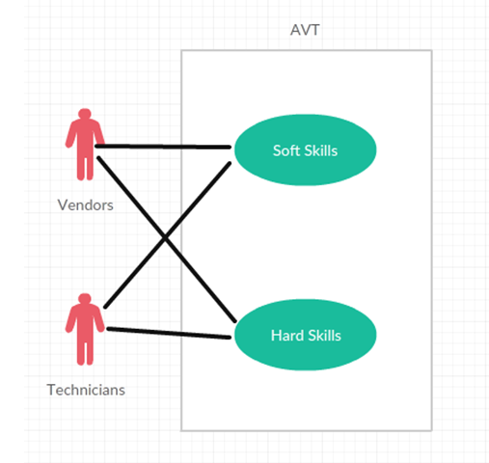

Slide 15
ACTIVITY DIAGRAM

Slide 16
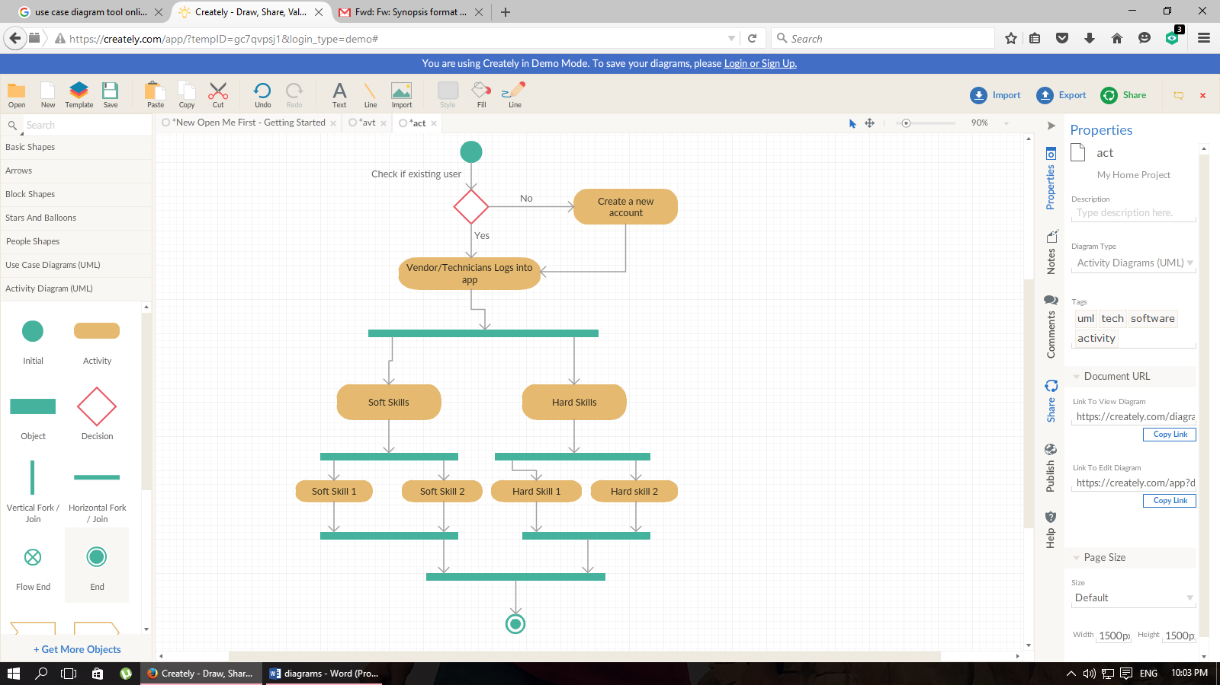

Slide 17
APRIORI ALGORITHM

Slide 18
The frequent item sets generated by Apriori algorithm are optimized using Genetic Algorithm as follows:
Step 1: Begin
Step 2: Read the sample record file, which fits in the memory (provided by the company)
Step 3: Apply Apriori algorithm on the sample data by setting the support and confidence values to generate the sets of requent item sets
Step 4: Apply selection method of genetic algorithm to this item set collection to select two technicians.
Step 5: Apply crossover and mutation on selected item sets to find association rules.
Step 6: Repeat the steps 3-5 till desired number of generations is obtained.
Step 7: End

Slide 19
Consider a sample database that contains the data of 20 maids with their name, experience, age, address, ID proof details.
We keep the minimum support in Apriori algorithm as 4 ( i.e the maid must have atleast 4 years of experience in cleaning houses). It consists of the sets:
{Meena, Jaya, Rekha, Sushma}, {Meena, Jaya, Rekha, Sushma, Heena}, {Jaya, Rekha,Sushma},
{Jaya, Rekha, Heena}, {Meena,Jaya,Rekha}, {Meena,Rekha,Sushma}, {Jaya,Rekha,Sushma,Heena},
{Meena,Rekha,Sushma,Heena}, {Rekha,Sushma,Heena}, {Meeena,Jaya,Rekha,Heena}

Slide 20
STEP 1
ITEMSET(Name of Maid) | SUPPORT(Experience)
Meena(1) | 6
Jaya(2) | 7
Rekha(3) | 9
Sushma(4) | 8
Heena(5) | 6

Slide 21
ITEMSET(Name of Maid) | SUPPORT(Experience)
{1,2} | 4
{1,3} | 5
{1,4} | 5
{1,5} | 3
{2,3} | 6
{2,4} | 5
{2,5} | 4
{3,4} | 7
{3,5} | 6
{4,5} | 4

Slide 22
STEP 2
ITEMSET(Name of Maid) | SUPPORT(Experience)
{1,3,4} | 4
{2,3,4} | 4
{2,3,5} | 4
{3,4,5} | 4
The algorithm will end here because the pair {2,3,4,5} generated at the next step does not have the desired support. So the above dataset will be considered feasible as per the organization’s demand.
Similarly, if we want 5 years of experience we would keep the minimum support as 5, as we are considering experience as the parameter.

Slide 23
ADVANTAGES
It will be easier to train technicians with the help of the application through visual representations.
Everything the technicians need to learn will be present at their finger tips.

Slide 24
DISADVANTAGES
It will be tedious to train those technicians to use the app who have absolutely no experience with android devices.

Slide 25
EXPECTED OUTCOMES:
Daily use of the application will help vendors to develop their skills.
It will solve a major problem for the startup which is finding trained professionals.
The startup can easily hire untrained professionals and train them with the help of the application.
The organization will be able to actively pursue continuous improvement.

Slide 26
Future Scope
In the initial period it will be tough to determine the future applications of the app but as the number of users grow many more ideas such as skill enhancing games can be included in the app.
A quiz feature can be included where in the user can test the knowledge they have acquired and the skills they have learnt

Slide 27
Thank You

