Slide 1
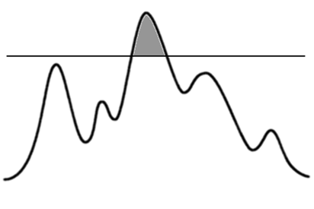
THRESHOLD ENCRYPTION SYSTEM
Mentor:
Professor Marina Blanton
Project By: Aditya Nalge
Arti Gupta
THRESHOLD

Slide 2
Project Motivation
Developing a (n, t) threshold encryption system for ‘n’ members which allows any single member to encrypt a message but requires atleast ‘t’ members to work together in order to decrypt it.
Even if up to ‘t-1’ members work together, they learn nothing about the original message from the cipher text.

Slide 3
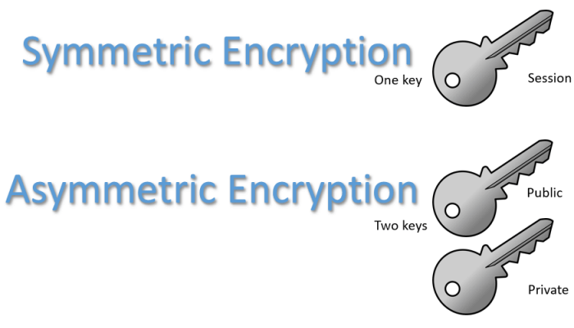

How is TES different from traditional encryption schemes?
Traditional Encryption Schemes
Encrypt
Decrypt
Threshold Encryption Schemes

Slide 4
Elgamal Encryption - Creating the Public Key
Public Key (p, q, g, h) is comprised of –
2 large primes ‘p’ and ‘q’ such that p = 2q + 1
‘g’ which is a generator of p
‘h’ is decided by all the members together
Each member ‘Pi’ chooses a random number ‘Xi’
Their own Xi becomes the secret for each member Pi
Each member then calculates hi = gXi and shares hi
h = (h1 x h2 x h3 x …. hn) mod q

Slide 5
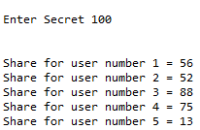
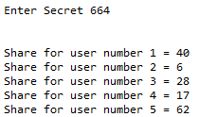
Adi Shamir’s Secret Sharing Algorithm
“Distribute secret ‘s’ to ‘n’ parties in a way that when threshold ‘t’ out of n party members work together, only then are they able to recover the secret.”
t-1,t-2,… parties are not able to recompute the secret.
Every member (or group of members) is unable to retrieve any information about the global secret from their own secret(s)

Slide 6
Elgamal Encryption - Creating the Shares
The main secret ‘X’ = X1 + X2… Xi
However, no user knows this secret ‘X’
Each user creates shares of their secret Xi using Shamir’s Secret Sharing Algorithm and distributes them to other users.
Adding the shares which they received from other users, each user computes a share of ‘X’ without knowing ‘X’.
This share of X, possessed by each user is denoted by Si.

Slide 7
Elgamal Encryption – Encrypting a Message
Public Key – (p,q,g,h)
Message – m Gq
Choose a random y Z*_{q}
Cipher Text –
C1 = g^{y} mod p , C2 =h^{y}.m mod p

Slide 8
Elgamal Encryption – Creating Decryption Shares
Unlike traditional encryption schemes, there is no secret key for decryption.
Instead users have to create decryption shares using their own share of the secret key and C1 i.e. first part of cipher text.
Si is a share of the main secret ‘X’ obtained by adding shares of X₁,X₂,X₃…X_{n}
Creating Decryption Share d_{i}:
K_{i} = ( S_{i} * ((u2*u3)/((u2-u1)*(u3-u1))))
d_{i} = (c1^K_{i}) % p

Slide 9
Elgamal Encryption – Decrypting a Message
If the total number of members that are a part of this encryption scheme is ‘n’ and if the threshold of the encryption system is ‘t’, we require atleast t ‘Decryption Shares’ to decrypt the message.
Decryption is done as –
Multiply the ‘t’ decryption shares together
d = (d₁ x d₂ x d₃…d_{t}) mod p
Obtain the original message as
m = ( c2 * d⁻¹) % p

Slide 10


Digital Signatures
It provides non-repudiation and authorization.
It utilizes 2 methods:
sk vk
Signing Key
Verification Key

Slide 11
References:
http://www.cs.cornell.edu/courses/cs754/2001fa/307.PDF
https://www.dcl.hpi.uni-potsdam.de/teaching/cloudsec/presentations/threshold-cryptography.pdf
All images are from google images.
https://en.wikipedia.org/wiki/ElGamal_encryption
https://www.cryptoworkshop.com/ximix/lib/exe/fetch.php?media=pedersen.pdf
http://mathworld.wolfram.com/LagrangeInterpolatingPolynomial.html
https://en.wikipedia.org/wiki/Lagrange_polynomial#Definition
QUESTIONS?

