Slide 1

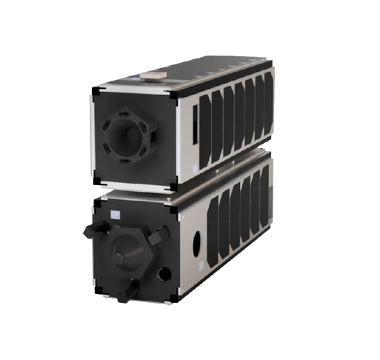
ME701
23B2120 | Aditya Nimbalkar
Docking Adapter
Latch Optimization

Slide 2

0
OVERVIEW
Problem Statement
-
03
Notation
04
-
Constraints
06
-
Objective Function
07
-
Optimizer
11
-
Results
12
-

Slide 3
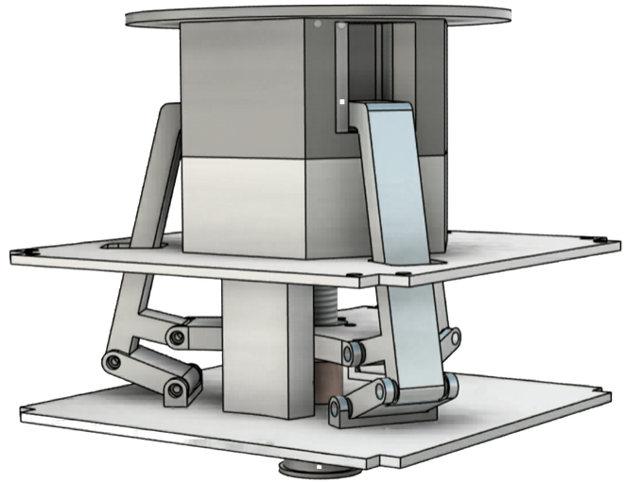
1
PROBLEM STATEMENT
The Docking Adapter Unit (DAU) uses a three-latch mechanism, each implemented as a planar RRRP linkage actuated by a linear slider.
The slider motion produces a coupled radial and axial motion of the latch tip:
Radial motion allows the latch to enter the recess of the female docking interface
Axial motion pulls the two docking ports together and generates preload DAU-work-updates
The geometry of this linkage determines the trajectory of the latch tip and the force transmission characteristics of the mechanism.
A feasible linkage geometry has already been obtained through preliminary synthesis, but it is not optimal.

Slide 4
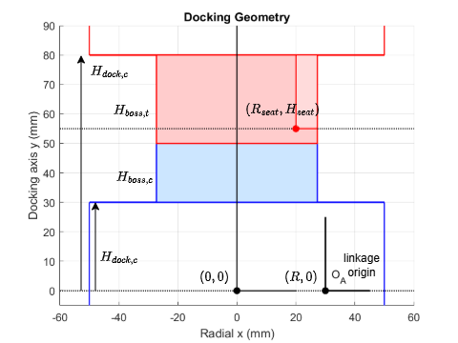
2
NOTATION
H
dock,c

Slide 5
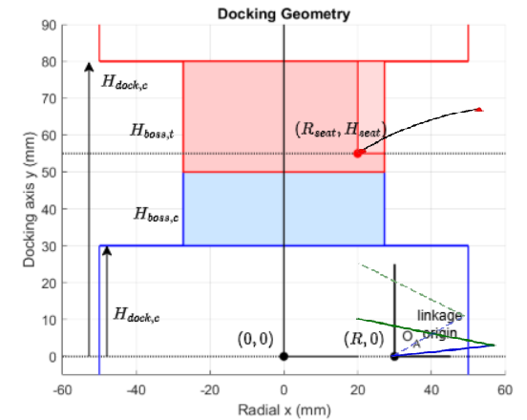
2
NOTATION
a2
a1

Slide 6
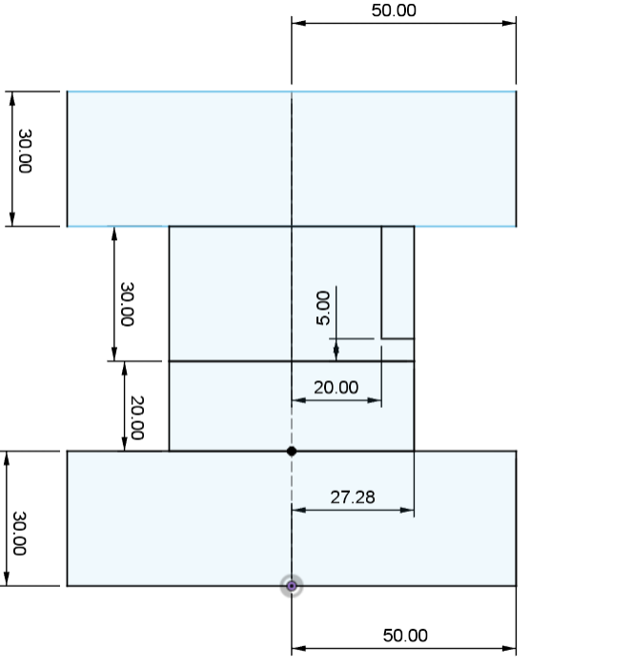
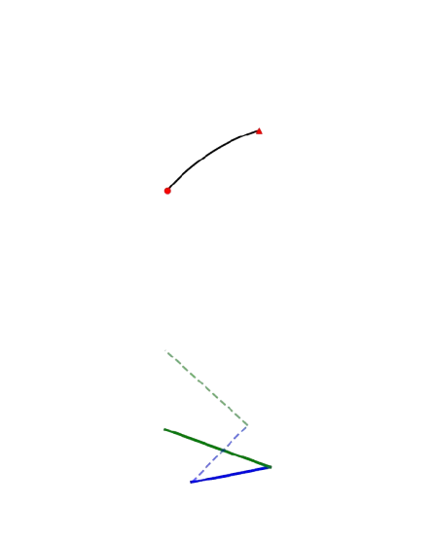
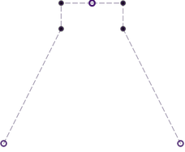
4
CONSTRAINTS
Latch Tip
Radial Clearance: x_open >= R_hex
Interference Mitigation: x>= R_seat
Vertical Bounds: H_seat <= y_open <= H_dock,t
R_hex
Packaging
H_boss,t
Maximum Allowable Radial Footprint: a1 <= R_max - R
Hardware Interference: R - S >= 5mm
“Upward Bending Right Elbow”
(R_seat,H_seat)
H_dock,t
H_boss,c
H_dock,c
a2
a1
s

Slide 7
4
OBJECTIVE FUNCTION
PERFORMANCE TARGETS
Closed Position Accuracy (Weight: 20): Heavily penalizes any deviation from the precise target seat coordinates (R_seat, H_seat) at the end of the stroke .
Capture Capability (Weight: 15): Rewards designs that open wider than the required R_hex boundary, maximizing lateral capture margin .
Axial Tolerance (Weight: 10): Rewards trajectories that maintain high clearance above the seat as the tip crosses the entry threshold, maximizing vertical misalignment tolerance .
R_hex
H_boss,t
H_dock,t
(R_seat,H_seat)
H_boss,c
H_dock,c
a2
a1
s

Slide 8
4
OBJECTIVE FUNCTION
KINEMATIC METRICS
Monotonic Motion (Weight: 15): Enforces strict inward and downward motion; heavily penalizes any trajectory that zig-zags or reverses direction to prevent jamming .
Force Transmission (Weight: 8): Rewards high mechanical advantage. By favoring lower tip velocities porjected to downward motion, the mechanism guarantees higher pulling force when latching .
Smoothness (Weight: 2): Minimizes trajectory acceleration (second derivative) to ensure smooth, predictable movement.
R_hex
H_boss,t
H_dock,t
(R_seat,H_seat)
H_boss,c
H_dock,c
a2
a1
s

Slide 9
4
OBJECTIVE FUNCTION
SMOOTH PENALTIES
Gradient-Friendly Walls (Weight: 50): Hard geometric and physical constraints are converted into smooth quadratic penalties
(e.g., max(0, “violation”)^2). This prevents the optimizer from getting "blinded" by abrupt mathematical cliffs .
Plateau Problem with Discrete Penalties
R_hex
H_boss,t
H_dock,t
(R_seat,H_seat)
H_boss,c
H_dock,c
a2
a1
s

Slide 10
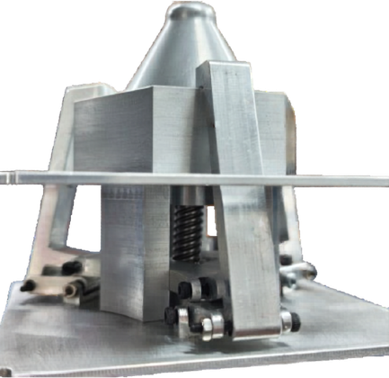
4
OBJECTIVE FUNCTION
OVERALL
20 * J_closed +
20 * J_capture +
10 * J_axial +
15 * J_mono +
2 * J_smooth +
8 * J_force +
50 * Penalty

Slide 11
4
OPTIMIZER
SLSQP (SEQUENTIAL LEAST SQUARES PROGRAMMING)
Gradient-Based
SciPy Library
Allows bounding variables
Great for Constraint Non-Linear Optimization Problems

Slide 12
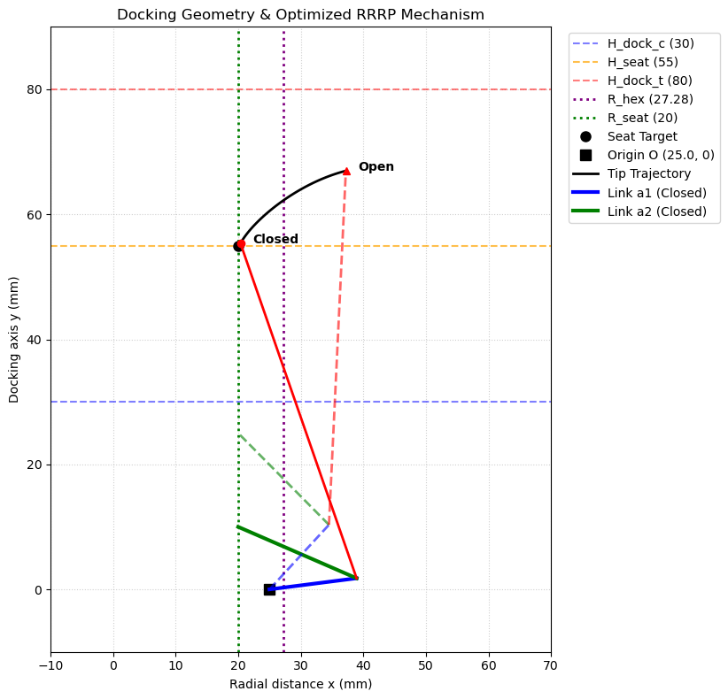
4
RESULTS
OPTIMIZED MECHANISM PARAMETERS
Link 1 (a1) : 14.039 mm
Link 2 (a2) : 20.635 mm
Origin (R) : 25.000 mm
Slider Pos (s) : 20.000 mm
Coupler offset (u,v) : (38.372, -41.745) mm
KEY PERFORMANCE METRICS
Seat Target Error : 0.510 mm (dx: 0.366, dy: 0.355)
Lateral Capture Margin: 9.931 mm (Positive = correctly outside R_hex)
Open Tip Height : 66.964 mm (Constraint: < 80.0)
Axial Tolerance : 7.268 mm (Height margin above seat when passing R_hex)
Max Reach Required : 25.495 mm

Slide 13
4
RESULTS
OPTIMIZED MECHANISM PARAMETERS
Link 1 (a1) : 14.039 mm
Link 2 (a2) : 20.635 mm
Origin (R) : 25.000 mm
Slider Pos (s) : 20.000 mm
Coupler offset (u,v) : (38.372, -41.745) mm
R_hex
H_boss,t
KEY PERFORMANCE METRICS
Seat Target Error : 0.510 mm (dx: 0.366, dy: 0.355)
Lateral Capture Margin: 9.931 mm (Positive = correctly outside R_hex)
Open Tip Height : 66.964 mm (Constraint: < 80.0)
Axial Tolerance : 7.268 mm (Height margin above seat when passing R_hex)
Max Reach Required : 25.495 mm
H_dock,t
(R_seat,H_seat)
H_boss,c
H_dock,c
a2
a1
s

Slide 14
THANK YOU

