Slide 1


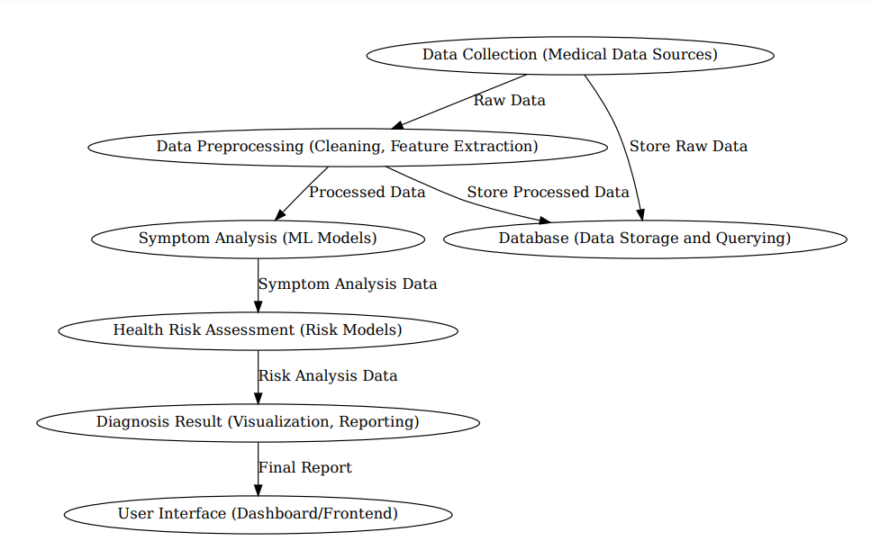
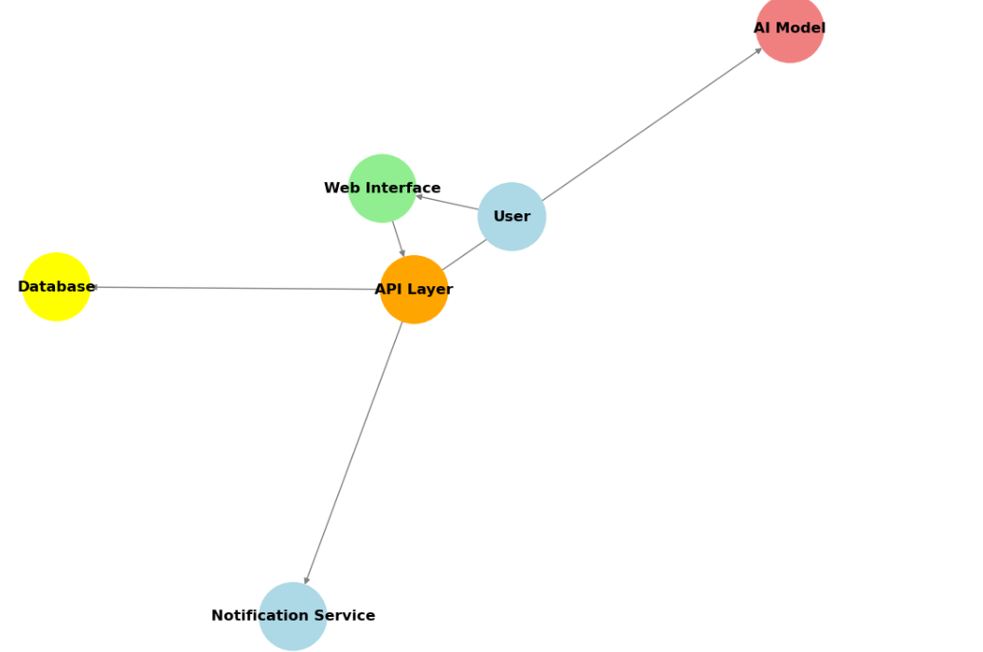
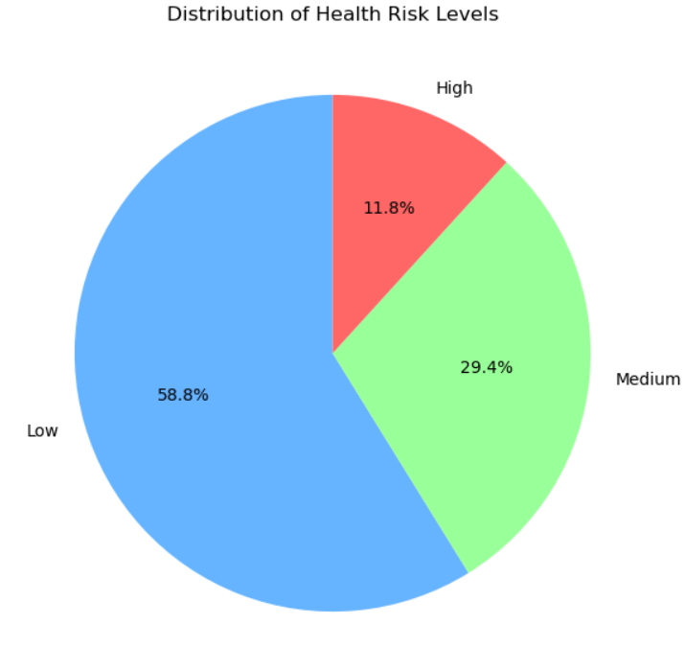
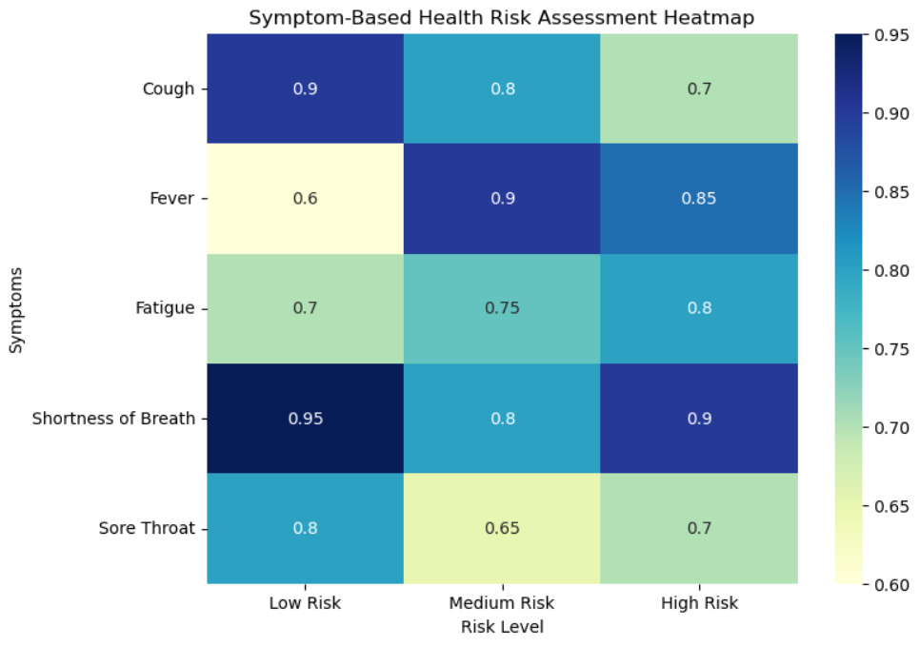
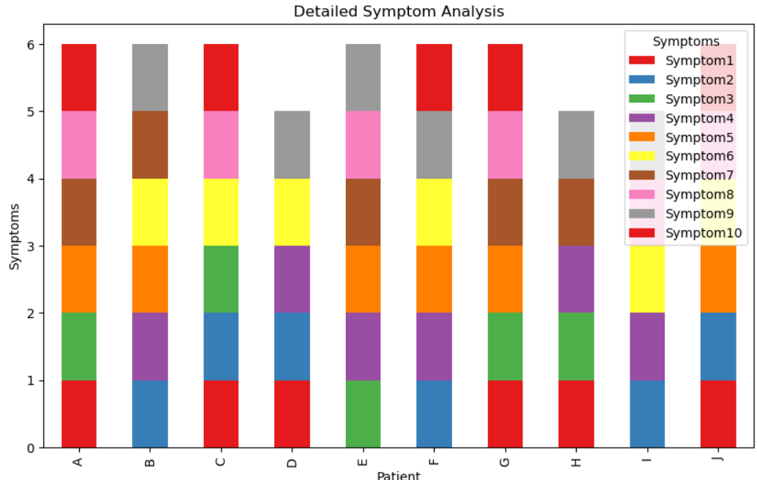
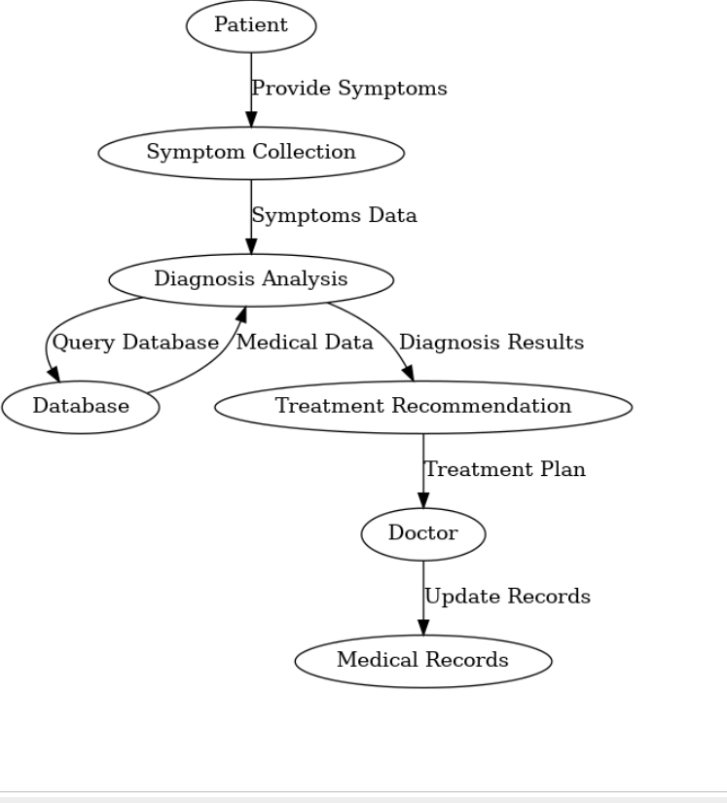
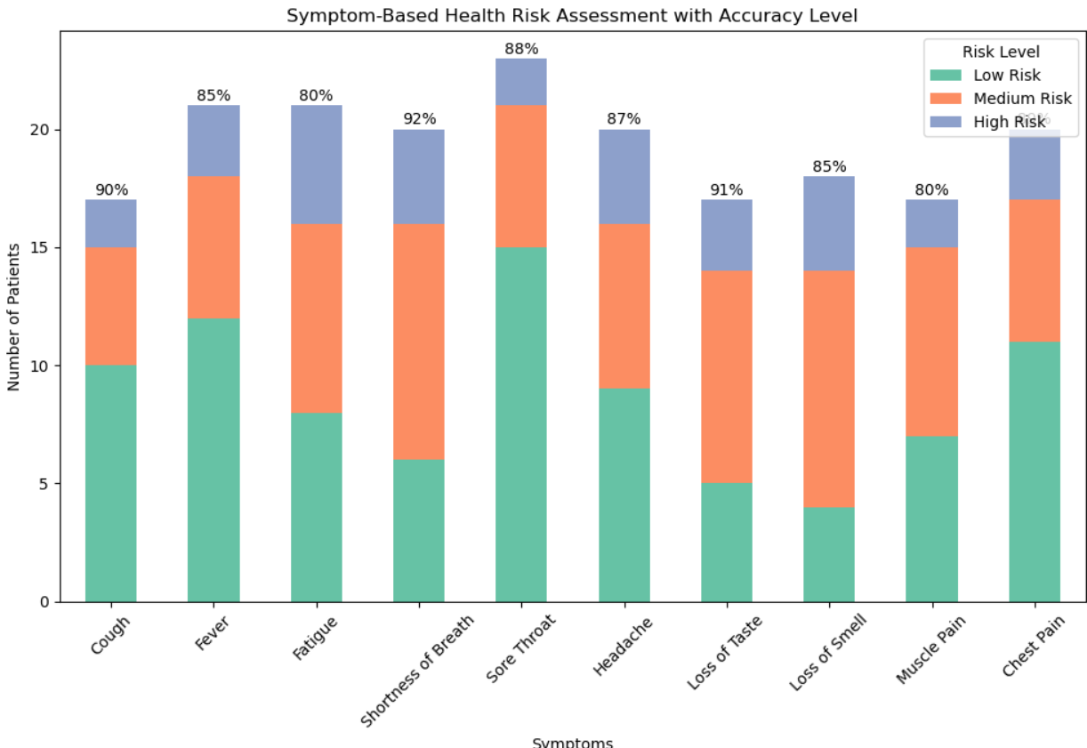
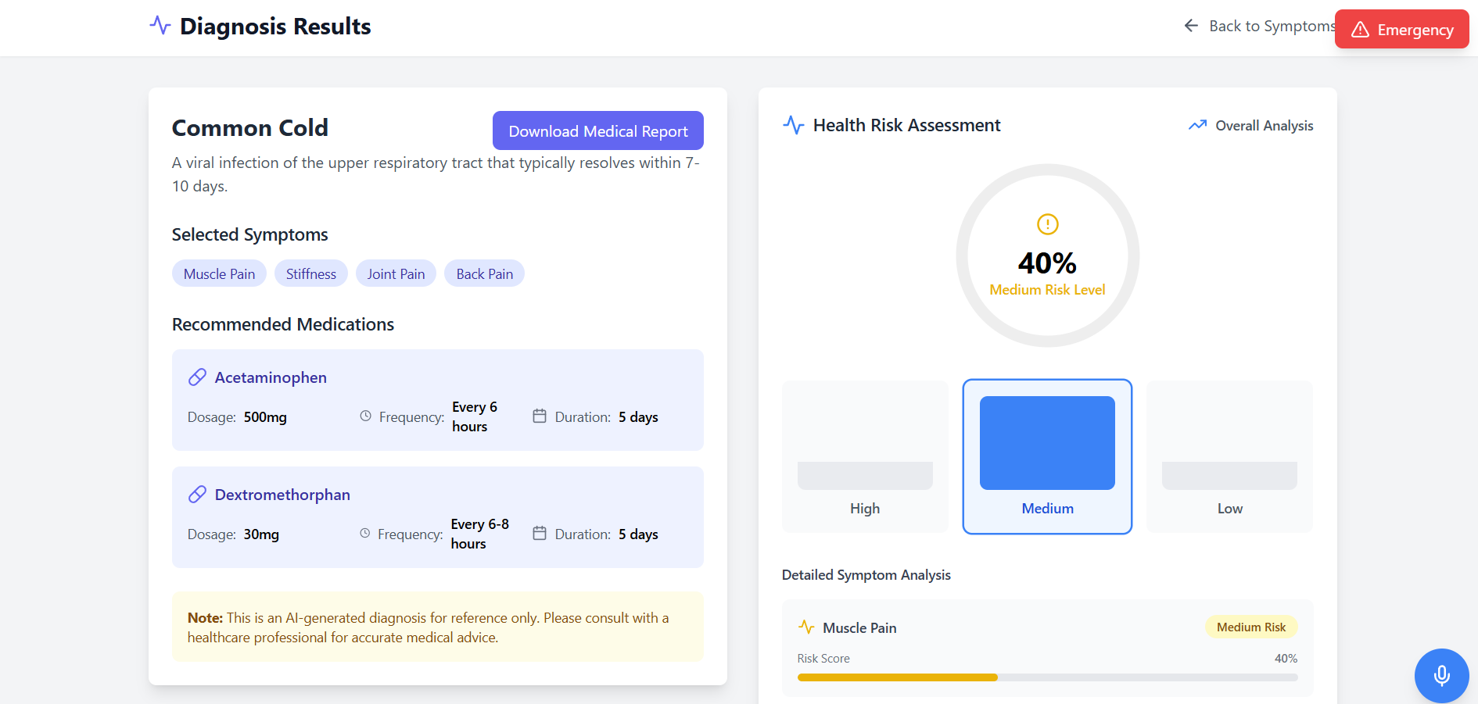
Sandip University Nashik, Maharashtra, (India)
School of Computer Sciences and Engineering (SOCSE)
Trimbak Road, Nashik, Maharashtra , Pin - 422213 Toll Free - 1800-212-2714
ADVANCED MEDICAL DIAGNOSIS (2024-25)
INTRODUCTION
Literature Review
Proposed System Architecture
CONCLUSIONS
In the rapidly evolving field of healthcare, advanced medical diagnosis represents a transformative approach to patient care. Leveraging cutting-edge technologies such as artificial intelligence, machine learning, and advanced imaging techniques, this innovative framework enhances the precision, speed, and accuracy of diagnostic processes. By integrating data-driven insights from diverse sources—genomics, imaging, electronic health records, and wearable devices—advanced diagnostics empowers healthcare professionals to detect diseases at earlier stages, personalize treatments, and improve patient outcomes.
Artificial intelligence and machine learning have demonstrated the ability to enhance diagnostic accuracy, particularly in areas like medical imaging and disease Prediction
Integration of diverse data sources, including genomics, electronic health records, and wearable devices, has proven effective in creating comprehensive diagnostic systems.
Research highlights the significance of early diagnosis in improving survival rates, emphasizing the role of advanced technologies in achieving this.
Studies identify challenges such as data security, ethical concerns, and limited access to advanced diagnostic tools in low-resource settings.
The visualization helps in understanding the relationship between symptoms and health risk levels, enhancing diagnosis accuracy. It provides a clear picture of symptom frequency and severity across different risk categories. This can assist healthcare professionals in identifying high-risk patients and tailoring treatment plans.
Data Flow Diagram
Objective of Project
REFERENCES
The project aims to develop an Advanced Medical Diagnosis System that enhances the accuracy and efficiency of disease detection through AI, machine learning, and integrated medical data. By enabling early diagnosis, personalized care, and real-time insights, it seeks to improve patient outcomes
World Health Organization (WHO) - Health Risk Assessment https://www.who.int
Centers for Disease Control and Prevention (CDC) - Symptom Analysis https://www.cdc.gov
PubMed - Research on Medical Diagnosis and Symptom Data https://pubmed.ncbi.nlm.nih.gov
Applications
Problem Statement
Medical Diagnostics
Health Risk Assessment
Decision Support
Healthcare
Sponsorship Details
Despite advancements in healthcare, accurate and timely diagnosis remains a challenge due to limitations in traditional methods, fragmented medical data, and inadequate access to advanced diagnostic tools in remote areas. This leads to delayed interventions, misdiagnoses, and suboptimal patient outcomes.
IndusValley , Ambad MIDC, Maharashtra , Nashik-422010.
Subbalakshmi Enterprises (Indus valley) (HEAD OFFICE) , N51 AD 1-1/4 Pawan Nagar , Lokmanya Nagar , New Nashik , Nashik – 422009 Maharashtra , India.
www.indusvalley.site Contact - +91 8275944336
Statistics
RESULTS
Our Team
Social Importance
Prof. Sanjeev Shukla – Project Guide
210105231051 Shubham Bhor (Team Leader)
220105232002 Aditya Nimkar
220105232017 Suraj Pawase
210105231030 Jay Patil
Improve Healthcare access in remote and underserved areas.
Enhanced Public Detection For Timely Interventions.
Empowered Patients With Data-Driven Health Insights
Cost-Effective Care
Prof. Sanjeev Shukla
Prof. Kayyum shaikh
Project Coordinator
Project guide

