Slide 1
EIGENSTATES OF SCHRODINGER EQUATION
BY ADITYA SINGH 2K19/EP/005

Slide 2




Time Independent Schrodinger Equation
EIGEN VALUES
In general, the wave function gives the "state of the system" for the system under discussion. It stores all the information available to the observer about the system.
If you want to measure the energy of a particle, you have to operate on the wavefunction with the Hamiltonian operator.

Slide 3
EIGENFUNCTION
1
MATLAB

Slide 4

WHAT IS EIGEN VALUE ?
An eigenvector of a linear transformation is a nonzero vector that changes by a scalar factor when that linear transformation is applied to it. The corresponding eigenvalue is the factor by which the eigenvector is scaled.

Slide 5
EIG IN MATLAB
e = eig(A) - returns a column vector containing the eigenvalues of square matrix A.
[V,D] = eig(A) - returns diagonal matrix D of eigenvalues and matrix V whose columns are the corresponding right eigenvectors, so that A*V = V*D.
eigs - It finds largest eigenvalues and eigenvectors of a sparse matrix.
[V,D] = eigs(A) - returns a diagonal matrix D of A's six largest magnitude eigenvalues and a matrix V whose columns are the corresponding eigenvectors.

Slide 6
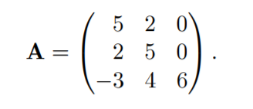

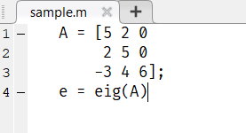
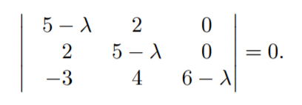
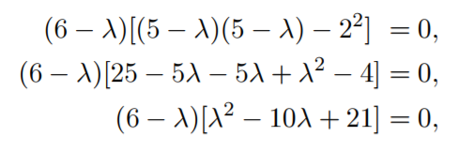
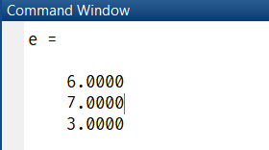

Find Eigen value of

Slide 7
SPDIAGS
2
MATLAB

Slide 8
SPDIAGS
B = spdiags(A) - extracts the nonzero diagonals from m-by-n matrix A and returns them as the columns in min(m,n)-by-p matrix B, where p is the number of nonzero diagonals.
S = spdiags(A ,d ,m ,n) - creates an m-by-n sparse matrix S by taking the columns of A and placing them along the diagonals specified by d.

Slide 9
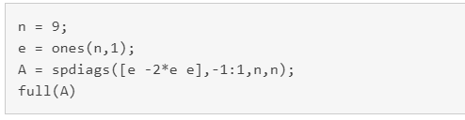
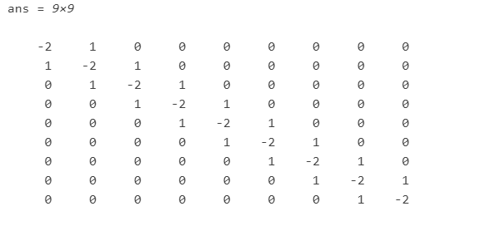
Create a 9-by-1 vector of ones, and then create a tridiagonal matrix using the vector.

Slide 10
REPMAT
3
MATLAB

Slide 11
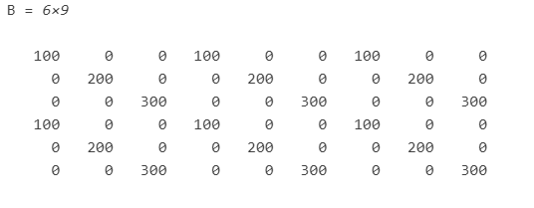
REPMAT
B = repmat(A,n) returns an array containing n copies of A in the row and column dimensions. The size of B is size(A)*n when A is a matrix.
A = diag([100 200 300]);
B = repmat(A,2,3)

Slide 12
SORT
4
MATLAB

Slide 13
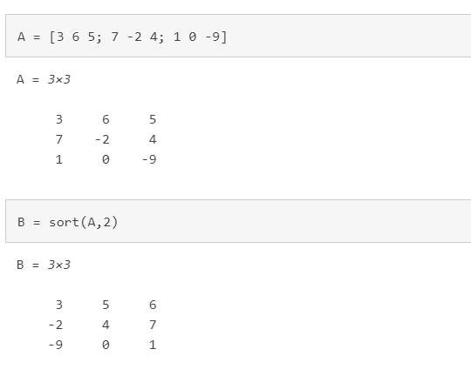

SORT
B = sort(A,d) - sorts the elements of dimension d of A in ascending order. d=2 for row-wise

Slide 14
MATLAB CODE

Slide 15
THANKS!

