Slide 1
NUMERICAL METHODS
DIFFERENTIAL EQUATIONS
EP-203 MATHEMATICAL PHYSICS
ADITYA SINGH 2K19/EP/005

Slide 2
INTRODUCTION
Numerical analysis, area of mathematics and computer science that creates, analyzes, and implements algorithms for obtaining numerical solutions to problems involving continuous variables.
Many differential equations arising in applications are so complicated that it is impractical to have solution formulas.. In either situation, numerical methods provide a powerful alternative tool for solving the differential equation.

Slide 3
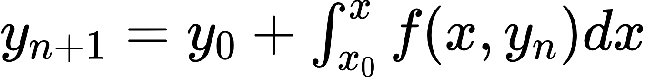
Methods to Solve ODE
This method of solving a differential equation approximately is one of successive approximation;
that is, it is an iterative method in which the numerical results become more and more accurate, the more times it is used.
The Picard’s iterative method gives a sequence of approximations Y1(x), Y2(x), …Yk(x) to the solution of differential equations such that the nth approximation is obtained from one or more previous approximations.
Picard’s Method

Slide 4
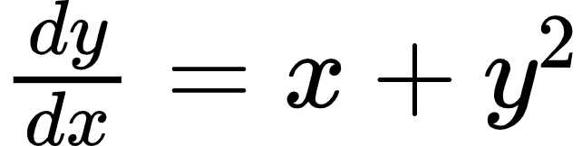
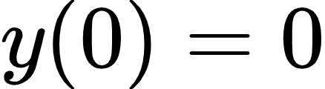
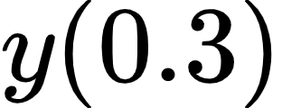
Applying the method
Given
Solve by Picard’s Method upto third approximation and find the value of

Slide 5
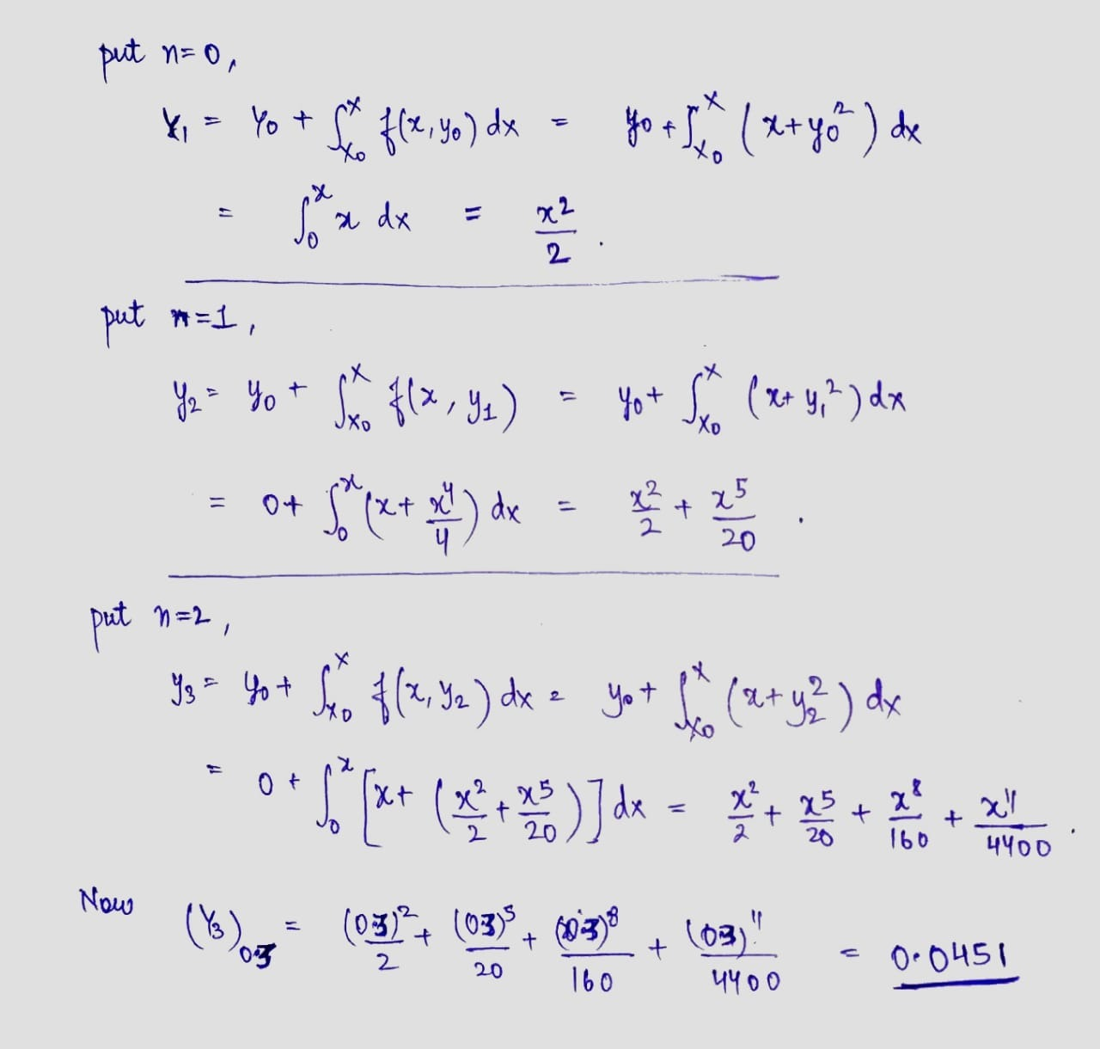

Slide 6
EULER’S METHOD
The simplest numerical method for solving the initial value problem is Euler’s method.
Generate a numerical solution to an initial value problem of the form:
y′ = f(x, y) with y(x_{o}) = y_{o}
We chop this interval into small subdivisions of length h. Then, using the initial condition as our starting point, we generate the rest of the solution by using the iterative formulas:
x_{n+1} = x_{n} + h
y_{n+1} = y_{n} + h f(x_{n}, y_{n})
to find the coordinates of the points in our numerical solution. We terminate this process when we have reached the right end of the desired interval.

Slide 7
Applying the Method
We now move on to get the next point in the solution, (x₂, y₂).
x₂ = x₁ + h => x₂ = 0.25 + 0.25 => x₂ = 0.5
y₂ = y₁ + h f(x₁, y₁) => y₂ = y₁ + h (x₁ + 2y₁)
y₂ = 0 + 0.25 (0.25 + 2*0) => y₂ = 0.0625
x₂ = 0.5
y₂ = 0.0625
We now move on to get the fourth point in the solution, (x₃, y₃).
x₃ = x₂ + h => x₃ = 0.5 + 0.25 => x₃ = 0.75
y₃ = y₂ + h f(x₂, y₂) => y₃ = y₂ + h (x₂ + 2y₂)
y₃ = 0.0625 + 0.25 (0.5 + 2*0.0625) => y₃ = 0.21875
x₃ = 0.75
y₃ = 0.21875
F(x, y) = x + 2y
initial condition:
x_{o} = 0
y_{o} = 0
We now use the Euler method formulas to generate values for x₁ and y₁.
x₁ = x_{o} + h => x₁ = 0 + 0.25 => x₁ = 0.25
y₁ = y_{o} + h f(x_{o}, y_{o}) => y₁ = y_{o} + h (x_{o} + 2y_{o})
y₁ = 0 + 0.25 (0 + 2*0) => y₁ = 0
x₁ = 0.25
y₁ = 0

Slide 8
We now move on to get the fifth point in the solution, (x₄, y₄).
x₄ = x₃ + h => x₄ = 0.75 + 0.25 => x₄ = 1
y₄ = y₃ + h f(x₃, y₃) => y₄ = y₃ + h (x₃ + 2y₃)
y₄ = 0.21875 + 0.25 (0.75 + 2*0.21875) => y₄ = 0.515625
x₄ = 1
y₄ = 0.515625
We could summarize the results of all of our calculations in a tabular form, as follows:
n | x_{n} | y_{n}
0 | 0.00 | 0.000000
1 | 0.25 | 0.000000
2 | 0.50 | 0.062500
3 | 0.75 | 0.218750
4 | 1.00 | 0.515625
It is very inaccurate and contains significant error.

Slide 9
Runge-Kutta Method
Runge–Kutta method is an effective and widely used method for solving the initial-value problems of differential equations.
Runge–Kutta method can be used to construct high order accurate numerical method by functions' self without needing the high order derivatives of functions.

Slide 10
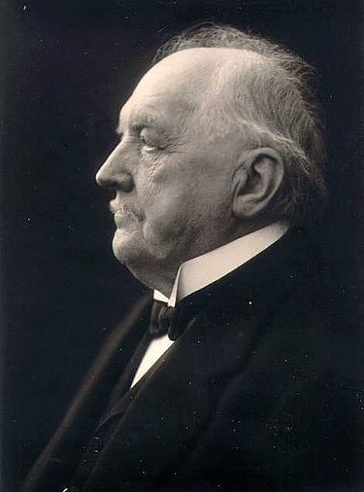
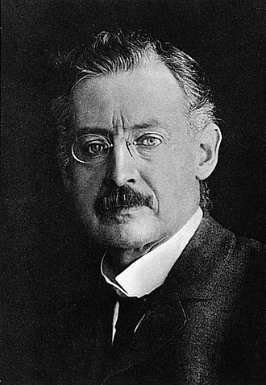
History
The Runge-Kutta Method was developed by two German men Carl Runge, and Martin Kutta in 1901. Carl Runge extended the approximation method of Euler to a more elaborate scheme which was capable of greater accuracy. K.W. Kutta analyzed some numerical methods and introduced amongst other methods used for the approximate solutions of ordinary differential equations. The paper, which appeared in 1901, made a complete classification of order 4 methods and introduced the famous method, known now as the classical Runge-Kutta method.
Carl David Tolmé Runge (30 August 1856 – 3 January 1927)
Martin Wilhelm Kutta (3 November 1867 – 25 December 1944)

Slide 11
THE COMPARISON
WHY THIS METHOD

Slide 12
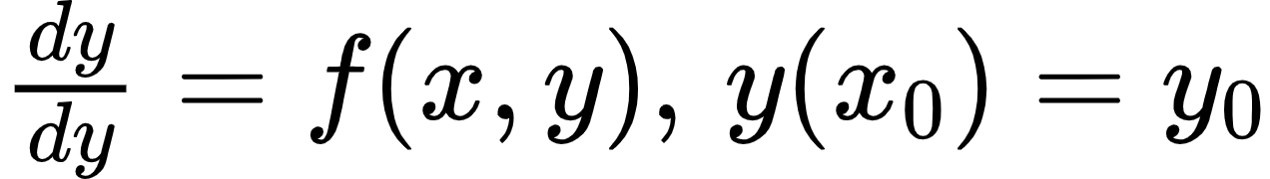
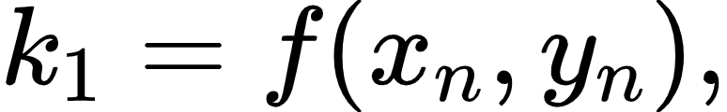
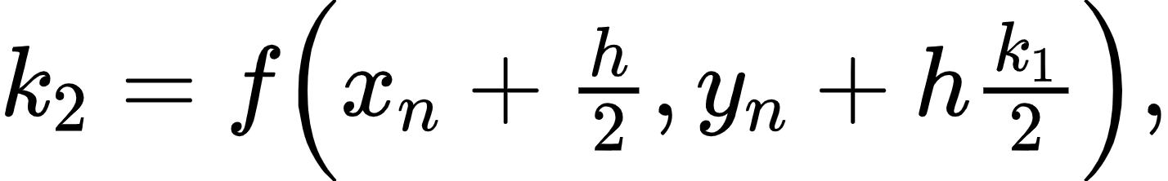
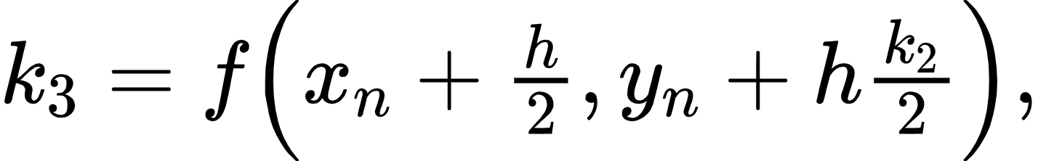
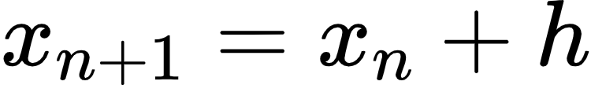
Formulas Used
for n = 0, 1, 2, 3,......

Slide 13
k₁=hf(x₀,y₀)=(0.1)f(0,1)=(0.1)⋅(-0.5)=-0.05
k₂=hf(x₀+h/2,y₀+k₁/2)=(0.1)f(0.05,0.975)=(0.1)⋅(-0.4625)=-0.04625
k₃=hf(x₀+h/2,y₀+k₂/2)=(0.1)f(0.05,0.97688)=(0.1)⋅(-0.46344)=-0.04634
k₄=hf(x₀+h,y₀+k₃)=(0.1)f(0.1,0.95366)=(0.1)⋅(-0.42683)=-0.04268
y₁=y₀+16(k₁+2k₂+2k₃+k₄)
y₁=1+16[-0.05+2(-0.04625)+2(-0.04634)+(-0.04268)]
∴ y(0.1)=0.95369
Applying the Method
Find y(0.2) for y′=x-y², y(0) = 1, with step length 0.1 using Runge-Kutta 4 method

Slide 14
Again taking (x1,y1) in place of (x0,y0) repeat the process
k₁=hf(x₁,y₁)=(0.1)f(0.1,0.95369)=(0.1)⋅(-0.42684)=-0.04268
k₂=hf(x₁+h/2,y₁+k₁/2)=(0.1)f(0.15,0.93235)=(0.1)⋅(-0.39117)=-0.03912
k₃=hf(x₁+h/2,y₁+k₂/2)=(0.1)f(0.15,0.93413)=(0.1)⋅(-0.39206)=-0.03921
k₄=hf(x₁+h,y₁+k₃)=(0.1)f(0.2,0.91448)=(0.1)⋅(-0.35724)=-0.03572
y₂=y₁+16(k₁+2k₂+2k₃+k₄)
y₂=0.95369+16[-0.04268+2(-0.03912)+2(-0.03921)+(-0.03572)]
y₂=0.91451
∴ y(0.2)=0.91451

Slide 15
THE APPLICATION

Slide 16
The initial conditions of the satellite are those find for a geostationary orbit.
Eccentricity, e= (1/GM) [(v² -(GM/r)r-(r.v)v] with v = dr/dt.
With an initial position above the Earth's surface of 35786 kilometres and an initial velocity of 3.07 kilometres per second resulting in a circular orbit.
The period of the simulation is of geostationary takes around that much time for single orbit.
The relativistic solutions can be used as the foundation for solving relativistic targeting problems that will be required by future spacecraft traveling with velocities close to the speed of light and/or orbiting in intense gravitational fields such as those that exist near black holes.
Orbiting mass around a central mass(satellite and earth)

Slide 17
THANK YOU

