Slide 1
EC-272 COMMUNICATION SYSTEM
SPREAD SPECTRUM
INNOVATIVE MID-TERM PROJECT
SUBMITTED TO : Dr. NITIN K. PURI
BY ADITYA SINGH 2K19/EP/005
AND ANSHUL SATIJA 2K19/EP/018

Slide 2
TABLE OF CONTENTS
INTRODUCTION
WHY THIS COMMUNICATION
HOW IT WORKS
SPREAD SPECTRUM TECHNIQUES
APPLICATION
MATLAB IMPLEMENTATION
CONCLUSION AND FUTURE SCOPE

Slide 3
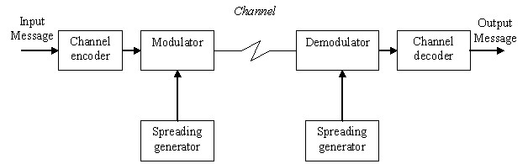
INTRODUCTION
Spread spectrum is a special technique used in telecommunication and radio communication. The idea behind spread spectrum is to use more bandwidth than the original message while maintaining the same signal power. A spread spectrum signal does not have a clearly distinguishable peak in the spectrum.

Slide 4
WHY SPREAD SPECTRUM COMMUNICATION?
Originally there were two motivations: either to resist enemy efforts to jam the communications (anti-jam, or AJ), or to hide the fact that communication was even taking place, sometimes called low probability of intercept (LPI).
Now these techniques are used for a variety of reasons, including the establishment of secure communications, increasing resistance to natural interference, noise, and jamming, to prevent detection, to limit power flux density and to enable multiple-access communications.

Slide 5
HOW SPREAD SPECTRUM WORKS
The signal occupies a bandwidth much larger than is needed for the information signal.
The modulation is done using spreading code (key) which is independent of the data in the signal.
Despreading at the receiver is done by correlating the received signal with a synchronized copy of the spreading code.

Slide 6
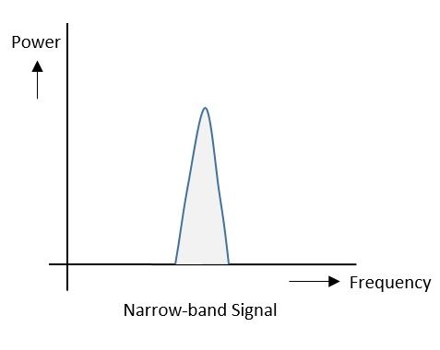
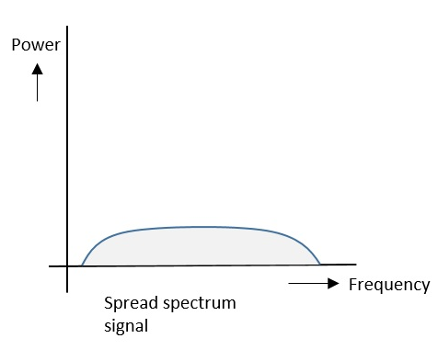
After Spreading, band of signals occupy a wide range of frequencies, power density is very low and signals are highly resistant to interference or jamming. Since multiple users can share the same spread spectrum bandwidth without interfering with one another, these can be called as multiple access techniques.

Slide 7
FHSS (Frequency-Hopping) | DSSS (Direct-Sequence)
Multiple frequencies are used | Single frequency is used
Hard to find the user’s frequency at any instant of time | User frequency, once allotted is always the same
Frequency reuse is allowed | Frequency reuse is not allowed
Sender need not wait | Sender has to wait if the spectrum is busy
Power strength of the signal is high | Power strength of the signal is low
Stronger and penetrates through the obstacles | It is weaker compared to FHSS
It is never affected by interference | It can be affected by interference
It is cheaper | It is expensive
This is the commonly used technique | This technique is not frequently used

Slide 8
DIRECT SEQUENCE SPREAD SPECTRUM
The aim of our project is to make end to end simulation of Direct Sequence Spread Spectrum (DSSS) technique. It’s a technique that message signal is multiplied by a pseudorandom sequence to spread message bandwidth so energy of message signal expand a wider spectrum, and it appears as noise.
The motivation of DSSS technique comes from channel capacity theorem. It says that we can have good communication performance by increasing bandwidth even when signal-to-noise power is low.
Whenever a user wants to send data using this DSSS technique, each and every bit of the user data is multiplied by a secret code, called as chipping code. This chipping code is nothing but the spreading code which is multiplied with the original message and transmitted. The receiver uses the same code to retrieve the original message.

Slide 9
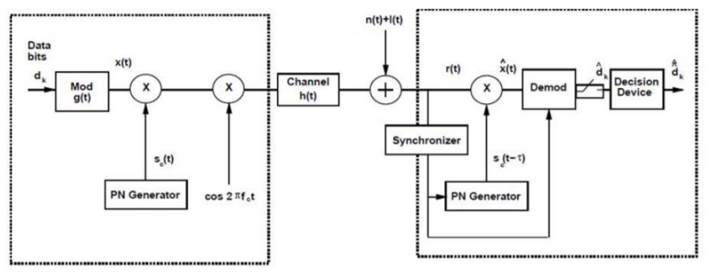
It provides security of transmission because receiver must know pseudo-random sequence to get transmitted data signal. Otherwise, receiver can’t detect original message signal, and it only sees transmitted signal as a noise. This property make it suitable to use for military communication systems. DSSS also enables to usage of a bandwidth by multiple users because each user multiply its message signal by different pseudo-random sequence, and a receiver gets its message signal if it has transmitter pseudo-random sequence.

Slide 10
EXPERIMENTAL WORK
It started with generation of message signal at transmitter. We generated 8 bits message signal where each bit has 0.1 seconds bit duration.
Then, we generated pseudo-random code that has higher frequency than message signal. This means that each message bit coded by randomly generated bit at DSSS signal.
To represent binary data, we used non-return-to-zero (NRZ) line code scheme because we chose BPSK modulation to transmit our signal. BPSK modulation has 180 degree phase shift between carriers of binary 0 and 1 so binary-1 represented as 1 while binary-0 represented as -1.
We obtained DSSS signal with multiplying message signal and pseudo-random code. The receiver must be aware of this pseudo-random code. Otherwise, it can’t get transmitted message signal, and transmitted signal appears as a noise at receiver.

