Slide 1
Simulating Diffraction with Python
EP-204 OPTICS
Aditya Singh 2K19/EP/005
Anshul Satija 2K19/EP/018

Slide 2
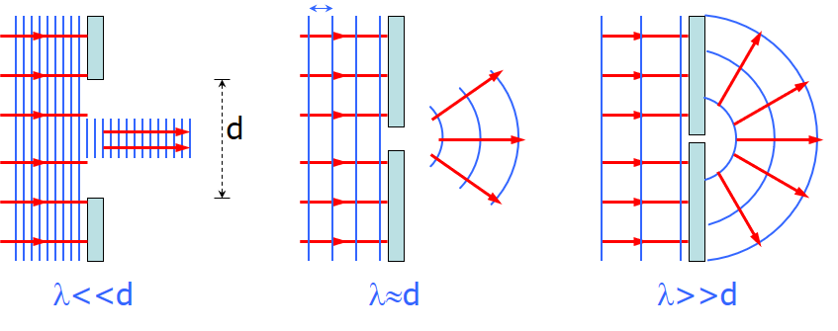
Diffraction Pattern
Diffraction is the spreading out of waves as they pass through an aperture or around objects. It occurs when the size of the aperture or obstacle is of the same order of magnitude as the wavelength of the incident wave.
A single slit placed between a distant light source and a screen produces a diffraction pattern.
It will have a broad, intense central band, called the central maximum
The central band will be flanked by a series of narrower, less intense secondary bands, called side maxima or secondary maxima
The central band will also be flanked by a series of dark bands, called minima

Slide 3
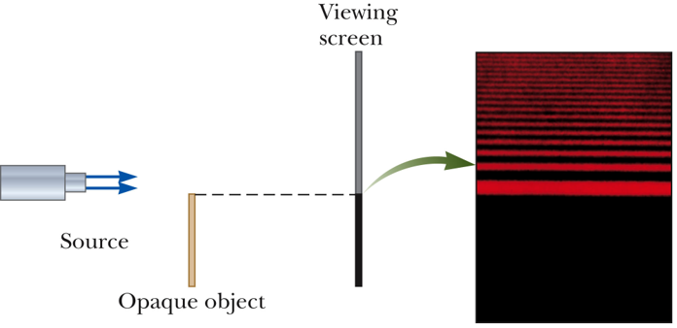
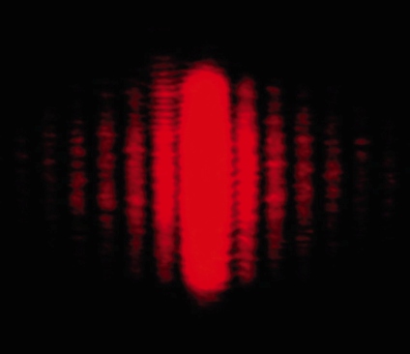
Object Edge
Single Slit Pattern
The diffraction pattern consists of the central maximum and a series of secondary maxima and minima.
The pattern is similar to an interference pattern.
This shows the upper half of the diffraction pattern formed by light from a single source passing by the edge of an opaque object.
The diffraction pattern is vertical with the central maximum at the bottom.

Slide 4
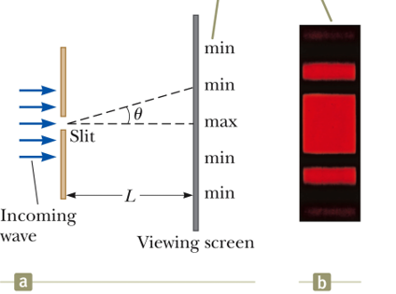
Fraunhofer Diffraction
Fraunhofer diffraction, describes the diffraction pattern observed in the far field where geometric optics is completely inapplicable
In Fraunhofer diffraction the rays leave the diffracting object in parallel directions.
Screen very far from the slit
Could be accomplished by a converging lens

Slide 5
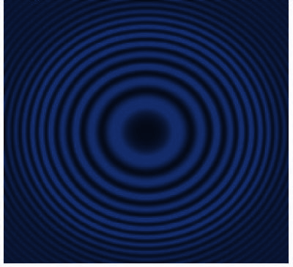
Fresnel Diffraction
In optics, the Fresnel diffraction equation for near-field diffraction is an approximation of the Kirchhoff–Fresnel diffraction that can be applied to the propagation of waves in the near field.
It is used to calculate the diffraction pattern created by waves passing through an aperture or around an object, when viewed from relatively close to the object.
The near field can be specified by the Fresnel number, F, of the optical arrangement.

Slide 6

Convolution Theorem
To handle more complex cases of diffraction using Fourier transforms we need to know the convolution theorem. Say g(x) is the convolution of two other functions f and h. Then

Slide 7
the blue line represents the function h(x−x′), the red line the function f(x) and the green line is the convolution. In the animation; follow the vertical green line that is the point where the convolution is being evaluated. Its value is the area under the product of the two curves at that point.

Slide 8
The convolution theorem states that if
G(k)=Ϝ{g(x)},
F(k)=Ϝ{f(x)}
and H(k)=Ϝ{h(x)}
and if g(x)=f⊗h, then
=> G(k)=F(k)H(k)
Now say we want to consider the case of two long slits with width a. This can be described by the convolution of one slit with two delta functions.

Slide 9
So two slits of a finite width can be described by the convolution of two delta functions and rectangular aperture function. Then the Fraunhofer diffraction pattern is just the product of the two Fourier transforms.
To summarize: Fraunhofer diffraction patterns are the Fourier transform of the aperture function. The Fourier transform of the convolution of functions is the product of the Fourier transforms of the individual functions.

Slide 10

Python Packages
Diffractio is a Python library for Diffraction and Interference Optics.
Additional packages :
hickle (dumping python variables to HDF5 files, and allows for transparent compression of your data)
mayavi (tool for 2-D and 3-D scientific data visualization)
py-pol (library for Jones and Stokes-Mueller polarization optics)

Slide 11
Steps for Simulation
Define linear vector in x and y planes.
Use module Scalar_source_XY with a defined wavelength.
Create of Mask of any shape of desire (eg. slit or a circle), and multiply with scalar source.
Define various fields around mask and plot the results

Slide 12
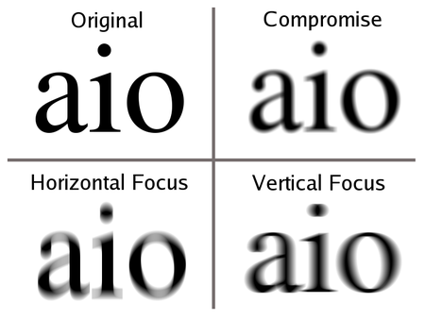
Astigmatism
Astigmatism is a type of refractive error in which the eye does not focus light evenly on the retina. This results in distorted or blurred vision at any distance.
The cause of astigmatism is unclear, however it is believed to be partly related to genetic factors. The underlying mechanism involves an irregular curvature of the cornea or abnormalities in the lens of the eye. Diagnosis is by an eye examination.

Slide 13
THANK YOU

