Slide 1
Foundations of Computer Science
Dr. Adeel hashmi
Asst. Prof.
Cse dept (2nd shift)
Msit, janakpuri, delhi

Slide 2
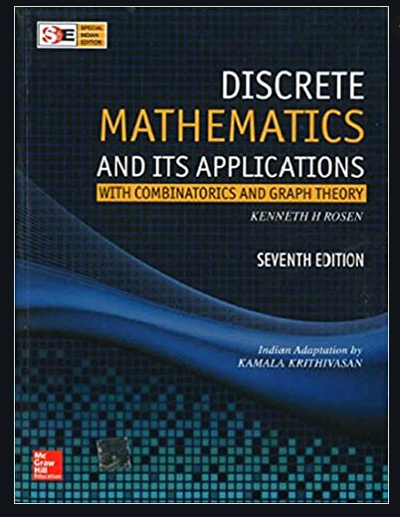
Book

Slide 3
Syllabus
Unit-1: Propositional Logic
Unit-2: Sets, Functions, Relations, Lattices
Unit-3: Recurrence Relations, Graphs
Unit-4: Groups, Boolean Algebra

Slide 4
Discrete Mathematics
Continuous: any value (always infinite)
Discrete: a pre-defined set of values (can be infinite)

Slide 5
1. Sets
A set is an unordered collection of objects, called the elements or members of the set.
The elements of a set are enclosed under curly braces e.g. {a,e,i,o,u} is a set of all vowels in the English alphabet.
A set is usually denoted by an uppercase letter e.g. V={a,e,i,o,u} .
A set is said to contain its elements. We write e∈V to denote that element e belongs to set V.

Slide 6
Set Representation
Roster/Tabular method:
N = {1, 3, 5, 7, 9}
Set-Builder method:
N = {x | x is an odd positive integer less than 10}
In roster method, all elements of the set are listed.
In set builder notation the property or properties fulfilled by elements of the set is/are stated.

Slide 7
Equal Sets
Two sets are said to be equal if and only if they have the same elements. The order of the elements and the duplicate elements do not matter.
The sets {2, 4, 6, 8} and {6, 4, 2, 8} are equal.
The set {1, 5, 5, 5, 5, 3, 3, 3} is equal to the set {1, 3, 5}.
We write A=B if A and B are equal sets.

Slide 8
NULL set
There is a special set that has no elements. This set is called the empty set, or null set.
Null/Empty set is denoted by ϕ (phi) or { }.
A set with one element is called a singleton set.
ϕ and {ϕ} are often confused to be the same, but ϕ has cardinality 0 whereas {ϕ} has cardinality 1.
{ϕ} is a set containing the empty set. It is equivalent to an empty directory in a computer.

Slide 9
Cardinality
Let X be a set. If there are “n” distinct elements in X, we say that X is a finite set and that “n” is the cardinality of X.
The cardinality of X is denoted by |X|.
The cardinality of set V={a,e,i,o,u} is 5 i.e. |V|=5.
The cardinality of set {1, 7, 7, 7, 5, 5, 5, 5} is 3 as the count of distinct elements is 3.

Slide 10
Subsets
The set X is said to be a subset of set Y if and only if every element of X is also an element of Y.
We use the notation X⊆Y to indicate that X is a subset of Y e.g. {1,3,5} ⊆{1,2,3,4,5}.
When we wish to emphasize that a set X is a subset of a set Y but X≠Y, we denote X⊂Y and say that X is a proper subset of Y.

Slide 11
Power Set
The power set of set X is the set of all subsets of the set X. The power set of X is denoted by P(X).
If a set has “n” elements, then its power set has 2^{n} elements
e.g. the power set of {0,1,2} is
{ϕ,{0},{1},{2},{0, 1},{0, 2},{1, 2},{0, 1, 2}}.

Slide 12
Question
Find power sets of ϕ, {ϕ}, and {ϕ,{ϕ}}.
Answer.
P(ϕ) = {ϕ}
P({ϕ}) = {ϕ,{ϕ}}
P{ϕ,{ϕ}} = {ϕ, {ϕ}, {ϕ,{ϕ}}, {{ϕ}} }

Slide 13
Set Operations
Union
Intersection
Complement
Difference
Cartesian product

Slide 14
Union and Intersection
Let A and B be two sets.
The union of the sets A and B, denoted by A⋃B, is the set that contains all elements present in both the sets e.g. {1, 3, 5} ⋃ {1, 2, 3} = {1, 2, 3, 5}
The intersection of the sets A and B, denoted by A⋂B, is the set containing those elements common to A and B e.g. {1, 3, 5} ⋂ {1, 2, 3} = {1, 3}.
Two sets are called disjoint if their intersection gives the empty set.

Slide 15
Set Difference
The difference of sets A and B, denoted by A−B is the set containing those elements that are in A but not in B. Note that A−B ≠ B−A.
{1, 3, 5} − {1, 2, 3} = {5}
{1, 2, 3} − {1, 3, 5} = {2}
The symmetric difference of A and B, denoted by A ⊕ B, is the set containing those elements which are either in A or B but not in both i.e. A ⊕ B = (A−B) ⋃ (B−A).
The complement of the set A, denoted by A′, is U − A, where U is the universal set.

Slide 16
Cartesian product
The Cartesian product of A and B, denoted by A × B, is the set of all ordered pairs (a, b), where a∈A and b∈B.
Hence, A × B = {(a, b) | a∈A, b∈B}.
For example, the Cartesian product A × B of sets A={1, 2} and B={a, b, c} is
{(1, a), (1, b), (1, c), (2, a), (2, b), (2, c)},
whereas B × A = {(a,1), (b,1), (c,1), (a,2), (b,2), (c,2)}.
Note that A × B ≠ B × A.

Slide 17
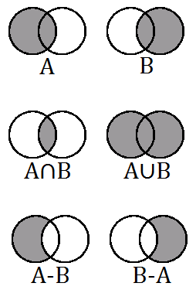
Venn diagrams for Set operations

Slide 18
Principle of Inclusion-Exclusion
The number of elements in the union of the two sets A and B is the sum of cardinality of the sets minus the number of elements in their intersection.
|A ⋃ B| = |A| + |B| − |A ∩ B|
Example, A={1,2,3,4}, B={2,4,6}
So, A ⋃ B={1,2,3,4,6} and A ∩ B={2,4}
|A ⋃ B| = |A| + |B| − |A ∩ B|
5 = 4 + 3 -2
5 = 5

Slide 19
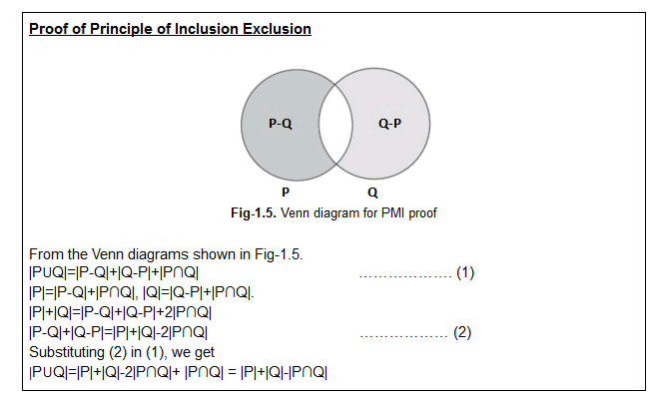
Proof of PIE

Slide 20
Extended PIE
|A ⋃ B ⋃ C| = |A| + |B| + |C| − |A ∩ B| − |A ∩ C| − |B ∩ C| + |A ∩ B ∩ C|
|A1 ⋃ A2 ⋃ A3 ⋃ A4| =
|A1| + |A2| + |A3| + |A4| −
|A1 ∩ A2| − |A1 ∩ A3| − |A1 ∩ A4| −
|A2 ∩ A3| − |A2 ∩ A4|− |A3 ∩ A4|+
|A1 ∩ A2 ∩ A3| + |A1 ∩ A2 ∩ A4| +
|A1 ∩ A3 ∩ A4| + |A2 ∩ A3 ∩ A4|−
|A1 ∩ A2 ∩ A3 ∩ A4|.

Slide 21
Question
In a room containing 28 people, there are 18 people who speak English, 15 people who speak Hindi and 22 people who speak Kannada. 9 persons speak both English and Hindi, 11 persons speak both Hindi and Kannada whereas 13 persons speak both Kannada and English. How many people speak all three languages?
Answer
|E| = 18, |H| = 15, |K| = 22, |E ∩ H| = 9, |H ∩ K| = 11, |E ∩ K| = 13, and |E ⋃ H ⋃ K| = 28. When we insert these quantities into the equation |E ⋃ H ⋃ K| = |E| + |H| + |K| − |E ∩ H| − |H ∩ K| − |E ∩ K| + |E ∩ H ∩ K| we obtain, 28 = 18 + 15 + 22 − 9 − 11 − 13 + |E ∩ H ∩ K|. We now solve for |E ∩ H ∩ K|. We find that |E ∩ H ∩ K| = 6.

Slide 22
2. Permutation & Combination
Permutation refers to arrangement/selection of objects when order of the objects matters.
Combination refers to arrangement/selection of objects when order of the objects does not matter.
For example we have 3 objects (A, B, C) from which we have to select 2 objects. If the order does not matter, the combinations are AB, BC, and AC. If the order does matter, then the permutations are AB, BA, BC, CB, AC, and CA.

Slide 23
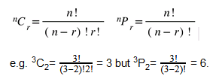
Formulas

Slide 24
Question
How many ways are there to select
(a) 3 persons
(b) 3 prize winners (1st/2nd/3rd position)
from 100 people?
Answer.
(a) ¹⁰⁰C₃
(b) ¹⁰⁰P₃

Slide 25
Question
In how many ways can a team of 11 cricketers be chosen from 6 bowlers, 4 wicket-keepers and 11 batsmen to give a majority of batsmen, if it at least 4 bowlers are to be included and there is one wicket-keeper?
Answer.
1 wicket-keeper can be selected in ⁴C₁=4 ways.
As at least 4 bowlers are needed then we can have a maximum of 6 batsmen. We also need majority of batsmen, hence we can not have 5 batsmen and 5 bowlers.
So, this selection can be done in ⁶C₄·¹¹C₆=6930 ways.
Hence, the total number of ways= 4·6930 = 27720.

Slide 26
Circular Permutation
In how man ways can 10 people sit around a table?
Answer: 9!
If there are 7 boys and 5 girls, how many circular arrangements are possible if the ladies do not sit adjacent to each other?
Answer: 6! * ⁷P₅

Slide 27
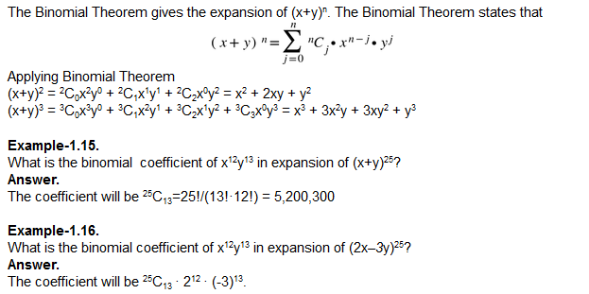
3. Binomial Theorem

Slide 28
4. Functions
Let X and Y be two non-empty sets.
A function “f” denoted by f : X → Y is the mapping of exactly one member of Y to every member of X, and f(x) = y denotes mapping of x∈X to y∈Y.
X is called as the domain and Y as the co-domain of f : X → Y, whereas “x” is called as pre-image and “y” is called the image of f(x) = y. The range of “f” is the set of all images.

Slide 29
Types of Functions
One-to-One / Injective
Onto / Surjective
One-to-One Correspondence / Bijective

Slide 30
One-to-One function
A function is said to be one-to-one mapping or injective mapping if each pre-image is mapped only to one image in the function
i.e. f(x)=f(y) implies x=y.
In simple terms, unique input has unique output.
g(x)=x² is not one-to-one as
g(2)=4 as well as g(-2)=4.

Slide 31
Onto function
A function is said to be onto mapping or surjective mapping if every image has a pre-image in the function (multiple pre-images also allowed). i.e.
all elements of set Y has a pre-image in X.
The function f(x)=x² from
X = set of integers to the Y=set of integers
is “not onto” as only elements
0, 1, 4, 9, 16, 25, … of the co-domain are mapped to
elements of the domain, rest remain unmapped.

Slide 32
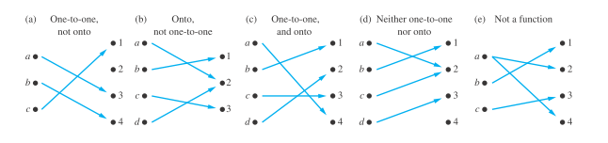
Mappings

Slide 33
Bijective Function
A mapping is called one-to-one correspondence or bijective if it is one-to-one as well as onto.
An inverse function can be defined only for a bijective function, where the inverse of a function f : X → Y is defined to be the function f⁻¹ : Y → X i.e. if f(x)=y then f⁻¹(y)=x.
The inverse function is also bijective.

Slide 34
Composition of Functions
Let “g” be a function from the set X to the set Y and let “f” be a function from the set Y to the set Z. The composition of the functions “f” and “g”, denoted for all a∈A by f◦g, is defined by (f◦g)(a)=f(g(a)).
f(x) = 4x + 3 and g(x) = 3x + 1
(f ◦ g)(x) = f (g(x)) = f (3x + 1) = 4(3x + 1) + 3 = 12x + 7
(g ◦ f )(x) = g(f (x)) = g(4x + 3) = 3(4x + 3) + 1 = 12x + 10.

Slide 35
Floor & Ceiling Functions
The floor function assigns to a real number x the largest integer that is less than or equal to x.
The ceiling function assigns to a real number x the smallest integer that is greater than or equal to x.
The floor function is denoted by ⌊x⌋, whereas ceiling function is denoted by ⌈x⌉.
e.g. ⌊3.1⌋=3,⌊3.9⌋=3, ⌈3.1⌉=4, ⌈3.9⌉=4

Slide 36
Thank You

