Slide 1
Scheduling Time Table Using Graph Coloring
CO - 205 Discrete Structures
Aditya Singh 2K19/EP/005
Gaurav Arya 2K19/ME/088

Slide 2
Theory
Graph coloring problem is to assign colors to certain elements of a graph subject to certain constraints.
Vertex coloring is the most common graph coloring problem. The problem is, given m colors, find a way of coloring the vertices of a graph such that no two adjacent vertices are colored using same color.

Slide 3
Applications of Graph Colouring
Making Schedule or Time Table
Suppose we want to make am exam schedule for a university. We have list different subjects and students enrolled in every subject. Many subjects would have common students. How do we schedule the exam so that no two exams with a common student are scheduled at same time? How many minimum time slots are needed to schedule all exams? This problem can be represented as a graph where every vertex is a subject and an edge between two vertices mean there is a common student. So this is a graph coloring problem where minimum number of time slots is equal to the chromatic number of the graph.

Slide 4
Applications of Graph Colouring
2. Mobile Radio Frequency Assignment:
When frequencies are assigned to towers, frequencies assigned to all towers at the same location must be different. How to assign frequencies with this constraint? What is the minimum number of frequencies needed? This problem is also an instance of graph coloring problem where every tower represents a vertex and an edge between two towers represents that they are in range of each other.

Slide 5
Applications of Graph Colouring
3. Map Coloring: Geographical maps of countries or states where no two adjacent cities cannot be assigned same color.
4. Register Allocation: In compiler optimization, register allocation is the process of assigning a large number of target program variables onto a small number of CPU registers. This problem is also a graph coloring problem.

Slide 6
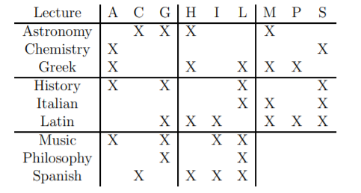
Hypothesis
Suppose that you are responsible for scheduling times for lectures in a university. You want to make sure that any two lectures with a common student occur at different times to avoid a conflict. We could put the various lectures on a chart and mark with an “X” any pair that has students in common:

Slide 7
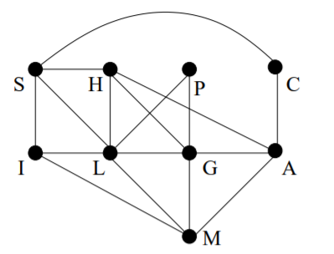
A more convenient representation of this information is a graph with one vertex for each lecture and in which two vertices are joined if there is a conflict between them:

Slide 8
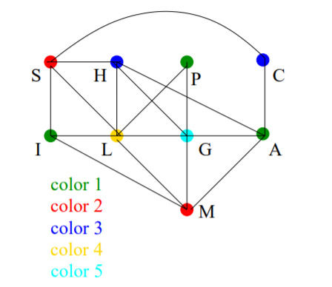
We can code each time with a color, for example 11:00-12:00 might be given the color green, and those lectures that meet at this time will be colored green. The no-conflict rule then means that we need to color the vertices of our graph in such a way that no two adjacent vertices (representing courses which conflict with each other) have the same color.

Slide 9
Implementation
Imported packages:
pandas - for File Handling
numpy - for arrays
itertools - for iterating values
matplotlib.pyplot - for plotting the points
networkx - for graph making

Slide 10
Working
We read a file name course.txt which include records of 30 students Record includes student's Roll no., Course, Semester, and Subjects The file contents are: (“NaN” denotes not any more subjects).
Now we generated the matrix which contains the number of Subjects in Column and Semester no. in Row which tells us - in which how many subjects are taken by student in a particular semester and course.
Now for Course 1, We have 3 semesters and, in each semester, - students have different subjects, so our goal is to plot a graph of subjects in each semester and color them so that each subject in one semester is allotted a different color. Here each subject is denoted by a unique color vertex.

Slide 11
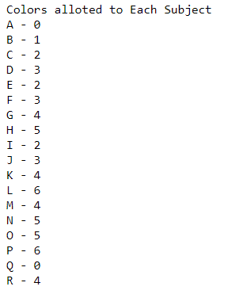
Conclusion
After using graph coloring concept, we are able to find timeslots for each subject.
These Colors denotes the Time-slot (in which timeslots which subject’s class will take place)
Link to the code, here

