Slide 1
DNA Sequencing Using Machine Learning
EP-305 BIOPHYSICS
Aditya Singh 2K19/EP/005
Arkajyoti Chakraborty 2K19/EP/022

Slide 2
Introduction
A genome is a complete collection of DNA in an organism. All living species possess a genome, but they differ considerably in size.
A human genome has about 6 billion characters or letters. If you think the genome(the complete DNA sequence) is like a book, it is a book about 6 billion letters of “A”, “C”, “G” and “T”.
The ability to extract new insights from the exponentially increasing volume of genomics data requires more powerful machine learning models. So we will try to interpret a DNA structure and apply machine learning algorithms to build a prediction model on DNA sequence data.

Slide 3
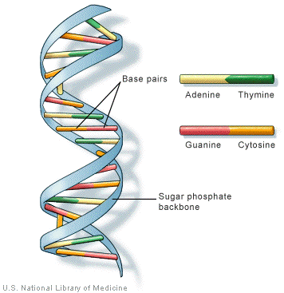
DNA
The double-helix is the correct chemical representation..
These four chemicals link together via hydrogen bonds making a chain. And the second thread balances the first. So if you have A on the first thread, you have to have T on the second.
Similarly, C and G always balance each other. So once you identify one thread of the helix, you can always spell the other.
The order, or sequence, of these bases, determines what biological instructions are contained in a strand of DNA.

Slide 4
Applying Machine Learning
We will use Bio.SeqIO from Biopython for parsing DNA sequence data(fasta). It provides a simple uniform interface to input and output assorted sequence file formats.
There are 3 general approaches to encode sequence data:
Ordinal encoding DNA Sequence
One-hot encoding DNA Sequence
K-mer Language DNA Sequence
So we will implement each of them and see which gives us the perfect input features.
A research paper proves K-mer counting is the most efficient way to sequence DNA.

Slide 5
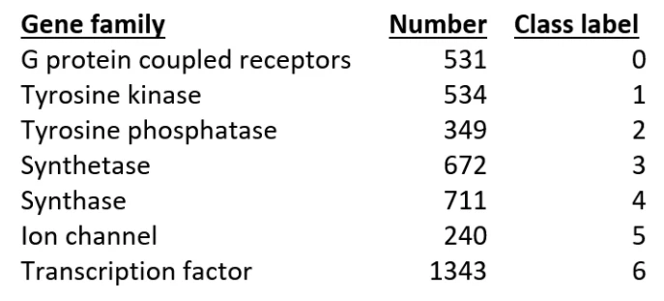
Objective
Build a classification model that is trained on the human DNA sequence and can predict a gene family based on the DNA sequence of the coding sequence. To test the model, we will use the DNA sequence of humans and dogs and compare the accuracies.
We will see how our model performs on the DNA sequences from other species. First we'll try the Macaca Primates, which we would expect to be very similar to humans. Then we will try, the Dog DNA sequences.

Slide 6
THANK YOU
Link to the code, here.

