Slide 1
Radiation Pattern Plot of Antenna Arrays
EP-303 EMT
Aditya Singh 2K19/EP/005
Arkajyoti Chakraborty 2K19/EP/022

Slide 2

Antenna Arrays
A set of antennas working together to produce certain radiation pattern. Each antenna in an array is called an element antenna (or simply an element).
(Array pattern) = (Array factor) X (element pattern)
The array factor of an N element antenna array can be calculated using the following formula:
where β is the wave vector and r is the distance between the observation point and the i^{th} antenna element. β=2π/λ and, λ is the wavelength of the processed signal.

Slide 3


The r distance is calculated as follows:
if x₀, y₀ and z₀ denotes the coordinates of the observation point and x_{i},y_{i} and z_{i} denotes the coordinates of the i^{th} antenna element.
The array factor of the antenna system is calculated by moving the observation point around the antenna system on a circle and calculating the expression of the AF continuously.
For uniformly spaced linear antenna array using the plane wave approximation the array factor can be calculated by the following formula:
Notes:
where d is the distance between the antenna elements.

Slide 4
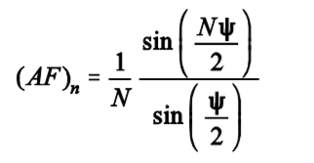
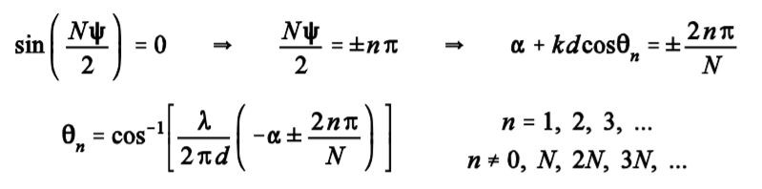
Radiation Pattern
The nulls of the array function are found by determining the zeros of the numerator term where the denominator is not simultaneously zero.

Slide 5
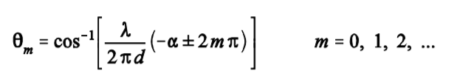
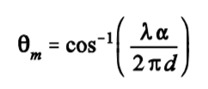
The peaks of the array function are found by determining the zeros of the numerator term where the denominator is simultaneously zero.
The m = 0 term,
represents the angle which makes = 0 (main lobe)

Slide 6
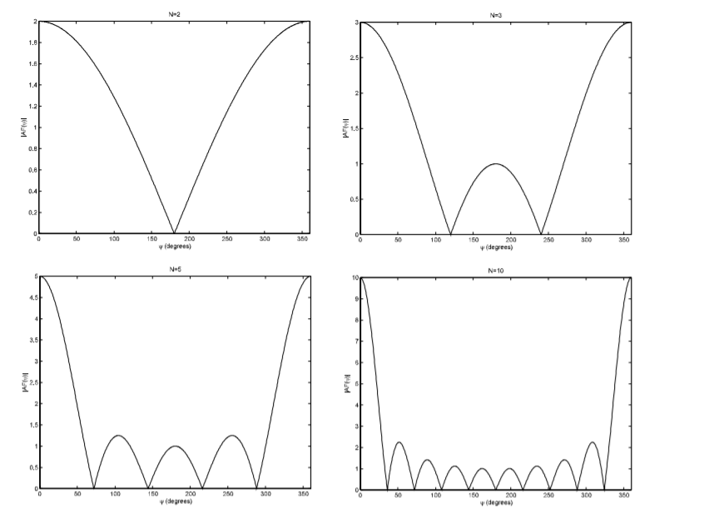

Slide 7
pyArgus
pyArgus is an open-source python library which aims to implement signal processing algorithms applicable in antenna arrays.
In the formula of the Array Factor (AF), w_{i} is the i^{th} coordinate of the weight coefficient vector. The rad_pattern_plot function implements this described function. The array_alignment parameter describes the alignment of the antenna system elements in the x,y plane.
Note that, the antenna system described by the array_alignment parameter should be placed with having center in the origin.

Slide 8
THANK YOU

