Slide 1
Stock Market Prediction
Review
MG 301 - FOM
Submitted by : ADITYA SINGH 2K19/EP/005
ARKAJYOTI CHAKRABORTY 2K19/EP/022

Slide 2
Overview
Finance management is one of the key things we often witness people losing money that is being invested in stocks. We bring the case study of the stock market and how technology can be used that can help us in making a wise decision.
We will be using machine learning and deep learning techniques to draw a comparative study and will be performing forecasting over a dummy data set.
We will Build the dashboard using Plotly dash and run as a backend in the browser.

Slide 3
Understanding the problem
Dataset
Plot
Algorithms
We will first load the dataset and define the target variable for the problem.
The profit or loss calculation is usually determined by the closing price of a stock for the day, hence we will consider the closing price as the target variable.
We will explore these variables and use different techniques to predict the daily closing price of the stock.

Slide 4
Project Objective
In this machine learning project, we will be talking about predicting the returns on stocks. This is a very complex task and has uncertainties. We will develop this project into two parts:
First, we will learn how to predict stock price using the LSTM neural network.
Then we will build a dashboard using Plotly dash for stock analysis.

Slide 5
Build the Dataset
To build the stock price prediction model, we will use the NSE TATA GLOBAL dataset. This is a dataset of Tata Beverages from Tata Global Beverages Limited, National Stock Exchange of India: Tata Global Dataset
To develop the dashboard for stock analysis we will use another stock dataset with multiple stocks like Apple, Microsoft, Facebook: Stocks Dataset

Slide 6
Python Libraries & Methods Used
39
Numpy
Pandas
Matplotlib
SkLearn
Deep Learning Methods:
LSTM
GRU (Gated recurrent units)
Regression
4
29
27
4
5
20
35
5
25
22
15
pandas
numpy
LSTM
Plot

Slide 7
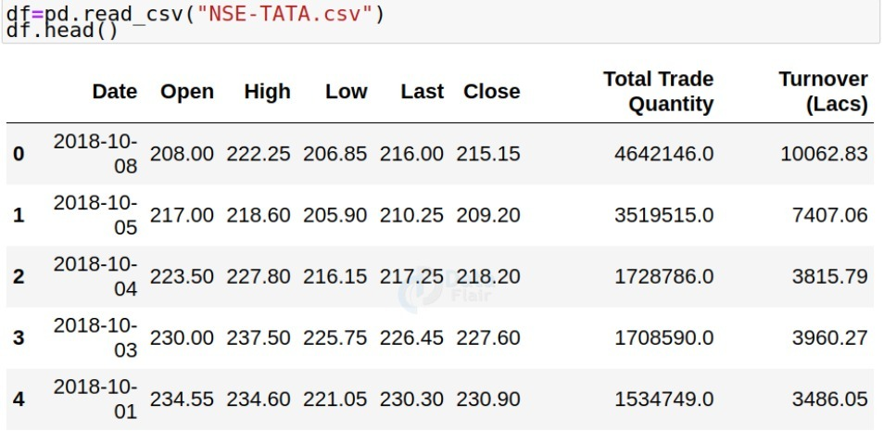
Read the Dataset

Slide 8
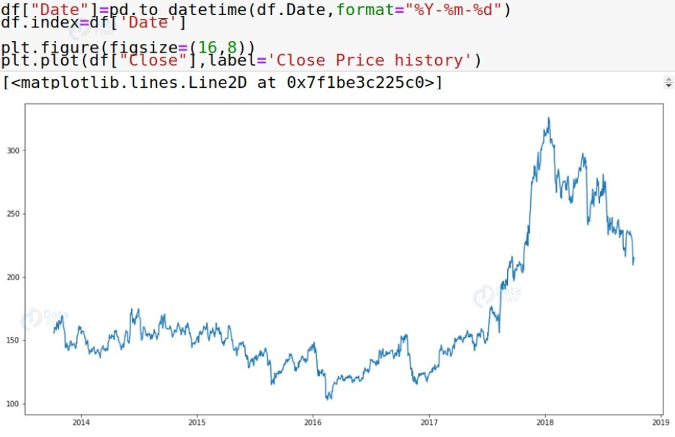
2. Visualising of the Data over Time

Slide 9
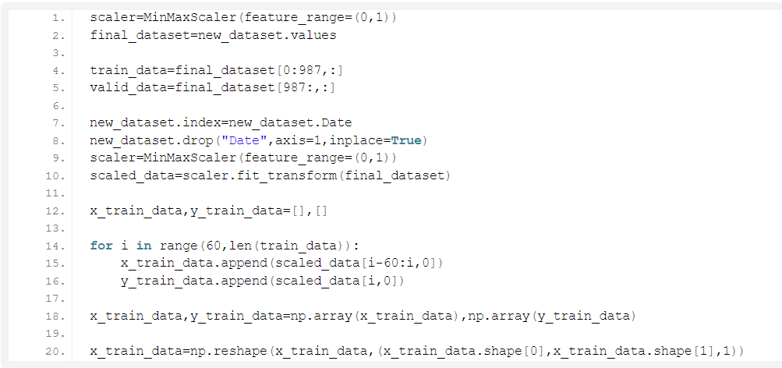
3. Normalize the new Filtered Dataset

Slide 10
Further Work Need to be Done
Building and training the LSTM model.
Taking a sample of a dataset to make stock price predictions using the LSTM model.
Save the model and Visualize the predicted stock costs with actual stock costs.
Build the dashboard using Plotly dash and run as a backend in the browser.

Slide 11
Summary
Thank You
We learned how to develop a stock cost prediction model and how to build an interactive dashboard for stock analysis. We implemented stock market prediction using the LSTM model. Plotly dash python framework for building dashboards.

