Slide 1




FastAPI Workshop: Building APIs with Database Connectivity
Aditya Parthasarathy

Slide 2
Agenda
REST API Basics
Intro to FastAPI
Pydantic Models
DB Connectivity: SQL Alchemy

Slide 3



Client-Server Architecture
HTTP
Request
DB Query
JSON/XML/HTML Response
Data
Client (UI)
Server(API)
DB

Slide 4
REST API
API – Application Programmable Interface
Enables two software components to communicate with each other using a set of definitions and protocols (contract)
REST – REpresentational State Transfer
Software architectural style, or a set of design constraints, for creating web services
Principles:
Client server communication – Separation of concerns
Uniform Interface – URL, HTTP verbs, status codes
Stateless – Each request should contain all details required for an operation. No session state stored.

Slide 5
HTTP Methods/Verbs
GET /products
GET /products/{id}
POST /products
PUT /products/{id}
DELETE /products/{id}
UI
API

Slide 6
HTTP Methods/Verbs
GET: fetch data
POST: create data
PUT: update data (complete replacement)
PATCH: update data (field level updates)
DELETE: remove data

Slide 7


Response Status Codes

Slide 8
Response Status Codes
Few commonly used codes:
Successful responses
200: OK
201: CREATED
Client error responses
400: BAD REQUEST
401: UNAUTHORIZED (Unauthenticated)
403: FORBIDDEN (Unauthorized)
404: NOT FOUND
Server error responses
500: INTERNAL SERVER ERROR

Slide 9
Response Status Codes
200: OK
403: FORBIDDEN
404: NOT FOUND
500: INTERNAL SERVER ERROR
UI
API

Slide 10
What is FastAPI?
Modern, high-performance web framework for Python
Asynchronous support built-in
Automatic interactive API docs (Swagger, Redoc)

Slide 11
Why FastAPI?
Faster development with less boilerplate
Data validation with Pydantic
Performance comparable to Node.js & Go
Great for microservices & ML model serving (async supported)

Slide 12
FastAPI vs Flask/Django
Flask: lightweight but no built-in async
Django: batteries included but heavier
FastAPI: modern, async, easy, with auto docs

Slide 13

FastAPI Basics
Define routes with decorators - (@app.get, @app.post)
Use type hints for validation
Returns JSON responses automatically
Web API Framework
Web Server
API Docs

Slide 14
Parameter Types
Path param (What resource?)
Example: /products/{id}
Part of the URL path
Chosen for locating/pinpoint to a specific resource
Mandatory, order matters
Query param (How to view/filter that resource?)
Example: /products/?limit=10&sort=name
Modifies the behavior of an API request by adding more information
Used to filtering, sorting, searching, pagination
Optional, order doesn’t matter

Slide 15
DEMO

Slide 16
Using Pydantic Models
Define request and response schemas
Automatic validation of incoming data
Helps maintain clean contracts between client & server

Slide 17
DEMO

Slide 18
Why Database?
Persistence beyond in-memory data
Support for larger applications
Data integrity and relationships

Slide 19
ORM vs Raw SQL
ORM (Object Relational Mapper) maps Python classes to DB tables
SQLAlchemy is the most popular ORM in Python
Avoids manual SQL for most operations

Slide 20
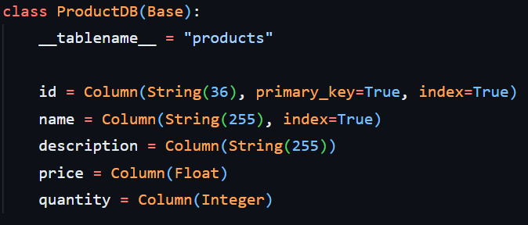
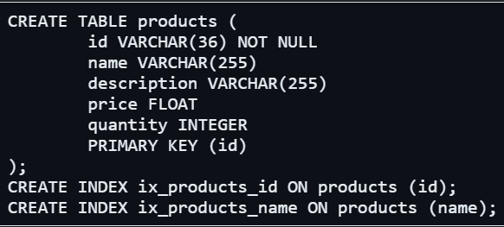
Python Model vs DB Table

Slide 21
SQLAlchemy with FastAPI
Define models as Python classes
Create tables with Base.metadata.create_all() (using ORM Mapped classes)
Use SessionLocal for DB operations
Integrate with FastAPI dependencies (using Depends())

Slide 22
DEMO

Slide 23
Best Practices
Organized code structure – code reusability, readability and maintainability
Implementation of custom loggers – console and file logging
Exception handling – create custom exceptions wherever applicable
Validation of request/response data – to ensure data consistency and help mitigate attacks (SQL injection)
Write unit tests for APIs (pytest + httpx) – to validate endpoints

Slide 24
What to Explore Next?
Middleware (e.g., CORS Middleware)
Authentication & Authorization (OAuth2, JWT)
Dependency Injection in depth
Cookies
Response Headers
Async programming
Deploying FastAPI (Docker, Cloud, Gunicorn/Uvicorn workers)

Slide 25
References
https://restfulapi.net/
https://developer.mozilla.org/en-US/docs/Web/HTTP/Reference
https://fastapi.tiangolo.com/
https://fastapi.tiangolo.com/tutorial/
https://docs.sqlalchemy.org/en/20/tutorial/
https://docs.pydantic.dev/latest/

Slide 26
THANK YOU

