Slide 1



AI-Based Voice Command Home Automation.
By:- Nitin Kumar
Aditya Pratap Singh
Aditya Pachaury

Slide 2

Problem Statement
Traditional home automation sytems require manual control (switches, apps, or remotes) and lack personalization. Existing voice assistants (Alexa, Google Home) depend heavily on cloud, which raises privacy concerns, and they don’t adapt well to individual users habits.

Slide 3
Solution
The proposed Voice Command Home Automation System provides a smart, hands free way to control home appliances, lights, and security systems. The system begins by capturing user input through speech-to-text processing, converting spoken words into digital text. Using Natural Language Understanding (NLU), it identifies the intent behind the command—for example, recognizing “Goodnight” as a request to turn off lights, lock doors, and activate the alarm.

Slide 4




1 Quick setup and pairing process
2 Speech Recognition (STT)
3 Automation rules for daily tasks
4 Device Management
5 Android App (Java)
KEY FEATURES & FUNCTIONALITIES
5-Step Ordering Process

Slide 5





Flow Chart
5-Step Process
Microphone captures → Speech-to-text
Command sent → Device via API
1
2
3
4
5
User says → "Turn on the lights"
NLU identifies intent → Turn on lights
Device acts → Light turns on

Slide 6

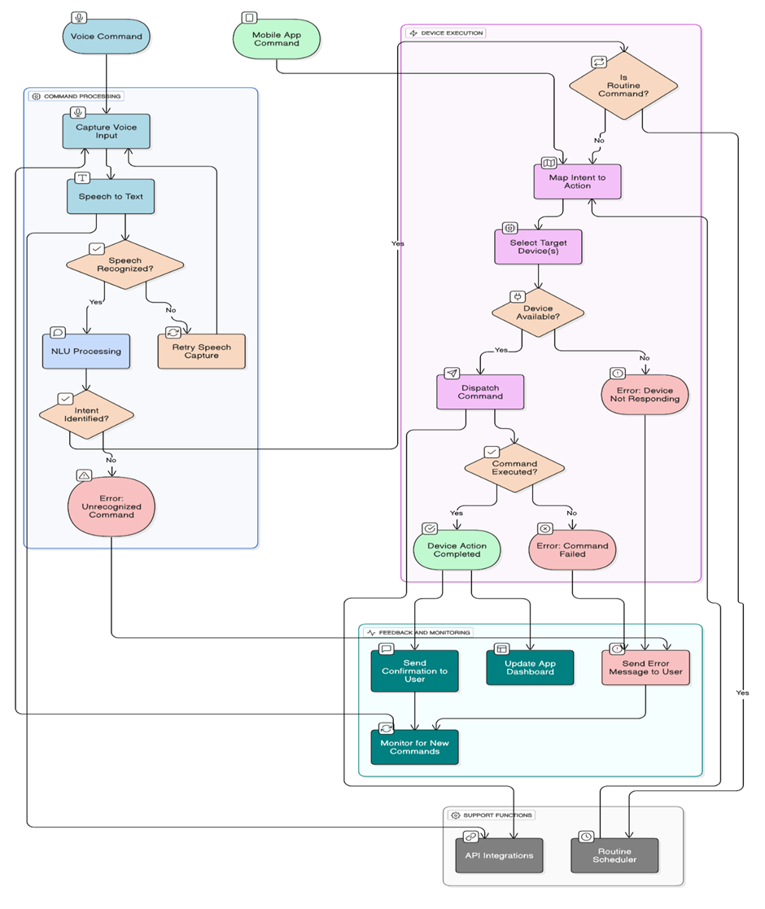

Diagram

Slide 7
Technology Used

Slide 8
UNIQUENESS AND INNOVATION
1
2
Adaptive Voice Recognition
Cost-Effective & Scalable
5
4
3
Privacy-Aware Design
Routine Automation
Real-Time Interaction

Slide 9
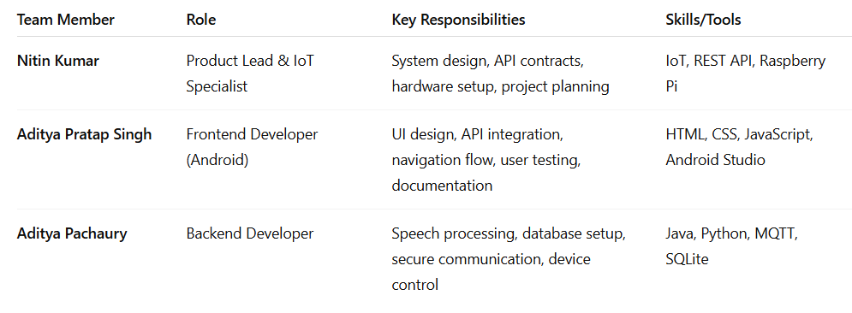


Team Contribution

Slide 10

Weekly timeline of the project

Slide 11
T
H
A
N
K
Y
O
U

