Slide 1
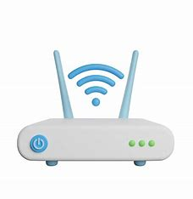
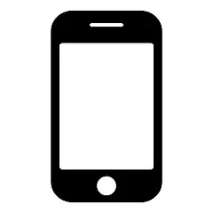
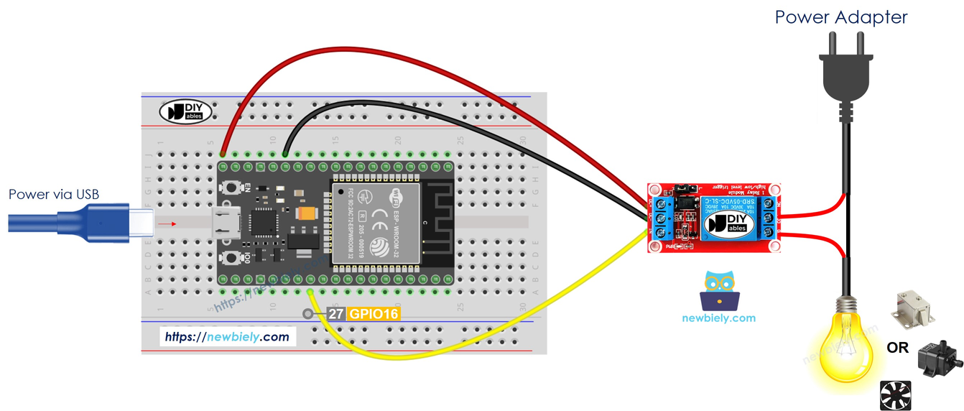
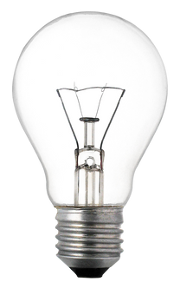

Hey Home Turn-On Light
ESP 32 + Relay
User

Slide 2
Hey Home Turn-On Light
ESP 32 + Relay
User

Slide 3
Turn-On Light
ESP 32 + Relay
User

Slide 4
ESP 32 + Relay
User

