Slide 1



Genesis Ideathon: Final Presentation
Team ID: GEN26-A0H-I216
Power Rangers: POWER RANGERS
Domain: Domain 7
Amrita Vishwa Vidyapeetham, Coimbatore Campus
Date: 11th October 2026

Slide 2
Presentation Outline
Problem Statement
Problem Understanding
Existing Gaps & Challenges
Our Proposed Solution
Technical Approach
Innovation & Uniqueness
Feasibility & Scalability
Cost for Product
Use Cases
Impacts and Benefits
Sustainable Development Goals
Individual Member Contribution

Slide 3

Problem Statement
Students waste time and miss opportunities to use campus facilities because the lack a centralized reliable, and real-time way to discover the availability of resources such as classrooms, laboratories, study spaces and other campus resources.

Slide 4
Problem Understanding
College students who need available classrooms, project rooms, and laboratory computers. Students working on assignments, group projects, and practical tasks.
No centralized platform to check resource availability. Lack of real-time, reliable availability information. Dependence on manual checking and communication.
Students are unable to save time and find available facilities easily. College administration cannot identify overcrowded and underused resources. Faculty and staff spend more time helping students locate facilities.

Slide 5
Existing Gaps & Challenges
Manual checking wastes time and requires visiting different locations.
Timetables show scheduled activities but may not reflect actual resource availability.
No centralized platform at our college to discover available campus resources. Lack of reliable, up-to-date information about actual availability. Difficulty in finding suitable alternatives and identifying underutilized facilities.

Slide 6
Our Proposed Solution
A centralized campus platform that helps students and faculty find and list resources that are actually usable using official schedules.
The solution works by deploying an application that integrates directly with the intranet in real time to track timetable changes and academic schedules. To maintain accurate records, the platform provides full access to the administration and limited access to class representatives to update cancelled classes and timetable changes. With this synchronized data, students can check ahead to locate empty classrooms, study areas, and specialized facilities like 3D-printing labs, the supercomputer room, and CISCO labs while verifying required access permissions. Concurrently, the app monitors campus facilities such as the library, gyms, PE department, and swimming pool to show students whether these spaces are currently overcrowded or open for use.
Our app helps users find and book available campus facilities easily, saving time and improving resource utilization.

Slide 7
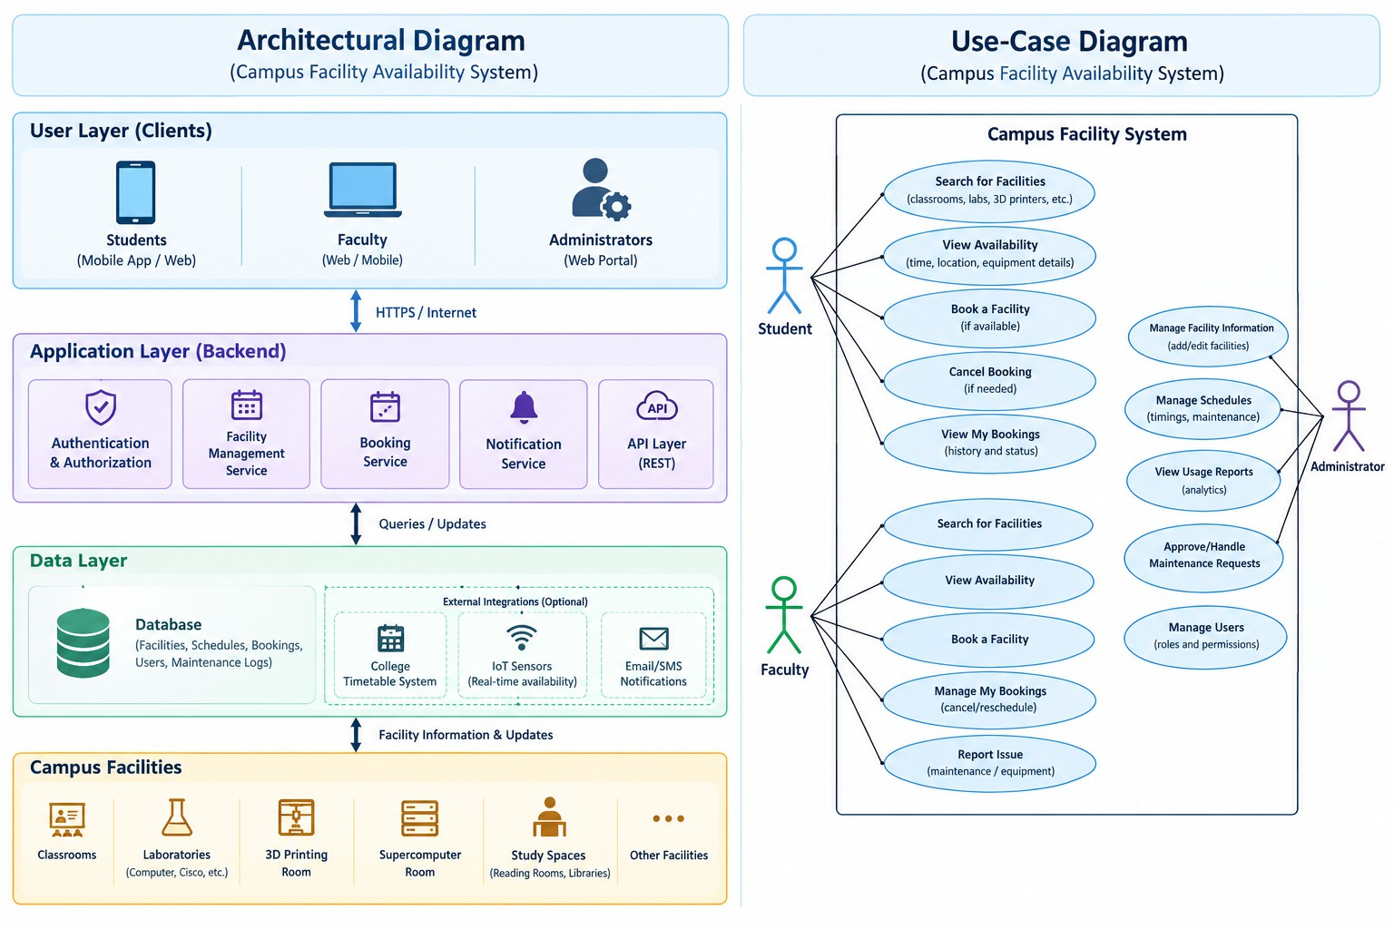
Technical Approach
[Explain how the system components work together.]
Tech Stack
Frontend: [HTML, CSS, Database: [MySQL] JavaScript]
Backend:
(Flask)]
[Python AI/ML, APIs, or Hardware: [REST API for com-munication between frontend and backend]

Slide 8
Innovation & Uniqueness
Unlike traditional systems, our app provides a single platform to check availability, locate, and book different campus facilities, including classrooms, labs, 3D printers, and supercomputer rooms.
This approach is suited to the problem because it centralizes facility information, reduces manual searching and confusion, and helps students and staff access available campus resources quickly and efficiently.
Our key differentiator is a single platform that combines facility availability, location, equipment details, and booking options for the entire campus.

Slide 9
Feasibility & Scalability
Feasibility: The project is technically and financially feasible using open-source technologies, existing campus infrastructure, and secure role-based access
Scalability: The modular architecture supports adding more facilities, labs, and campus amenities with minimal changes.
Risks: Outdated availability data, incorrect timetable updates, unauthorized access, and server downtime may affect system reliability. These risks can be reduced through regular updates, secure authentication, backups, and proper access controls.

Slide 10
Cost for Product (Optional)
Development or hardware cost: Rs. 0-2000
Hosting or maintenance cost: Rs. 0-500 per month
Estimated total: Rs. 0–8,000 for the initial prototype, assuming free tools and existing hardware.

Slide 11
Use Cases (compulsorily 3 use cases must be there)
Use case 1: A student checks the availability and location of classrooms, computer labs, and study spaces before visiting.
Use case 2: A student views available time slots and books a lab or 3D-printing facility for project work.
Use case 3: An administrator updates facility schedules, manages bookings, and records equipment faults to ensure accurate availability information.

Slide 12
Impacts and Benefits
Helps students and faculty find available campus facilities quickly, saving time and improving efficiency.
Improves campus coordination, reduces unnecessary expenses, and promotes efficient use of resources.
Aims to reduce facility-search time by 50 percent and increase resource utilization by 20–30 percent.

Slide 13
Sustainable Development Goals (SDGs)
SDG Number | Target Number | Goal Name | Connection
SDG 4 | Target 4.a | Quality Education | Improves access to campus facilities and creates a more efficient learning environment.
SDG 11 | Target 11.7 | Sustainable cities and communities | Promotes efficient use of campus spaces and creating accessible, sustainable learning environments.

Slide 14
Individual Member Contribution
Member | Contribution or responsibility
Aditya Pakharia | Team Leader and Project Coordination
Yeshwanth R | Research and Idea Development
Doradla Santosh Charan | Problem Analysis and Solution Planning
Bongu Sasanth | Documentation and Presentation Preparation

Slide 15
Yukti ID
Yukti ID
[IR2026-1051061]

