Slide 1



IILM UNIVERSITY
GREATER NOIDA
INTERNSHIP PRESENTATION
Introduction to Data Science
INTERNSHIP TOPIC / TITLE
Introduction to Data Science
STUDENT NAME
Aditya Panday
STUDENT NAME
Aditya Panday
ENROLLMENT / ROLL NO.
2410031676
ENROLLMENT NUMBER
2410031676
PROGRAM & SECTION
B.Tech CSE • 3CSE13
PROGRAM & SEMESTER
B.Tech CSE • 3CSE13
BATCH
2026–27
ORGANIZATION NAME
Not specified in the supplied certificate/report
ORGANIZATION / PROVIDER
School of Computer Science and Engineering • IILM University, Greater Noida, U.P.
School of Computer Science and Engineering • IILM University, Greater Noida, U.P.
IILM University • School of Computer Science & Engineering
1

Slide 2
Internship Overview
A concise view of the training, certificate and learning focus
Programme
Certificate
Learning Focus
Introduction to Data Science
Foundational training focused on understanding the data science lifecycle.
Completed on 11 April 2026
Certificate code: 10090201.
Data handling, basic statistical thinking, exploratory analysis, visualization and interpretation.
The internship/training built a structured understanding of how data can be collected, prepared, explored and interpreted.
The supplied documents do not verify specific programming languages, software platforms or organization-specific tools.
The presentation therefore focuses on the documented conceptual learning outcomes.
IILM University • School of Computer Science & Engineering
2

Slide 3
What is Data Science?
The internship report’s conceptual framing
Interdisciplinary Field
From Raw Data to Insight
Data Science combines ideas from statistics, programming, data handling and analytical thinking to discover useful information, patterns and insights from data.
The central learning theme is transforming raw or unorganized data into information that can be explored, analyzed and communicated clearly.
Why It Matters
A structured data workflow helps identify patterns, interpret results and communicate findings in a meaningful way that can support decision-making.
IILM University • School of Computer Science & Engineering
3

Slide 4
Problem Statement & Objectives
Problem Statement
Understand the basic concept and role of Data Science.
Understand the general data science workflow from data to insights.
Develop familiarity with data preparation and exploratory analysis.
Understand how analytical results can support decision-making.
Build a foundation for further learning in data analytics and machine learning.
Modern applications generate large amounts of data, but raw data alone does not directly provide useful conclusions.
The challenge is to transform raw or unorganized data into a form that can be explored, analyzed and communicated clearly.
IILM University • School of Computer Science & Engineering
4

Slide 5
Scope of the Internship
Fundamentals of the analytical lifecycle
Data Collection
Data Preparation
Understanding how relevant data is identified and gathered.
Checking quality, cleaning and organizing data for analysis.
Exploratory Analysis
Visualization
Studying distributions, relationships and patterns.
Presenting analytical findings in a clear and interpretable form.
IILM University • School of Computer Science & Engineering
5

Slide 6
Conceptual Data Science Workflow
System architecture described in the internship report
Data Sources
Data Collection
Cleaning &
Preparation
Exploratory
Data Analysis
Analysis /
Modeling
Visualization &
Interpretation
Insights /
Decision Support
Interpretation
The architecture represents a general data science task flow; it is not a claim that a specific system was implemented during the certificate programme.
IILM University • School of Computer Science & Engineering
6

Slide 7
Methodology
Sequential stages used to understand a data science problem
01
Define
02
Collect
03
Prepare
Identify the problem and required data.
Gather data and check its quality.
Clean and prepare data for analysis.
04
Explore
05
Analyze
06
Communicate
Understand distributions, relationships and patterns.
Apply appropriate analytical methods.
Visualize, interpret and clearly communicate findings.
IILM University • School of Computer Science & Engineering
7

Slide 8
Technologies & Tools
Documented conceptual areas — no specific software was verified
Data Handling
Statistical Thinking
Exploration & Visualization
Working with data, understanding data quality, organizing information and preparing it for analysis.
Using basic statistical reasoning to understand distributions, relationships and patterns.
Exploring data and communicating findings through interpretable visual representations.
Note: The supplied certificate does not specify particular programming languages, software tools or platforms.
IILM University • School of Computer Science & Engineering
8

Slide 9
Expected Learning Outcomes
Clear understanding of the Data Science lifecycle.
Improved ability to reason about data.
Awareness of data preparation and exploratory analysis.
Foundation for progressing toward data analytics and machine learning.
Development of analytical and problem-solving skills.
IILM University • School of Computer Science & Engineering
9

Slide 10
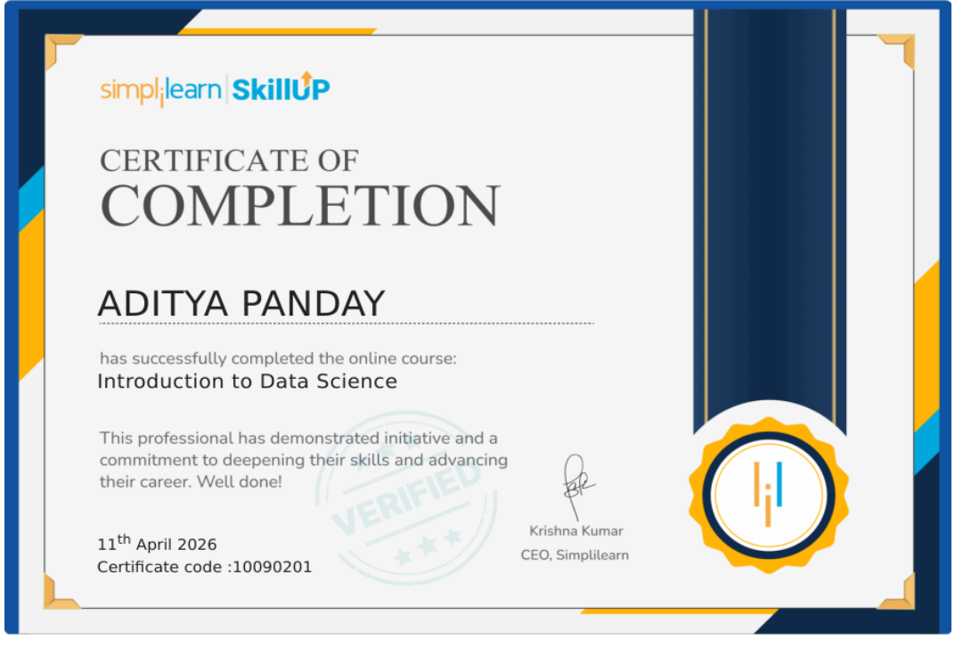
Internship Completion Certificate
Supporting proof supplied with the internship report
ADITYA PANDAY • Introduction to Data Science • 11 April 2026 • Certificate Code 10090201
IILM University • School of Computer Science & Engineering
10

Slide 11
Key Takeaways
What this internship/training established
Foundation
Workflow
Next Step
Built an introductory understanding of Data Science and its role in turning data into useful insights.
Understood the end-to-end conceptual lifecycle: collection → preparation → exploration → analysis → visualization → insights.
Established a base for further learning in data analytics, machine learning and related areas.
Thank You
IILM University • School of Computer Science & Engineering
11

Slide 12
References & Source Documents
IILM University, School of Computer Science and Engineering — Internship Report Format 2026–27.
Aditya Panday, “Introduction to Data Science” Internship Report, submitted to IILM University, Greater Noida.
Internship Completion Certificate — Introduction to Data Science, dated 11 April 2026, Certificate Code 10090201.
Prepared using the supplied internship report, completion certificate and the PPT guidelines shown in the provided instruction image.
IILM University • School of Computer Science & Engineering
12

