Slide 1
Assignment 2 - Implementation of Recurrent Perceptron
Aditya Pande | 22M2108
Balbir Singh | 22M0747
Tarun Bisht | 23D0386
Vivek Kumar Trivedi | 22N0457
Date - 31 March, 2024

Slide 2
Problem Statement
Input: POS-tagged input tokens
Output: Noun chunk labels on tokens .The beginning of the chunk will be labeled 1 and the rest of the words in the chunk will be labeled 0. All other words are labeled 1.

Slide 3
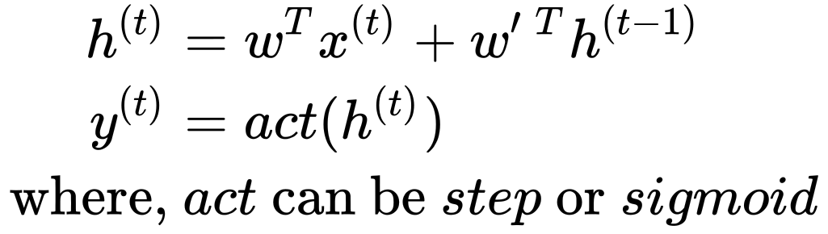
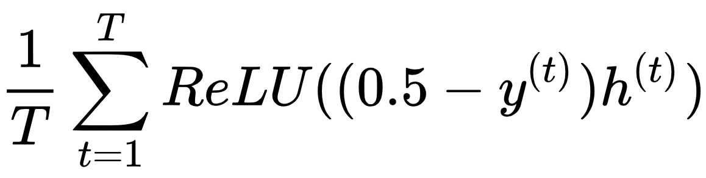
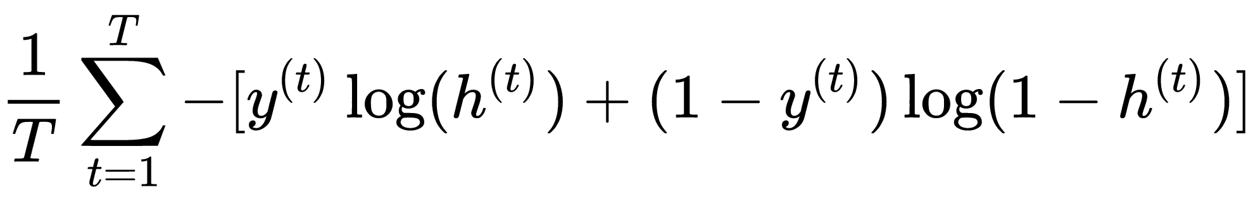
Implementation Details
t=0
t=1
t=N
 | W | 0.006
 | ^ | 0.85
 | VOT | 0.79
 | VNN | 0.79
 | VJJ | 0.36
 | VDT | -0.10
 | WOT | 0.28
 | WNN | -0.14
 | WJJ | -0.14
 | WDT | 0.38
 | θ | 0.65
Boys
Play
field
SOS
Boys
big
sos | Boys | Play | joyfully | with | brown | balls | in | the | Green | big | field
 | 1 | 4 | 4 | 4 | 3 | 1 | 4 | 2 | 3 | 3 | 1
 | 1 | 1 | 1 | 1 | 1 | 0 | 1 | 1 | 0 | 0 | 0
Previous Word One hot
Forward Pass
Loss Function
Current Word One hot
Hyperparameters
Derivative of hinge loss gives perceptron update rule.
Factor of 0.5 introduced as labels in our case are 0, 1 instead of 1, -1.
We searched for hyperparameters, with learning rate: [.001, .005, .01, .05] and batch size: [64, 128, 256, 512]
Learning Rate: 0.05
Batch Size: 64

Slide 4
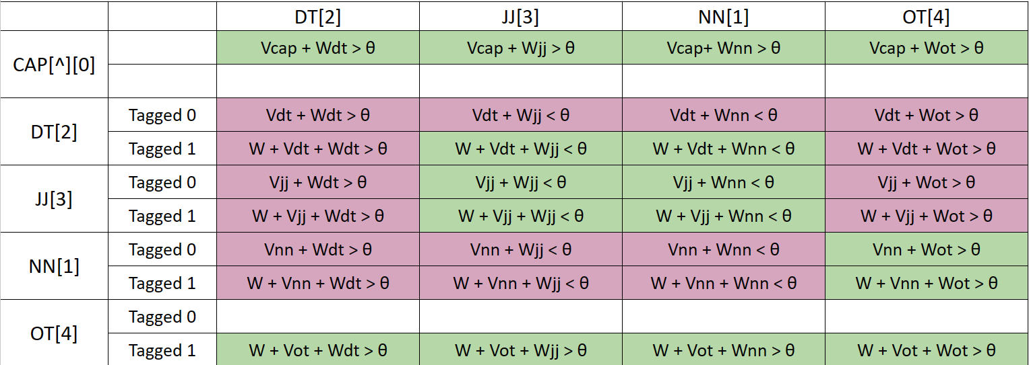
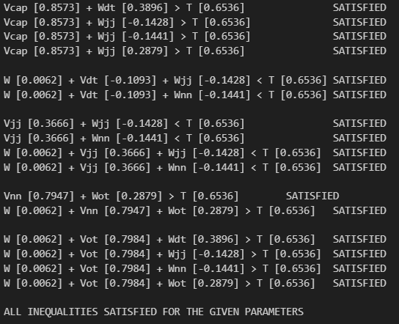
Language constraint table
 | W | 0.006
 | ^ | 0.85
 | VOT | 0.79
 | VNN | 0.79
 | VJJ | 0.36
 | VDT | -0.10
 | WOT | 0.28
 | WNN | -0.14
 | WJJ | -0.14
 | WDT | 0.38
 | θ | 0.65
Previous Word One hot
Current Word One hot

Slide 5
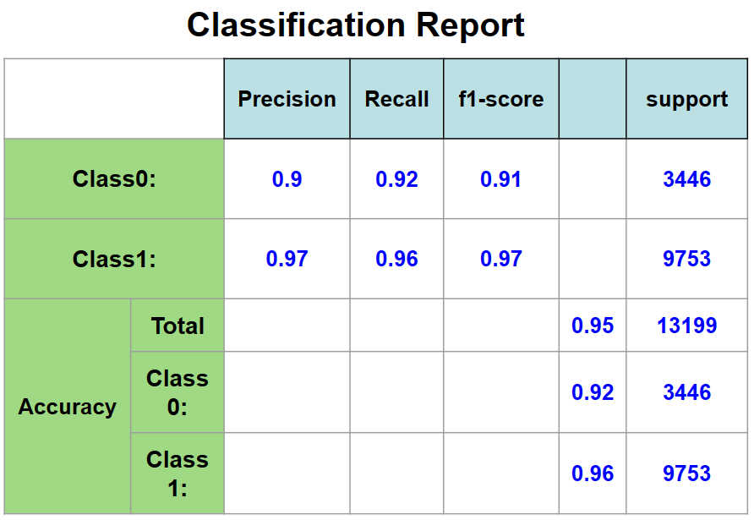
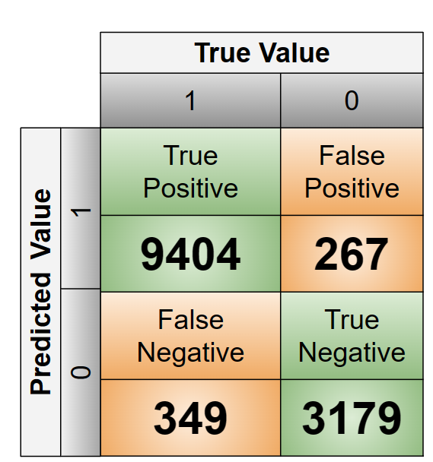
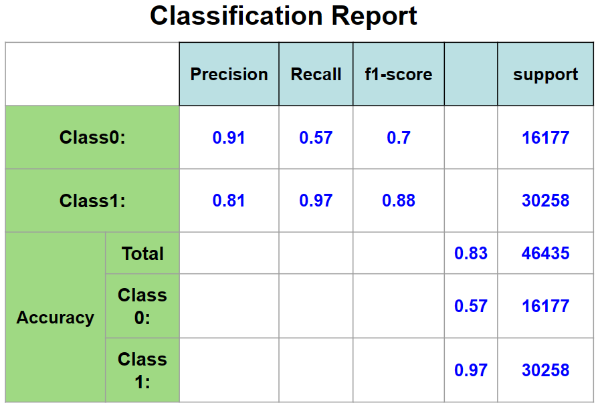
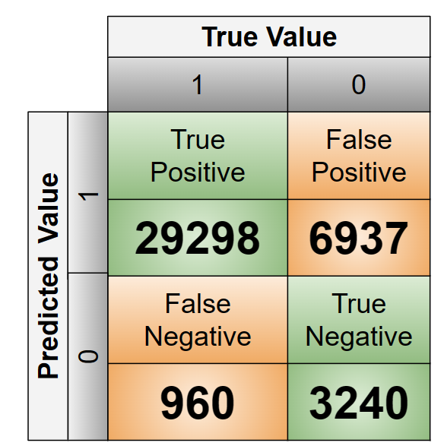
Overall performance

Slide 6

Error Analysis
tokens | It | was | mostly | short | points | . | “
pos_tags | 4 | 4 | 4 | 3 (JJ) | 1 (NN) | 4 | 4
chunk_tags | 1 | 1 | 1 | 1 | 1 ( 0) | 1 | 1
………… | both | frame | ……….
………… | 2 (DT) | 1 (NN) | ……….
………… | 1 | 1 (correct =0) | ……….
['AL-AIN', ',', 'United', 'Arab', 'Emirates', '1996-12-06']
********************************************************************************
POS [1 4 1 1 1 4]
********************************************************************************
True [1 1 1 0 0 0]
********************************************************************************
Pred [1 1 1 0 0 1]
['Bitar', 'pulled', 'off', 'fine', 'saves', 'whenever', 'they', 'did', '.']
*******************************************************************
POS [1 4 4 3 4 4 4 4 4]
*******************************************************************True [1 1 1 1 1 1 1 1 1]
*******************************************************************
Pred [1 1 1 1 0 1 1 1 1]
Error is due to the ambiguity in the remaining conditions other than given conditions
also dataset did not satisfy the given conditions
Prediction for OT is 1, but given test case is 0
For Previous DT and Current DT, many predict 0 and 1

Slide 7
Learnings
BPTT performed better for step activation compared to sigmoid activation.
The given data did not satisfy all the given conditions.
Even when the data satisfied all the given inequalities the model performance was not 100% (~82%). This is because of the ambiguity in the remaining rules.
Finally, when all conditions were imposed and the data was filtered the ML model converged to a rule based model giving an accuracy of 100%.

Slide 8
Evaluation Scheme
Correct implementation of BPTT from scratch: 10 marks (show the code parts that implement weight change rules)
Overall Performance: accuracy >=90: 10 marks; 80-89: 9; 70-79: 8; 60-69: 7; 50-59: 40-49: 5; 30-39: 4. And so on
Error Analysis: 10
Inequality Table: 10
Demo: 10

Slide 9
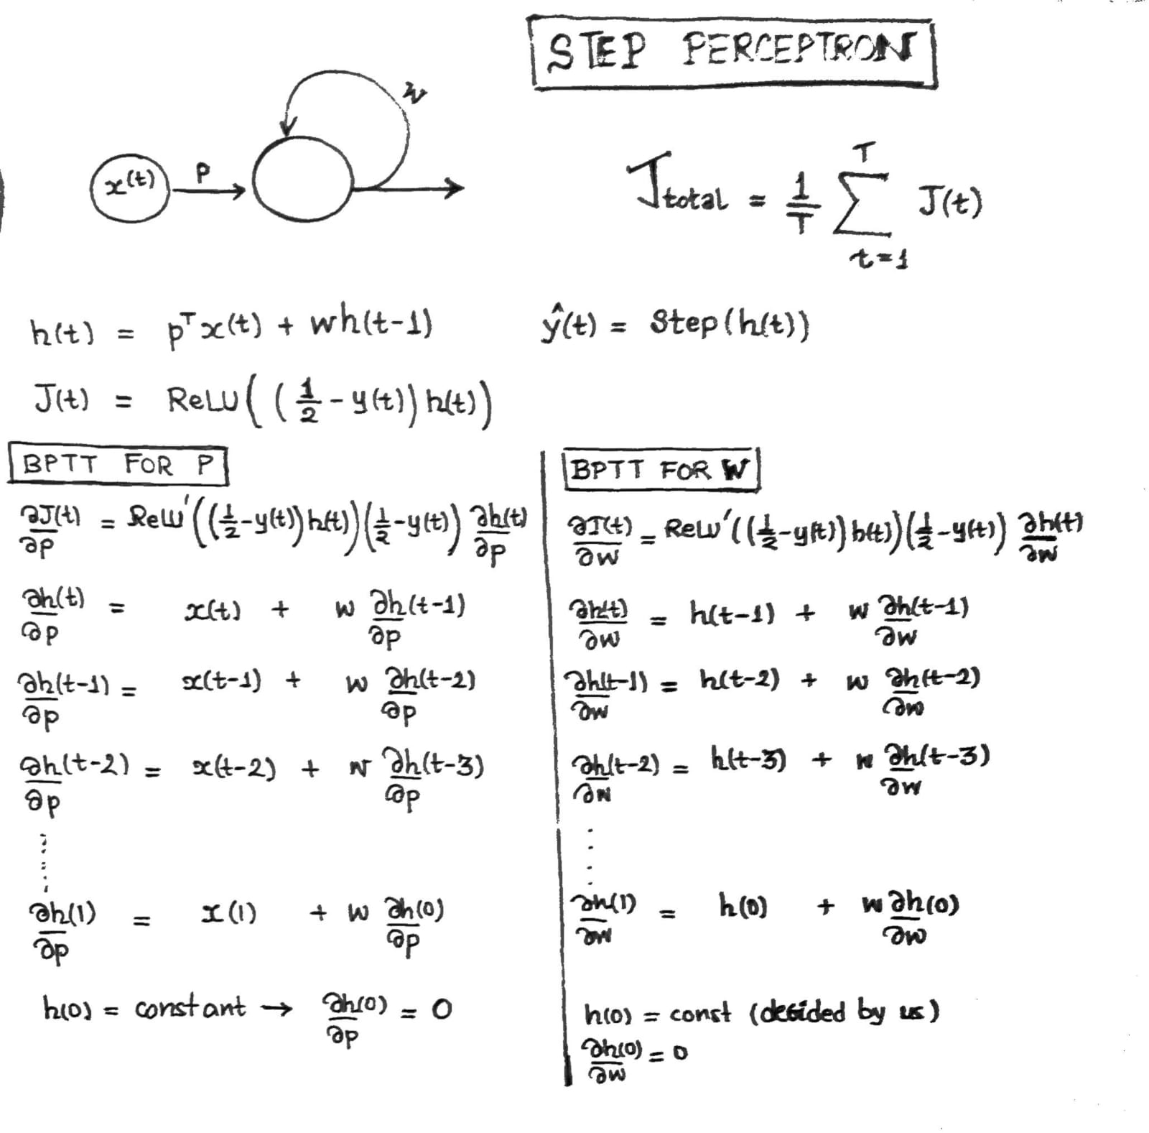
Appendix (BPTT)

Slide 10
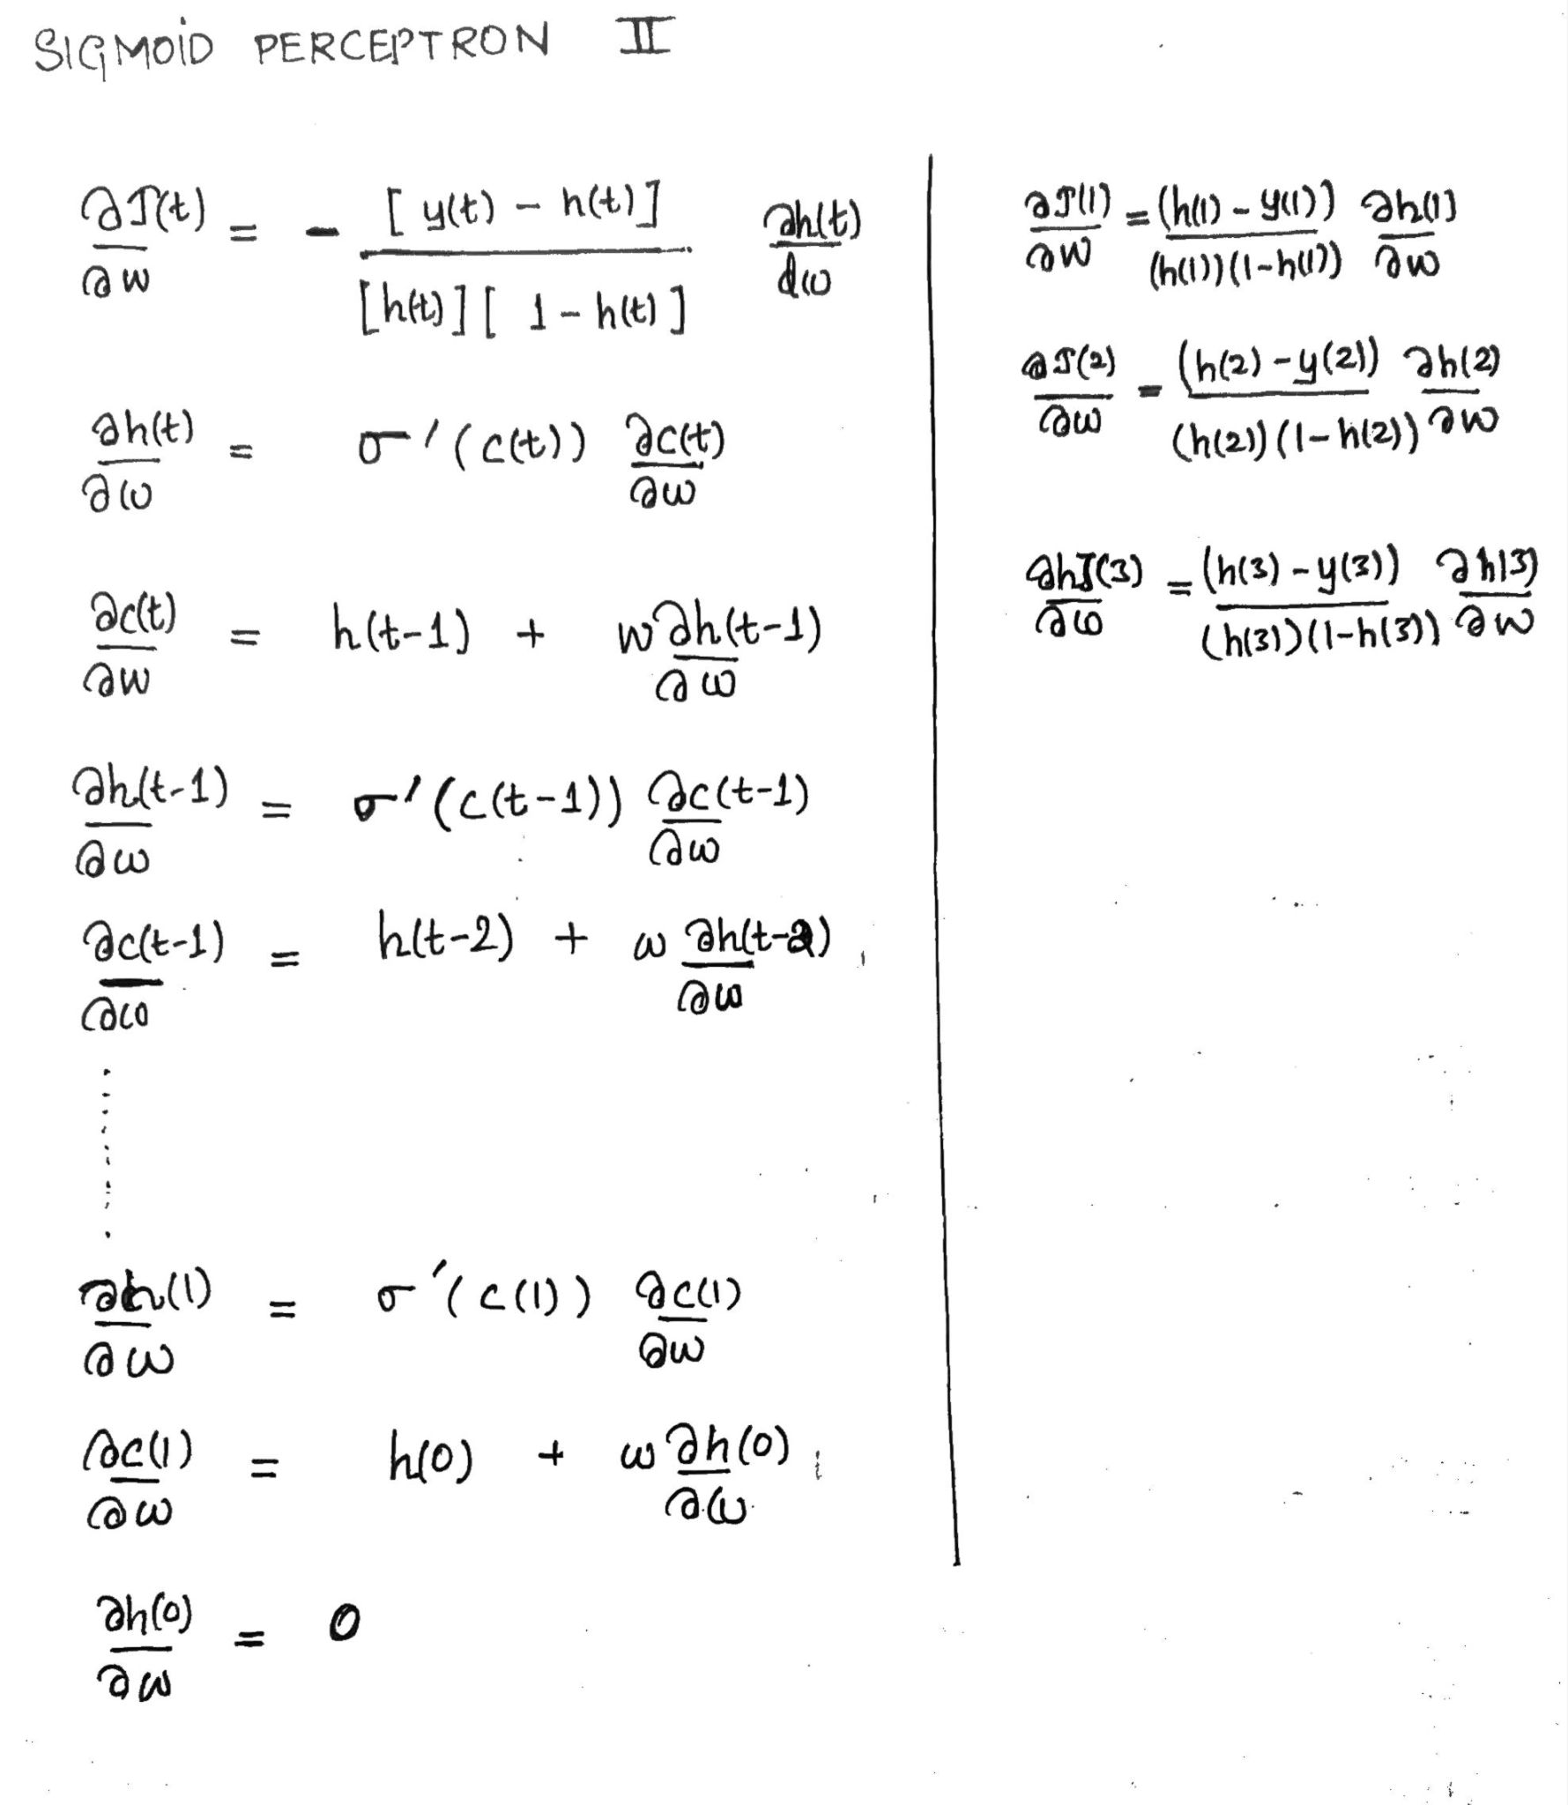
Appendix (BPTT)

Slide 11
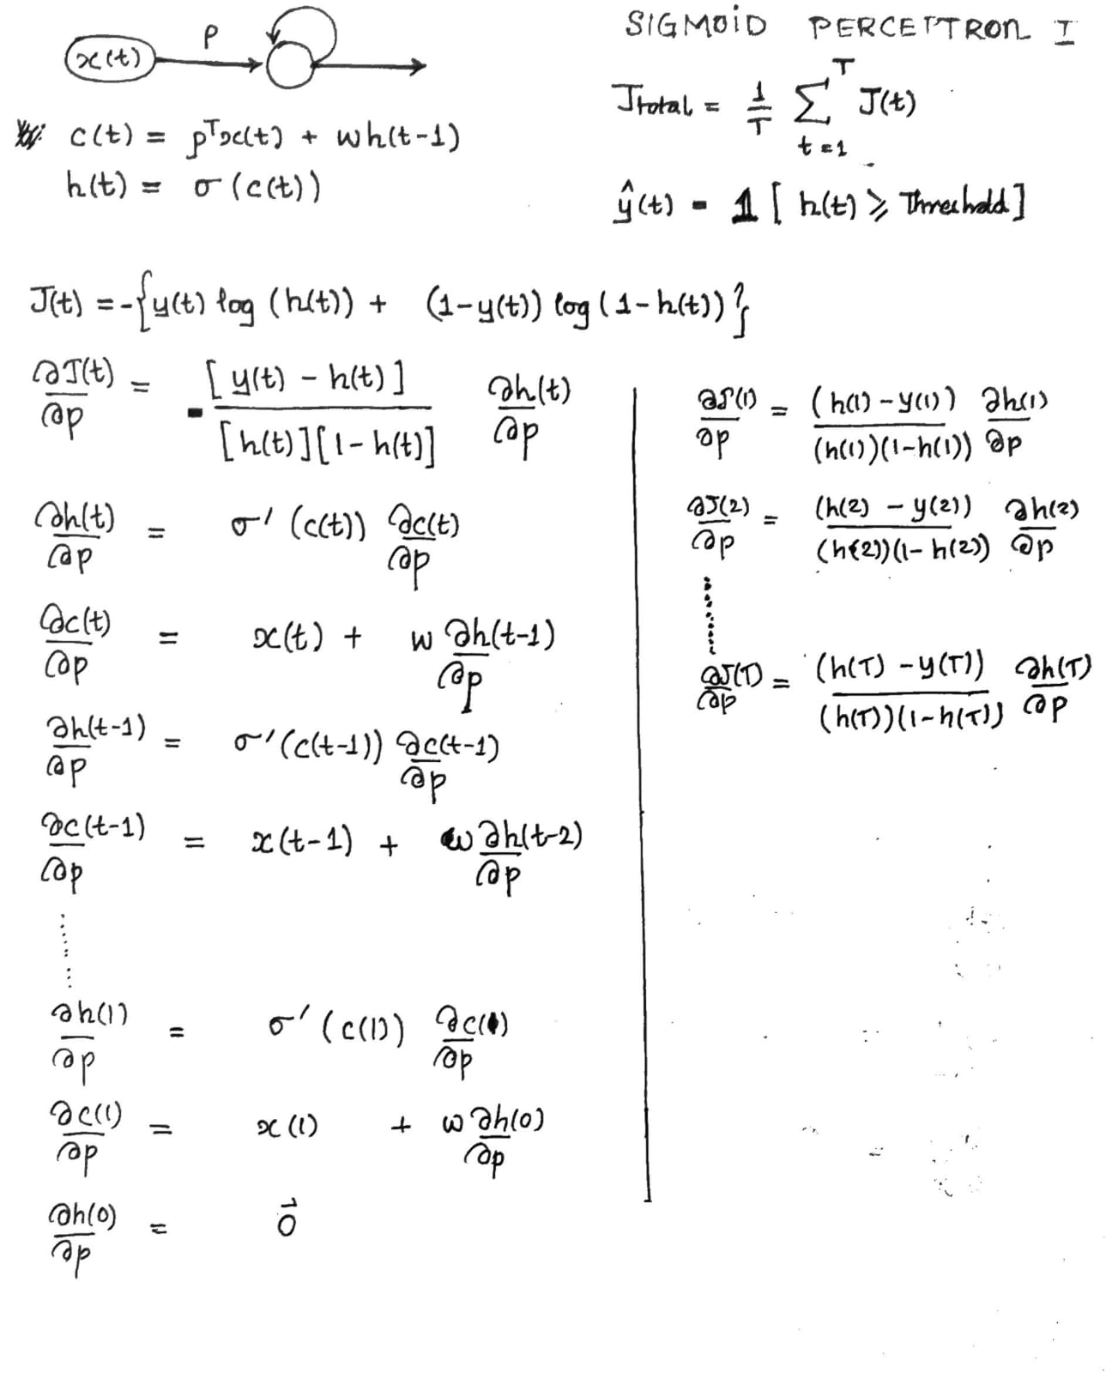
Appendix (BPTT)

Slide 12
Given Conditions
 | Train | Test | Train (Accuracy) | Test (Accuracy)
Original data (sentence) | 14041 | 3453 |  | 83
Given Conditions | 5139 | 1185 |  | 95
All Conditions | 4439 | 1039 | 100 | 100

