Slide 1

SHOPPING BAZAR
E-Commerce Microservices
on Docker & Kubernetes
A cloud-native shopping platform built with independent Node.js services,
containerized with Docker and orchestrated with Kubernetes.
github.com/adityapandeybst2006-cyber/ecommerce-microservices

Slide 2

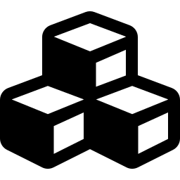
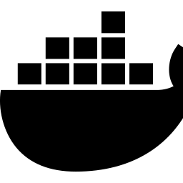

Project Overview
What Shopping Bazar is, in one sentence
An e-commerce web app split into small, independent services (auth, products, cart, orders, payments) instead of one large application — each service can be built, deployed, and scaled on its own.
Frontend
Microservices
Containerized
Orchestrated
HTML, CSS & JavaScript static website served by the API gateway
6 independent Node.js services, each with a single responsibility
Every service packaged as a Docker image for consistent environments
Deployed & scaled on Kubernetes with declarative YAML manifests
02

Slide 3
Why Microservices?
Moving away from one giant application
Traditional Monolith
Shopping Bazar Approach
✖ One codebase for the entire app
✓ Each feature is its own small service
✖ A single bug can crash everything
✓ One service failing doesn't take down the rest
✖ Whole app must be redeployed for one change
✓ Deploy & update services independently
✖ Hard to scale just the busy part
✓ Scale only the service under load (e.g. product-service)
03

Slide 4





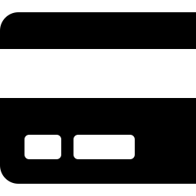
System Architecture
API Gateway routes requests to 5 backend microservices
Browser / Client
API Gateway port 4000
auth-service
product-service
cart-service
order-service
payment-service
port 4001
port 4002
port 4003
port 4004
port 4005
04

Slide 5
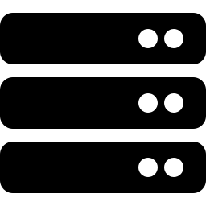
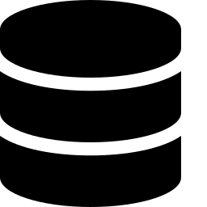
Technology Stack
What powers each layer of the application
Frontend
Backend
HTML5, CSS3, Vanilla JavaScript (static site)
Node.js microservices (auth, product, cart, order, payment)
Gateway
Database
Custom API Gateway — single entry point, request proxying
In-memory (dev) / MongoDB via optional Express backend
Containers
Orchestration
Docker + docker-compose for local multi-service orchestration
Kubernetes — Deployments & Services for each component
05

Slide 6
Containerization with Docker
Packaging each service so it runs the same way everywhere
1
Base image
Starts from node:18-alpine — small & fast
2
Install dependencies
COPY package*.json → npm install
3
Copy source & expose port
One Dockerfile
builds the app
into a portable image
COPY . . then EXPOSE 4000
4
docker-compose for local dev
Spins up gateway + all 5 microservices together with one command
06

Slide 7

Orchestration with Kubernetes
Running, scaling & healing containers automatically
Deployments
Services
MongoDB Deployment
LoadBalancer
Declarative specs describing how many replicas of each service to run
Stable internal networking — pods can find each other by service name
Database runs as its own pod with a dedicated Service for connectivity
Exposes the gateway to the outside world through a single external IP
kubectl apply -f kubernetes/ — deploys MongoDB + all microservices in one command
07

Slide 8


Deployment Pipeline
From local code to a running cluster
Write Code
Build Image
Push to Registry
kubectl apply
Live on Cluster
Alternative simple deploy (used for demo): Render.com — Build Command: echo "No build required" | Start Command: node start-services.js
08

Slide 9

Challenges & Learnings
Real issues faced while building and deploying
Hardcoded localhost API URLs
Switched frontend to window.location.origin so it works in any environment
Render tried to build from a Dockerfile
Explicitly selected Node runtime with a plain build/start command
No root package.json for npm start
Documented node start-services.js as the direct run command
CORS errors across services
Routed everything through a single API Gateway on one origin
09

Slide 10

Future Scope
Where this project can go next
Persistent MongoDB Atlas integration for real data storage
JWT-based authentication and role-based access control
Ingress controller for a single custom domain across services
CI/CD pipeline (GitHub Actions) for automated build & deploy
Horizontal Pod Autoscaling based on real traffic load
Thank You

