Slide 1
Smart Memory
Operating System
Aditya Parikh
121001

Slide 2
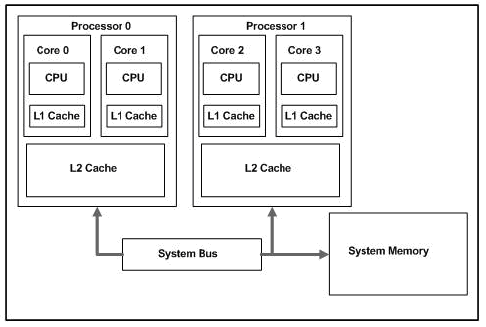
Smart Cache
Smart Cache is a level 2 or level 3 caching method for multiple-execution cores. Smart Cache shares the actual cache memory among cores; both CPU cores and integrated GPU are sharing the same cache.
A single core can use the full level 2 cache or level 3 cache, if the other cores are inactive.

Slide 3
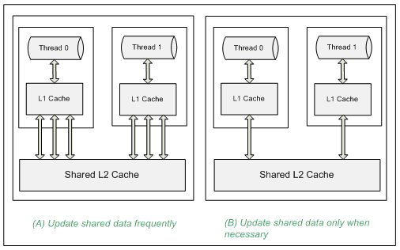
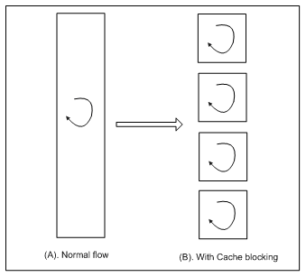
Software techniques for shared-cache multi-core systems
Processor Affinity:
Cache blocking (data tiling): The cache blocking technique (also called data tiling) tries to allow data to stay in the cache while being processed by data loops.
Hold approach: The hold approach involves reducing the frequency of access to the shared data by letting each thread maintain its own private copy of data, only updating the shared copy when it is necessary.

Slide 4
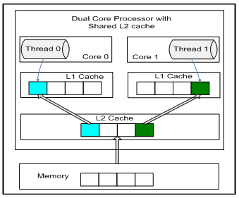
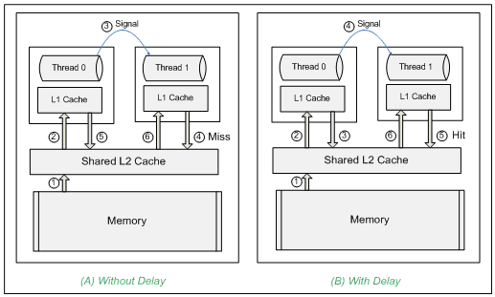
Software techniques for shared-cache multi-core systems-cont.
Delayed approach: The delayed approach takes advantage of the natural L1 cache eviction by inserting a wait until data gets pushed to the shared L2 cache before the other core requests access to it.
Avoid false sharing: Cache coherency problem.

Slide 5
DDR3 architectures (Hewlett Packard):
DDR3 uses the same basic DRAM configuration and architecture as previous DDR implementations. Each DIMM consists of ranks of 9 or 18 DRAMs that deliver 72 bits—64 bits of data and 8 bits of ECC (error correction code)—in parallel to the memory bus to the CPU.
Fly-by topology
On-die Termination
Address parity checking
System memory bandwidth
DDR3 latency
Maximizing system throughput
Minimizing memory latency
Using balanced memory configurations

Slide 6
SmartTrim - The intelligent RAM Optimizer
SmartTrim acts conservatively and with sophisticated selectivity. It doesn't force everything out of memory all at once. It politely asks memory hogging background processes to release their working sets. It has many other criteria built in, such as never trimming the application you're actively engaged with. It is the first truly intelligent RAM optimization algorithm ever conceived.
Conservative
Selective
Throttled paging
User-controlled

Slide 7
S.M.A.R.T(Self-Monitoring, Analysis and Reporting Technology)
S.M.A.R.T. (Self-Monitoring, Analysis and Reporting Technology; often written as SMART) is a monitoring system included in computer hard disk drives (HDDs) and solid-state drives (SSDs) that detects and reports on various indicators of drive reliability, with the intent of enabling the anticipation of hardware failures.
Many motherboards display a warning message when a disk drive is approaching failure.

Slide 8
Thank You
References:
http://www.seminarsonly.com/computer%20science/Smart-Memories.php
http://www.pcper.com/reviews/Processors/Detailed-Look-Intels-New-Core-Architecture/Smart-Memory-Access-and-Smart-Cache
http://www.simmtester.com/page/news/showpubnews.asp?num=149
http://www.simmtester.com/page/news/showpubnews.asp?num=145
https://www.google.co.in/url?sa=t&rct=j&q=&esrc=s&source=web&cd=3&cad=rja&uact=8&ved=0CC4QFjAC&url=http%3A%2F%2Fwww.simmtester.com%2Fpage%2Fnews%2Fshowpubnews.asp%3Fnum%3D145&ei=lBNCVf2pEpWUuQTrtYCAAw&usg=AFQjCNGagrif5CYt679Do9ZjWCABMNw0Vg&sig2=gwjgAZy8X3rGmJjJgxTrzg&bvm=bv.92189499,d.c2E
http://en.wikipedia.org/wiki/Smart_Cache
http://uk.hardware.info/reviews/850/5/intel-core-micro-architecture-advanced-smart-cache

