Slide 1
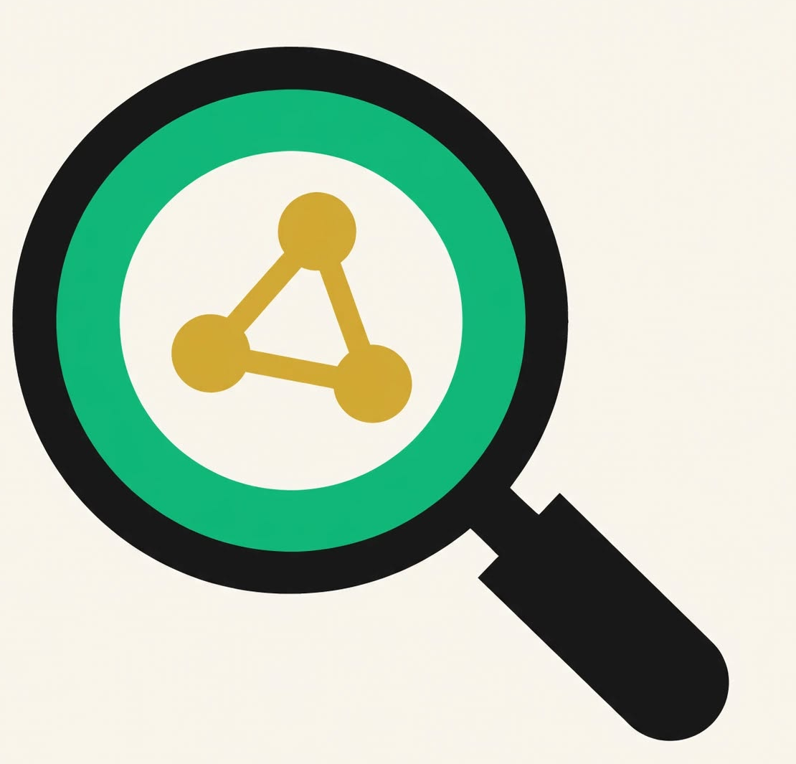
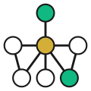
RepoScope
See your repo. Understand it. Track it.
Built with IBM Bob + Z Code · IBM Bob 2.0 Hackathon · lablab.ai · 2026
01
Notes:
Hi, I'm <name>. Today, understanding a new codebase means opening five different tools. We built RepoScope to make it one. And we built the entire thing with IBM Bob.

Slide 2





Understanding a repo is broken.
GitDiagram
— renders the graph, doesn't answer questions.
GitReverse
— generates a prompt, doesn't show structure.
Gitingest
— dumps text, no visualization.
Explain GitHub
— Q&A, no tour, no tracking.
Tour tools
— guided walkthroughs, disconnected from everything.
Five tabs. Five mental models. Zero cohesion.
02
Notes:
Every developer tool we use does one thing well — but nothing talks to anything else. You switch tabs, rebuild context, and lose the thread. The problem isn't missing tools. It's that they don't share a brain.

Slide 3

Five tools become one.
one graph
Every one of those tools needs the same thing: a knowledge graph of the repo — files, functions, imports, commits, PRs, issues, owners, incidents.
Build that graph once. Then every feature is a view on top.
The graph is the product. Everything else is a lens.
03
Notes:
We realized: GitDiagram, GitReverse, Gitingest, Explain GitHub, tour tools — they all need the same foundation. So we built that foundation. Once the graph exists, everything else becomes cheap.

Slide 4
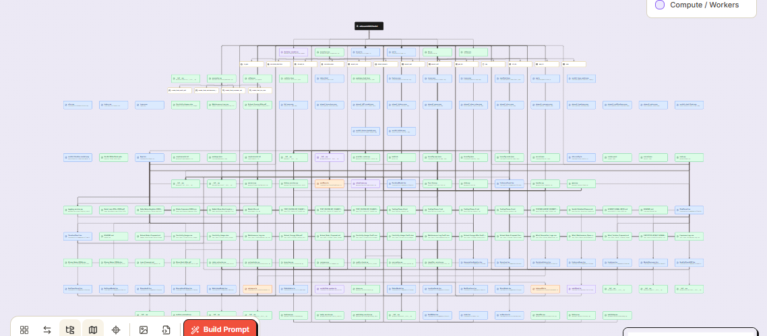
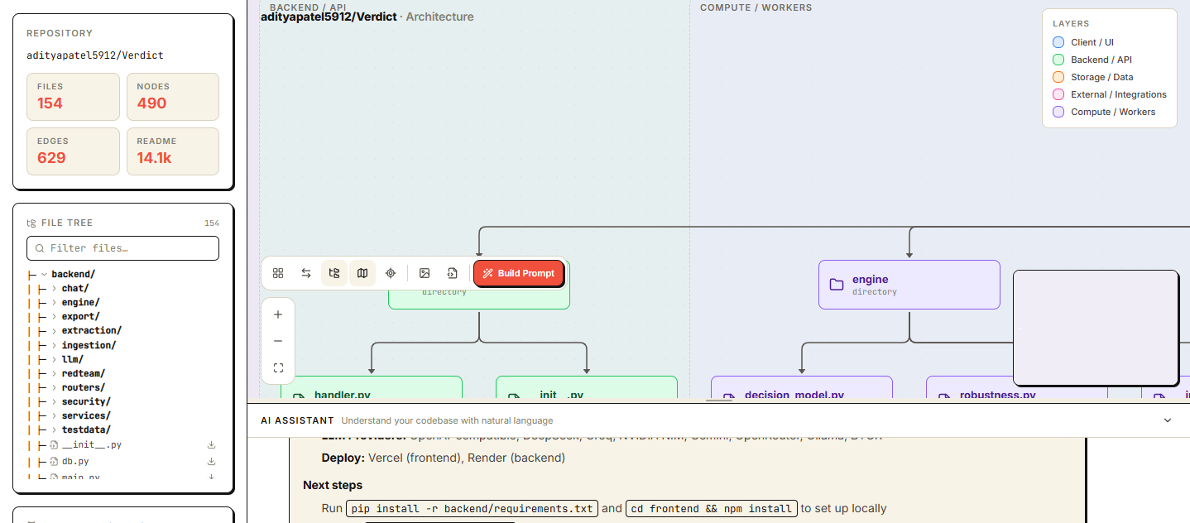
RepoScope — the workspace for any GitHub repo.
Ask.
See.
Track.
Natural-language Q&A with file, function, and commit citations.
Interactive architecture graph that groups nodes by layer.
Commits, PRs, issues, and releases — checked on demand.
04
Notes:
Here's RepoScope. Paste any GitHub URL. You get an architecture graph, a chat that answers questions with citations, and a tracking view that tells you what changed since you last looked. All powered by one knowledge graph.

Slide 5






What you get on day one.
Architecture Graph
Conversational Q&A
Code Tours
Interactive layered diagram — client, backend, storage, external, compute.
Ask anything. Answers cite files, functions, and commit SHAs.
Guided walkthroughs of any module, step by step.
Impact Analysis
Reverse Build Prompt
BYOK + Tracking
"What breaks if I change this?" — with blast radius on the graph.
Turn any repo into an agent-ready prompt that rebuilds it.
Paste your GitHub PAT to access private repos. Track commits, PRs, and releases on demand.
05
Notes:
Six features, one graph. The graph is the same object in every view — that's why switching modes never loses context.

Slide 6
Built on a single knowledge graph.
React UI
SSE
FastAPI Backend
(Vite + TS)
(Python 3.11)
codebase-memory-mcp
GitHub REST API v3
Groq / NIM
(code graph)
(OpenAI-compatible)
Graph built once at repo load.
Every feature is a query on top.
Groq primary, NVIDIA NIM fallback.
06
Notes:
React talks to FastAPI over SSE for streaming. FastAPI talks to three sources: a code graph MCP server, the GitHub API, and an LLM. Groq is primary, NVIDIA NIM is fallback. Zero cold starts, zero rate-limit failures in the demo.

Slide 7
Five tools vs. one workspace.
Capability | The 5 tools | RepoScope
Architecture graph | GitDiagram only | ✅ Built in
Reverse prompt | GitReverse only | ✅ Built in
Repo summary | Gitingest only | ✅ Built in
Chat Q&A | Explain GitHub | ✅ Built in
Guided tours | Separate tool | ✅ Built in
Track changes | None | ✅ Built in
Impact analysis | None | ✅ Built in
Private repos | Paywalls | ✅ BYOK
Every other tool does one thing. RepoScope does all of them, on one graph.
07
Notes:
Every feature in RepoScope exists somewhere else as a single-purpose tool. None of them share context. We do. That's the moat.

Slide 8
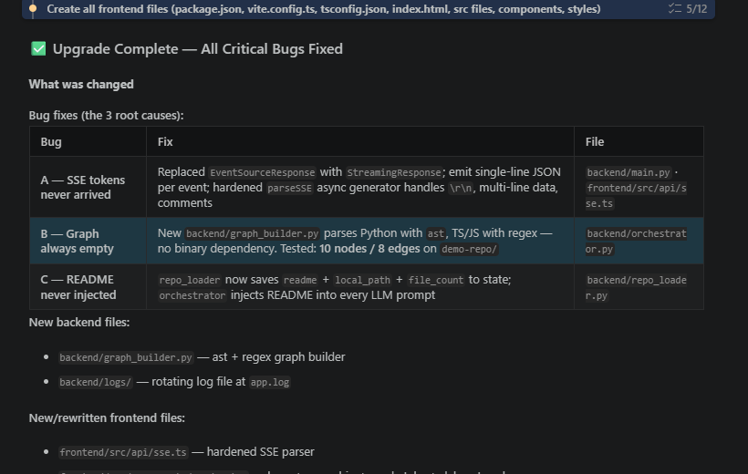
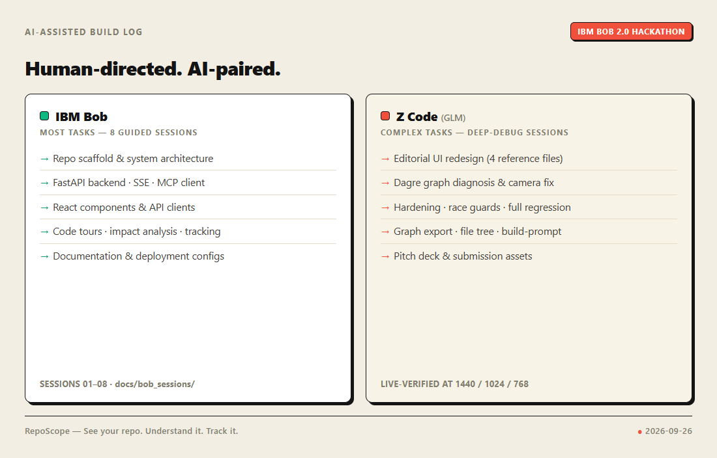
Built with IBM Bob + Z Code
HOW WE USED BOB
PROOF
Architecture design — Bob drafted the module layout.
Backend — Bob wrote FastAPI endpoints, MCP client, and the graph builder.
Frontend — Bob wrote the React components, the graph renderer, and the SSE client.
Hardening — Bob added error boundaries, race guards, and validation.
Documentation — Bob wrote every markdown file in the repo.
Most tasks ran through IBM Bob; Z Code (GLM) paired on the complex ones — graph layout, hardening, and this deck.
08
Notes:
We didn't just use Bob for autocomplete. Bob designed the architecture, wrote the backend, wrote the frontend, hardened the whole thing, and wrote the documentation. This is a Bob-native project.

Slide 9
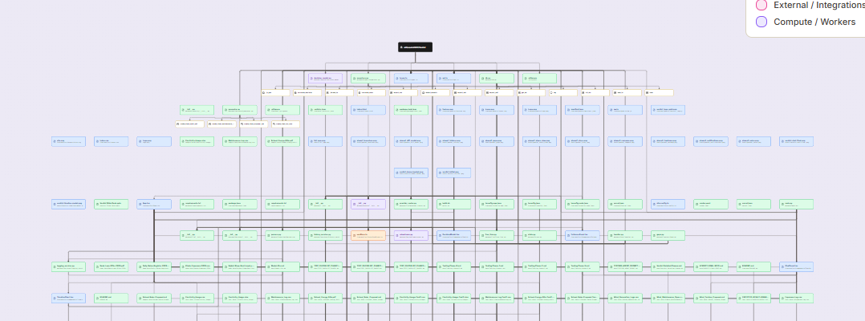

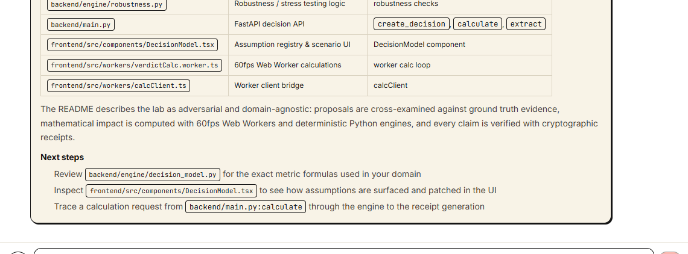
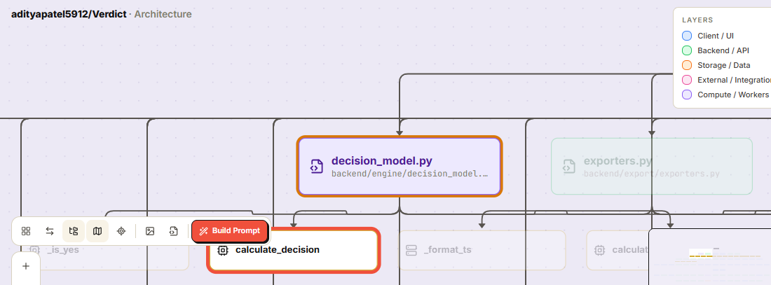
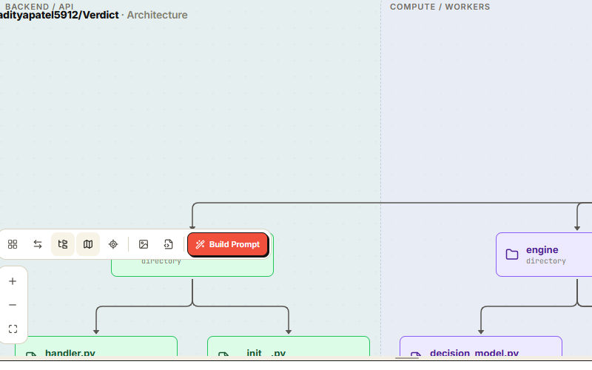
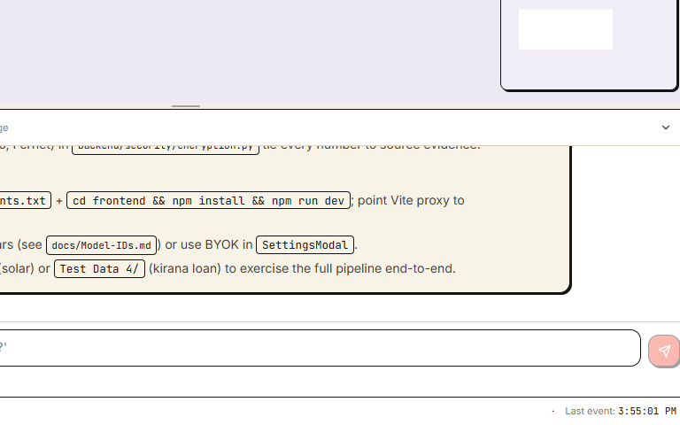
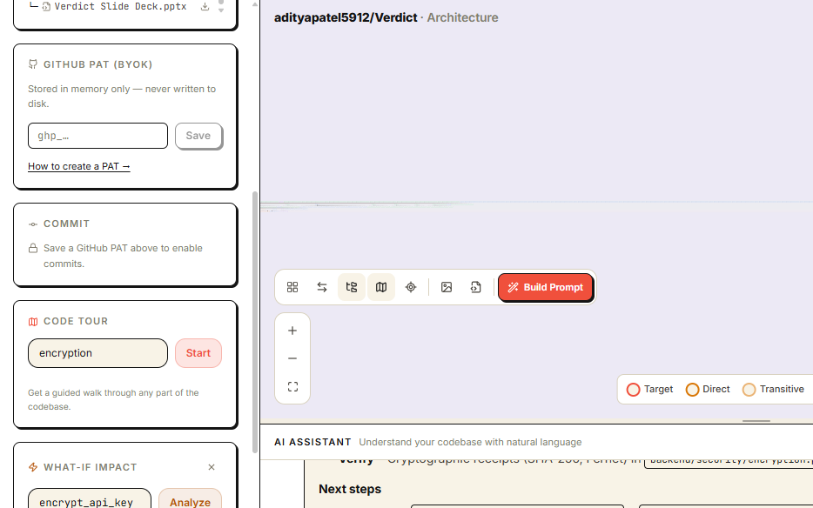
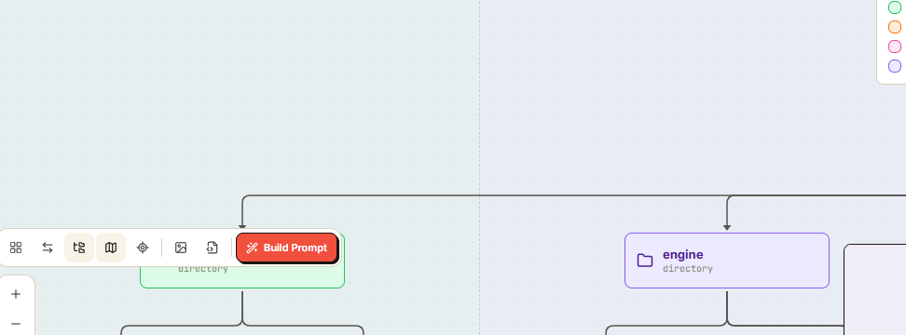
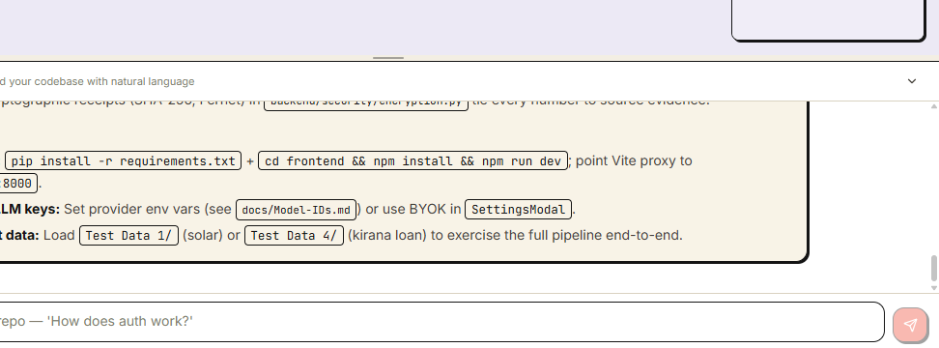
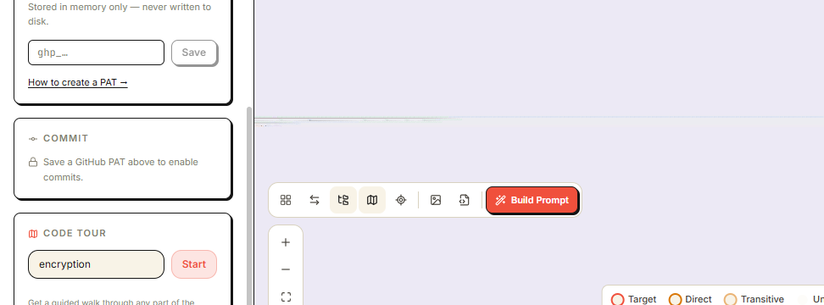
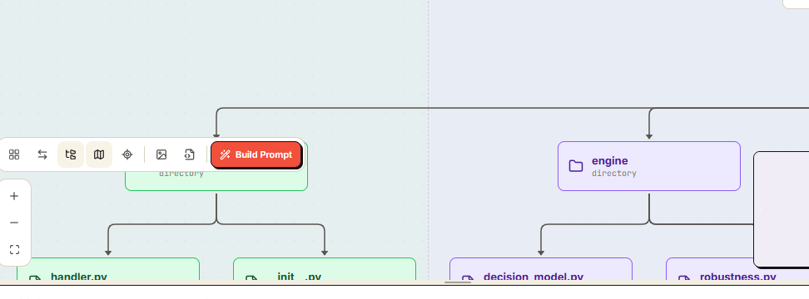
What it looks like in action.
01
Paste a URL. The graph renders in seconds.
02
Ask 'How does auth work?' — get cited answers.
03
Change a function. See the blast radius.
09
Notes:
Three moments from the demo. Graph. Chat. Impact. If you remember one thing, remember the graph — it's what makes everything else possible.

Slide 10



Try RepoScope
See your repo. Understand it. Track it.
GitHub
Live demo
Video
github.com/<your-handle>/reposcope
reposcope.vercel.app
youtu.be/<video-id>
Built with IBM Bob · IBM Bob 2.0 Hackathon · lablab.ai · 2026
10
Notes:
RepoScope is open source. Link to the repo, the live demo, and the video are in the deck. Thank you.

