Slide 1
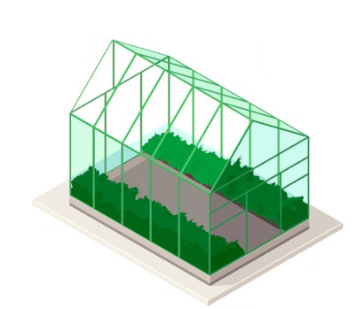
Greenhouse Management System Using IOT
Presented By
Aditya Patil
Siddhesh Munfan
Shreyas Kulkarni
Rushikesh Shinde

Slide 2

Introduction
The agribusiness industry today faces several challenges such as increasing demand for food stagnant production and shrinking resources.
Technology can help to overcome the challenge.
Analytics and monitoring of farm in real-time.

Slide 3
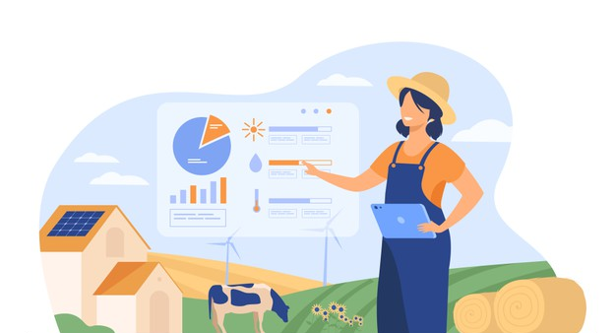
How can we Improve Greenhouse Efficiency and Management ?
IOT
Sensors
Cloud
Data analytics

Slide 4
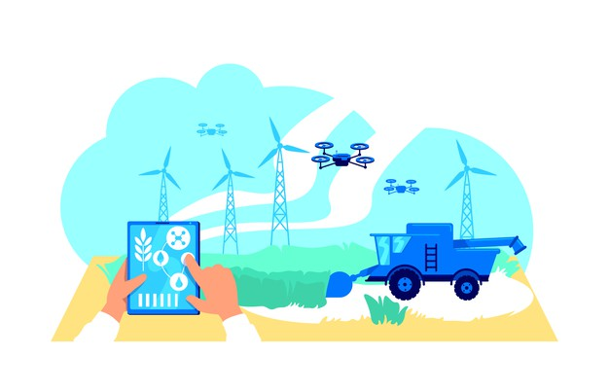
Benefits of this project
Reduces the possibility of crop damage.
Improves crop growth.
Efficient water supply, also saves water.
Provides data analysis .
Provides control for managing water, temperature, etc.

Slide 5
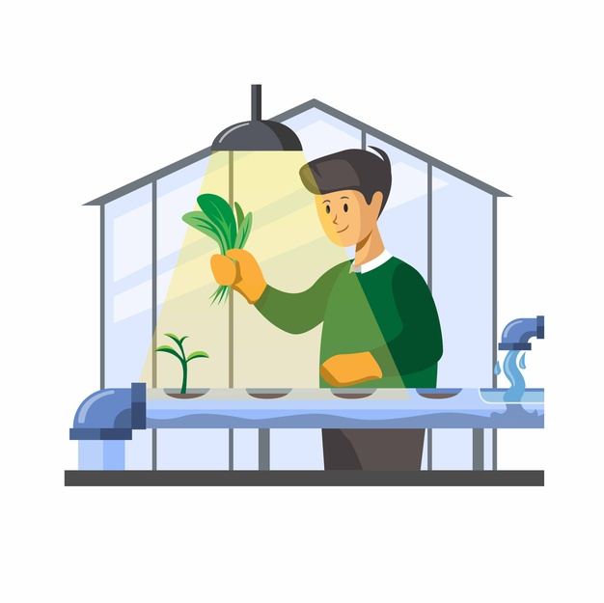
Purpose
Hydroponics, vertical farming and etc agriculture trends.
Artificial Environment Creation.
Reliability of crop increases under greenhouse cultivation.
To give good control from anywhere for effective green house management

Slide 6
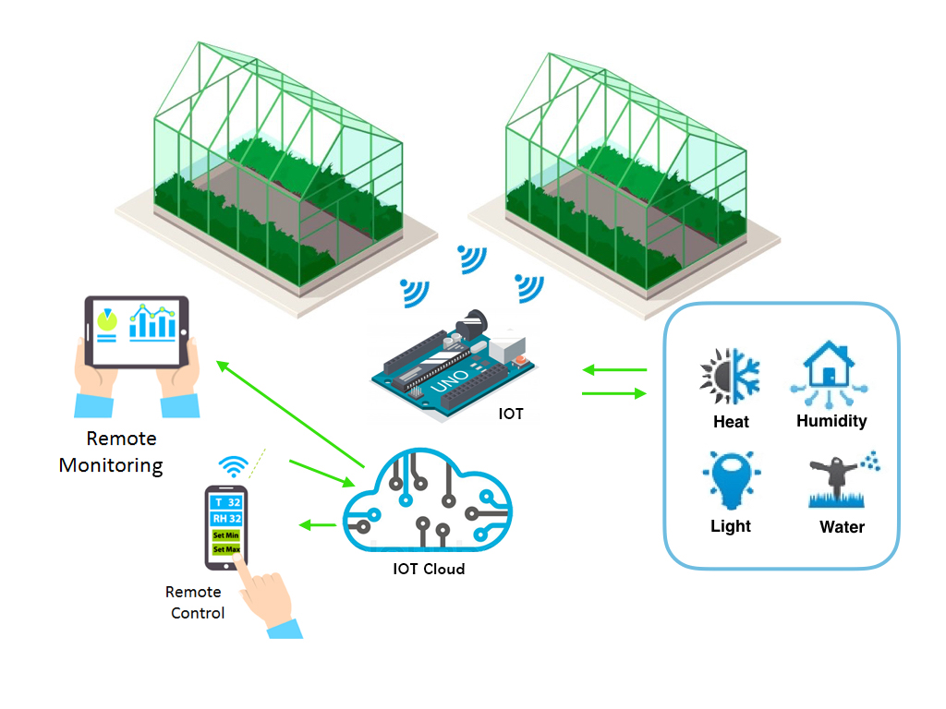
Overview

