Slide 1

Film Production Management
IST659 M001
Aditya Sanjay Pawar
Tian Tian
Yixing Zhu
Zimin Zhu

Slide 2
Contents
What we look up
How to carry out
What we achieved

Slide 3

What we LOOK UP

Slide 4
Introduction
In the communication industry, data-native mindset has become a crucial tool, and an advanced data system has also become an effective tool for the diverse range of stakeholders.
Our team focuses highly on the film production process.
Film production field needs a powerful application to leverage data and theory to inform budget strategy.
We are doing for this need.

Slide 5
Purpose
In some extent, cast decide whether movies can attract more audience going to buy the ticket. But meanwhile, cast’s salary may cost too high to cut the budget used on shooting film. To better control cost, producers want to know the name of cast who earn the salary less than $500,000 each movie. And sort by the salary.
Sometimes, spending more budget on crew rather than cast can enhance the quality and reputation of the film. Producers would like to know those movies which put more expense on crew than cast.
From shooting view, movies are an art that restores the real world. Film can rebuild the impression of certain city, just like Paris always related with romantic story and Wall Street always link to the financial filed. Location can impact on the style of a film and can impact on the budget. Producers want to know the expense of those movies which shoot on New York, and those movies’ profit.

Slide 6

Purpose
Cost
Director, cast, crew
location

Slide 7
Identifying Data Needs
What is the range of expenses required for specific types of movies?
Which actors and actresses have starred in certain specific types of movies and were hired on lower budgets?
Which crew members are experienced in making certain types of movies and are paid lower wages?
Which directors have experience making certain types of movies and how much do they get paid?
Which shoots took place at locations that cost less than budget?

Slide 8

Identifying Data Needs
Expenses
Actors and Actresses
Crew
Directors
Locations

Slide 9

How to CARRY OUT

Slide 10



Data Source
Movies Budget Planning
Movies Ranking
Director, Cast, Producer
High Reputation Crew
Film Shooting Location

Slide 11
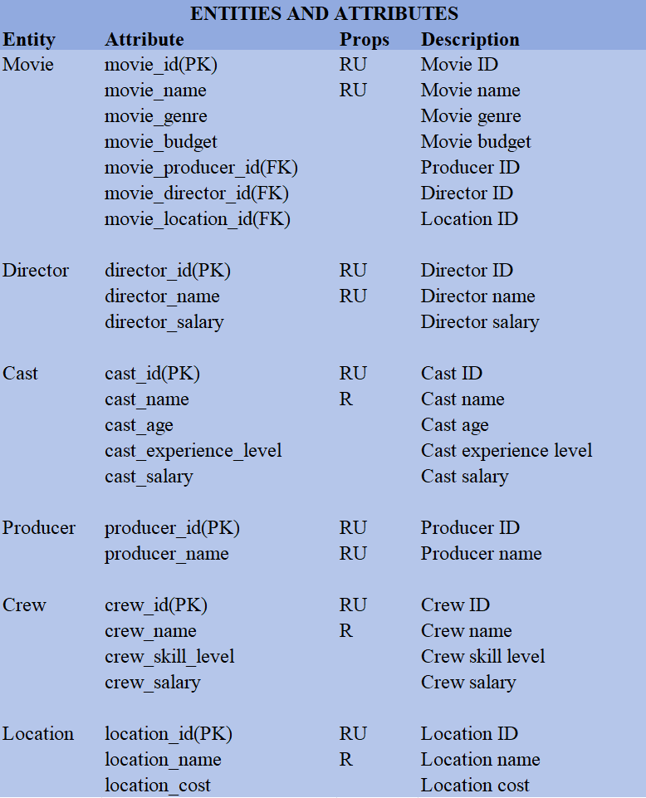
Data entities and attributes

Slide 12
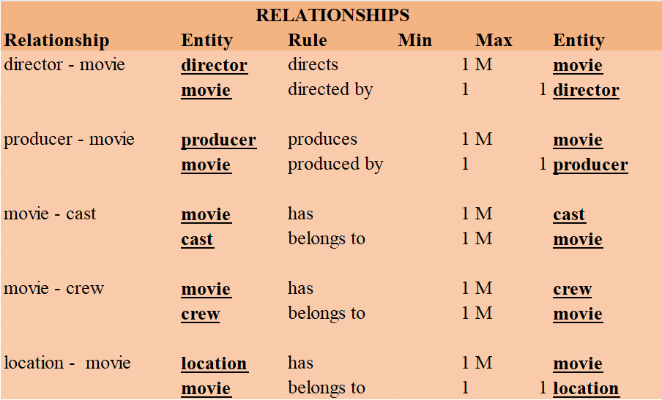
Relationships

Slide 13
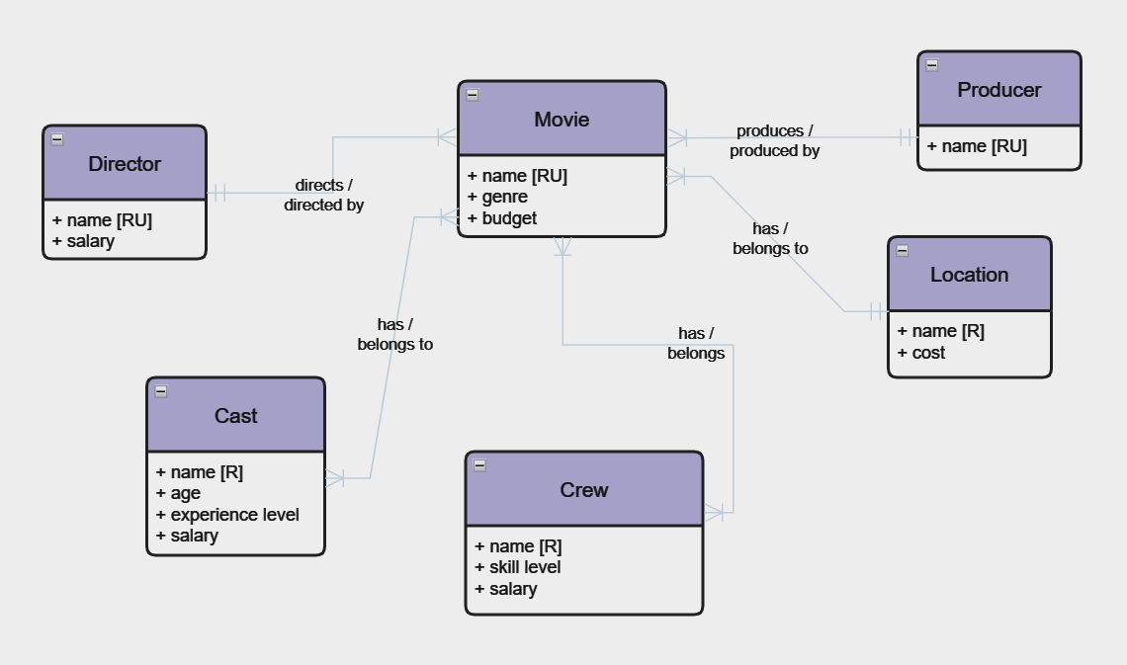
Conceptual Diagram

Slide 14
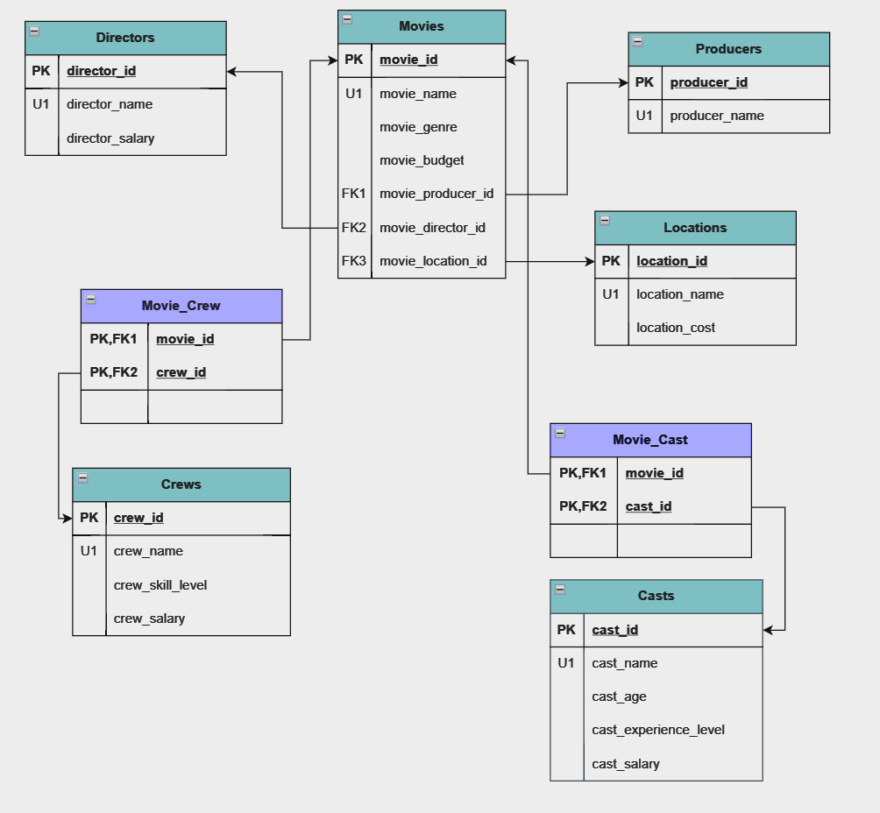
Logic Diagram

Slide 15

What we ACHIEVED

Slide 16
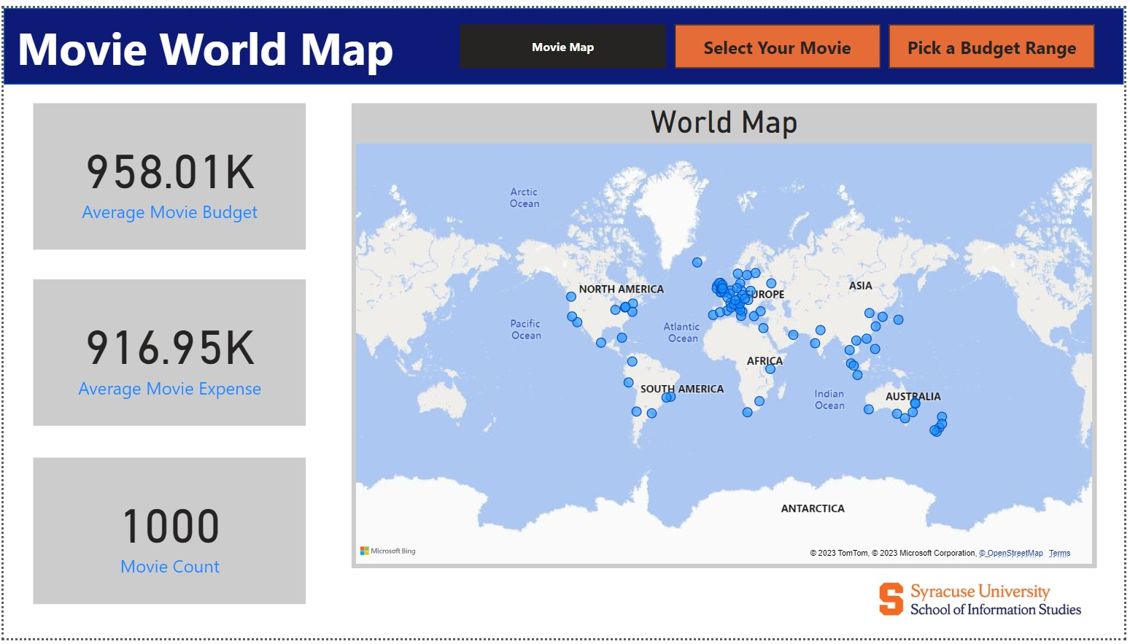
Data Visualization

Slide 17
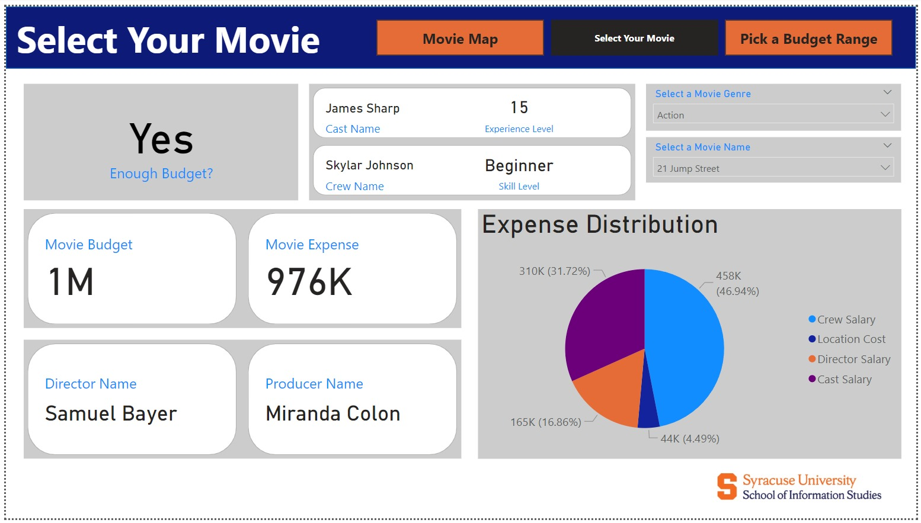
Data Visualization

Slide 18
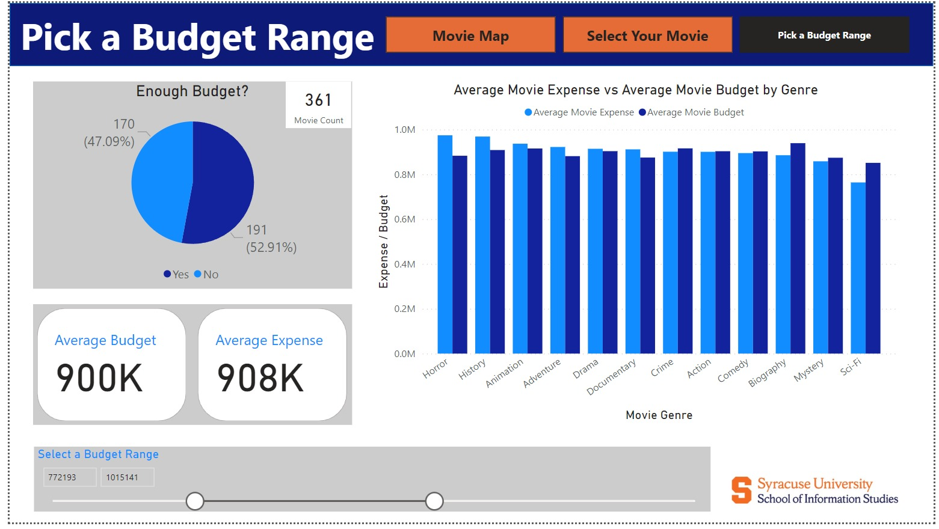
Data Visualization

Slide 19
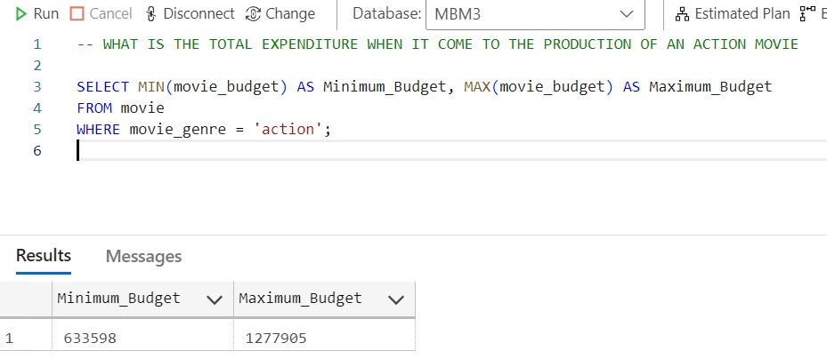
Data Visualization

Slide 20
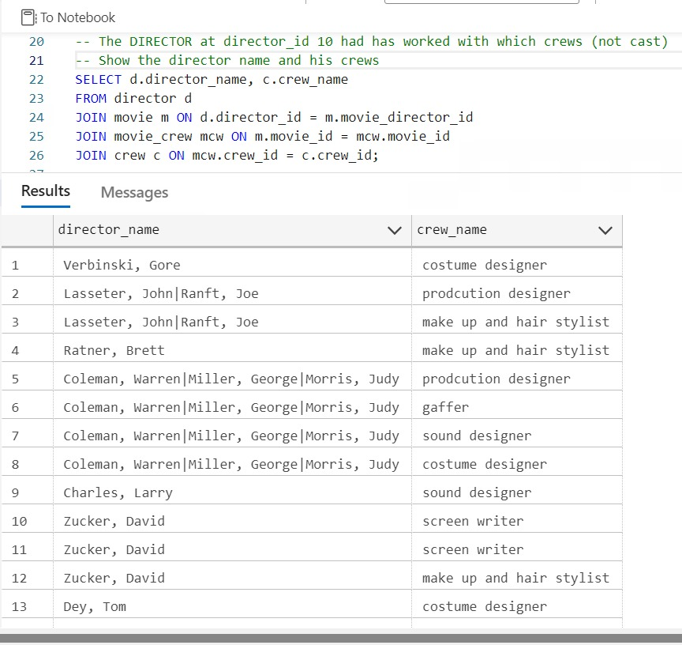
Data Visualization

Slide 21
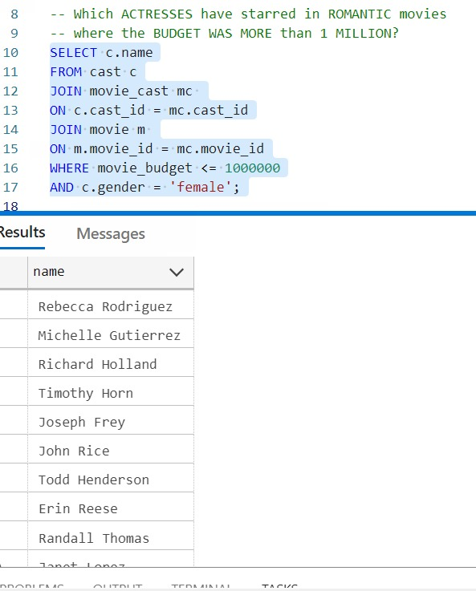
Data Visualization

Slide 22
Data Visualization

Slide 23
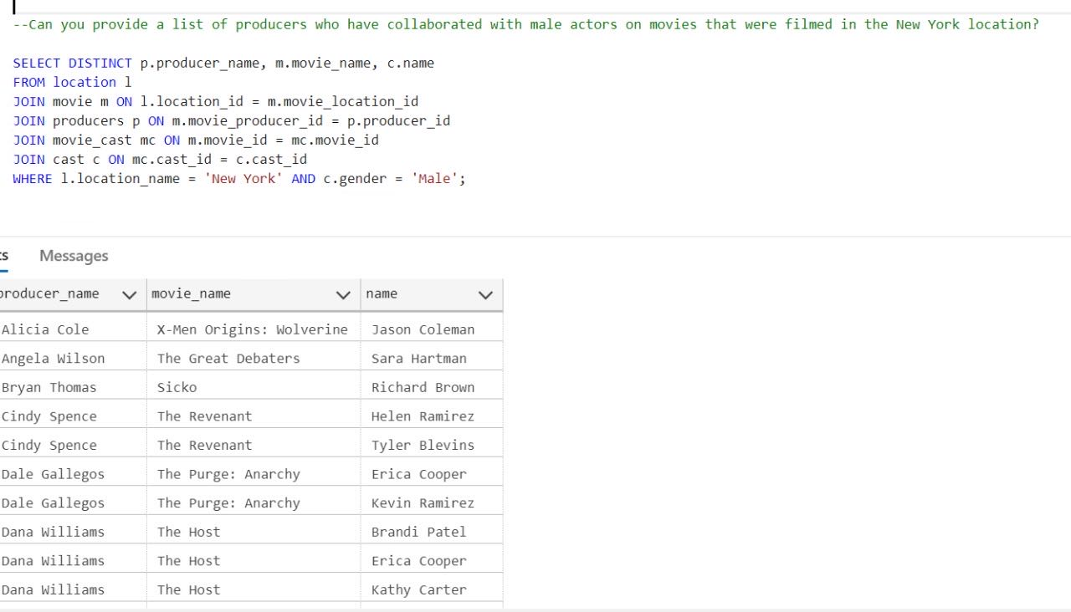
Data Visualization

Slide 24
Thank You
Aditya Sanjay Pawar
Tian Tian
Yixing Zhu
Zimin Zhu

