Slide 1
PEOPLE ANALYTICS
Workforce Insights Report
A department-level view of headcount, compensation, satisfaction, attrition and hiring across 1,500 employees.
1,500
10.33%
75.2%
TOTAL EMPLOYEES
ATTRITION RATE
PROMOTION RATE

Slide 2
EXECUTIVE SUMMARY
Six takeaways from the workforce data
1
R&D & Sales are the growth centers — and the risk centers
2
No gender pay gap working against women
Together they hold 54% of headcount and also post the highest attrition (24.5% each).
Average female salary ($65.56K) is ~6% above average male salary ($61.84K) company-wide.
3
R&D pay sits well above every other department
4
Engagement is flat, not failing
Its $98K average monthly income is 66% higher than Finance, the next-highest department.
Job satisfaction, work-life balance, and environment scores cluster near 2.8–2.95 of 4 in every department.
5
Promotions track headcount, not risk
6
Hiring leans on three channels
Promotion share is near-even across departments (~16–17% each) regardless of attrition rate.
LinkedIn, Referral, and Job Portal together source about two-thirds of all hires.

Slide 3
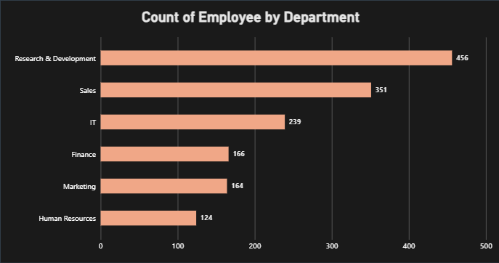
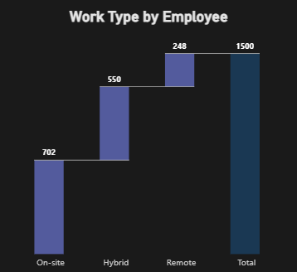
WORKFORCE OVERVIEW
Headcount concentrated in R&D and Sales
WHAT IT MEANS
WORK ARRANGEMENT
R&D and Sales together make up 54% of the workforce (456 + 351 of 1,500), making them the departments to watch for retention risk.
On-site work still leads (47%), but Hybrid is close behind at 37% — remote remains the smallest group at 16%.
On-site
702
47%
Hybrid
550
37%
Remote
248
16%

Slide 4
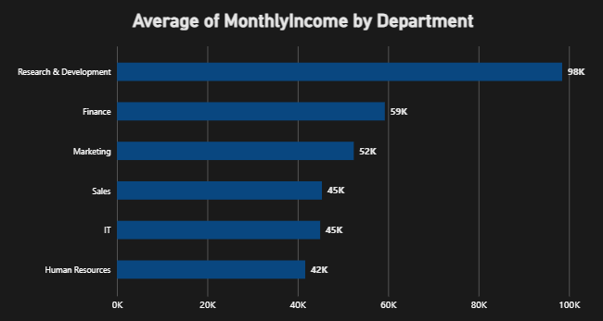
COMPENSATION
R&D pays furthest above the rest — women edge out men on average
WHAT IT MEANS
R&D's average income ($98K) is 66% above the next highest department (Finance, $59K) — likely a mix of senior/specialist roles concentrated there .
Finance, Marketing, Sales, IT and HR are all clustered in a tighter $42K–$59K band.
Women earn ~6% more than men on average company-wide ($65.56K vs $61.84K) — worth a role-level pay equity review to confirm it holds within job levels, not just in aggregate.
AVG SALARY — FEMALE
AVG SALARY — MALE
$65.56K
$61.84K

Slide 5
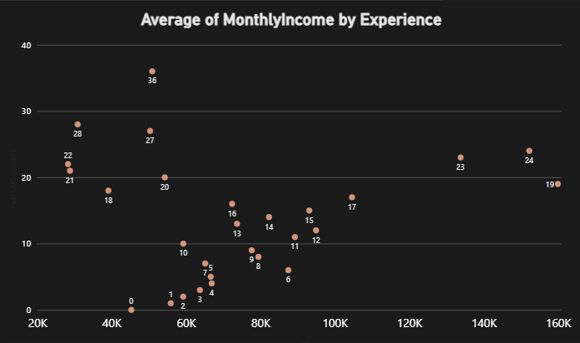
TENURE & TEAM STRUCTURE
Pay generally rises with tenure; team sizes are fairly uniform
WHAT IT MEANS
Income trends upward with tenure overall, though a few long-tenured outliers (e.g. 36 years / $28K) suggest role or grade, not just seniority, drives pay.
Team sizes barely vary by department (12.9–14.2) — management spans are consistent company-wide.

Slide 6
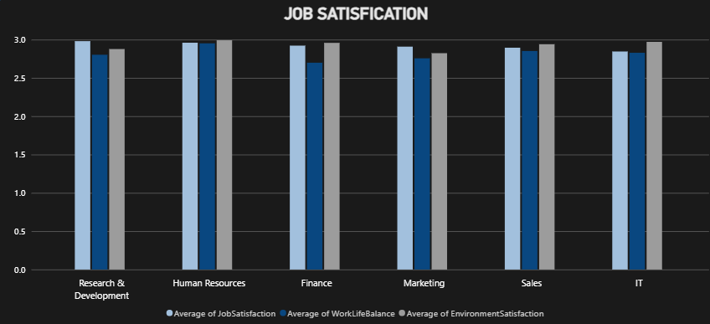
ENGAGEMENT
Satisfaction scores are consistent — and consistently middling
WHAT IT MEANS
Job satisfaction, work-life balance, and environment scores all sit near 2.8–2.95 out of 4 in every department — no clear outlier, good or bad.
That uniformity cuts both ways: nothing is on fire, but nothing stands out as strong either — scores hover just under 75% of the scale ceiling company-wide.
Finance shows the softest work-life balance score (2.68) — a candidate for a closer look.

Slide 7
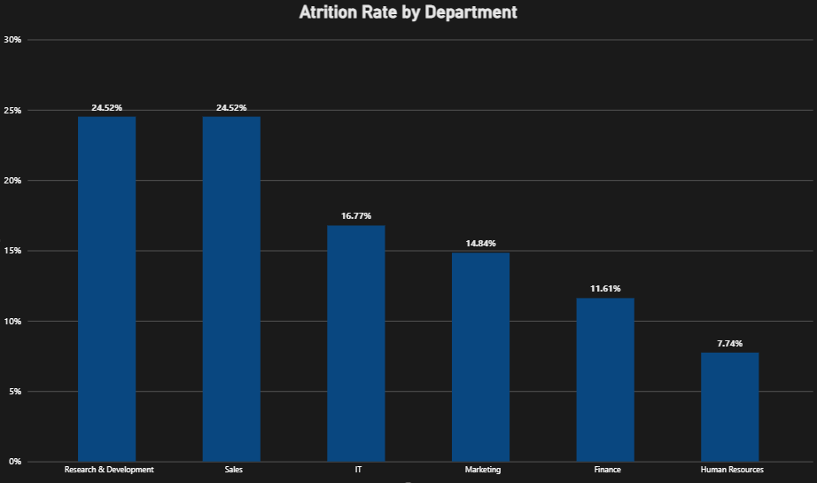
ATTRITION
R&D and Sales carry the heaviest attrition load
OVERALL ATTRITION RATE
10.33%
WHAT IT MEANS
R&D and Sales — the two largest departments — also attrite fastest (24.5% each), more than 3x HR's rate (7.74%).
Attrition roughly mirrors headcount at the low end (HR, Finance) but breaks from it at the top — IT is smaller than Sales yet still attrites faster than Marketing or Finance.

Slide 8
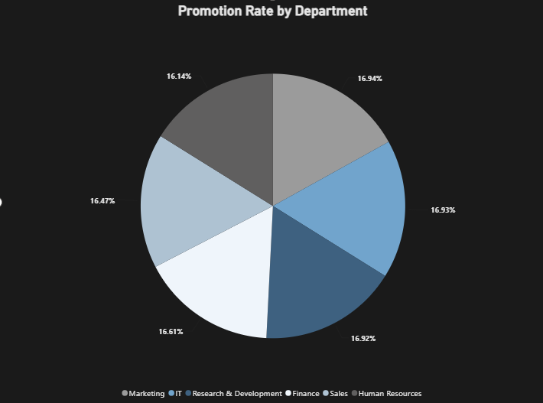
PROMOTION
Promotions are spread evenly, not risk-weighted
OVERALL PROMOTION RATE
75.2%
WHAT IT MEANS
Promotion share is nearly identical across departments (16.1%–16.9%) — it tracks headcount almost exactly rather than performance or attrition risk.
That's notable given R&D and Sales attrite at more than double the rate of Finance or HR, yet don't receive a larger share of promotions to help retain talent.

Slide 9
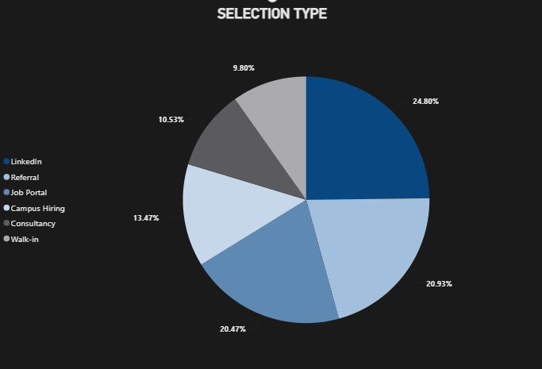
TALENT ACQUISITION
LinkedIn and referrals drive most hiring
WHAT IT MEANS
LinkedIn (24.8%) and Referral (20.9%) together bring in nearly half of all hires — the two most cost-effective and typically highest-quality channels.
Job Portals add another 20.5%, meaning ~66% of hires come through just three digital channels.
Campus Hiring (10.5%) and Walk-in (9.8%) are the smallest sources — potential room to grow early-career pipelines if long-term cost is a priority.

Slide 10
RECOMMENDATIONS
Where to focus next
01
02
Target retention in R&D & Sales
Audit pay equity by role, not just company-wide
These two departments hold 54% of headcount but drive the highest attrition (24.5% each). A focused stay-interview and career-pathing effort here has the biggest overall impact on the 10.33% company attrition rate.
The female average salary edges out male ($65.56K vs $61.84K) in aggregate. Confirm this holds within job level and department — aggregate averages can mask level-based gaps in either direction.
03
04
Investigate Finance's work-life balance dip
Diversify sourcing beyond LinkedIn
Finance's work-life balance score (2.68) trails every other department while job and environment satisfaction stay average — worth a targeted pulse survey.
LinkedIn and Referral drive ~46% of hires. Growing Campus Hiring and Walk-in (currently under 11% each) could lower long-run cost-per-hire and build an early-career pipeline.

