Slide 1
SALES REPORT
POWER BI REPORT REVIEW
What the sales dashboard is telling us
January 2014 – February 2018
Notes:
This deck walks through the BrightMart Power BI report page by page, using the same charts and the same data behind them, with a plain-English takeaway for each.

Slide 2
The report at a glance
$1.24B
$462M
37.4%
10,684
$116K
Total Revenue
Total Profit
Profit Margin %
Total Orders
Revenue per order
1
2
3
Executive Overview & Trends
Product & Channel Performance
Geographic & Customer Insights
Monthly revenue and profit by year, price versus margin, and how big our orders are.
Which products sell most and earn most, customer profitability, and the three sales channels.
Top and bottom customers and states, profit on the map, and the regional split.
Notes:
The report has three pages and five headline KPI cards. The first row of cards is exactly what sits at the top of the Executive Overview page.

Slide 3
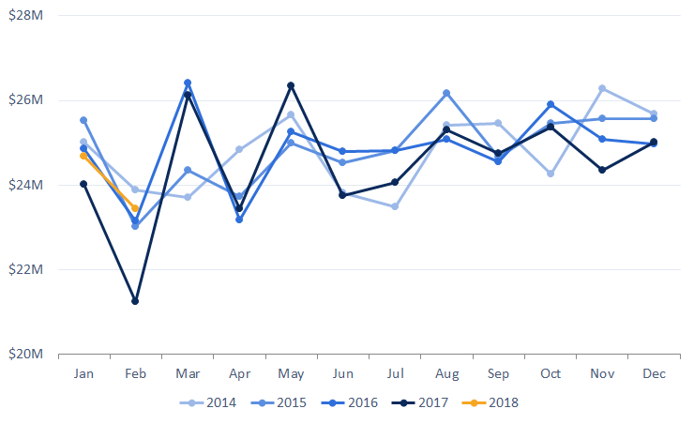
Every year follows almost the same revenue rhythm
DASHBOARD CHART · MONTHLY REVENUE RHYTHM
$24.7M
average month, Jan 2014 – Feb 2018
Lines for 2014–2017 stay inside a band of roughly $23M to $26.5M, so the yearly pattern barely changes.
February 2017 at $21.2M is about 14% under average and the one dip worth investigating.
Notes:
Each line is one year. They overlap closely, which tells us demand is stable year to year. The standout is February 2017, which fell to 21.2 million. 2018 only has January and February so far.

Slide 4
Profit moves in lockstep with revenue
DASHBOARD CHART · TRACKING MONTHLY EARNINGS MOMENTUM
$9.2M
average monthly profit
Profit ranges from $8.0M (Feb 2017) to $9.9M (Aug 2015).
That is about 37 cents of profit on every dollar of revenue, so a revenue dip becomes a profit dip almost one for one.
Notes:
Monthly profit follows the same shape as revenue, because the margin is steady at about 37 percent. The weakest profit month is February 2017 and the strongest is August 2015.

Slide 5
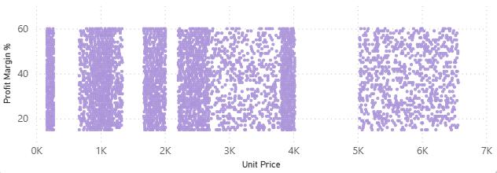
Price level tells us nothing about margin
DASHBOARD CHART · UNIT PRICE VS PROFIT MARGIN
−0.01
correlation of unit price with margin
Prices run from $168 to $6,566 and margins from 15% to 60%.
A cheap line is as likely to be thin-margin as an expensive one, so margin has to be managed through discounts and costs, not by price tier.
Each dot is one order line (random sample of 500 of 64,104).
Notes:
Unit price and profit margin are plotted for a sample of 500 order lines. The cloud has no slope, and the correlation is essentially zero.

Slide 6
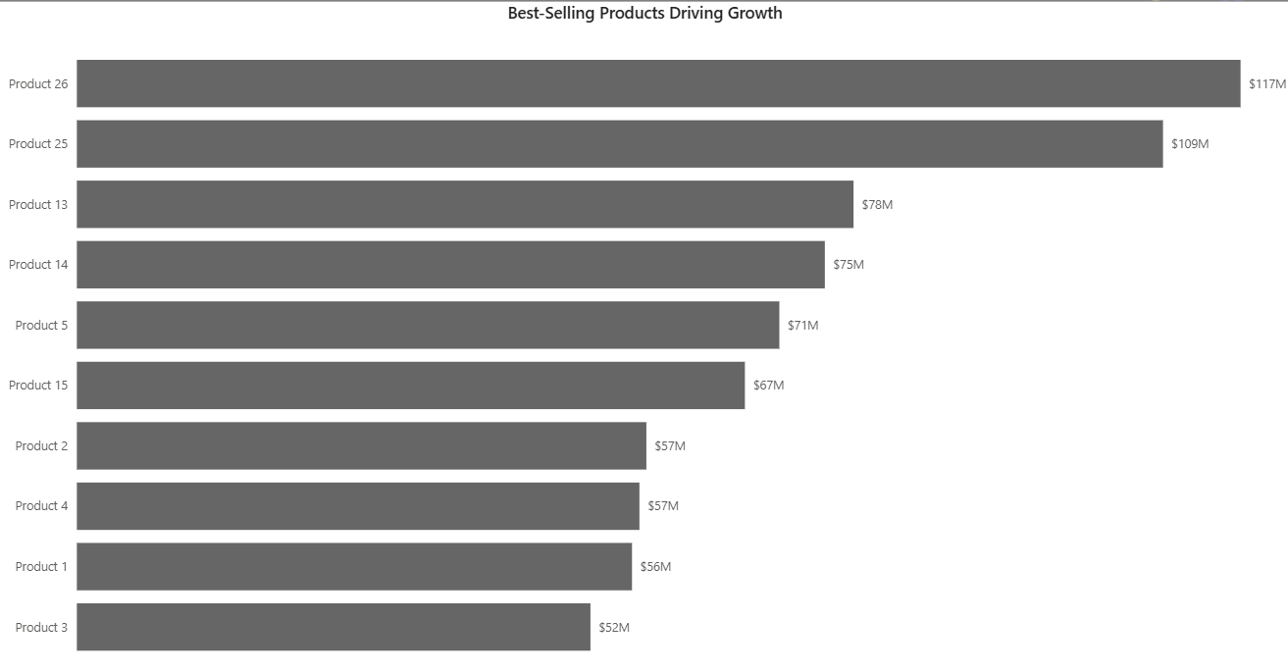
Two products lead, and a long tail trails behind
DASHBOARD CHART · BEST-SELLING PRODUCTS DRIVING GROWTH
Products 26 and 25 bring in $227M together, 18% of all revenue. 11 of 30 products each sell under $20M, so the mid-tier is where growth pilots make sense.
Notes:
All 30 products ranked by revenue. Product 26 and Product 25 are well ahead. After a tight middle group the tail is long, with eleven products under 20 million each.

Slide 7
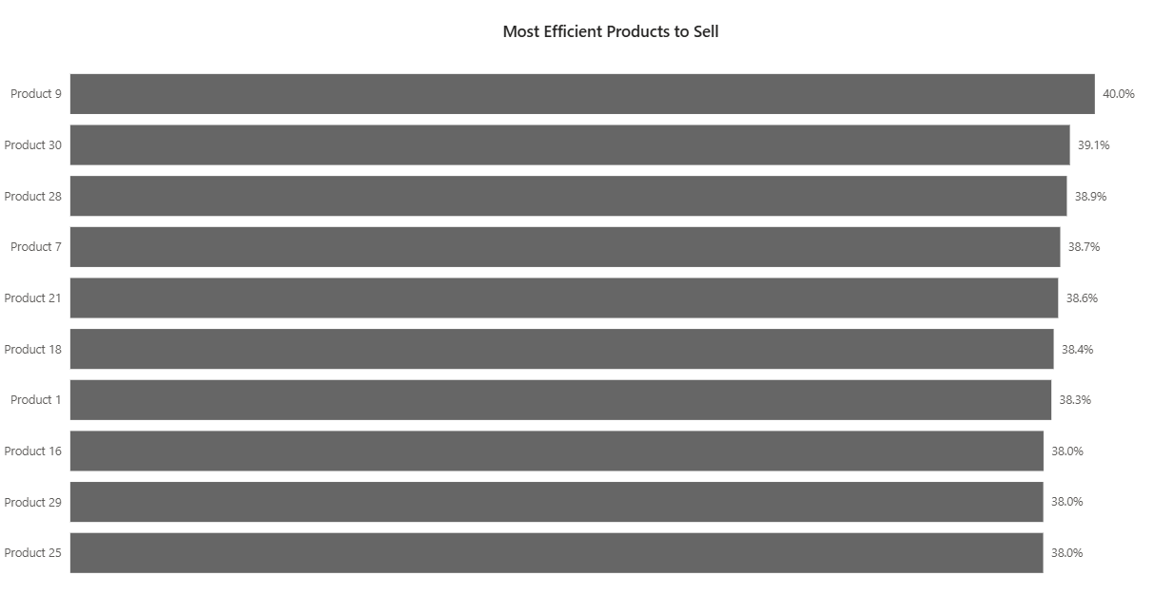
Margins are tightly packed, so volume decides
DASHBOARD CHART · MOST EFFICIENT PRODUCTS TO SELL
Product 9 is the most efficient at 40.0% but only brings in $14.6M. Product 12 is the lowest at 34.4% on $24.2M. With margins this close, the best sellers are simply the ones that sell the most.
Notes:
The same 30 products ranked by profit margin. The whole range is only about six points, 34 to 40 percent. The most efficient product, Product 9, is also one of the smallest sellers.

Slide 8
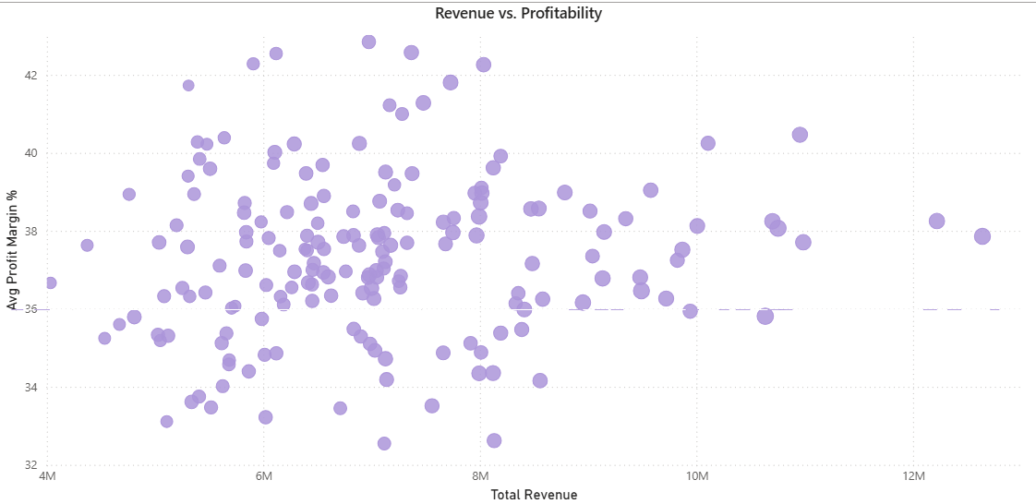
Bigger customers are not more profitable customers
DASHBOARD CHART · REVENUE VS. PROFITABILITY
0.03
correlation of order count with margin
Across 175 customers, margins sit mostly in the 35–40% range whatever the order count.
Revenue growth in an account does not erode its margin, so scaling top customers is safe.
Notes:
Each dot is one customer. Across is how many orders they placed and up is their average margin. Customers with more orders are not noticeably more profitable.

Slide 9
Wholesale is the engine; Export earns the best margin
DASHBOARD CHART · CHANNEL POWER PLAY · PROFIT PIPELINE · EFFICIENCY SCORECARD
Wholesale: $668M revenue (54%) at 37.0% margin. Distributor: $387M at 37.6%. Export: $181M at 38.0%, the best. Growing Export spreads risk without giving up profit.
Notes:
Three donuts, the same as the dashboard: revenue, profit and margin by channel. Wholesale carries over half of the revenue and profit. Export is the smallest channel but has the highest margin.

Slide 10
Our biggest customers are only about twice our smallest
DASHBOARD CHART · TOP 5 AND BOTTOM 5 CUSTOMERS BY REVENUE
Top 5 by revenue
Bottom 5 by revenue
The ten biggest customers make up only 8.8% of revenue across 175 customers. That is low dependency, so the focus should be retaining and upselling the top group while lifting the bottom cohort.
Notes:
The five largest customers bring in 10 to 12.6 million each. The five smallest bring in 4 to 4.8 million. With 175 customers, no single account is a risk.

Slide 11
Customer margins differ by about ten points
DASHBOARD CHART · TOP 5 AND BOTTOM 5 CUSTOMERS BY PROFIT MARGIN
Top 5 by profit margin
Bottom 5 by profit margin
Revitol Company earns 42.9% while Twitterbri Ltd earns 32.5%, against a company average of 37.4%. Reviewing discounts for the lowest group is a quick way to lift overall profit.
Notes:
The best customer margins are above 42 percent and the lowest are about 32.5 percent. Both groups are small accounts, so this spread is about pricing and discounts, not size.

Slide 12
California is in a league of its own
DASHBOARD CHART · TOP 5 AND BOTTOM 5 STATES BY REVENUE
Top 5 states by revenue
Bottom 5 states (different scale)
California alone is 18.5% of revenue and 2.1× Illinois, and California, Illinois, Florida and Texas together earn 42% of all profit. The bottom five are each under 0.2% of sales (note the different scale on the right).
Notes:
California brings in almost 229 million, more than twice Illinois. At the other end, the five smallest states each contribute under 2 million.

Slide 13
The West leads, the Northeast trails, margins are equal
DASHBOARD CHART · TOTAL REVENUE BY REGION · PROFIT MARGIN % BY REGION
West brings in $372M (30%), South $335M and Midwest $320M. The Northeast is $208M (17%). Margins are all about 37%, so local promotions are the lever.
Notes:
Two donuts, as on the dashboard: revenue by region and profit margin by region. The Northeast has the smallest slice of revenue, but margins are the same everywhere, so it is a reach issue.

Slide 14
What the dashboard tells us to do
Grow Export
Close the Northeast gap
Smallest channel, best margin. Overseas marketing and partners spread risk away from Wholesale.
Only 17% of revenue at the same margin as everywhere else. Local promotions come first.
Plan around February
Fix margin line by line
The weakest month every year, and February 2017 was an outlier. Time campaigns to soften it.
Margin has no link to price or customer size. Review discounts for low-margin customers and the 11 sub-$20M products.
Suggested next addition to the report: a budget versus actual view.
Notes:
Four actions, each tied to one of the report pages. A budget-versus-actual view is not in the report yet, so that is the logical next addition.

