Slide 1
Decision Tree
A decision tree is a graph that uses a branching method to illustrate every possible output for a specific in
Entropy: Entropy is the measure of randomness or unpredictability in dataset.
Information Gain: It is the measure of decrease in entropy after the dataset is split.
Gini index: Gini Index, also known as Gini impurity, calculates the amount of probability of a specific feature that is classified incorrectly when selected randomly.
Leaf Node: Leaf node carries the classification or final decision.
Root Node: The top most decision node is known as the root node.

Slide 2
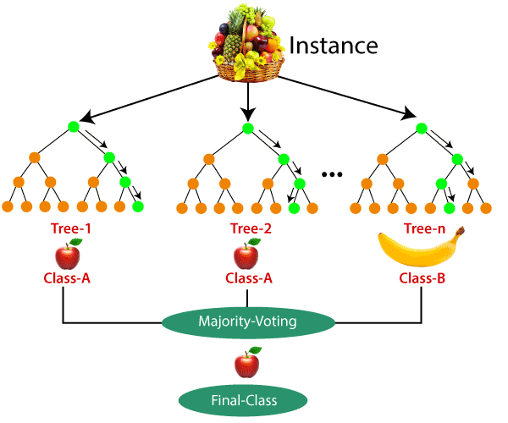
Random Forest

Slide 3
Steps to perform decision tree and random forest
Import libraries
Load dataset
Encoding the categorical columns
Implement decision tree and random forest classifier and regression and fit the model
Score and predict
Plot the tree.

Slide 4
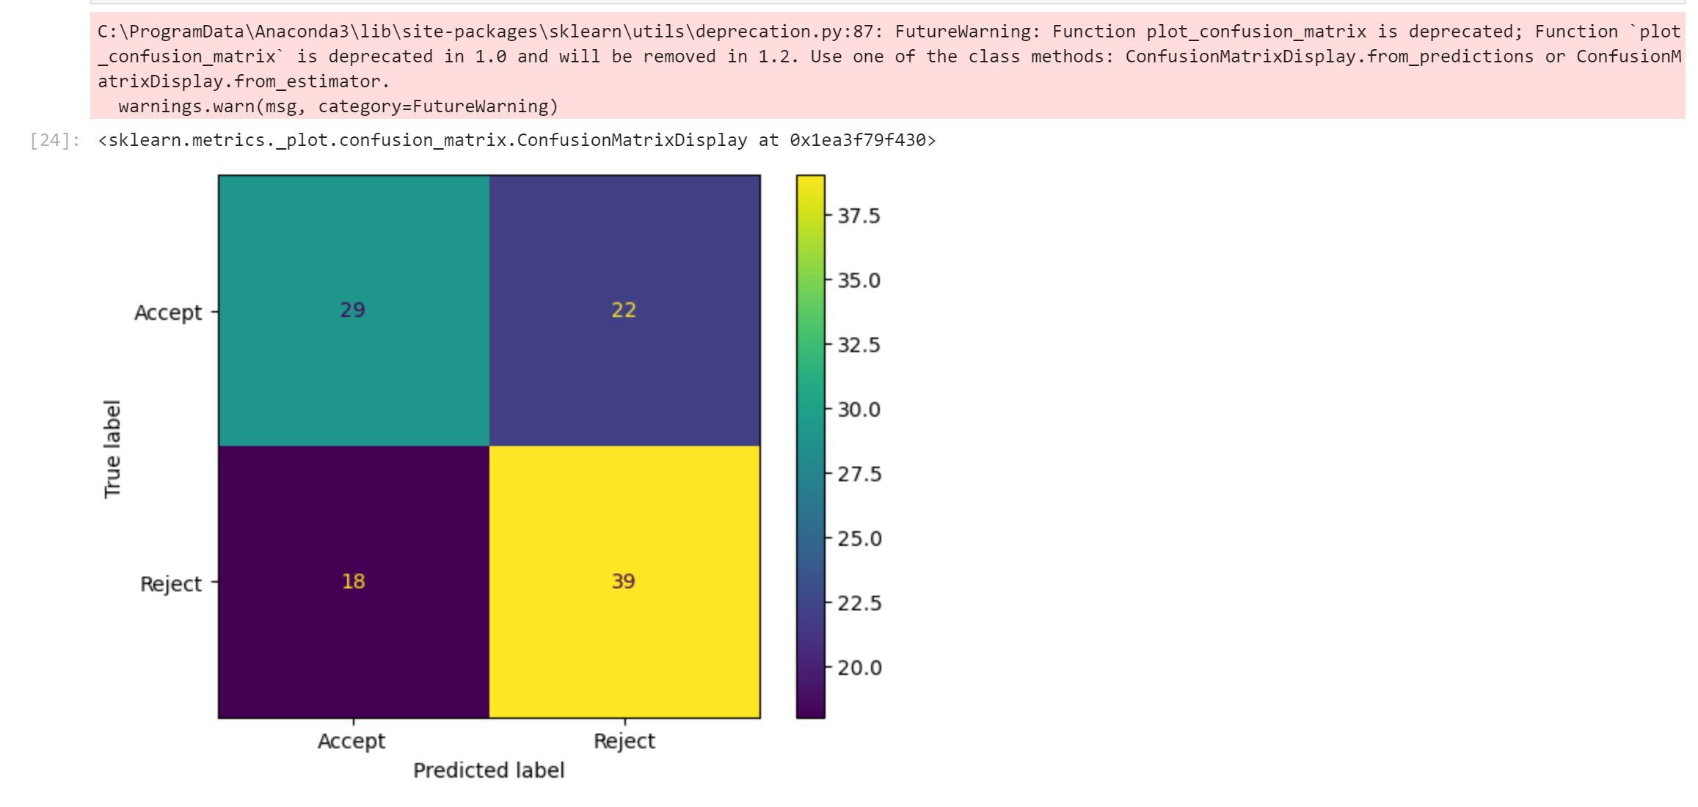
Decision Tree Confusion Matrix

Slide 5
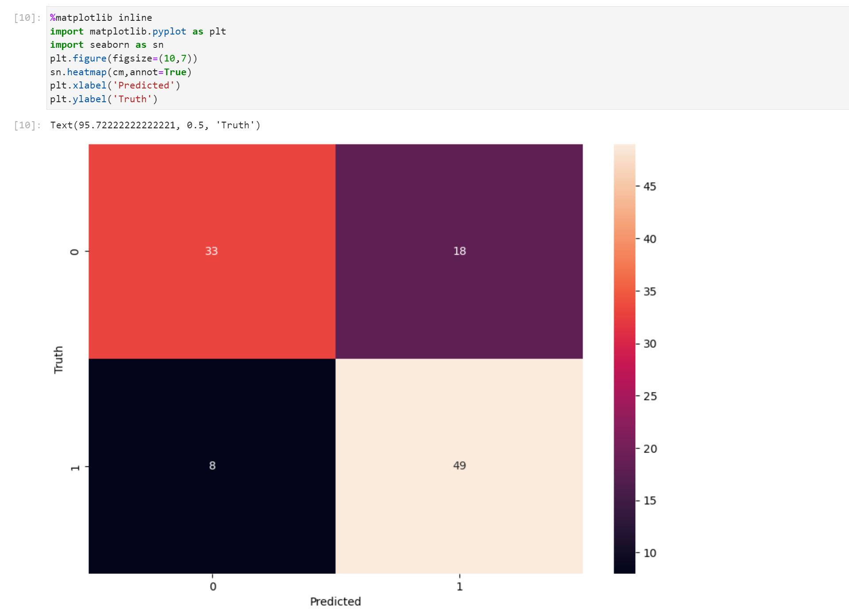
Random Forest Confusion Matrix

Slide 6
Decision Tree Accuracy score = 63% Decision Tree Accuracy score (After Ginni Index and Entropy)= 72% Random Forest Accuracy Score = 74%

