Slide 1

XGBoost Demystified
Unlocking the Magic of Extreme Gradient Boosting

Slide 2
PROBLEM STATEMENT
Applying XGBoost algorithm on the Boston housing dataset to predict the median value
Use a suitable metric like RMSE

Slide 3

XGBoost (eXtreme Gradient Boosting)
popular machine learning algorithm, used for building decision trees.
implementation of the gradient boosting algorithm, optimized for performance
combines the predictions of multiple models to create a more accurate prediction.

Slide 4
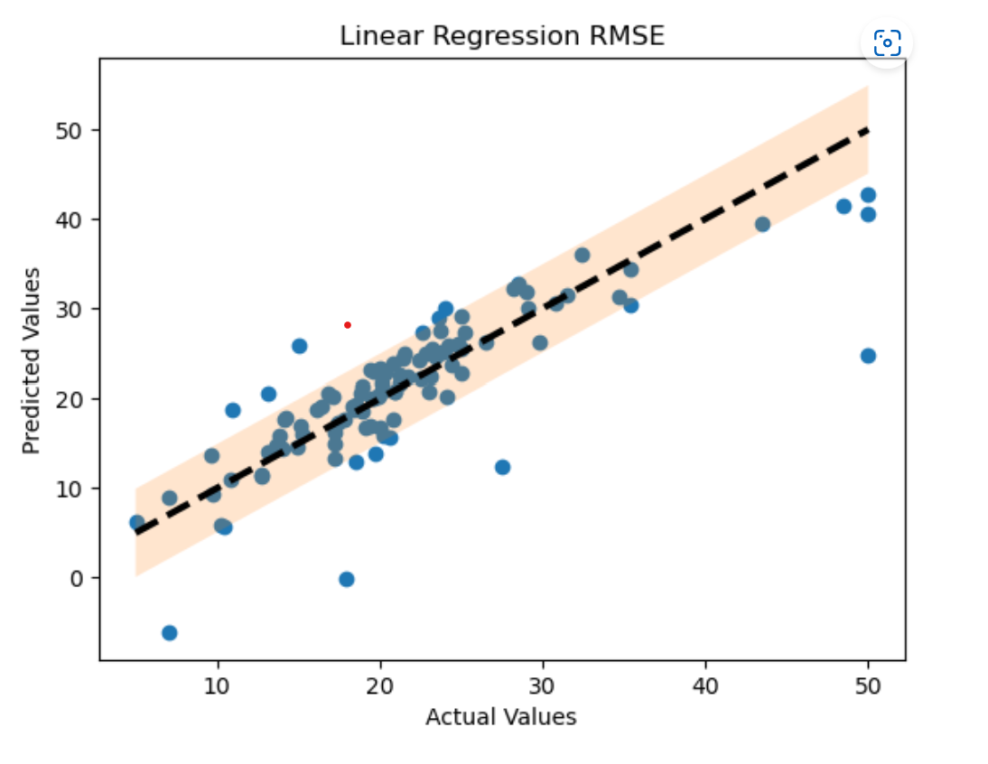
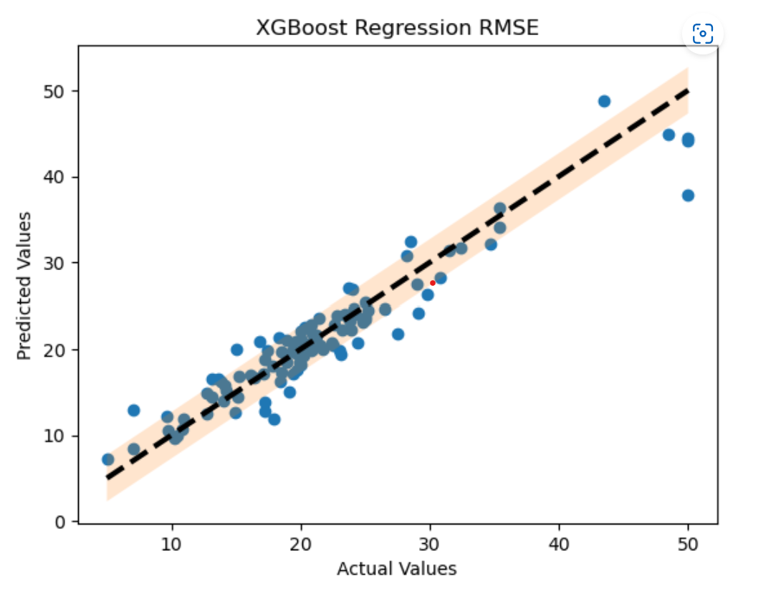
Outcomes:
Linear Regression RMSE: 4.928601965955659
XGBoost RMSE: 2.6956868146651685

Slide 5
Conclusion
Linear Regression is a simpler algorithm that is easy to interpret and implement
XGBoost is a more complex algorithm that can handle a wide range of data types and features
The choice between Linear Regression and XGBoost depends on various factors, such as:
the nature and size of the dataset
the level of accuracy and interpretability required
the resources available for modeling and deployment.

